Slide 1
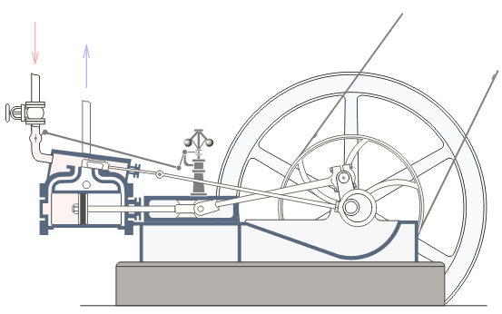
Chem 108
Introductory Chemistry
Dr. Ron Rusay
CONNECTIONS: Chemistry  STE(A)M
STE(A)M
S Science
T Technology
E Engineering
M Mathematics
< A: Arts & Applications
Notes:
Image is a machine that is an example of STEAM

Slide 2
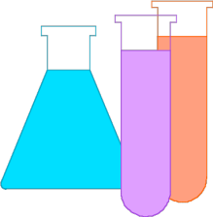
Chemistry Connections
(CHEM 108)
STE(A)M  Chemistry  Allied Careers
Linked by the Scientific Method
Chemistry focuses on the study of
  Energy & Matter:
  Classification, Behavior & Properties
All Science, Technology, Arts & Engineering involves:
  Observations & Measurements:
  (Qualitative & Quantitative)
  Applying metric & related units
Notes:
Rooted in observations (reality? & truthful?); empiricism

Slide 3
Chemistry  Physics  Engineering
The Scientific Method (A Unifying Practice)
Energy & Matter: central in all three areas
eg. Forces & Gravity
Observations: Visible & Measureable
Mathematics: Calculations & Models
Progressions & Connections: ArithmeticAlgebraCalculusDifferential EquationsPartial Differential EquationsLinear AlgebraNon-linear EquationsNon-deterministic Systems
RESULTS: Protocols, Explanations, Predictions & Products
Examples: GPS, Cosmology, Space Travel, Space Probes, New Materials: Structural, Mechanical, Industrial & Molecular
Notes:
Rooted in observations (reality? & truthful?); empiricism

Slide 4
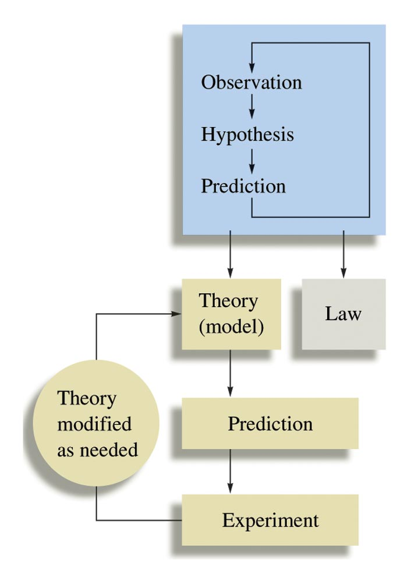
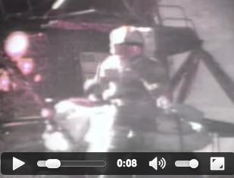
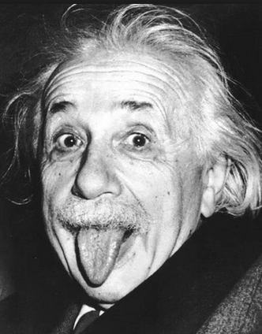
Law or Theory of Gravity?
Hipparchus and Erastothenes (~ 270 B.C.E.)
Galileo (~1600) & Isaac Newton (1687)
Theory of General Relativity:
Space & Time (1915-2015)
The key idea of Einstein's theory of general relativity is that gravity is not an ordinary force, but rather a property of space-time geometry.
https://www.youtube.com/watch?v=wtsNOMTlS7E
Which falls faster, a feather or a hammer?
……. in a vacuum? …… on the moon?

Slide 5
Chemistry  Physics
The Scientific Method (A Unifying Practice)

Slide 6
Chemistry  Physics
Law vs. Theory
A New Explanation of Gravity
http://www.youtube.com/watch?v=vyomGtZCsmI
The Case of Gravity
http://www.science20.com/hammock_physicist/it_bit_case_gravity
Law(s)? vs. Theory
Spinoza Prize €2.5 x 10⁶
“The NWO Spinoza Prize is the highest Dutch award in science; that is awarded to Dutch researchers who rank among the absolute top of science.”
Notes:
http://www.nwo.nl/en/research-and-results/programmes/spinoza+prize

Slide 7
QUESTION
Theories are best validated, proven or disproven by
observations.
models.
laws.
experiments.
guesses.
Notes:
HMClass Prep: Figure 1.5

Slide 8
QUESTION
The difference between a scientific law and a scientific theory can, at times, be confusing. For example, we will refer to the “Atomic theory” or perhaps the “Law of Gravity.” Should the Law of Gravity be changed to the Theory of Gravity?
Yes, no one can see gravity, it is better described as a theory.
No, scientific laws are based on summaries of many observations and gravity observations are well known and predictable. More than one theory may explain the observations.
Yes, gravity is better described as a theory because gravity explains why masses attract each other and theories are about explaining observations.
No, keep it as a law, laws offer explanations and gravity explains why masses attract each other and laws are about explaining observations.
Notes:
HMClass Prep: Figure 1.5

Slide 9
Some Possible Steps in the Scientific Method
Observations
  qualitative (general, descriptive, subjective)
  quantitative (numbers, values)
2. Formulating hypotheses
   possible explanation(s) for the observation(s)
3. Performing experiments
  gathering new information
  testing whether the hypotheses are valid
4. Developing a theory
5. Testing & Refining
Notes:
Fibonacci & Plants
https://www.khanacademy.org/math/recreational-math/vi-hart/spirals-fibonacci/v/doodling-in-math--spirals--fibonacci--and-being-a-plant--1-of-3

Slide 10
QUESTION
Which statement most resembles a scientific theory?
When the pressure of a sample of oxygen gas is increased 10%, the volume of the gas decreases by 10%.
The volume of an ideal gas doubles when the pressure of the gas is reduced by one half.
Gases are composed of very small particles that are constantly moving. They collide with the surface of containers which hold them, producing pressure.
A gas sample has a mass of 15.8 grams and a volume of 10.5 Liters.
Notes:
HMClass Prep: Figure 1.5

Slide 11
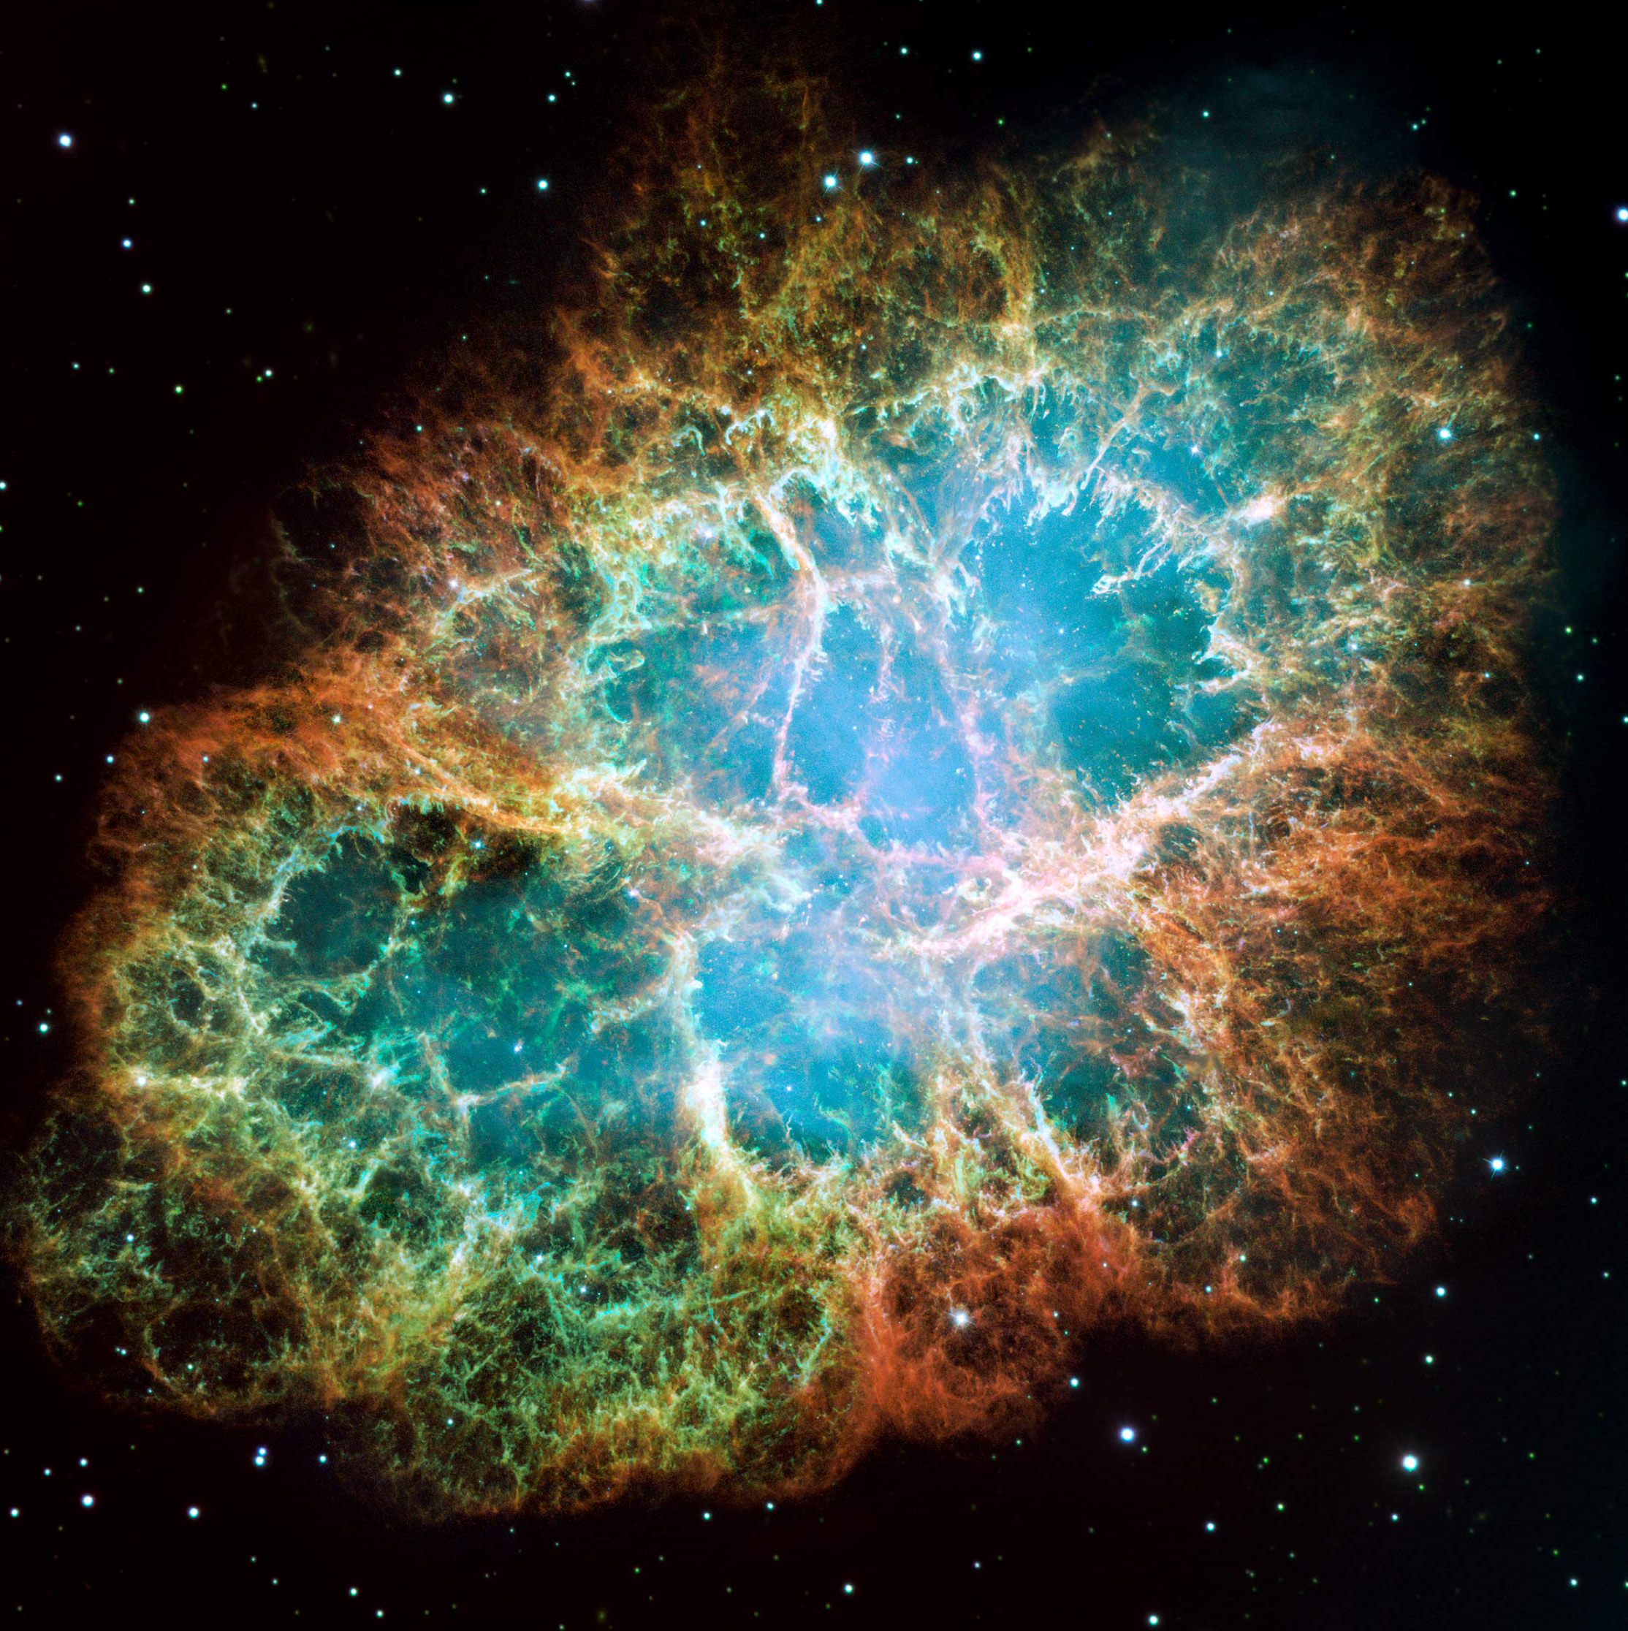
Energy & Matter
E = mc²
http://energy.gov/articles/livestream-our-latest-nobel-prize-winner
Based on the standard model of cosmology, the total mass/energy of the universe is comprised of 4.9% ordinary matter, 26.8% dark matter and 68.3% dark energy.^{[1][2]} Thus, dark matter is estimated to constitute 84.5% of the total matter in the universe and 26.8% of the total content of the universe.^{[3]}
Dark matter is matter that is undetectable by emitted or absorbed radiation, but whose presence can be inferred from gravitational effects.
Ade, P. A. R.; Aghanim, N.; Armitage-Caplan, C.; et al. (Planck Collaboration) (22 March 2013). "Planck 2013 results. I. Overview of products and scientific results – Table 9.". Astronomy and Astrophysics (submitted). arXiv:1303.5062. Bibcode:2013arXiv1303.5062P.
Francis, Matthew (22 March 2013). "First Planck results: the Universe is still weird and interesting". Arstechnica.
3) "Planck captures portrait of the young Universe, revealing earliest light". University of Cambridge. 21 March 2013. Retrieved 21 March 2013.
Notes:
George Smoot (UCB/MIT)
http://physics.berkeley.edu/people/faculty/george-smoot-iii
Vs. Oliver Smoot (MIT): Harvard Bridge spans the Charles River linking Boston and Cambridge. In 1958 Lambda Chi Alpha took 5' 7" MIT freshman pledge Oliver R. Smoot, Jr. and rolled him head over heels the entire length of the bridge. Every ten smoots they calibrated the bridge, painting marks. The bridge was found to be exactly 364.4 smoots plus an ear. Successive pledge classes repainted the markings.

Slide 12
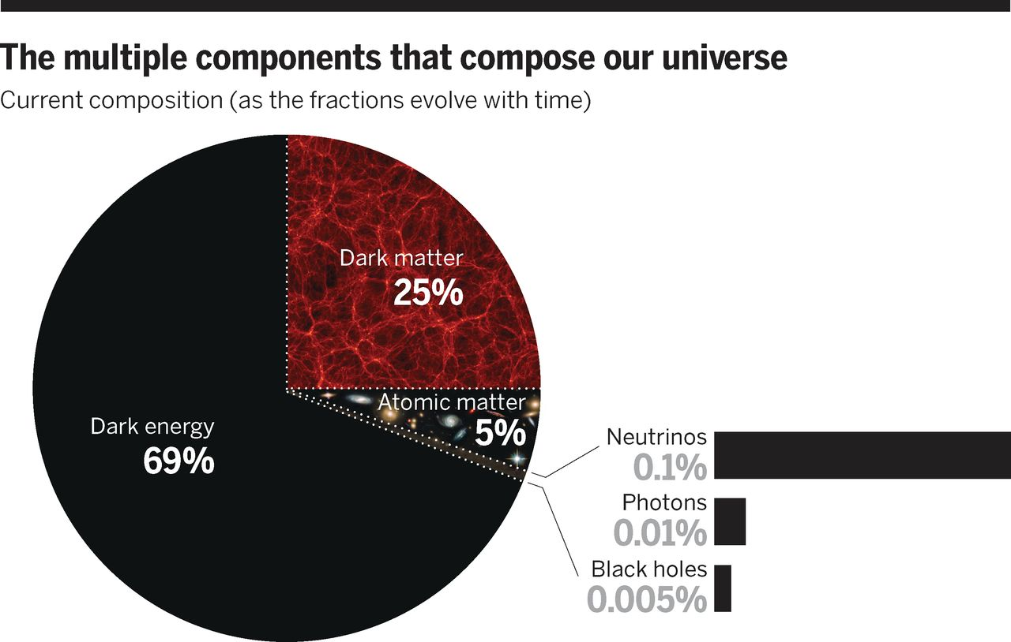

Fig. 1 The multiple components that compose our universe.Dark energy comprises 69% of the mass energy density of the universe, dark matter comprises 25%, and “ordinary” atomic matter makes up 5%.
David N. Spergel Science 2015;347:1100-1102
Published by AAAS
Notes:
http://science.sciencemag.org/content/347/6226/1100.full#F1
The multiple components that compose our universe.Dark energy comprises 69% of the mass energy density of the universe, dark matter comprises 25%, and “ordinary” atomic matter makes up 5%. There are other observable subdominant components: Three different types of neutrinos comprise at least 0.1%, the cosmic background radiation makes up 0.01%, and black holes comprise at least 0.005%.

Slide 13
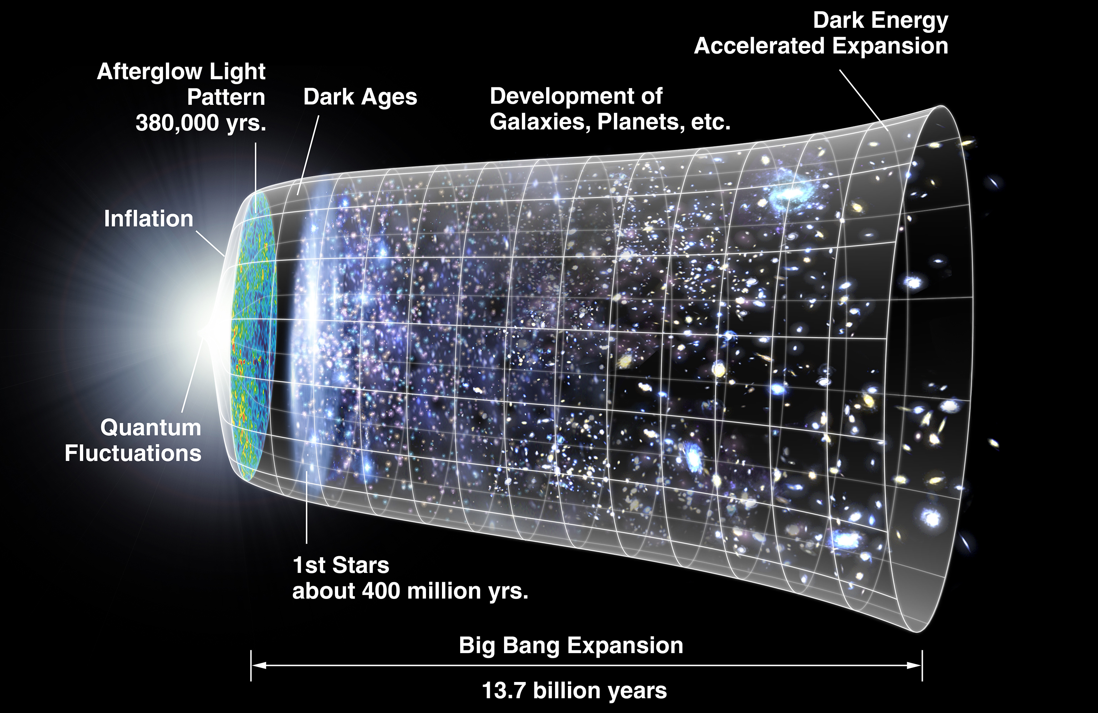
Properties of the Universe
Diameter 8.8×10²⁶ m
Volume 4×10⁸⁰ m³
Mass (ordinary matter) 10⁵³ kg
Density 9.9×10⁻³⁰ g/cm³ (equivalent to 6 protons per cubic meter of space)
Age 13.799 ± 0.021 billion years
Average temperature 2.72548 K

Slide 14
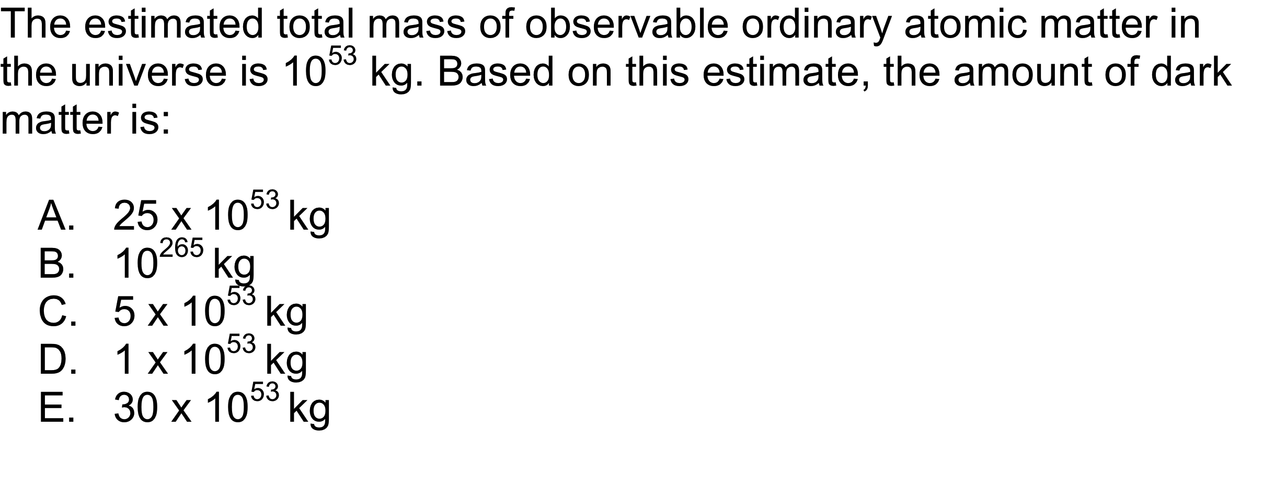
QUESTION

Slide 15
Percent
A comparison based on normalization to 100.
In mathematics, a percentage is a number or ratio expressed as a fraction of 100. It is denoted by the percent sign, %, and is a dimensionless (pure) number.
George Washington University:
64 unsealed addressed envelopes with $10 in each were dropped on campus in two different classrooms.
In economics 18 of 32 were mailed back, in [business, history and psychology] 10 of 32 were mailed.
(WSJ)

Slide 16
QUESTION
George Washington University:
64 unsealed addressed envelopes with $10 in each were dropped on campus in two different classrooms.
In economics (econ) 18 of 32 were mailed back, in [business, history and psychology (bhp)] 10 of 32 were mailed. What is the percent for each of the 2 groups of students?
28% econ 72% bhp
56% econ 44% bhp
56% econ 31% bhp
79% econ 31% bhp
79% econ 44% bhp
Notes:
HMClass Prep: Figure 1.5

Slide 17
QUESTION
Percent Continued
64 unsealed addressed envelopes with $10 in each were dropped on campus in two different classrooms.
The professor conducting the study received 43.75% of the original $640 in the mail. How much did he receive?
$28.00
$43.75
$140.00
$280.00
$360.00
(WSJ)

Slide 18
QUESTION
Percent Continued
Would you mail the envelop presuming no one knows you found it?
One student mailed an empty envelop with the return address:
Mr. IOU, 1013 Indebted Lane, Bankrupt City, MS
Did the professor count this envelope in the data?
YES
NO
Be prepared to explain your answer.
(WSJ)

Slide 19
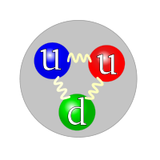
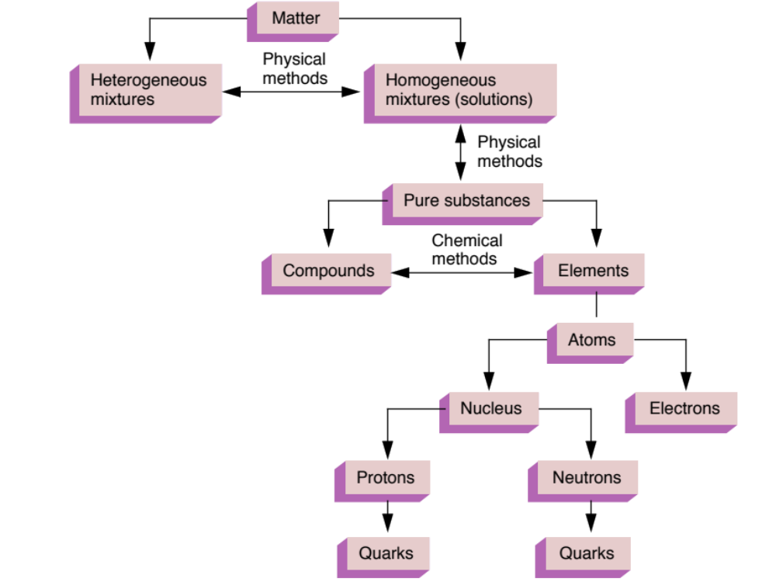
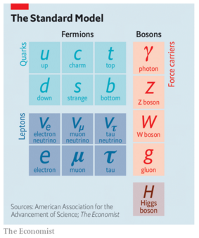
Organization of Matter
Chemistry  Physics
proton
Classification of Matter
leptons
muon, tau, neutrino
[up, down, strange, charm, bottom, top]

Slide 20
Organization of Matter
Chemistry  Physics
proton
Classification of Matter
Quarks (sub-atomic particles):
* Protons: composed of two up and one down quarks (uud)
* Neutrons: composed of two down and one up quarks (ddu)
leptons
muon, tau, neutrino
[up, down, strange, charm, bottom, top]

Slide 21
Organization of Matter
Chemistry:
Classification of “ordinary”
Atomic Matter
(~5% of the Universe)

Slide 22
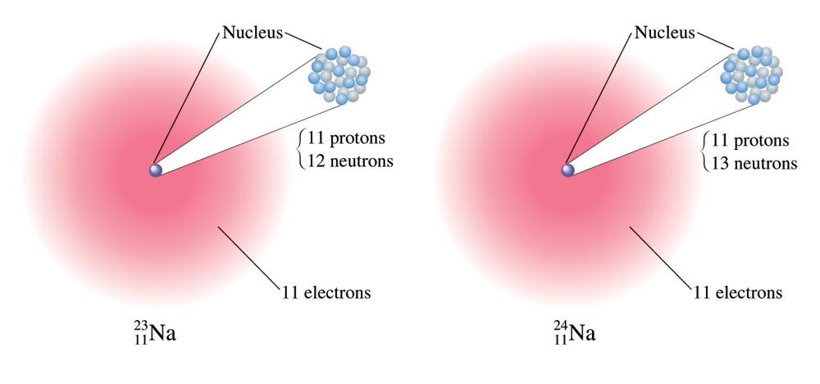
Atoms (CHEM 108)
Atoms consist of 3 sub-atomic particles
  # Protons = Atomic Number = Unique Name
  # of Neutrons [different numbers = isotopes]
  # of Electrons [different numbers = ions]

Slide 23
QUESTION
Which statement is incorrect for the three atoms in the following table.
Atom | # protons | # neutrons | # electrons
1 | 6 | 6 | 5
2 | 6 | 7 | 6
3 | 6 | 8 | 7
Atoms 1, 2, and 3 have the same name.
Atoms 1, 2, and 3 are isotopes.
Atoms 1, 2, and 3 are ions.
Atoms 1, 2, and 3 are not identical.
Notes:
HMClass Prep: Figure 1.5

Slide 24
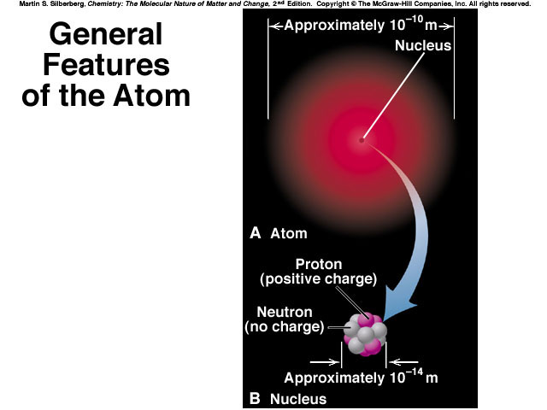
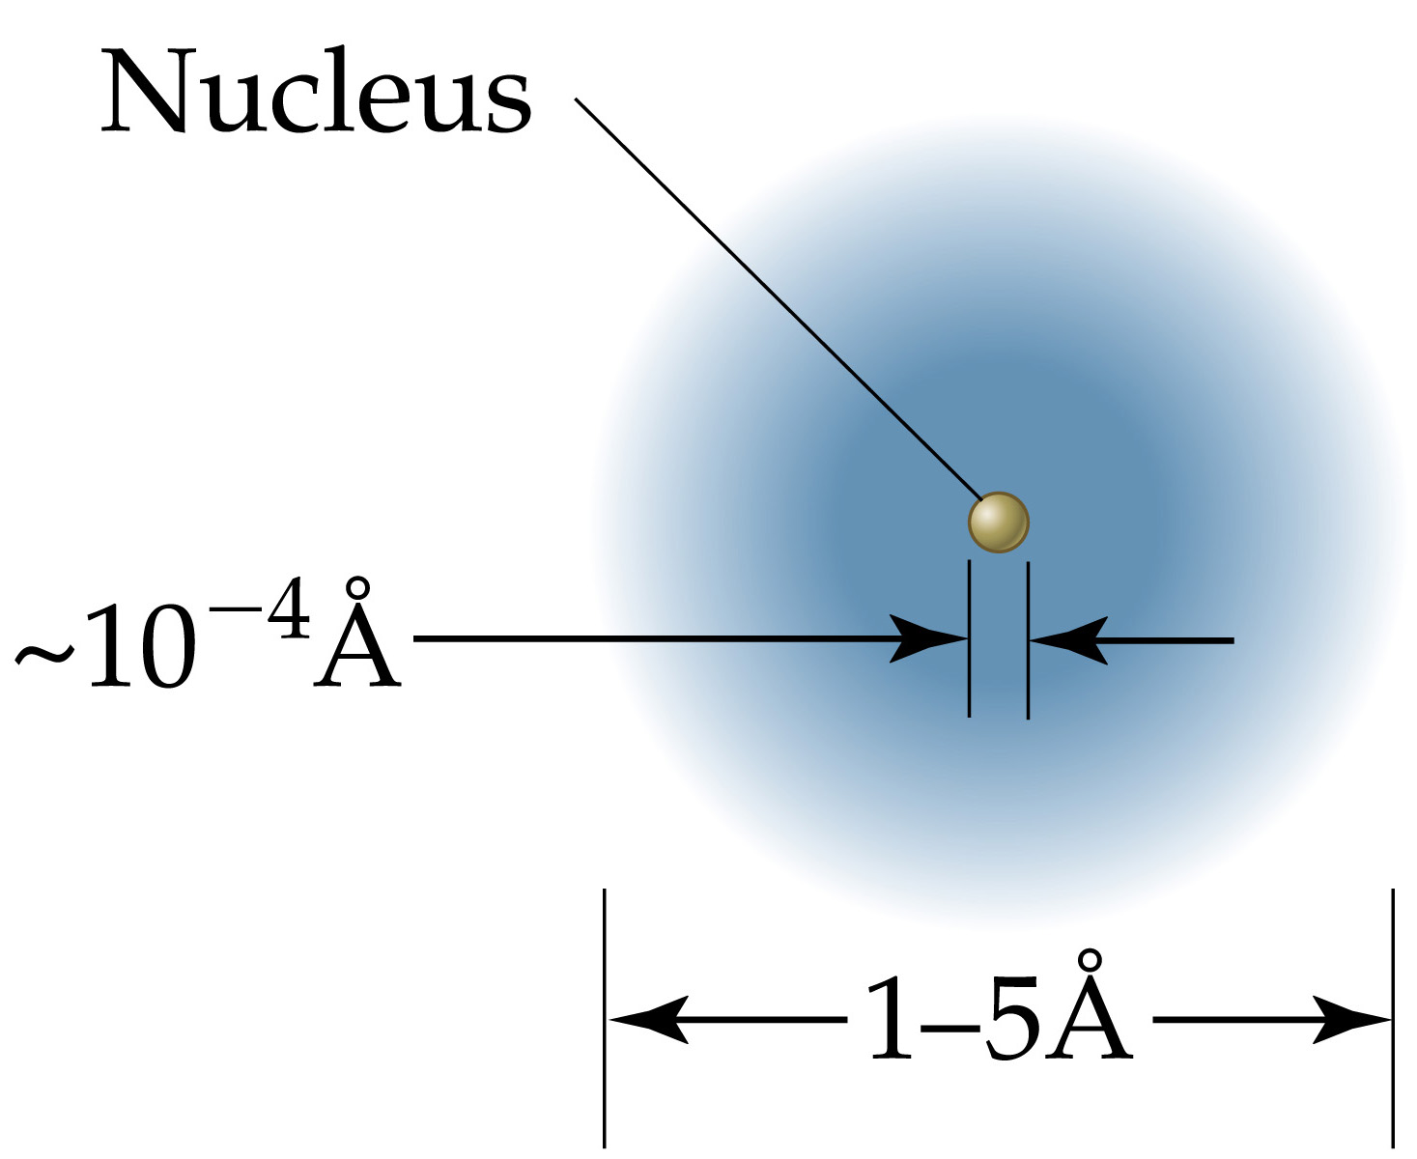
~ 0.1 nm
Anders Jöns Ångström
(1814-1874)
1 Å = 10 picometers = 0.1 nanometers =
10⁻⁴ microns = 10⁻⁸ centimeters
Nucleus =
1/10,000
of the atom
1 nm = 10 Å
An atom vs. a nucleus
~10,000 x larger

Slide 25
CHEMISTRY of the Atom
FUNDAMENTAL PARTICLES:
Mass Charge Symbol
Nucleus:
PROTON 1 amu +1 H+, H, p
        1.67 x 10 ⁻²⁷ kg
NEUTRON 1 amu 0 n
        1.67 x 10 ⁻²⁷ kg
_________________________________________
ELECTRON very small -1 e ⁻
        ≈ 2000 x smaller than a proton or neutron
The particle is said to “hold” or “bond” atoms together in molecules.

Slide 26
QUESTION
Which statement is correct for the three atoms in the following table.
Atom | # protons | # neutrons | # electrons
1 | 6 | 6 | 5
2 | 6 | 7 | 6
3 | 6 | 8 | 7
Atoms 1, 2, and 3 have the same mass.
Atoms 1, 2, and 3 have the same charge.
Atoms 1 and 3 have the same charge.
Atoms 1, and 3 have the same mass.
Atoms 1, 2, and 3 have different masses and different net charges.
Notes:
HMClass Prep: Figure 1.5

Slide 27
http://science.kqed.org/quest/video/the-worlds-most-powerful-microscope/
Can we “see” individual atoms using a microscope?
With TECHNOLOGY: Yes, using atomic force microscopy (AFM) and a variety of instruments such as Scanning Transmission Electron Microscopes.
TEAM 0.5:
LBL’s
Transmission Electron
Aberration-corrected Microscope
Resolution:
+/- 0.5 Å (0.05 nm)
1 nm = 10 Å
An atom vs. a nucleus
~10,000 x larger

Slide 28
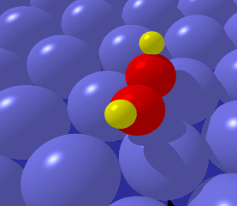
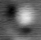
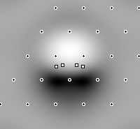
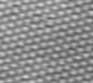

Imaging: acetylene on Pd(111) at 28 K
Molecular Image
Tip cruising altitude ~700 pm
Δz = 20 pm
H
C
We don’t see the Pd atoms
because the tip needs to be very close to image the Pd atoms and would knock the molecule away
C
H
TIP
Surface atomic profile
Tip cruising altitude ~500 pm
Δz = 2 pm
p_{z}
H
+
O
π orbital
Calculated image
(Philippe Sautet)
If the tip was made as big as an airplane, it would be flying at 1 cm from the surface and waving up an down by 1 micrometer
The STM image is a map of the pi-orbital of distorted acetylene
M. Salmeron (LBL)
1 cm
(± 1 μm)

