Slide 1
Acid-Base Equilibrium
BUFFERS
Dr. Ron Rusay

Slide 2
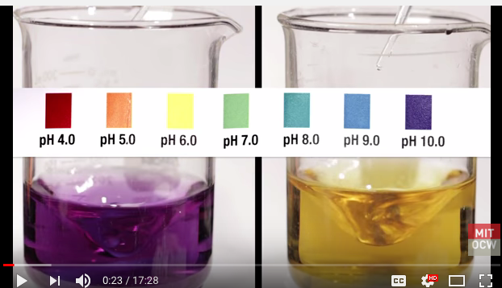
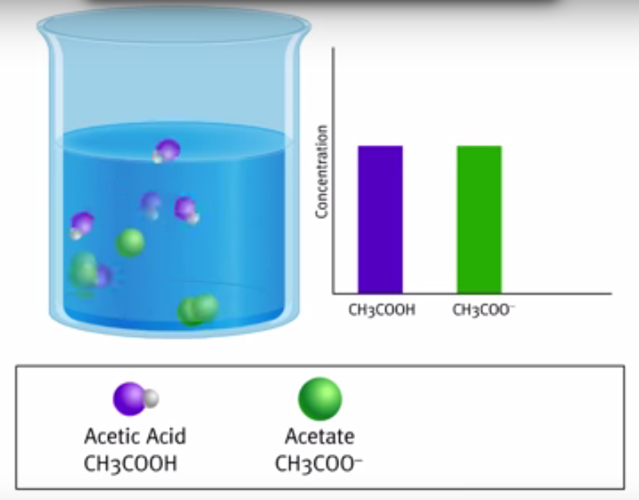
BUFFERS
Weak Acid-Weak Base Systems
Example:
H₂CO₃(aq) / HCO₃⁻¹(aq) / CO₃⁻²(aq)
CO₂(g) + H₂O (l)  HCO₃⁻¹(aq) + H⁺¹(aq) CO₃⁻²(aq) + H⁺¹(aq)
https://www.youtube.com/watch?v=XR_0k8JIawY
  https://www.youtube.com/watch?v=ZLKEjXbCU30

Slide 3
QUESTION
In the following equilibrium:
HCO₃⁻ (aq) + H₂O (l)  H₂CO₃ (aq) + OH⁻ (aq)
A) HCO₃⁻ is an acid and H₂CO₃ is its conjugate base.
B) H₂O is an acid and OH⁻ is its conjugate base.
C) HCO₃⁻ is an acid and OH⁻ is its conjugate base.
D) H₂O is an acid and H₂CO₃ is its conjugate base.
E) H₂O is an acid and HCO₃⁻ is its conjugate base.

Slide 4
H₂CO₃(aq) / HCO₃⁻¹(aq) / CO₃⁻²(aq)
Two VERY IMPORTANT Buffer Systems
“Bicarbonate”
  Blood: a human’s blood serum volume is relatively small, 4-6 Liters with a narrow pH range, pH = 7.35 – 7.45; pH is maintained through buffering (homeostasis)
  Have you ever had respiratory alkalosis during an exam?
  Oceans: an extraordinarily large volume of a “salt water” solution with a pH ~ 8.1; maintained through buffering
CO₂(g) + H₂O (l)  HCO₃⁻¹(aq) + H⁺¹(aq) CO₃⁻²(aq) + H⁺¹(aq)

Slide 5
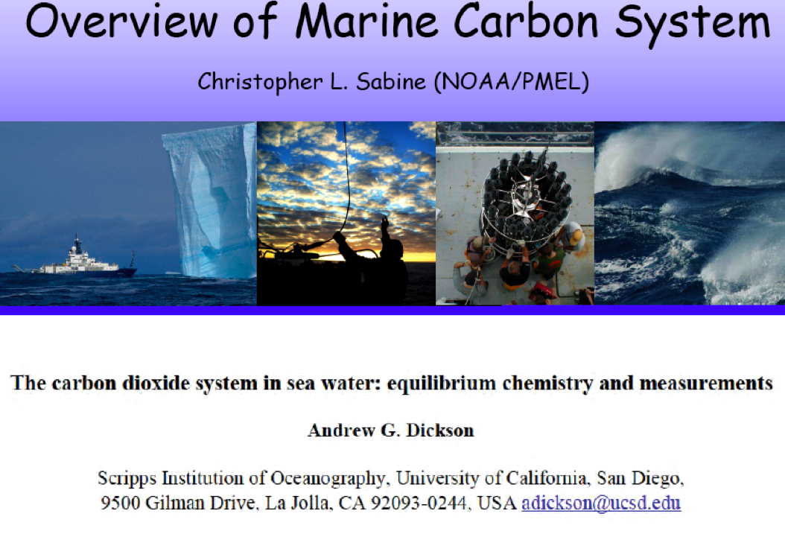

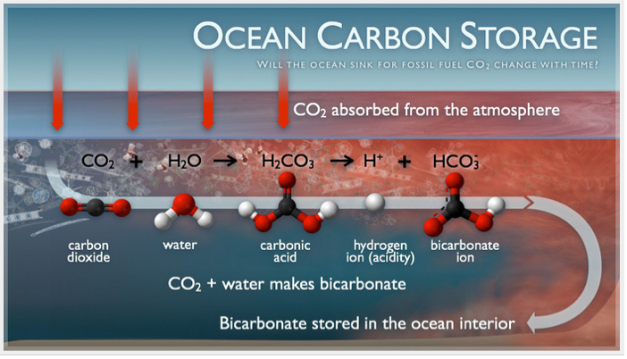
Human & Oceanic Bicarbonate Buffer Systems
http://chemconnections.org/general/chem121/Buffers/Buffers-Med-Pres.htm
http://chemconnections.org/general/chem121/Buffers/Buffers-CO2-Oceans-2011.htm

Slide 6
EQUILIBRIUM
CO₂ & Oceanic Bicarbonate Buffering
CO₂(g) + H₂O (l)  HCO₃⁻¹(aq) + H⁺¹(aq) CO₃⁻²(aq) + H⁺¹(aq)
  Oceans: pH ~ 8.1 and falling
  http://www.tos.org/oceanography/issues/issue_archive/22_4.html
  Increasing CO₂ is decreasing ocean pH; long term effects?http://sos.noaa.gov/datasets/Ocean/ocean_acidification.html

Slide 7
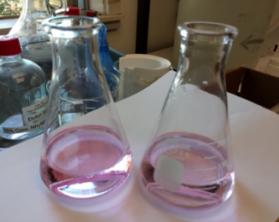
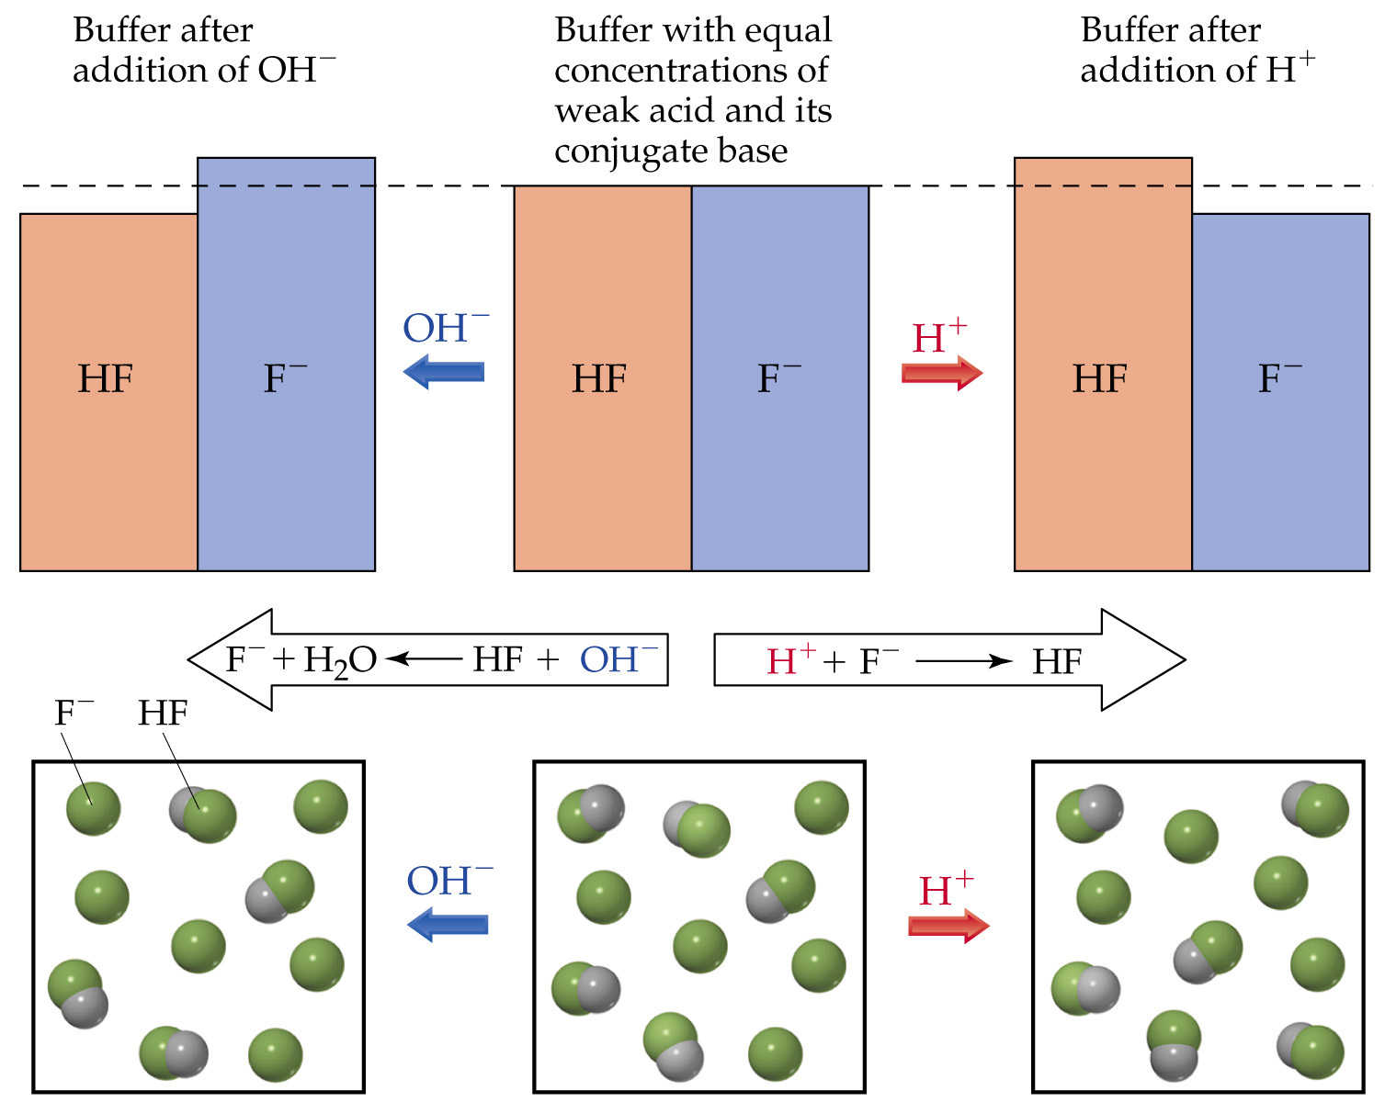
Bicarbonate Buffer Systems
Which is the buffer?
One is bicarbonate
buffer to pH ≈ 8 - 9.
One is water plus sodium hydroxide,
pH ≈ 8 - 9.
Volunteers to
experiment and find
out which is which?
HCO₃⁻¹
CO₃⁻²
HCO₃⁻¹
CO₃⁻²
HCO₃⁻¹
CO₃⁻²
conj. base
acid
CO₃⁻²
HCO₃⁻¹
CO₃⁻²
HCO₃⁻¹
CO₃⁻²
HCO₃⁻¹
Notes:
Figure: 17-02

Slide 8
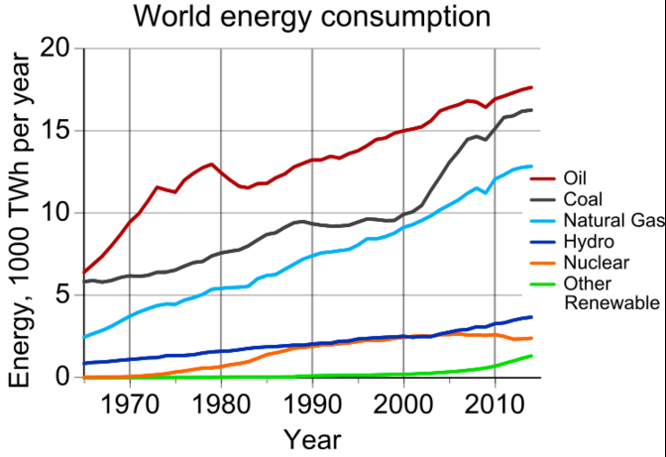
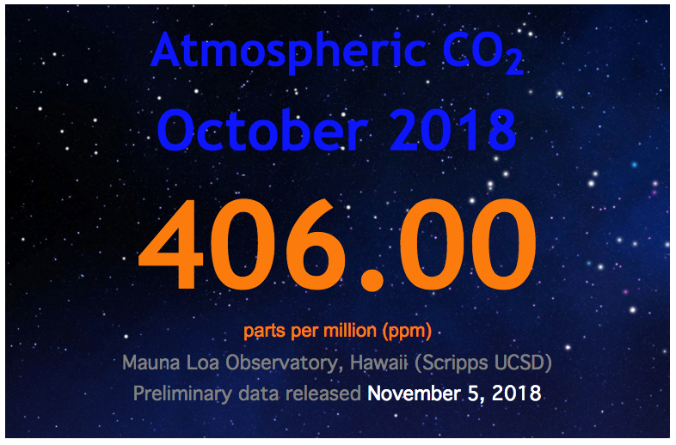
Energy Global Warming
Economy
(Jobs)
(Carbon)
(CO₂)
(Carbon)
(CO₂)
https://www.co2.earth/

Slide 9
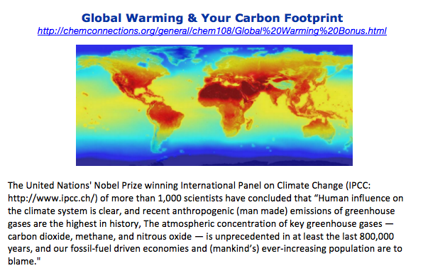
Your Future?
Notes:
97 percent of publishing climate scientists agree that humans are causing climate change.

