Slide 1
Chemistry & STEM
Measurement I
Measurement, Conversions & Calculations
Dr. Ron Rusay

Slide 2
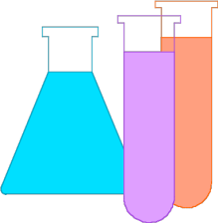
CHEM 108 Basic Measurements: for stuff that you can see or sense
LENGTH, WIDTH, HEIGHT, (DIAMETER)
TIME
VOLUME (occupied space)
TEMPERATURE
MASS (weight)
Qualitative vs. Quantitative
  Eg. Qualitative: Old (sloth dung) vs. Young (you?)
  Quantitative: 38,000 year old (dung) vs. a 20 year old (you?)

Slide 3
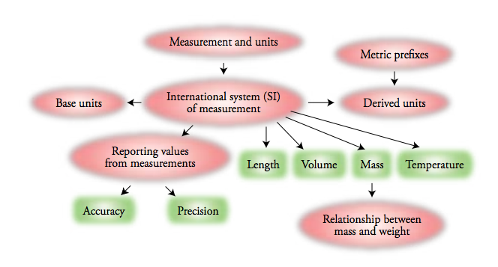

Units of Measure
Density

Slide 4
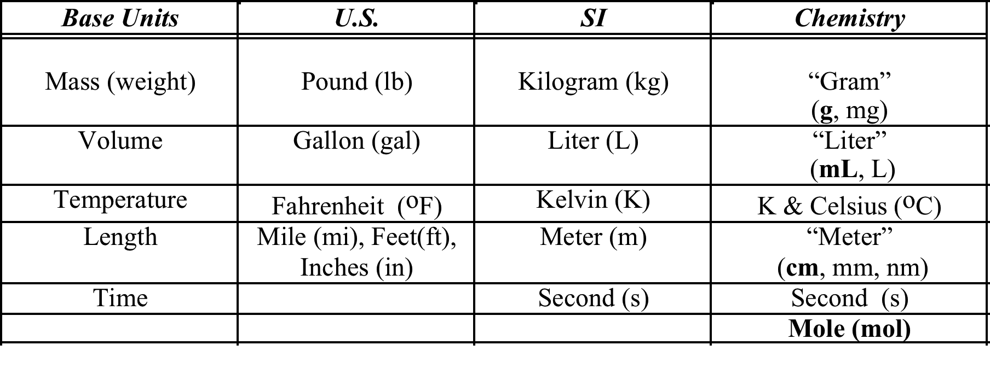
Units of Measure

Slide 5
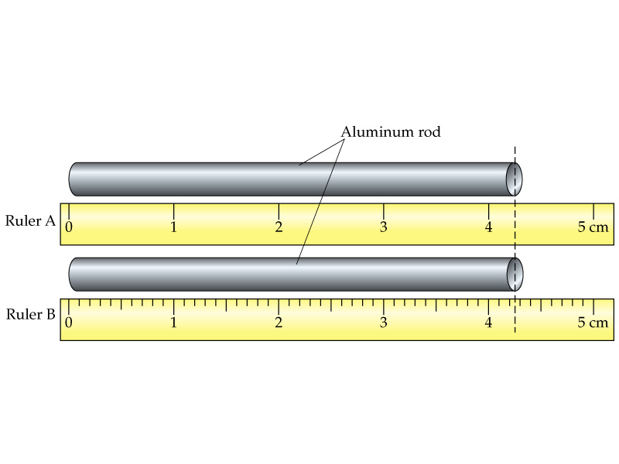
What is the length of the rod?
Different measurement tools give different numbers:
Which ruler is better?
4.3 +/- 0.1 cm
? cm
? cm
4.25 +/- 0.01 cm
or
4.25 +/- 0.05 cm

Slide 6
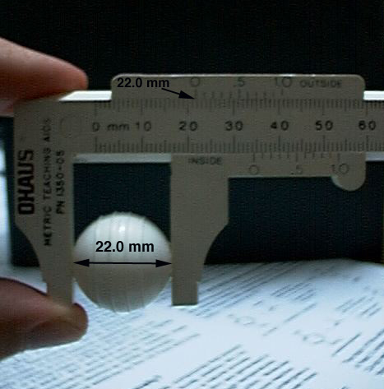
What is the diameter of a circle?
All measuring devices are not the same, and the values (numbers) that come from them indicate their limitations.
Is there a better instrument to use other than a ruler to measure the diameter of the sphere?
A caliper

Slide 7
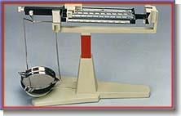
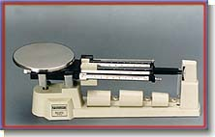
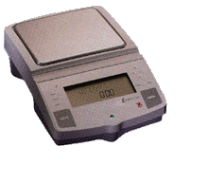
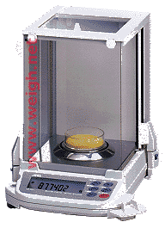
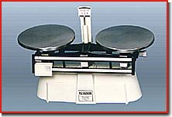
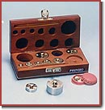
Mass Determination
(Weighing Devices: Balances)

Slide 8
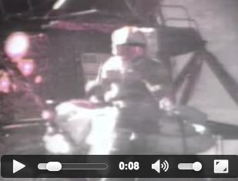
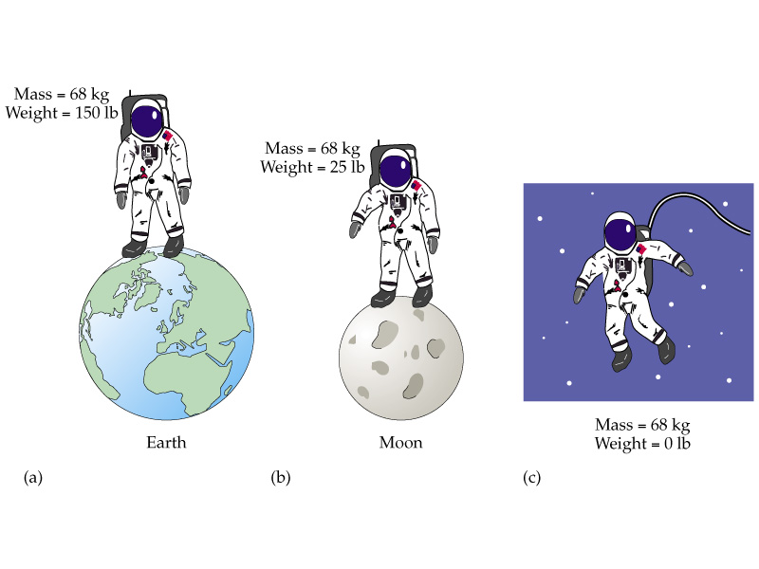
Mass vs. Weight
British vs. Metric

Slide 9
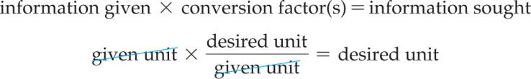


Dimensional Analysis
Conversion/Unit Factor Calculations
44.7 cm
?
? in
Notes:
http://boards.straightdope.com/sdmb/showthread.php?t=643437

Slide 10
Dimensional Analysis
Conversion/Unit Factor Calculations
Qualitative Description: Are you heavy, slim, average? vs. Quantitative?.....The weight on your driver’s license? birth certificate?
Calculate your weight in kilograms. Scale Factor UNITS: 1 kg = 2.2 lb; 1 lb = 16 ounces (oz); 1 ounce (oz) = 0.0283495 kg
___ lbs __ ounces ? kg
?
?
16
0.0283
0.0283
________________ + __________ = ______
?
lbs
oz
kg
?
oz
kg
? kg
1
1
oz
oz
1
lbs
Notes:
http://boards.straightdope.com/sdmb/showthread.php?t=643437

Slide 11
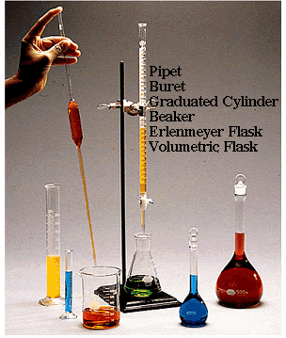
Volume
(Liquid Measurement Tools)
(CHEM 108)
METRIC UNITS:
milliliter
mL
m = milli
L = liter

Slide 12
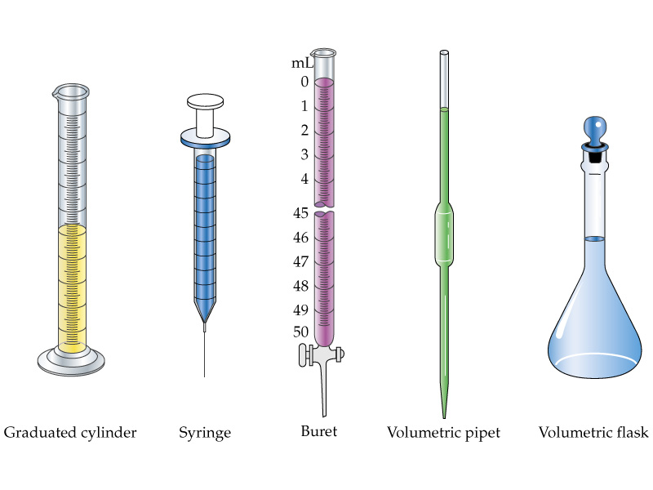
Volume UNITS: milliliter / mL / m = milli L = liter

Slide 13
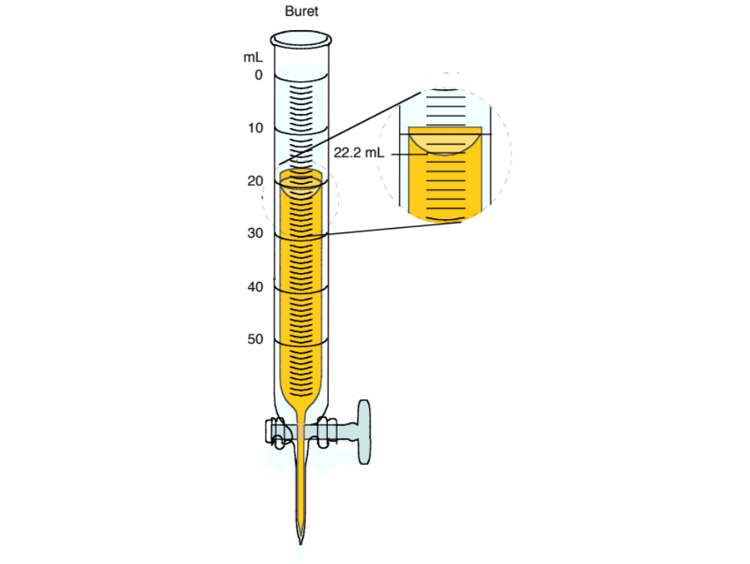
What does each line represent?
1 mL
What digit’s value can be estimated?
O.1 mL

Slide 14
What can be estimated?
O.1 mL
22.2 mL
The tenths decimal (last) place is estimated & “significant”;
Therefore, there are a total of 3 significant digits.)

Slide 15
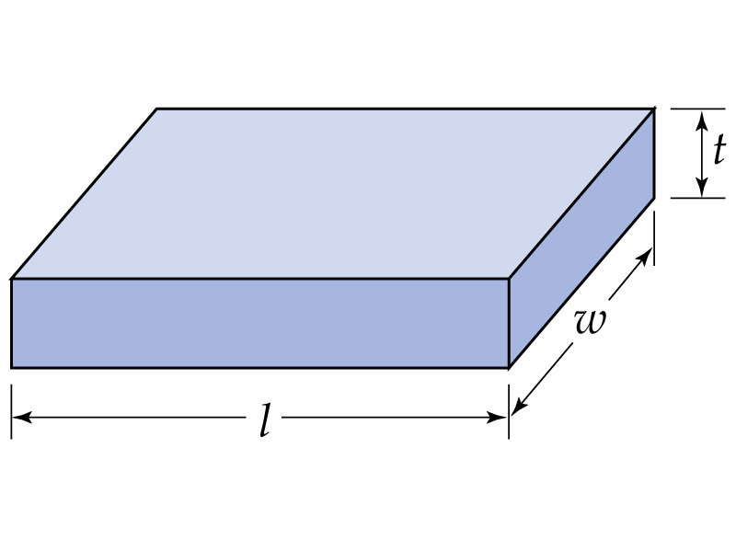
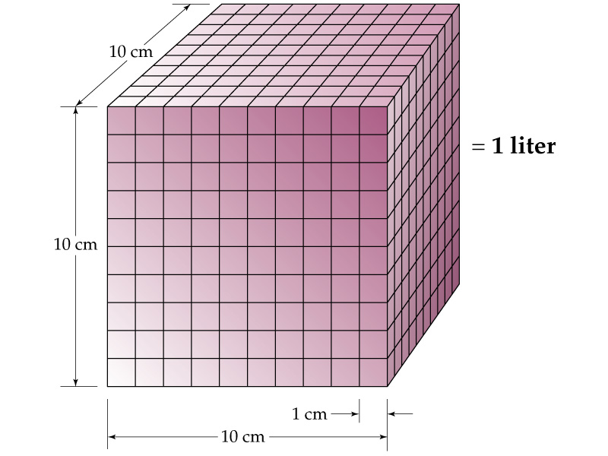
Volumes of regular shapes
V = s³
h
V = l x w x h

Slide 16
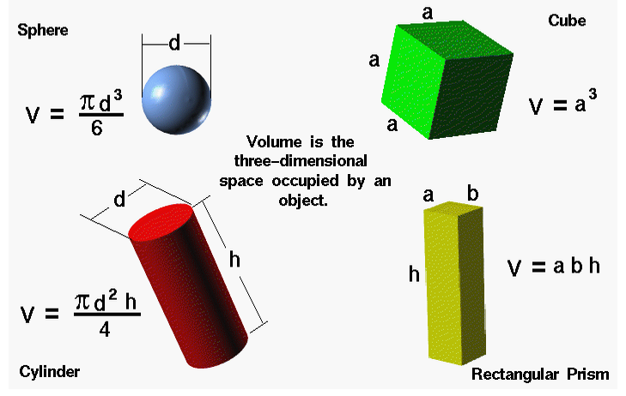

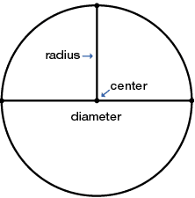

Volumes of regular shapes
Euclid ~300 B.C.E.

Slide 17
What is the volume the sphere?
V = 4/3 x 3.14 x (11.0 mm)³
= 5,570 mm³

Slide 18
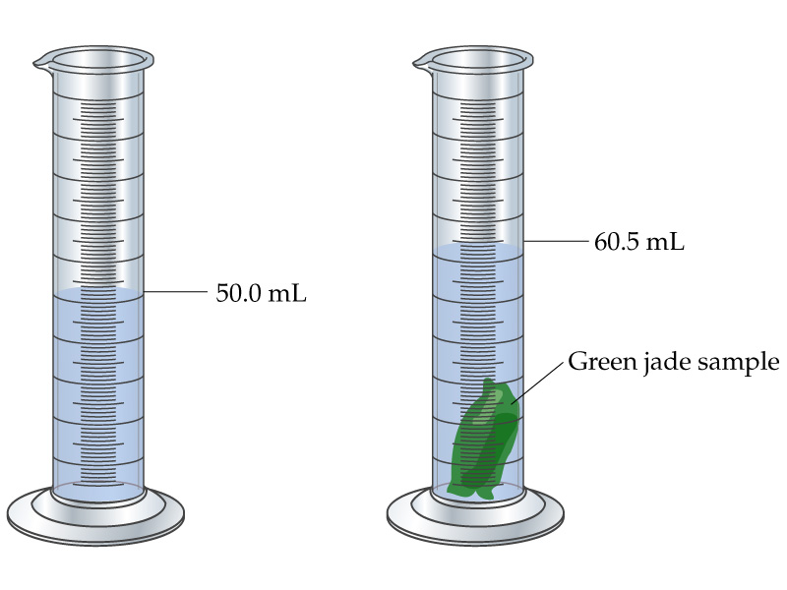
Volume of an object (any shape) by displacement
Archimedes 212 B.C.E.
V = 60.5 mL – 50.0 ml
=10.5 mL
= 10.5 cm³
What is the volume of the jade?

Slide 19

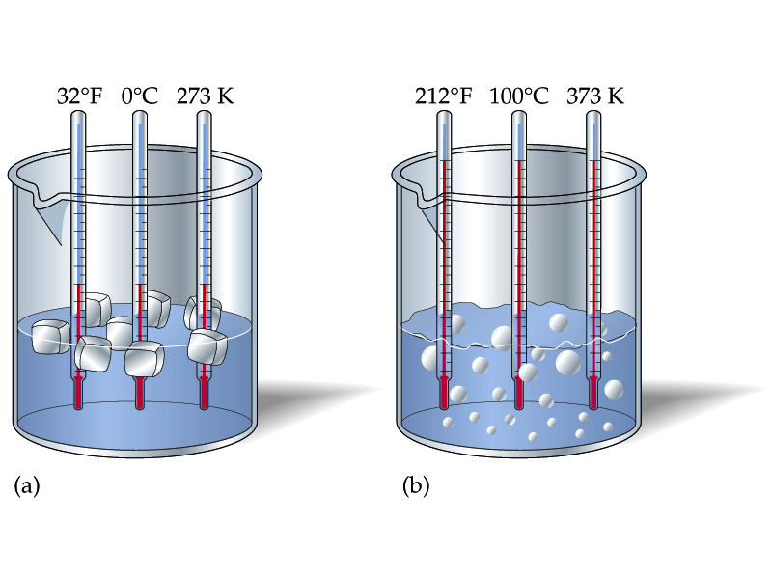
Temperature Scales
UNITS: Celsius (ºC) & Kelvin (K)
Temperature is NOT Energy
“Temperature (sometimes called thermodynamic temperature)
is a measure of the average kinetic energy of the particles in a system. Adding heat to a system causes its temperature to rise.”
August. 15, 2015 +142ºF Manama, Bahrain
ºC?
K?
= 61.7ºC
= 61.7ºC +273.15 = 334.85 K
Notes:
Wet bulb temperature.

Slide 20
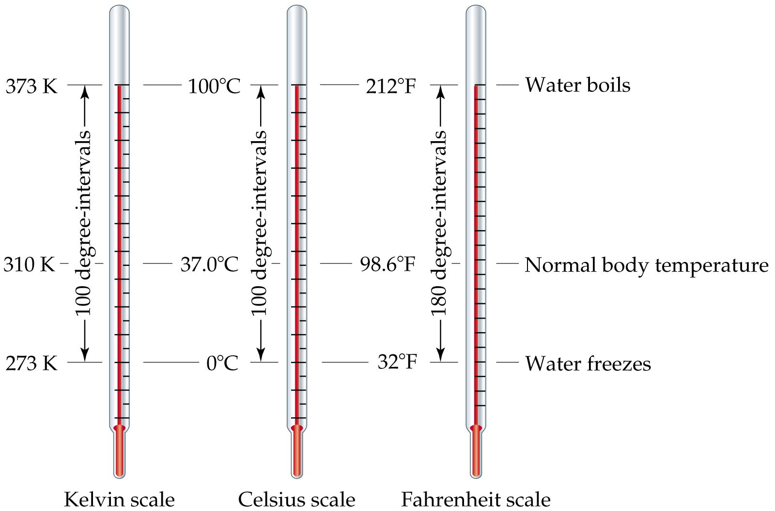
Temperature Scales
Relative to Water
Notes:
Can a human survive a temperature of 60oC?
Wet bulb? .. vs.Wind Chill.

Slide 21
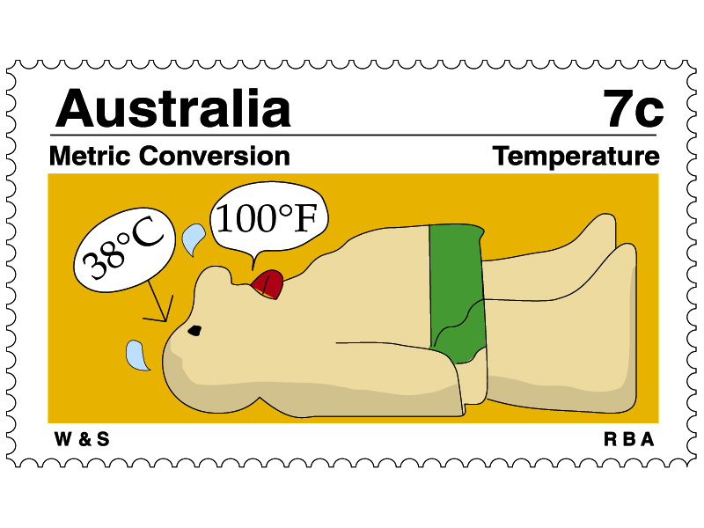
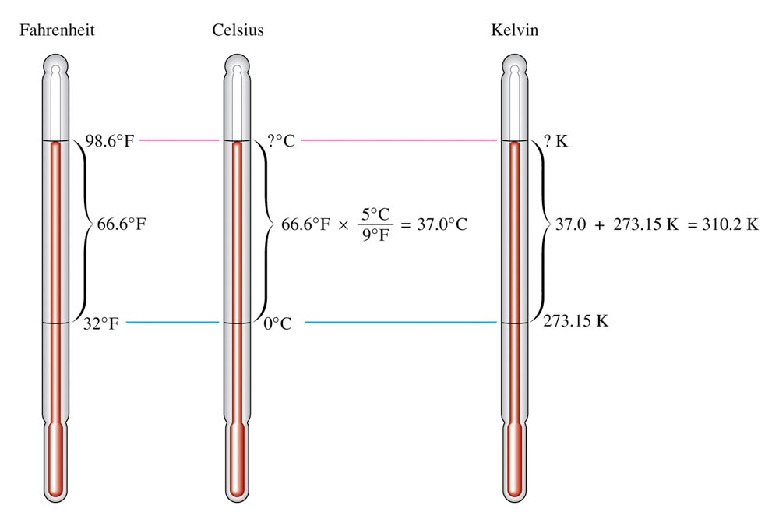
“Normal” Body Temperature
- 40oF
- 40oF
233K

Slide 22
QUESTION
Dr. R. walks into class and claims, “It is very cold in here today. It feels like 242 K.” If that were the temperature, would you agree that you would feel cold? What would that be in Celsius degrees?
I agree, that would be 31°C.
I agree, that would be – 31°C.
I do not agree, that would be 31°C.
I do not agree, that would be 515°C.
Notes:
HMClass Prep: Figure 1.12

Slide 23
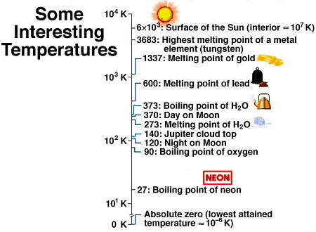
Temperature

Slide 24
QUESTION
Identify the best match between the dimension or quantity and the unit that is most likely to be measured in Chem 108 lab.
Dimension or Quantity Unit
A) Mass Kilogram
B) Length Meter
C) Volume Milliliter
D) Temperature Fahrenheit
E) Amount of substance Megamole

Slide 25
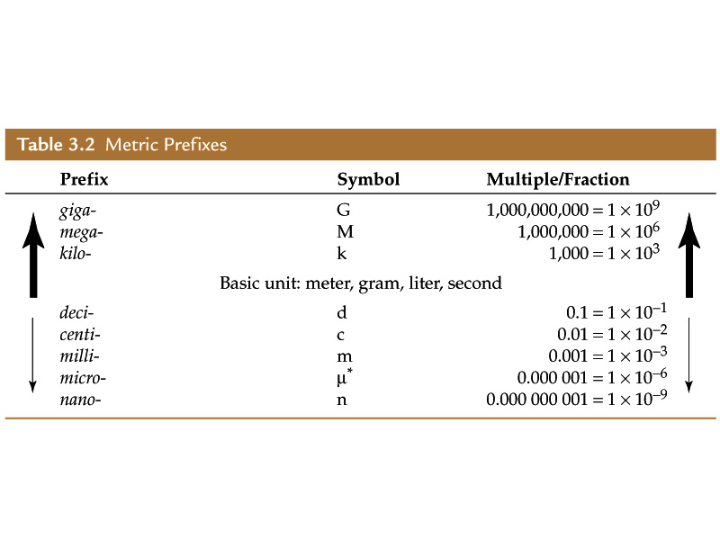
Commonly Used Prefixes in Chemistry

Slide 26
QUESTION
Select the correct relationship between these metric units of length or distance.
A) 1 km = 100 m B) 1 mm = 10 cm
C) 1 nm = 10⁹ m D) 10³ mm = 1 m

Slide 27
QUESTION
Coincidentally, a U.S. nickel has a mass of approximately 5 grams. If you had one dollar’s worth of nickels in your jean’s what would be the mass of the nickels in milligrams?
100 milligrams
50 milligrams
1,000 milligrams
100,000 milligrams
1000 milligrams (mg) = 1 gram (g)
Notes:
HMClass Prep: Table 1.2

Slide 28
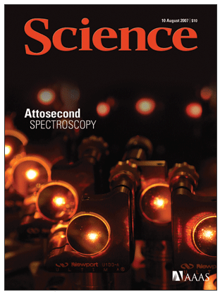
QUESTION
An array of multilayer mirrors compresses ultrabroadband laser pulses (orange beam). The attosecond x-ray pulses allow the real-time observation of atomic-scale electron motion. The previous spectroscopic method was on a femtosecond scale, which was too slow to capture the movement.
How many times faster is attosecond spectroscopy compared to femtosecond methods?
Science, 317, 765-775, (2007)
“The Electron Stopwatch”
A. 10x B. 100x C. 1,000x D. 1,000,000x

Slide 29
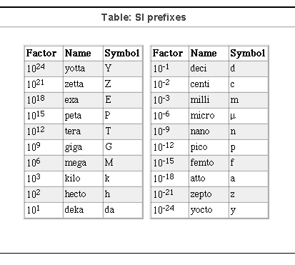
QUESTION
How many times faster is attosecond spectroscopy compared to femtosecond methods?
Science, 317, 765-775, (2007)
“The Electron Stopwatch”
A. 10x B. 100x C. 1,000x D. 1,000,000x

Slide 30
Numbers
Expressing a number correctly is determined by the method used in the measurement!
How many numbers should I include?
  Significant Digits (Figures)
  Consider: the exactness of the measured value
Short Hand expression translates the number to Scientific Notation

Slide 31
What is the length of the rod?
Different measurement tools give different numbers:
Which ruler is better?
  2 Significant Digits (Figures)
4.2 - 4.3cm
4.24 - 4.25cm
  3 Significant Digits (Figures)

Slide 32
Reporting Numbers
Rules for Significant Digits (Figures)
Nonzero integers always count as significant figures.
3456 g has how many sig figs?
4 sig figs.
  Expressed in scientific notation?
3.456 x 10 ³ g

Slide 33
Reporting Numbers
Rules for Significant (Digits) Figures
Exact numbers (unit, conversion or scale factors) can have an infinite number of significant figures.
1 liter = 1,000. ml, exactly
1 inch = 2.54 cm, exactly

Slide 34
Zeros
Leading zeros do not count as significant figures.
0.0486 mL has how many sig figs?
3 sig figs.
  Number expressed in scientific notation?
4.86 x 10 ⁻² mL

Slide 35
Zeros
Captive zeros always count as significant figures.
16.07 cm has how many sig figs?
4 sig figs.
Number expressed in scientific notation?
1.607 x 10 ¹ cm

Slide 36
Zeros
Trailing zeros are significant only if the number contains a decimal point.
9.300 kg has how many sig figs?
4 sig figs.
  Number expressed in scientific notation?
9.300 kg

Slide 37
QUESTION
In which of these measured values are the zeros
not significant figures?
        I) 0.0591 cm
        II) 504 g
        III) 2.70 m
        IV) 5300 L
A) I and II B) II and III C) I and IV
D) I, III, and IV E) II, III, and IV

Slide 38
QUESTION
Which one of the following does NOT represent four significant digits?
  0.07100 mg
  0.7100 mg
  0.7010 mg
  0.0710 mg
Notes:
HMClass Prep: Rules for Significant Figures

Slide 39
Mathematics & Arithmetic
Relative to method(s) of measurement
Short Hand expression: Scientific Notation
Numbers : How many to include?
Quantitative vs. Qualitative
Addition/Subtraction......
Multiplication/Division.....
What is “significant”?.....Rounding Off
http://www.chemteam.info/SigFigs/SigFigsFable.html

Slide 40
Computational Rules
Addition/Subtraction: Answer expressed to the least number of decimal places of the figures in the process
Multiplication/Division: Answer expressed to the least number of significant figures

Slide 41
Computational Rules
Rules for Rounding Off:
When numbers are used in a calculation, the result is rounded to reflect the significant figures of the data.
For calculations involving multiple steps, only the final answer is only rounded—NO rounding between steps.
This prevents small rounding errors being magnified in the final answer.
Use only the last (or leftmost) digit being dropped to decide how to round—ignore all digits to the right of it.
The last number to be reported remains the same if the neighboring digit to be dropped is 4 or less; rounded up if the neighboring digit is 5 or more.

Slide 42
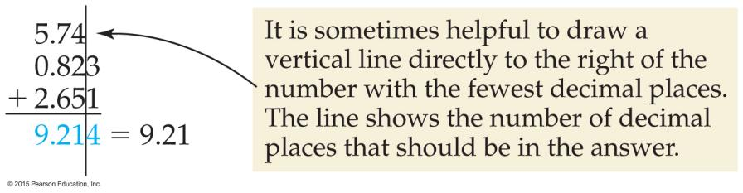
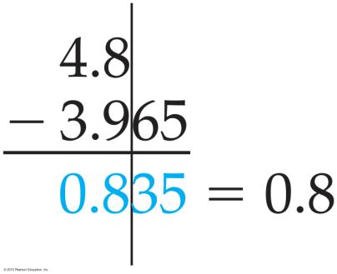
Computational Rules
Addition and Subtraction Rule:
In addition or subtraction, the reported result has the same number of decimal places as the number with the fewest decimal places.

Slide 43
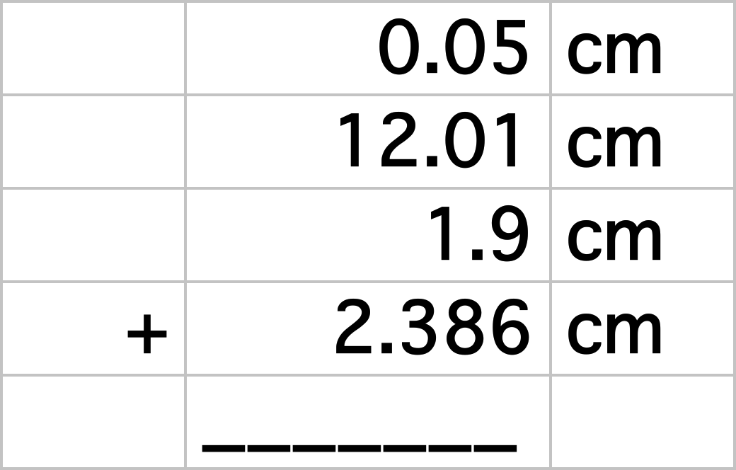
Addition
Four students were each asked to measure different pieces of wire and provide a total length for the four pieces.
Report the result correctly:
16.346 cm

Slide 44
QUESTION
If you were unloading a 23.50 kg box of books from your car and a “friend” added two more 482 gram chemistry books, how much in kg using the rules for significant digits, would you be lifting?
23.98 kg
24.464 kg
24.46 kg
24.5 kg
Notes:
HMClass Prep: Table 1.2

Slide 45

Computational Rules
Multiplication and Division Rule:
The result of multiplication or division carries the same number of significant figures as the factor with the fewest significant figures.

Slide 46
Computational Rules
In calculations involving both multiplication/division and addition/subtraction, do any steps in parentheses first;
determine the correct number of significant figures in the intermediate answer without rounding; then do the remaining steps.
3.489 cm × (5.67 cm – 2.3 cm) = ?
5.67 cm – 2.3 cm = 3.37 cm
Use the subtraction rule to determine that the intermediate answer has only one significant decimal place. Do not round; underline the least significant figure as a reminder.
3.489 cm × 3.37 cm = 11.758 cm²= 12 cm²
Use the multiplication rule to determine that the intermediate answer (11.758) rounds to two significant figures (12) because it is limited by the two significant figures in 3.37.

Slide 47
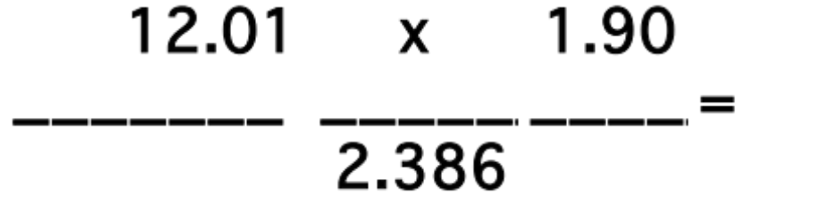
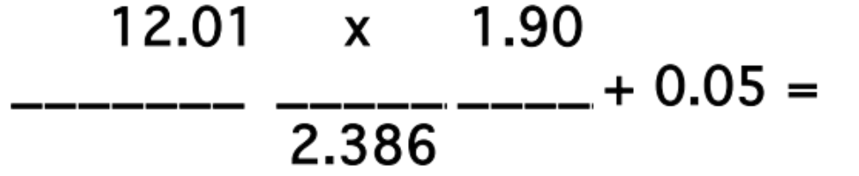
Mathematical Processes:
Provide correct answers assuming each value (unit omitted) is written with the correct number of significant figures:
9.56370
9.61370

Slide 48
QUESTION
The average mass of a certain brand of vitamin C tablets is 253 mg. What is the mass of three such tablets rounded to the proper number of significant digits?
0.760 grams
0.759 grams
0.7590 grams
0.253 grams
Notes:
HMClass Prep: Table 1.2

Slide 49
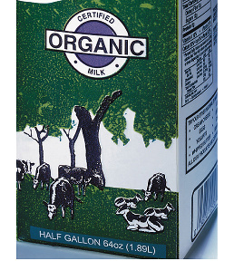
Systematic Problem Solving
Dimensional/Unit Analysis: Conversions
Workshop
How many mL of milk are in a1/2 gallon carton?
0.50 gal
? mL
1 gal = 4 qt
1 qt = 946 mL
0.50 gal | 4 qt | 946 mL
| 1 gal | 1 qt
= ? mL

Slide 50
Complete the following
Units & Conversions
Number Scientific Notation Named unit
1.3 x 10¹⁰ yrs
13,000,000,000 yrs. ________________ __? gigayears
13 Gyrs
546
5.46 X 10 ²
___________ mL ______________ mL 0.546 Liters
0.546 L
0.845
____________ kg __8.45 x 10 ⁻¹ kg___ _? grams__
845 g

Slide 51
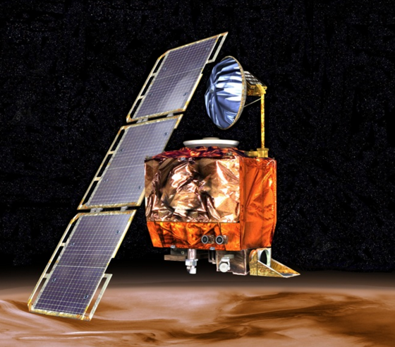
QUESTION
General Chemistry Level Challenge
In 1999, NASA lost the
$125 million Mars Climate Orbiter, when it mistakenly was sent to come within 37 miles from Mars’ surface, which took it far into the Martian atmosphere where friction caused it to burn and break apart. The failed plan had been to place it in an orbit 142 miles above Mars where the atmosphere is thinner.

Slide 52
QUESTION
General Chemistry Level Challenge
The problem was caused by a navigation error from different calculations & communications between two computer programs, one using English units for force (pounds of force), and the other using metric units (Newtons), which are numerically more than 4 times larger than the pound of force unit.

Slide 53
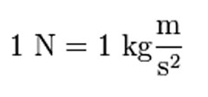

Comparing Distances (length)
Different measurement units give different numbers:
0.2248 lb_{F} =
1 lb . ft/s²
4.44 N
5,280 ft (1 mi)
23,400 ft (4.44 mi)
thrust equivalent
-> 25 mi
thrust
equivalent
->111 mi
inches
…..navigating thrust and distance for the Mars Climate Orbiter
Notes:
https://www.wired.com/2010/11/1110mars-climate-observer-report/
105 miles lower than it was supposed to go.
Ultimately, the Mars Climate Orbiter came within 37 miles of the Martian surface. Simulations showed that, at any altitude lower than 53 miles, atmospheric friction would tear the fragile craft apart.
http://mars.jpl.nasa.gov/msp98/news/mco990930.html
one team used English units (e.g., inches, feet and pounds) while the other used metric units for a key spacecraft operation. This information was critical to the maneuvers required to place the spacecraft in the proper Mars orbit. the problem was in the software controlling the orbiter’s thrusters. The software calculated the force the thrusters needed to exert in pounds of force. A separate piece of software took in the data assuming it was in the metric unit: newtons.
https://en.wikipedia.org/wiki/English_units

Slide 54
QUESTION
General Chemistry Level Challenge
One NASA program specified navigation of the Climate Orbiter to a distance of 7.55 × 10⁵ ft from the surface, while the second program using this value as a unitless number calculated thrust in Newtons that took it to 5.95 × 10⁴ m
What is the difference in kilometers between the
two altitudes?

Slide 55
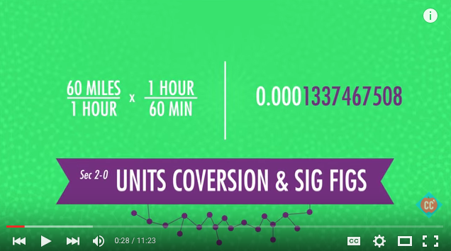
Numbers & Measurement
Units & Conversions
Crash Course: Hank & John Green
Unit Conversion & Significant Figures:
https://www.youtube.com/watch?v=hQpQ0hxVNTg&list=PL8dPuuaLjXtPHzzYuWy6fYEaX9mQQ8oGr&index=2 11:23 min/sec

Slide 56
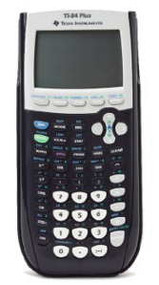
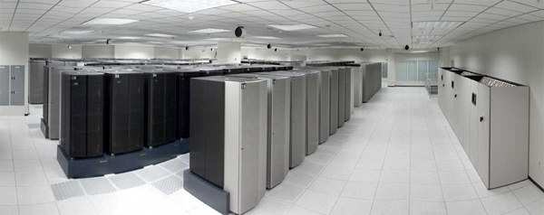
Calculations / Computations
Fastest computer (2001):12 TeraFLOPS/second)
TI-Graphing
6 Ghz
Cost ≈ $100 (2001 dollars)
Tera- = ?
Tera- = 10 ¹² (trillion)
Cost =
~$ 30,000,000 (2001 dollars)
http://www.llnl.gov/asci-scrapbook/

Slide 57
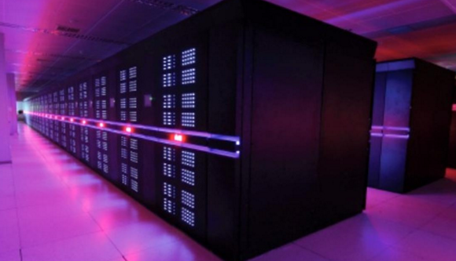
World’s fastest computers (2017)
https://www.youtube.com/watch?v=KEdsrT1mFAU
Peta- = 10 ¹⁵ (quadrillion); 1,000 trillion
Peta = ?
Sunway TaihuLight (93 PetaFLOPS), China
Tianhe-2, aka Milky Way (33.9 PetaFLOPS), China
Estimated Costs:
>$100 million (2016 dollars)
Notes:
https://www.recode.net/2017/6/20/15812270/china-fastest-supercomputer-us-exascale-department-energy-intel-nvidia-ibm
Tianhe-2 developed by a team of 1,300 scientists and engineers.
Tianhe-2 in China's National Computer Centre, Guangzhou, performs at 33.86 petaflops (quadrillions of calculations per second), almost twice as fast as the second-quickest machine, which is American. July 15, 2015, President Obama has signed an executive order calling for the US to build the world's fastest computer by 2025. to replace Titan in Oak Ridge @ 17.59 peta FLOPS
The supercomputer would be 20 times quicker than the current leading machine, which is in China.Such a computer would be called an exascale machine. targeting around 60 megawatts

Slide 58
Floating Point Operations (FLOPS)
Equivalent to adding one plus one
When told to begin, count 1+1.
Keep repeating the counting of 1+1 and keep track of how many times that you have repeated 1+1.
Stop when told to, note your total.

Slide 59
Floating Point Operations
FLOPS
https://www.youtube.com/watch?v=DsXXjMhHMVg
There about 60 of us here. The estimated processing power/min for our group is:_______. The median for our group is:______
(Average vs. Median?)
This is equal to how many FLOPS (FLoating point OPerations/ sec.)?_____
How many people would be needed to produce 1 petaFLOP (i.e. adding 1+1 one quadrillion [1 x 10¹⁵] times)? _____
In 2018, the estimated population of the U.S. is 327 million people, the world population estimated at 7.3 billion. How many of these respective U.S. populations and world populations are needed to do the work of the world’s fastest computer (93 petaFLOPS) ?
U.S. ______ World_______
(93 x 10¹⁵ FLOPs / 327 x 10⁶ persons) x 1 person / 1 FLOP =
/ 7.3 x 10⁹ persons
Notes:
https://seekingalpha.com/.../4127284-ibm-nvidia-team-build-worlds-fastest-computer
Nov 22, 2017 - Supercomputers are used for everything from long-range weather forecasting to the modeling and design of nuclear weapons. Currently, the fastest supercomputer in the world is China's Sunway TaihuLight, capable of 93 PetaFLOPS, or 93 x 10^15 floating point operations per second. In 2018, the US ...

Slide 60
Measurements: Scaling/ Problem Solving
Powers of Ten (Exponents: 10 ^{x})
General Chemistry Level Challenge
Scaling: U.S. Population in 2003 vs. 2018
  1 birth every 12 seconds (2003) vs. 8 seconds (2018)
  1 death every 20 seconds (2003) vs. 10 seconds in (2018)
  1 new immigrant every 21 s (2003) vs. 29 s (1/2018)
Considering the data, what is the net effect on the U.S. population in 2018…. Is it growing or declining? ..... faster or slower than 2003? … by what percent vs. 2003?
The U.S. census population was 321,442,019 on July 4, 2015. Calculate what it is today considering the data.
KEY: How many seconds from July 4, 2015 to February 1, 2018?
Notes:
https://www.census.gov/popclock/

