Slide 1
Organic Molecules
Functional Groups
alcohols, ethers, aldehydes, ketones
Carbohydrates / Saccharides / Sugars
Dr. Ron Rusay

Slide 2
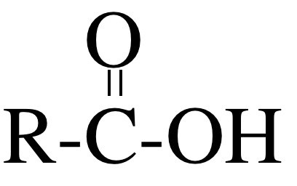
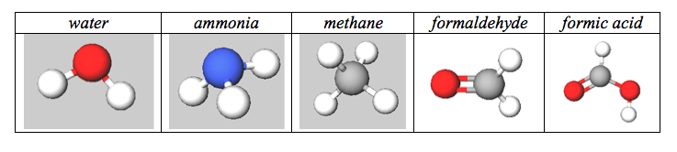
Sugars (Carbohydrates)
Common Functional Groups
Name General Formula
Alcohols R−ΟΗ
Ethers R−Ο−R′
Amines R−ΝΗ₂
Carboxylic Acids

Slide 3
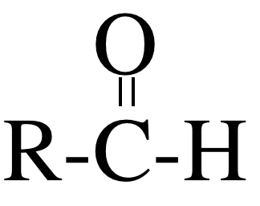
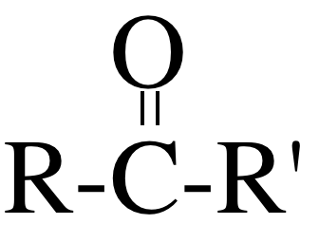
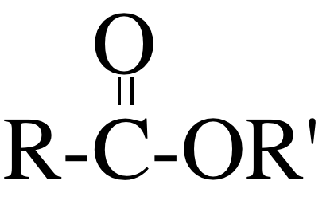
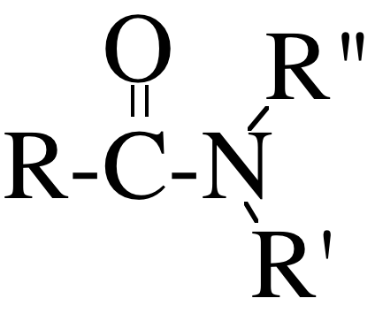
Sugars (Carbohydrates)
Common Functional Groups
Name General Formula
Aldehydes
Ketones
Carboxylic Acids
Esters
Amides

Slide 4
Carbohydrate (“-ose”) Formation
Photosynthesis
light + chlorophyll + two greenhouse gases,
which provide sugars (”carbs”) + oxygen
  n CO₂ + n H₂O C_{n} (H₂O)_{n} + n O₂
Empirical formula = CH₂O
Monosaccharides (simple sugars)
C₅ : pent-oses – rib-ose
C₆ : hex-oses – fruct-ose, gluc-ose
Can be either an ald-ose (aldehyde + alcohols) or ket-ose (ketone + alcohols)

Slide 5
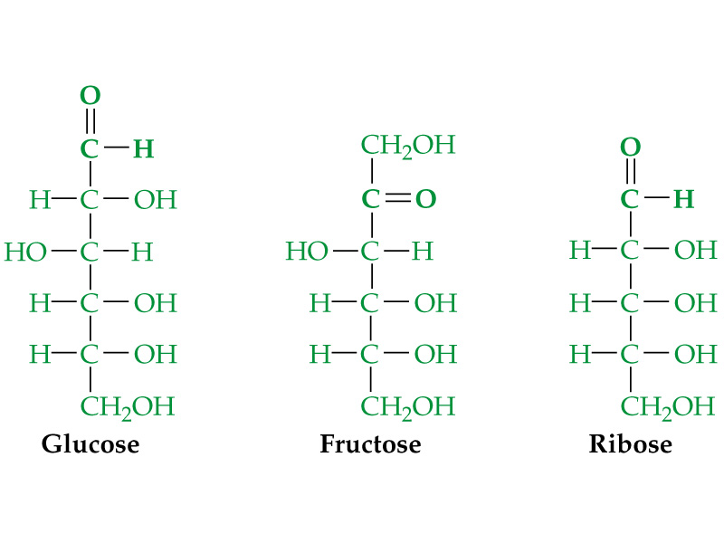
Aldose

Slide 6
Aldose
Aldose or Ketose?
Aldose or Ketose?
C
Ketose

Slide 7
Aldose
Aldose or Ketose?
Aldose or Ketose?
Ketose
Aldose
C
Ketose
There are 2^{n} possible stereoisomers, where n = the number of chiral atoms. Glucose? Fructose? Ribose?

Slide 8

Chirality & Carbon Atoms
http://chemconnections.org/general/movies/Chirality.mov
Each carbon atom with four different substituents is chiral.
Sugars have many chiral carbon atoms and 2^{n} possible stereoisomers.

Slide 9
Aldehyde
Aldose
Aldose or Ketose?
Aldose or Ketose?
Ketose
Aldose
C
Ketone
Ketose
n=4
2⁴
n=3
2³
There are 2^{n} possible stereoisomers, where n = the number of chiral atoms (alcohols). Glucose? Fructose? Ribose?

Slide 10
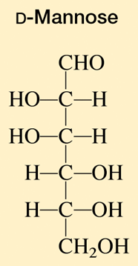
QUESTION
The monosaccharide mannose has how many chiral carbon centers?
None
Two
Four
Six
Notes:
HMClassPrep Table 22.8

Slide 11
QUESTION
The monosaccharide mannose has how many stereoisomers?
four
six
eight
sixteen
thirty two
Notes:
HMClassPrep Table 22.8

Slide 12

Sugars, Saccharides
Carbohydrates

Slide 13
Aldose
Aldose or Ketose?
Aldose or Ketose?
Ketose
Aldose
C
Ketose
There are 2^{n} possible stereoisomers, where n = the number of chiral atoms. Glucose? 16 Fructose? 8 Ribose? 8
And +1: Cyclization

Slide 14
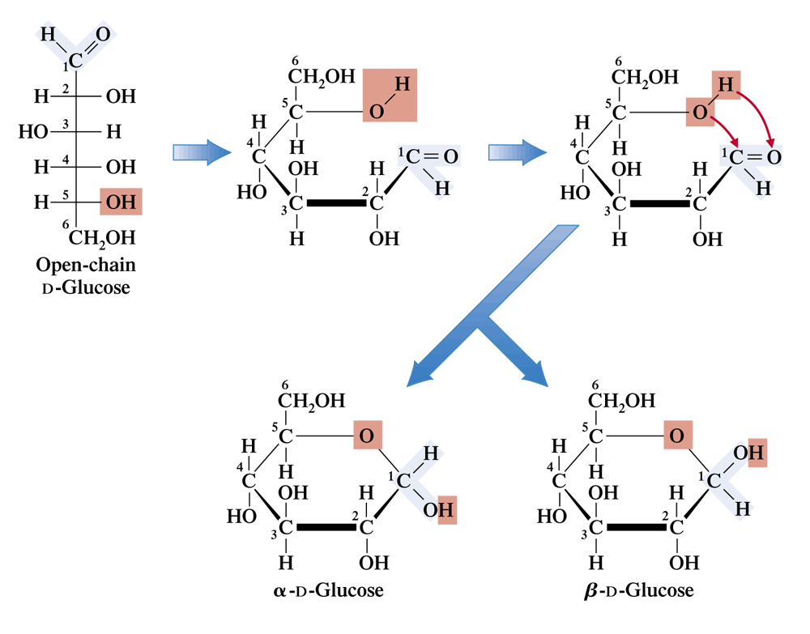
D-glucose can cyclize through an intramolecular reaction
Plus the cyclized forms of each of the sixteen, which adds a chiral carbon, D-Glucose for example:
Ethers

Slide 15
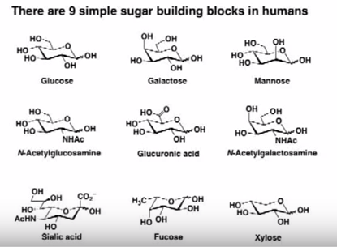
Simple Sugars & Glycosides in Humans

Slide 16
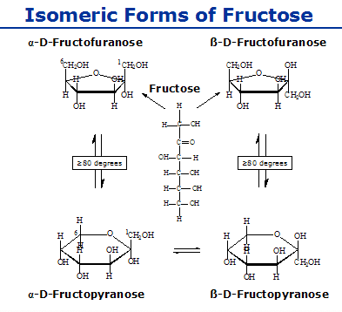
Sugar Equilibrium
The open chain predominates in the fructose equilibrium mixture
Amount of each form varies in the equilibrium mixture of each different sugar.
Notes:
http://www.medbio.info/Horn/Time%201-2/CarbChem1.htm

Slide 17
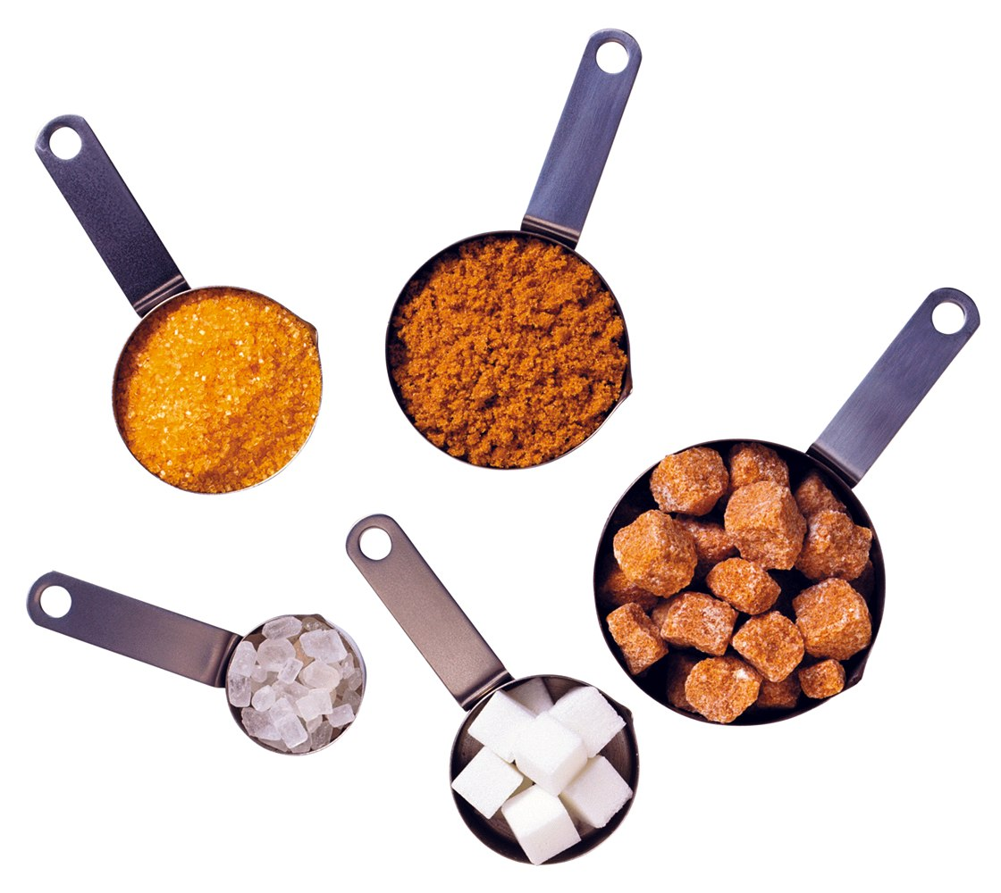
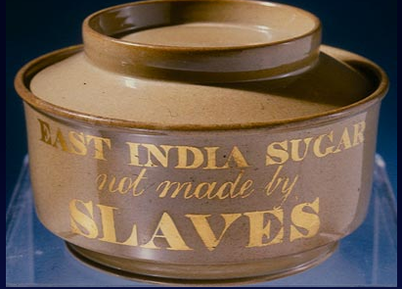
Different Raw & Refined Sugars (Carbohydrates)
Rum
Historical Significance & the
1791 British
Sugar Boycott
British
Abolition of the Slave Trade Act in 1807
Notes:
Britain, for example, consumed five times as much sugar in 1770 as in 1710.[25] By 1750 sugar surpassed grain as "the most valuable commodity in European trade — it made up a fifth of all European imports and in the last decades of the century four-fifths of the sugar came from the British and French colonies in the West Indies."[25] The sugar market went through a series of booms. The heightened demand and production of sugar came about to a large extent due to a great change in the eating habits of many Europeans. For example, they began consuming jams, candy, tea, coffee, cocoa, processed foods, and other sweet victuals in much greater numbers.

Slide 18
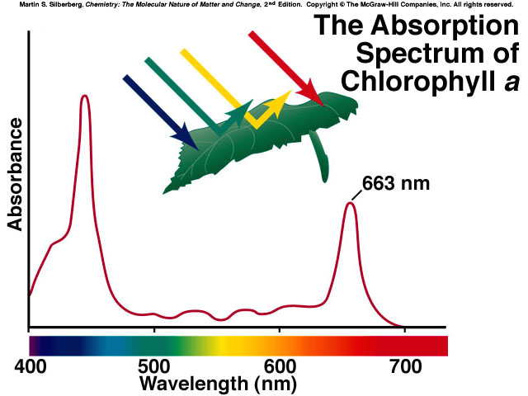
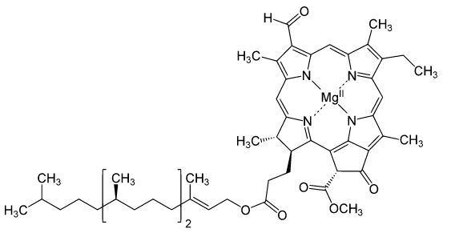
Photosynthesis
Energy Capture → Carbohydrates (Sugars)
Chlorophyll a
n CO₂(g) + n H₂O(g) + energy →
CARBOHYDRATES
a complex collection of enzymes with:
Artificially possible?
Notes:
http://chemconnections.org/general/chem106/Reading/Researchers%20Aim%20to%20Put%20Carbon%20Dioxide%20Back%20to%20Work%20-%20The%20New%20York%20Times.pdf

Slide 19
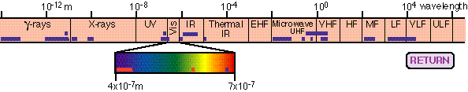
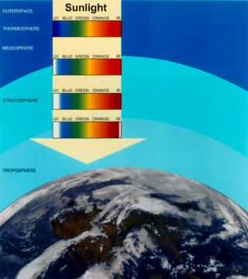
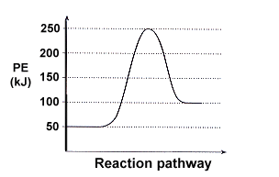
Plants absorb energy; i.e., visible light.
In turn, plants produce molecules that store the sun’s energy through endothermic reactions that form carbohydrates such as glucose.
http://chemistry.beloit.edu/Stars/EMSpectrum/index.html

Slide 20
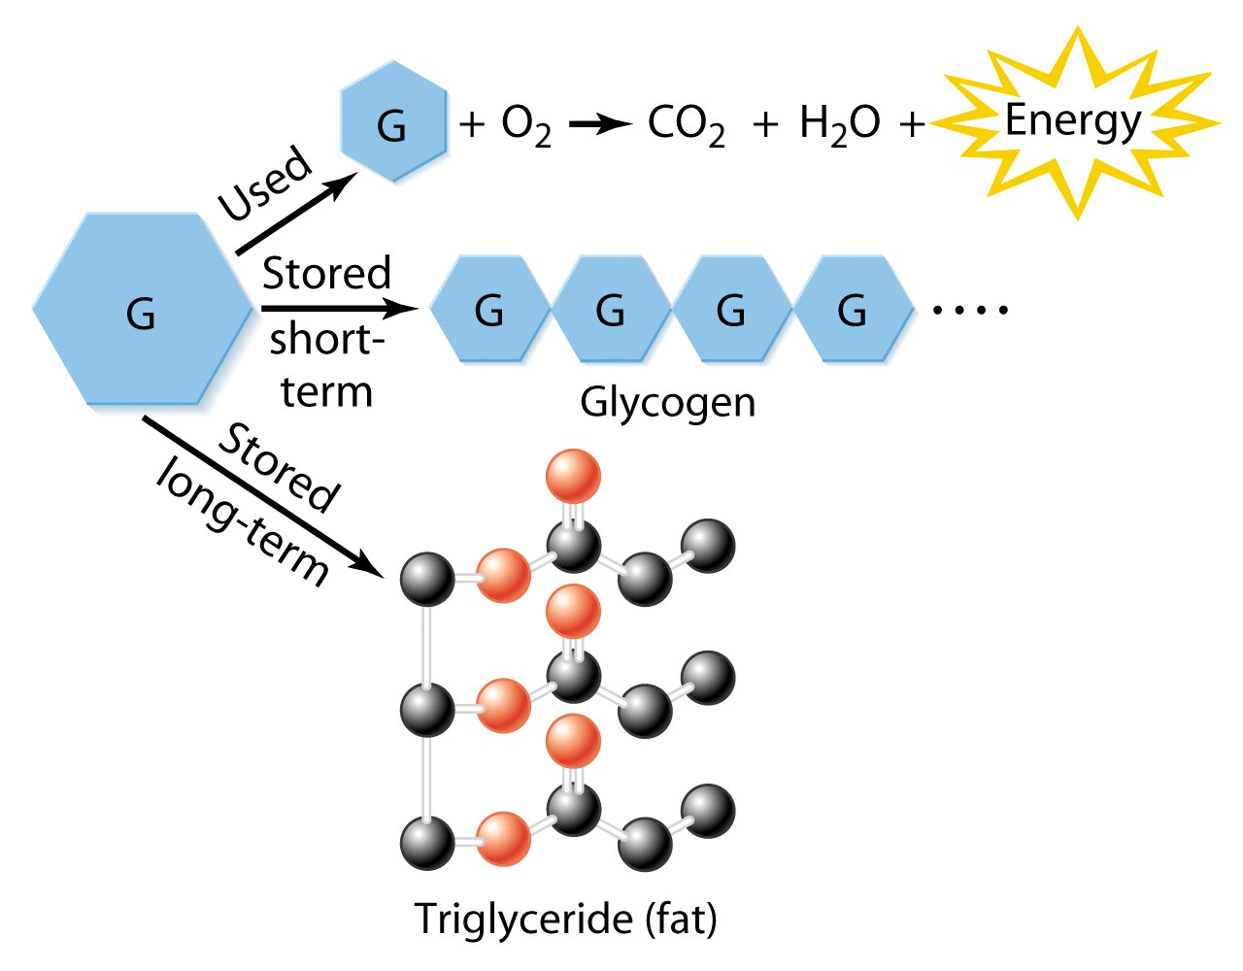
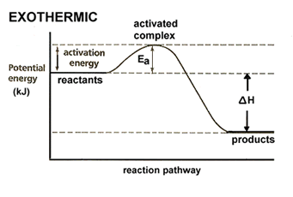
Glucose, which animals burn to produce:
Anaerobic:
Lactic acid
…. and to temporarily store energy for a time when it may be needed, and obtained through exothermic reactions breaking the molecule’s bonds.
Combustion (burning) of one gram: of carbohydrate produces 4 to 5 Calories, protein produces 4 to 5 Calories, fat produces 9 to 10 Calories — more than twice that of either sugars or proteins.
Notes:
http://www.scientificamerican.com/article/why-does-lactic-acid-buil/
the working muscles generate energy anaerobically. This energy comes from glucose through a process called glycolysis, in which glucose is broken down or metabolized into a substance called pyruvate through a series of steps. When the body has plenty of oxygen, pyruvate is shuttled to an aerobic pathway to be further broken down for more energy. But when oxygen is limited, the body temporarily converts pyruvate into a substance called lactate, which allows glucose breakdown--and thus energy production--to continue. The working muscle cells can continue this type of anaerobic energy production at high rates for one to three minutes, during which time lactate can accumulate to high levels.

Slide 21
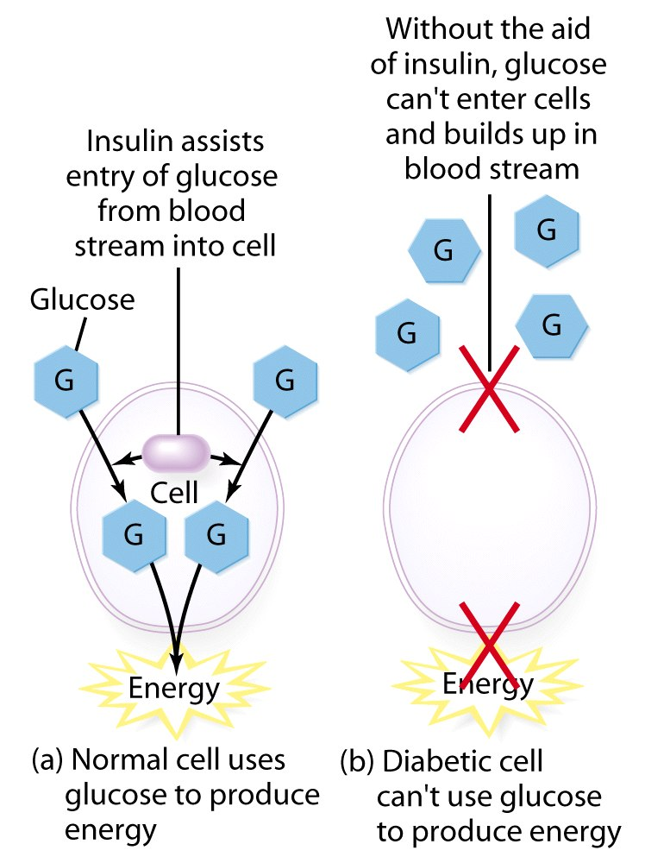
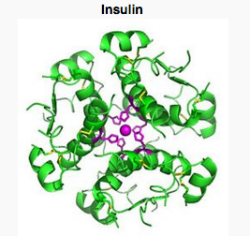
Sugars/Glucose & Insulin
Zinc is @ the center

Slide 22
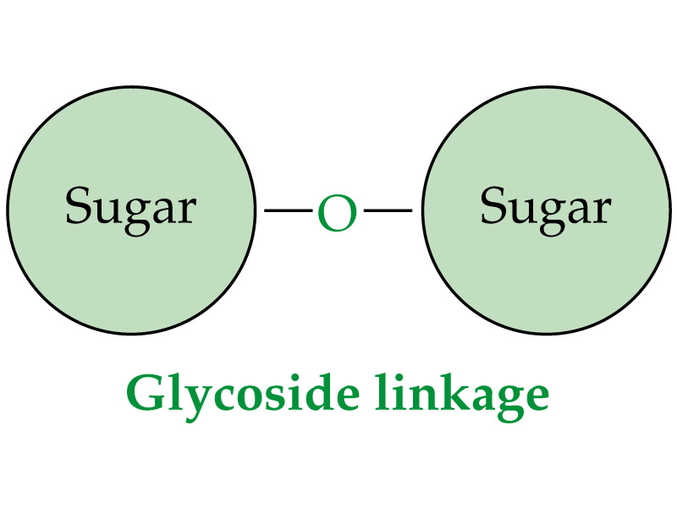
Carbohydrates
Prof. Carolyn Bertozzi: https://www.youtube.com/watch?v=VBwNMR3C0Ys&feature=PlayList&p=10F61E434B646DE1&index=1%20
Disaccharides
  (2 cyclic monosaccharides joined by a “glycoside” linkage α-alpha or β-beta [ether]
e.g. (glucose + fructose) sucrose
Polysaccharides
  (many linked monosaccharide units)
e.g. starch (α-alpha), cellulose (β-beta)

Slide 23
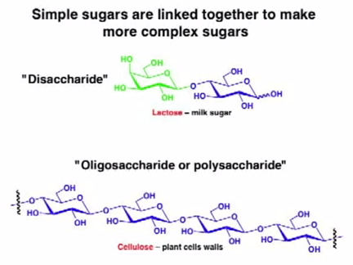
Disaccharide & Polysaccharide
Why are there relatively few dairy farms in Asia?
Do you eat starch? ..easily digested α-linkages
…tree bark (fiber)? .. Non digestible β-linkages
Do they smell and taste appetizing?
Notes:
Starch or amylum is a polymeric carbohydrate consisting of a large number of glucose units joined by glycosidic bonds. This polysaccharide is produced by most green plants as an energy store. It is the most common carbohydrate in human diets and is contained in large amounts in staple foods such as potatoes, wheat, maize (corn), rice, and cassava.
In photosynthesis, plants use light energy to produce glucose from carbon dioxide. The glucose is used to make cellulose fibers, the structural component of the plant, or is stored in the form of starch granules, in amyloplasts. Toward the end of the growing season, starch accumulates in twigs of trees near the buds. Fruit, seeds, rhizomes, and tubers store starch to prepare for the next growing season.

Slide 24
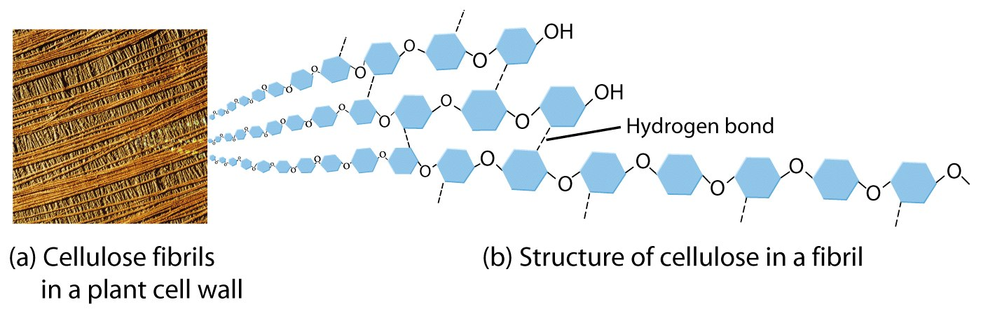
      Humans cannot digest cellulose, only alpha (α)-sugars, not (β)- beta.
      Goats and termites can digest (β)- beta sugars using enzymes humans do not have

Slide 25
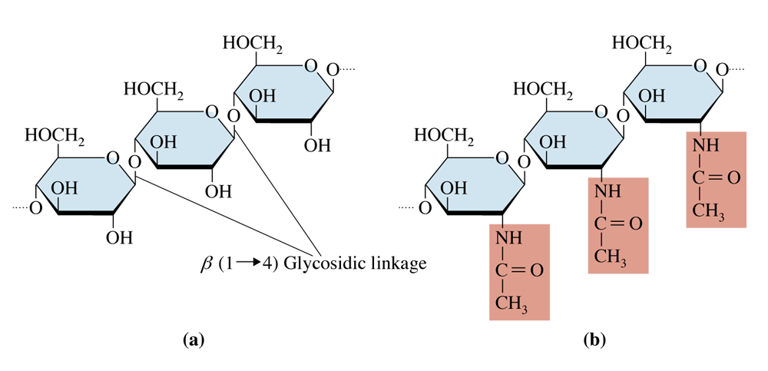
The structures of cellulose (a) and exoskeleton, chitin (b). In both substances, all glycosidic linkage are of the β-(1, 4) type.
Do you eat fried grasshoppers? … the shells of shrimp?

Slide 26
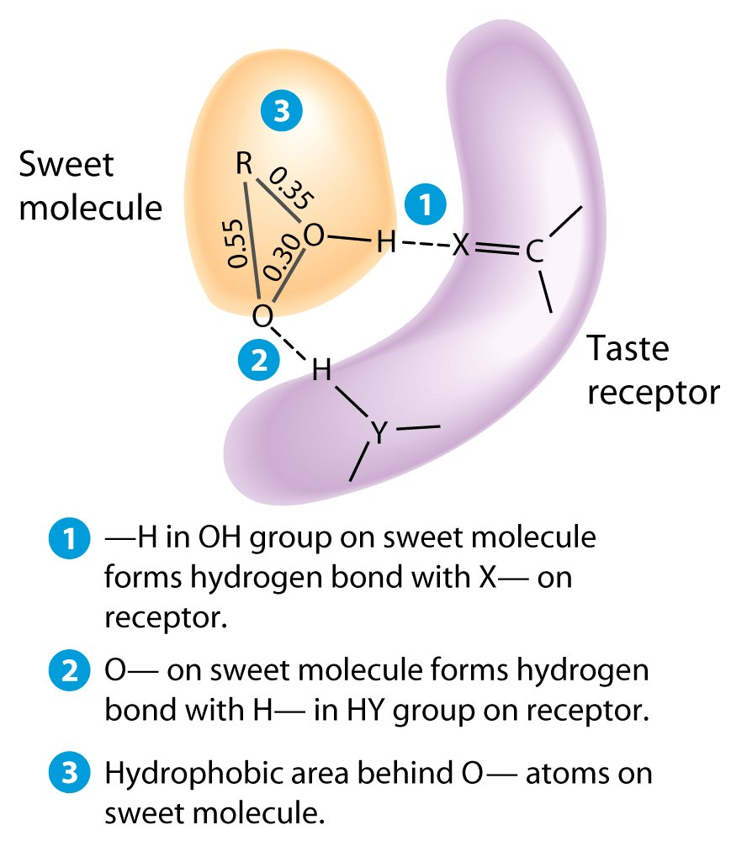
Protein binding & Taste Receptors
Sweet
Sour
Bitter
Salty
Umami

Slide 27
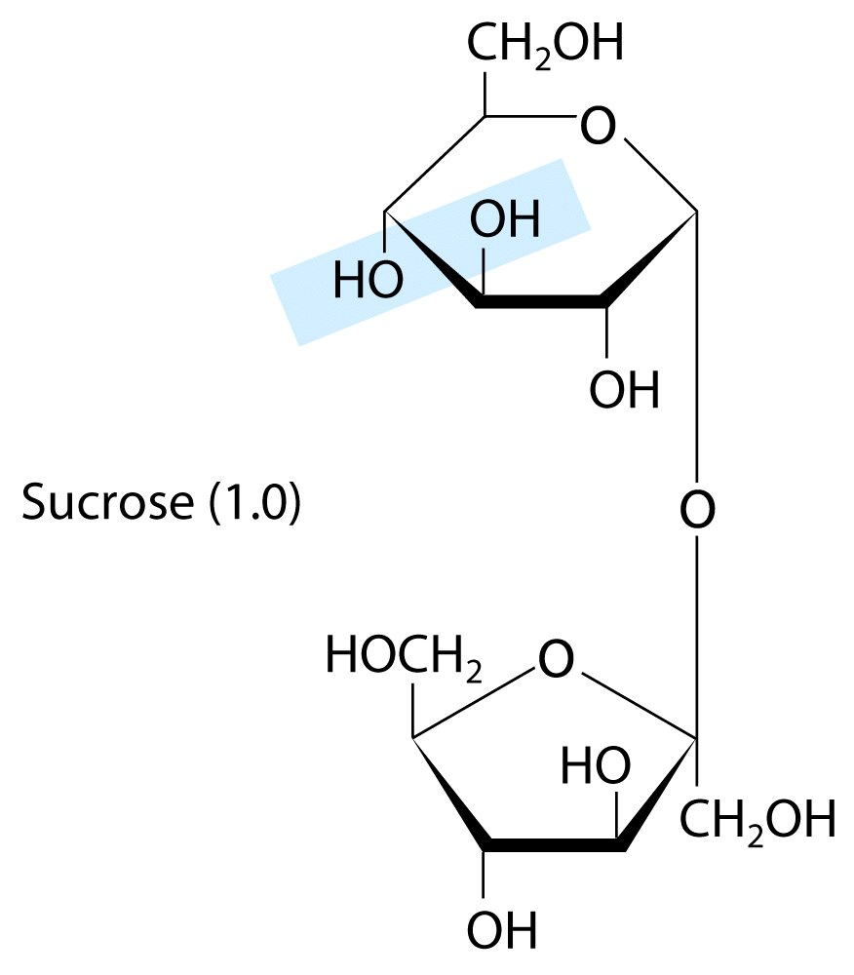
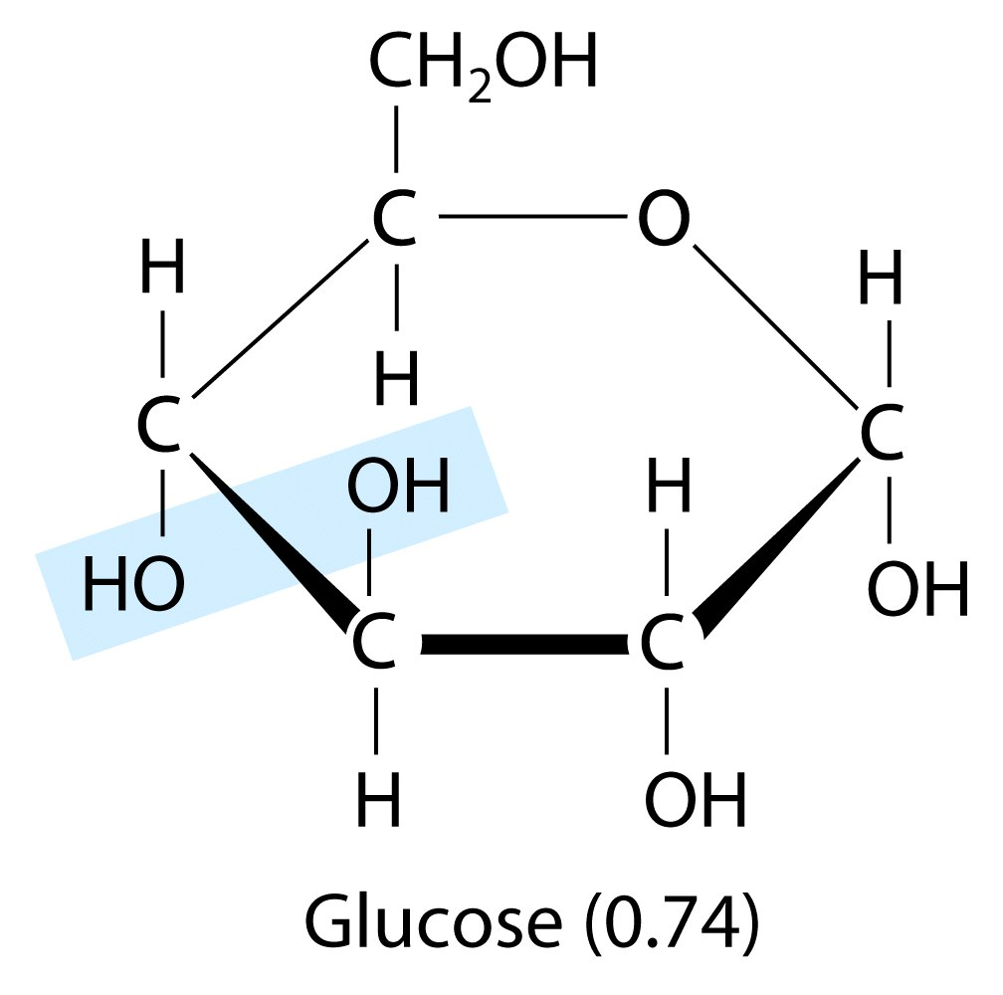
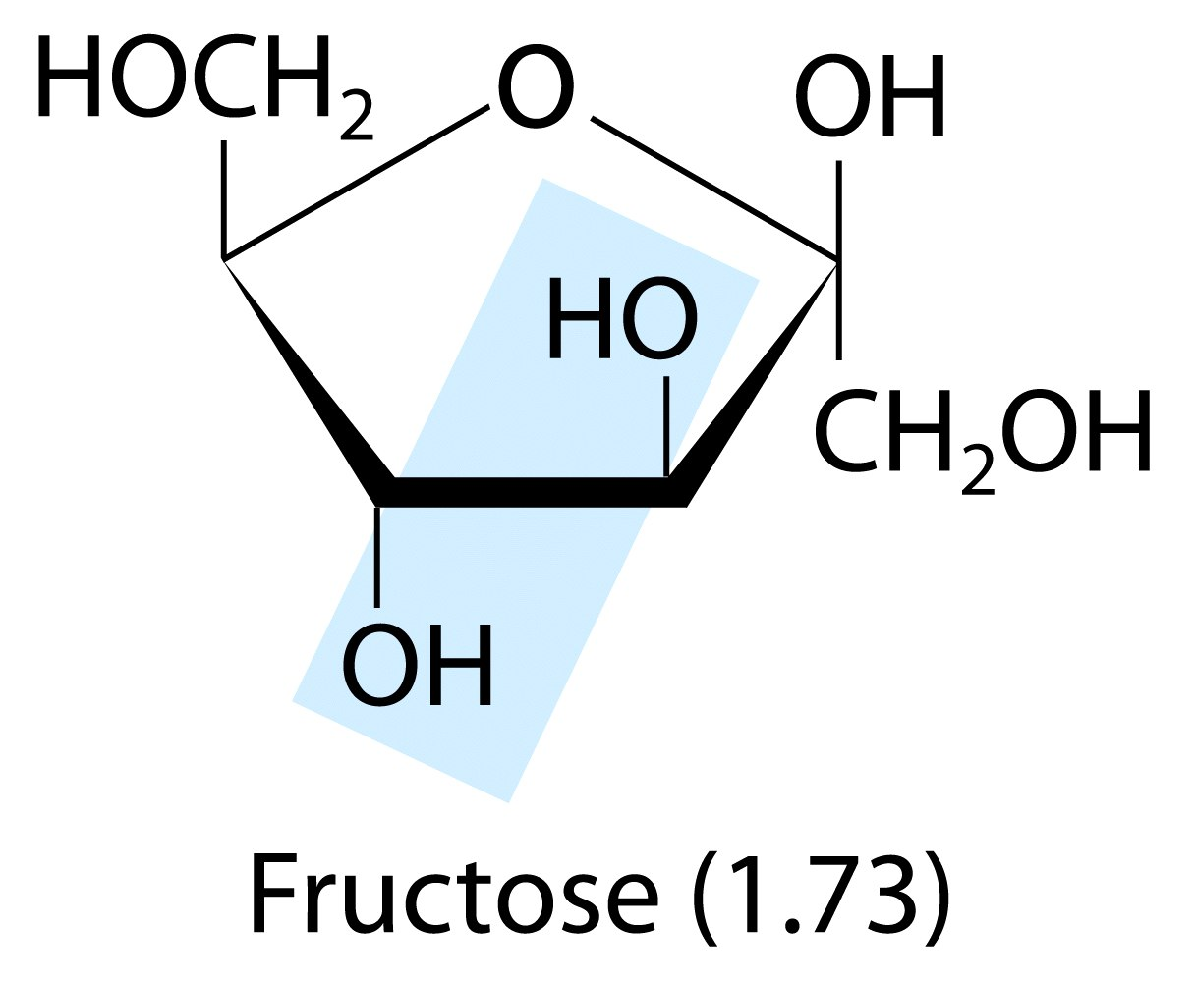
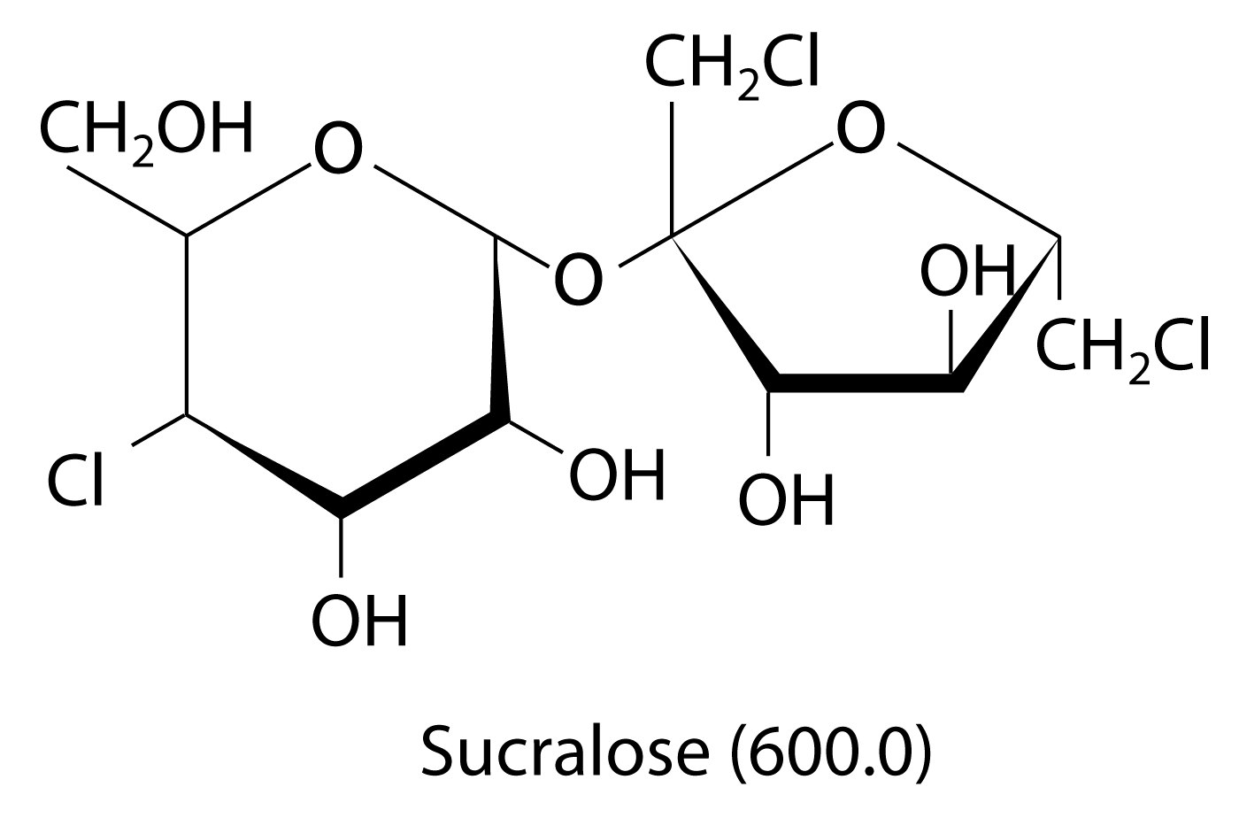
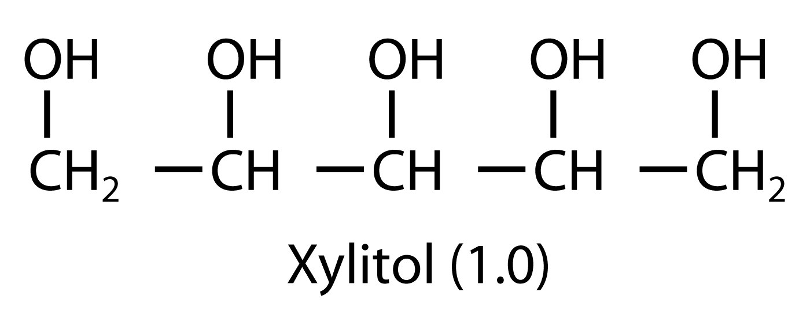
Sweetness factor = 1.0
Sweetness factor = 0.74
Notes:
high-fructose corn syrup usage in processed foods may be linked to various health conditions, including metabolic syndrome, hypertension, dyslipidemia, hepatic steatosis, insulin resistance, and obesity. However, there is to date little evidence that high-fructose corn syrup is any unhealthier, calorie for calorie, than sucrose or other simple sugars.

Slide 28
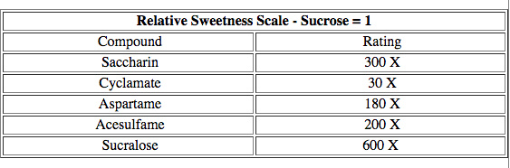
Notes:
http://chemistry.elmhurst.edu/vchembook/549sweet.html
high-fructose corn syrup usage in processed foods may be linked to various health conditions, including metabolic syndrome, hypertension, dyslipidemia, hepatic steatosis, insulin resistance, and obesity. However, there is to date little evidence that high-fructose corn syrup is any unhealthier, calorie for calorie, than sucrose or other simple sugars.

Slide 29
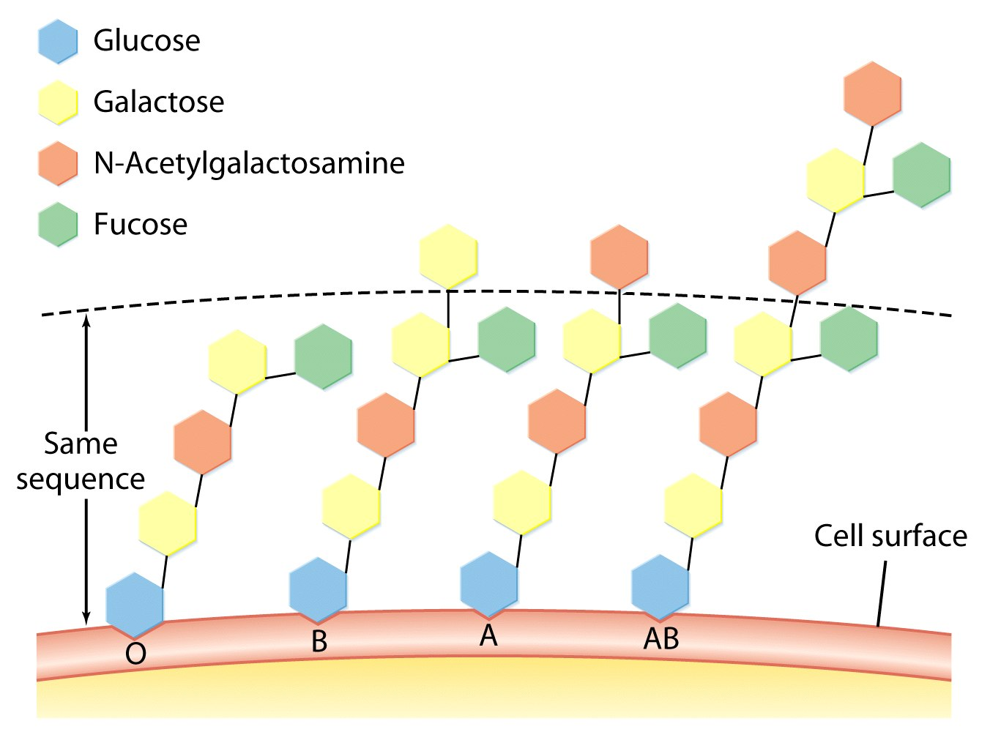
Blood Type
Also Rh factor, + or -

Slide 30
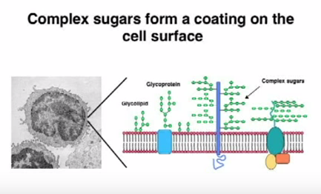
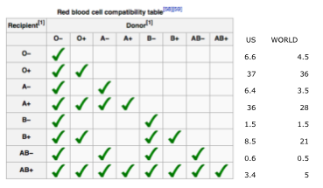
Blood Histocompatibility
http://anthro.palomar.edu/blood/Rh_system.htm

Slide 31
Glucose
FATS = lipids =
Esters of fatty acids from glycerol, a tri-ol (3 alcohols = 3 -OH groups)
Notes:
http://www.nytimes.com/2016/05/02/health/biggest-loser-weight-loss.html?rref=collection%2Fsectioncollection%2Fscience&action=click&contentCollection=science&region=rank&module=package&version=highlights&contentPlacement=1&pgtype=sectionfront

Slide 32
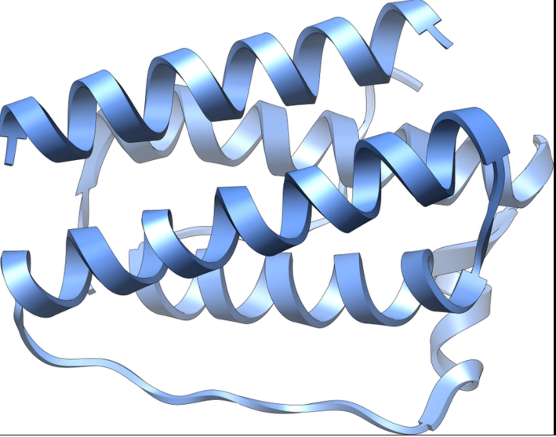
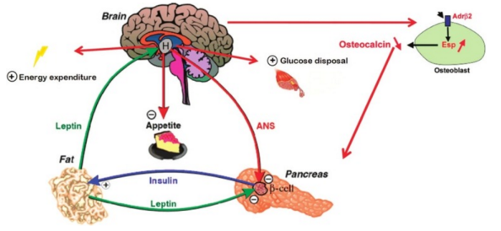
Leptin & Ghrelin: Glucose, Fat, Appetite & Weight
http://www.ncbi.nlm.nih.gov/pmc/articles/PMC3602983/figure/F2/
https://www.ncbi.nlm.nih.gov/pubmed/17212793
http://www.nytimes.com/2016/05/02/health/biggest-loser-weight-loss.html?rref=collection%2Fsectioncollection%2Fscience&action=click&contentCollection=science&region=rank&module=package&version=highlights&contentPlacement=1&pgtype=sectionfront&_r=0
Notes:
http://www.nytimes.com/2016/05/02/health/biggest-loser-weight-loss.html?rref=collection%2Fsectioncollection%2Fscience&action=click&contentCollection=science&region=rank&module=package&version=highlights&contentPlacement=1&pgtype=sectionfront

