Slide 1
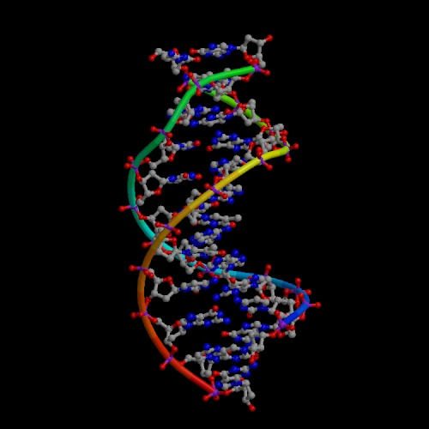
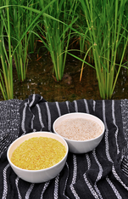
Chemical Biology
DNA  RNA  Proteins
Molecular Engineering
Dr. Ron Rusay
https://www.youtube.com/watch?v=gG7uCskUOrA

Slide 2
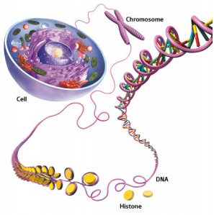
DNA & RNA: Nucleic Acids
Store & carry genetic information.
DNA (deoxyribonucleic acids) have molecular weights ~ 6 × 10⁶ to 16 × 10⁶ daltons (amu) and are found inside the nucleus of the cell.
RNA (ribonucleic acids) have molecular weights ~ 20,000 to 40,000 amu and are found in the cytoplasm outside the nucleus of the cell.

Slide 3
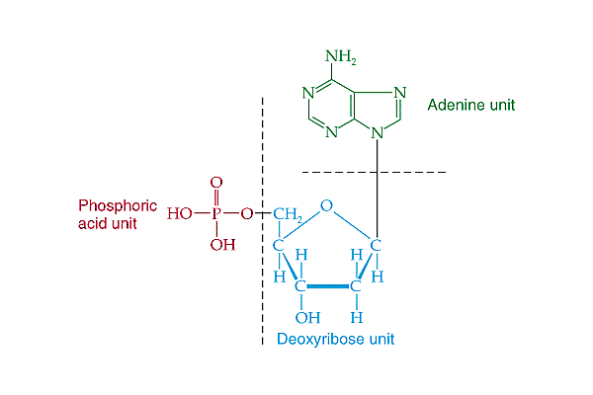
Nucleic “Acids”
Organic base: R-NH₂
Nucleotide: (3 units, base; sugar; phosphoric acid)
H₃PO₄
5’
3’
five carbon sugar
Nucleoside: does not include the phosphoric acid

Slide 4
Nucleic Acids (DNA & RNA)
DNA and RNA have different sugars (dexoyribose vs. ribose).
There are only five bases found in DNA and RNA:
  adenine (A),
  guanine (G),
  cytosine (C),
  thymine (T found in DNA only), and
  uracil (U found in RNA only).

Slide 5
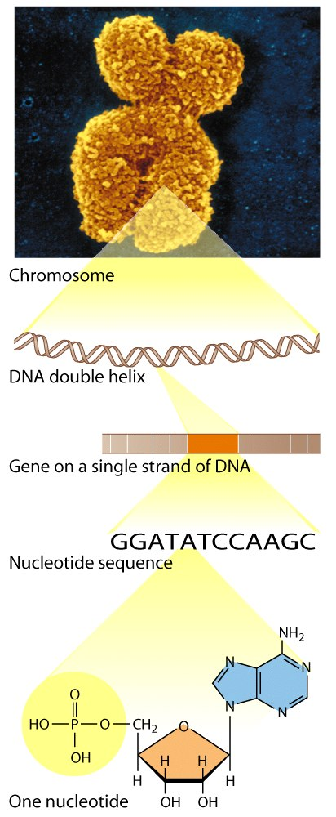
Genetics & DNA
XX
XY

Slide 6
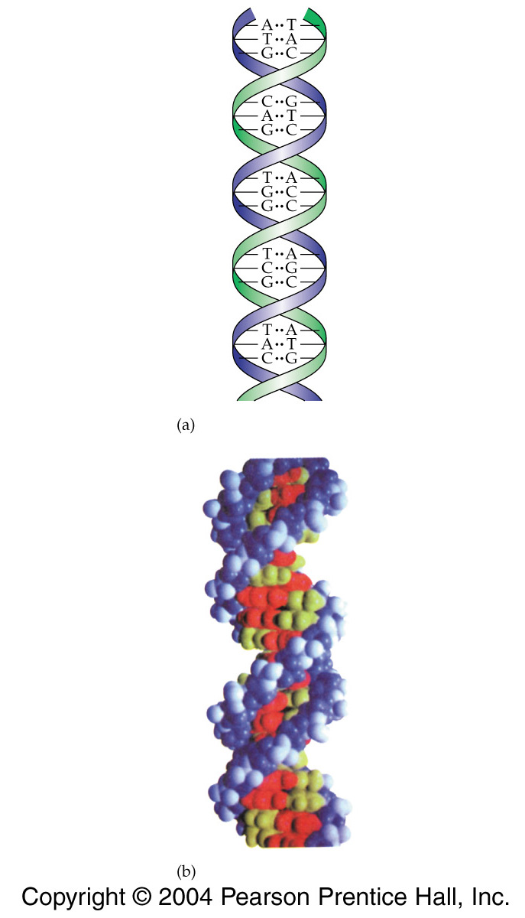
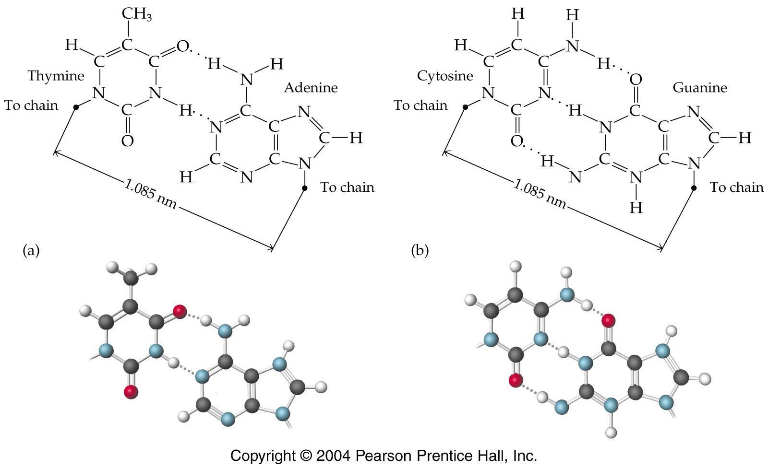
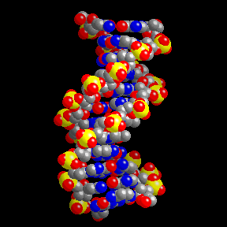

DNA: Size, Shape & Self Assembly
http://www.umass.edu/microbio/chime/beta/pe_alpha/atlas/atlas.htm
Views & Algorithms
10.85 Å
10.85 Å
Notes:
15-23
Title:
Base Pairs
Caption:
Representation of the base pairings of thymine and adenine, and cytosine and guanine, in line as well as ball-and-stick models.
Notes:
Base pairs occur through hydrogen bonding.

Slide 7
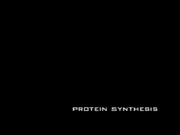
Protein Biosynthesis
https://www.dnalc.org/resources/3d/09-how-much-dna-codes-for-protein.html

Slide 8
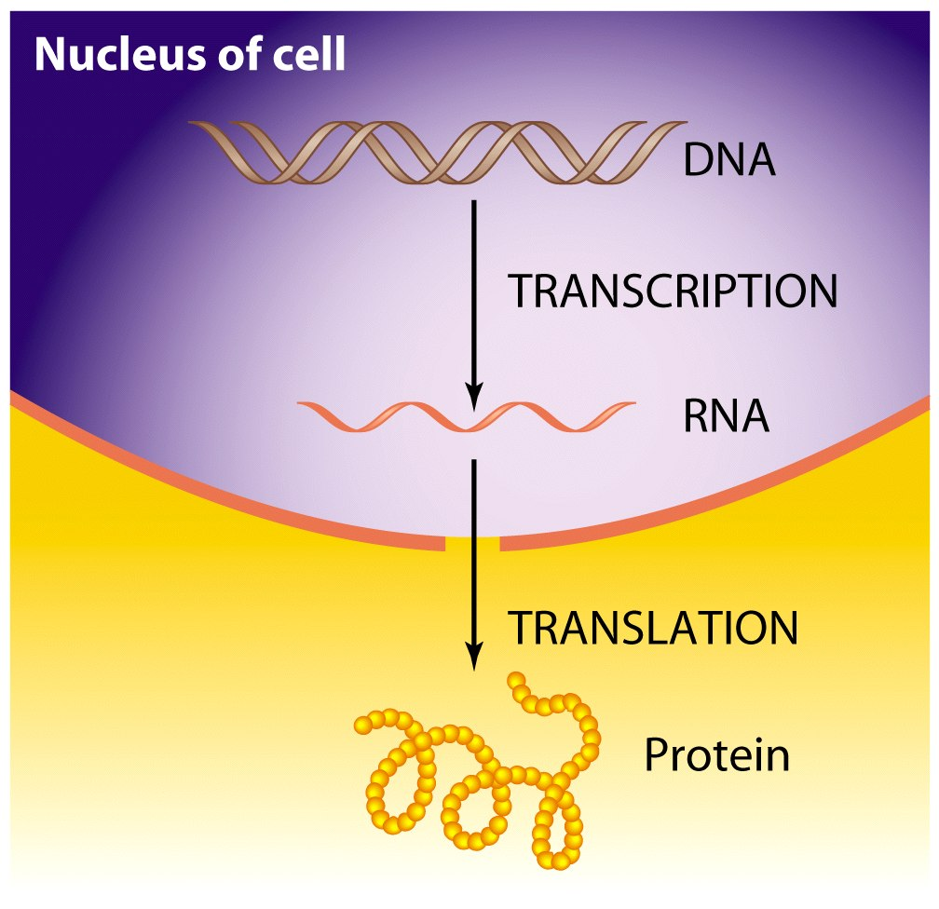
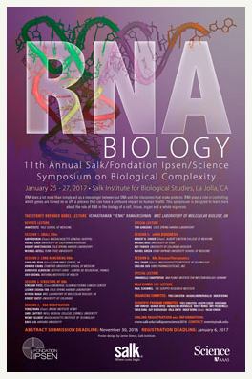
~22,000 define
a human
Notes:
RNA DOES A LOT MORE THAN SIMPLY ACT AS A MESSENGER BETWEEN OUR DNA AND THE RIBOSOMES THAT MAKE PROTEINS. RNA PLAYS A ROLE IN CONTROLLING WHICH GENES ARE TURNED ON OR OFF, A PROCESS THAT COULD HAVE A PROFOUND IMPACT ON HUMAN HEALTH.

Slide 9
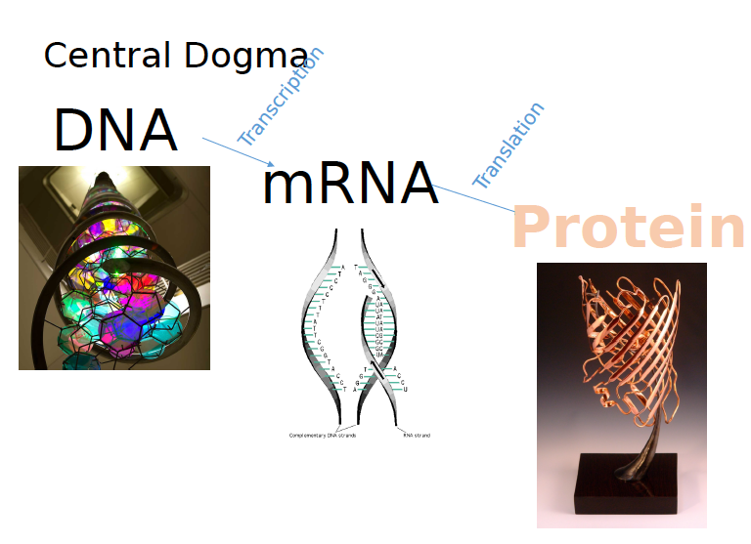
~22,000 define
a human
Amanda Ruby
Notes:
Amanda Ruby
https://www.buffalo.edu/content/www/ccr/outreach/k-12-outreach/summer-workshop/past-workshops/2014-workshop/_jcr_content/rightcol/download_14/file.res/Proteins.pdf

Slide 10
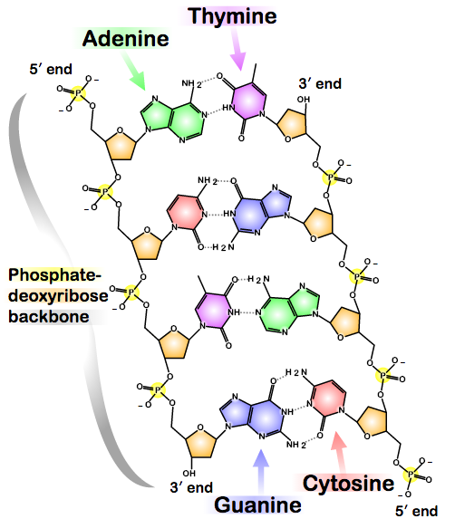
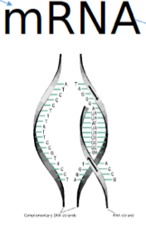
(Uracil)
Notes:
Amanda Ruby
https://www.buffalo.edu/content/www/ccr/outreach/k-12-outreach/summer-workshop/past-workshops/2014-workshop/_jcr_content/rightcol/download_14/file.res/Proteins.pdf

Slide 11
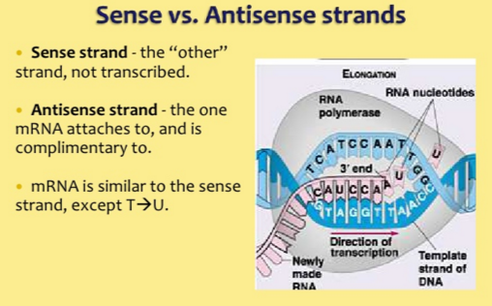
Antisense DNA from the left: GTAGGT…
mRNA: CAUCCA…
Notes:
Amanda Ruby
https://www.buffalo.edu/content/www/ccr/outreach/k-12-outreach/summer-workshop/past-workshops/2014-workshop/_jcr_content/rightcol/download_14/file.res/Proteins.pdf

Slide 12
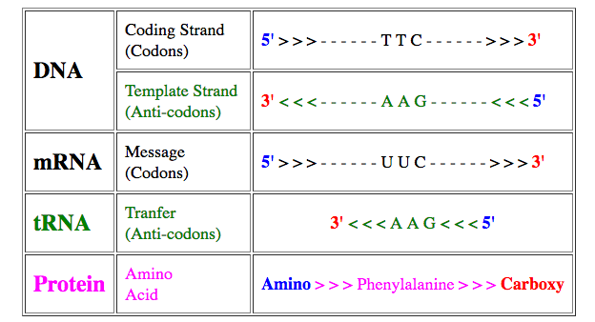
Coding Strand = Antisense strand: TTC
Anti-coding = Sense strand
mRNA: UUC
Notes:
Amanda Ruby
https://www.buffalo.edu/content/www/ccr/outreach/k-12-outreach/summer-workshop/past-workshops/2014-workshop/_jcr_content/rightcol/download_14/file.res/Proteins.pdf

Slide 13
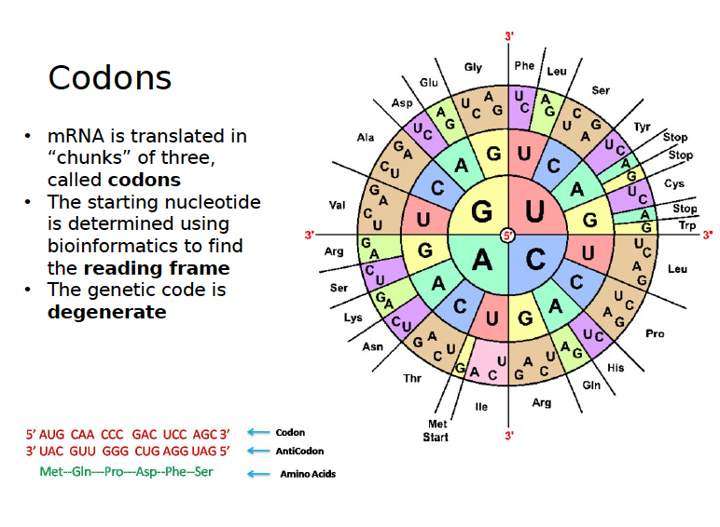
Protein Biosynthesis
(similar, but not identical)

Slide 14
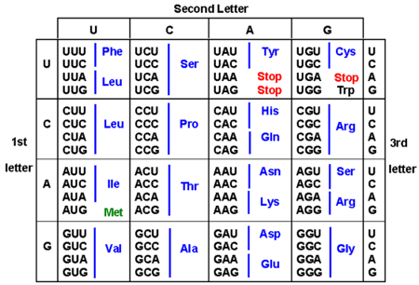
Protein Biosynthesis
Codon Chart

Slide 15
Several nucleic acids linked together form DNA
Three nucleic acids in a row form a codon, which codes for different amino acids
Several consecutive codons form genes
Genes code for a sequence of amino acids
Several amino acids linked together form proteins
~22,000 define
a human
Notes:
Amanda Ruby
https://www.buffalo.edu/content/www/ccr/outreach/k-12-outreach/summer-workshop/past-workshops/2014-workshop/_jcr_content/rightcol/download_14/file.res/Proteins.pdf

Slide 16
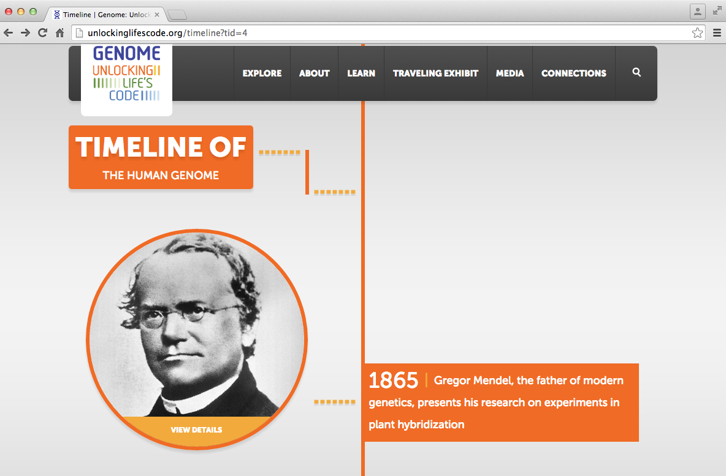
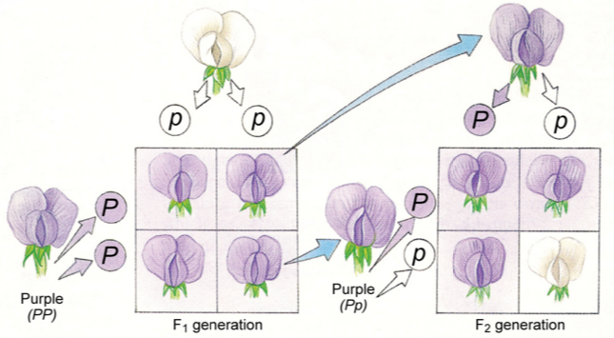
DNA: Genetics & Genomics
Timelines
1865
Gregor Mendel (1822-1884)
https://www2.edc.org/weblabs/Mendel/MendelMenu.html

Slide 17
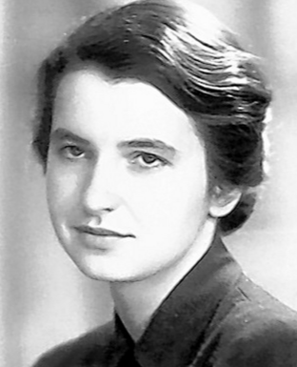
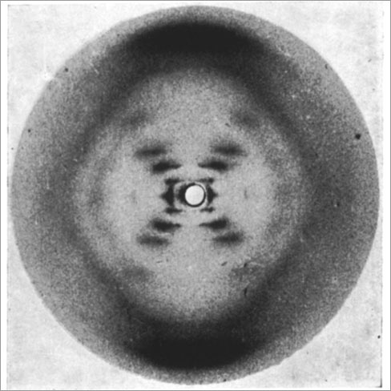
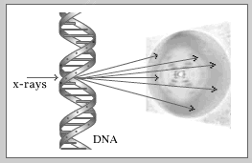
DNA: Molecular Discovery
1953
X-Ray Crystal Structure
http://info.bio.cmu.edu/courses/03231/ProtStruc/ProtStruc.htm
β-DNA: Rosalind Franklin
46 Å
12 base sequence
http://molvis.sdsc.edu/pdb/dna_b_form.pdb

Slide 18
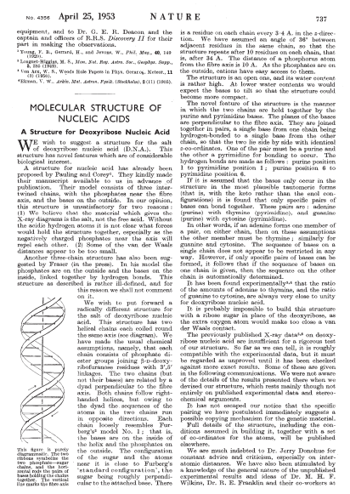
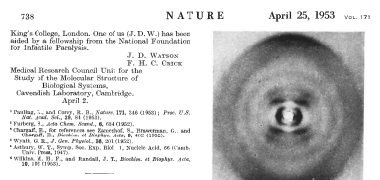
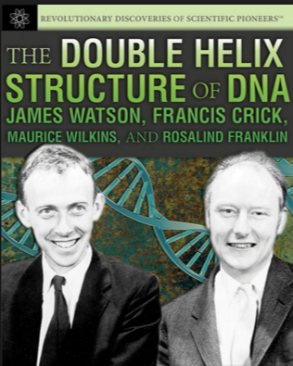

Slide 19
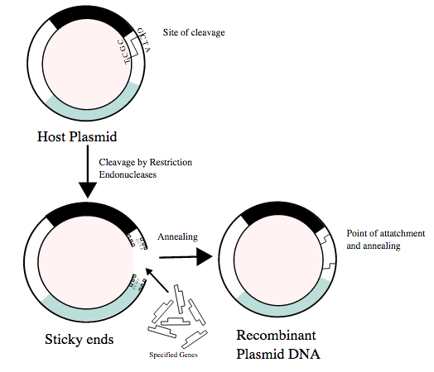
1975
Restriction Enzymes / Recombinant DNA
Berg, Boyer, Cohen, and many others
http://nar.oxfordjournals.org/content/early/2013/10/18/nar.gkt990.full

Slide 20
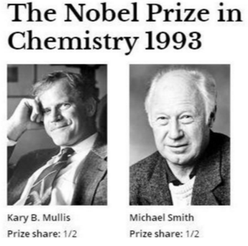
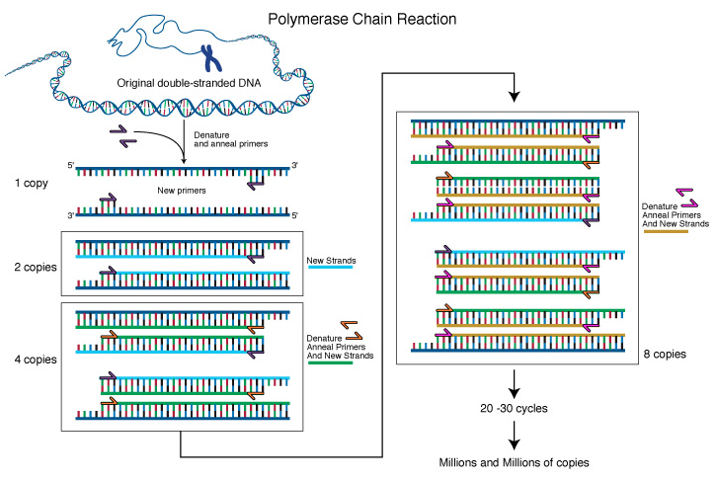
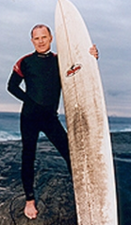
PCR: Polymerase Chain Reaction
Kary Mullis, Cetus-Chiron-Roche, Emeryville
1989
https://www.dnalc.org/resources/3d/19-polymerase-chain-reaction.html

Slide 21
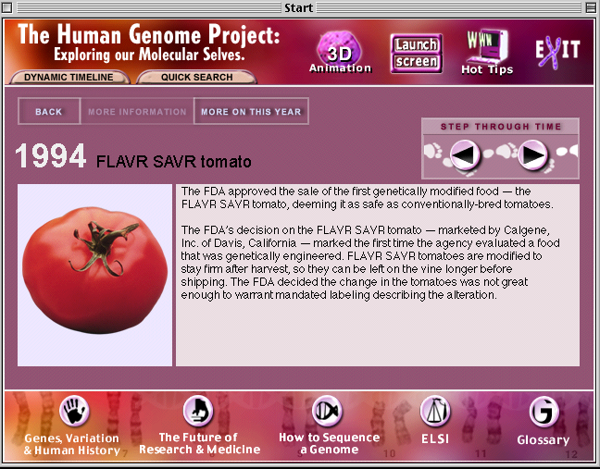

APPLICATIONS: Transgenic (GM: Genetically Modified) Crops
Roger Salquist
Chairman CEO
Calgene
Notes:
http://www.danielcharles.us/lordsweb/Calgene_tomato.htm
Canola plants, for instance, could be engineered to produce the kind of oil found in coconuts. (After P&G proved uninterested in pursuing the technology, Calgeneís researchers divined the truth: P&G just wanted a weapon in its back pocket against Ferdinand Marcos of the Philippines, who was organizing a coconut cartel and threatening to jack up prices.)

Slide 22
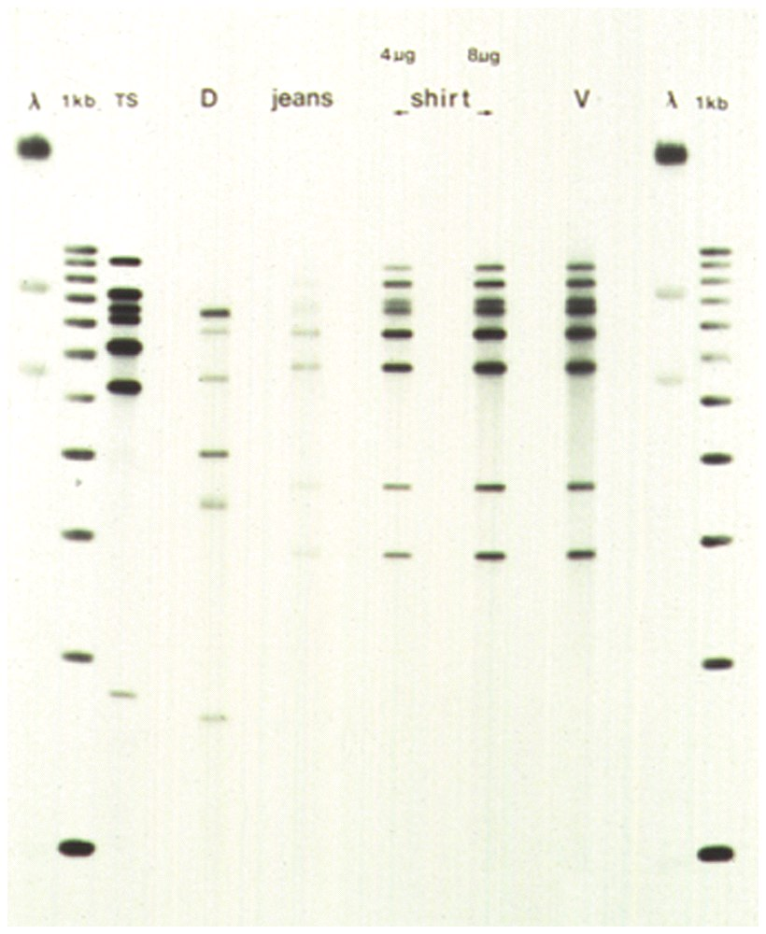

Genetic Fingerprinting
1995
Blood on glove found on Simpson's property appeared to contain genetic markers of Simpson and both victims.
OJ Simpson and the bloody glove.
Notes:
http://usatoday30.usatoday.com/news/index/nns25.htm
DNA tests showed blood on glove found on Simpson's property appeared to contain genetic markers of Simpson and both victims; a long strand of blond hair similar to Ms. Simpson's also was found on that glove.
http://www.pbs.org/wgbh/nova/education/body/create-dna-fingerprint.html
DNA profiles help forensic investigators determine whether two tissue samples -- one from the crime scene and one from a suspect -- came from the same individual. Fortunately, the genetic comparison doesn't require that investigators look at all of the DNA found in the tissue samples. That would take months or even years. Instead, by marking a small number of segments of DNA in one sample and then checking for the presence or absence of those segments in the other sample, investigators can say with some assurance whether the samples are from the same person.
How do they do it? Investigators use chemicals to cut the long strands of DNA into much smaller segments. Each segment has a specific length, but all of them share the same repeating sequence of bases (or nucleotides). The chemicals cut the segments at the beginning and at the end of the repeating string of nucleotides, so one segment might be ATCATCATCATCATC, for example, while another might be ATCATC. (The DNA segments used in forensic investigations are, of course, much longer than this.)
Investigators use a process called gel electrophoresis to separate these repeating segments according to length. Next, they introduce a small set of radioactive "markers" to the sample. These markers are segments of DNA of known length, with bases that complement the code of, and bind to, sample segments of the same length. The sample segment above (ATCATCATCATCATC), for example, would be tagged by a marker with the complementary code TAGTAGTAGTAGTAG.
Markers that do not bind to sample segments are then rinsed away, leaving in place only those markers that bound to complementary sample segments. Photographic film, which darkens when exposed to the radioactive markers, identifies the location of all marked sample segments. This film, then, becomes the DNA "fingerprint" that forensic investigators analyze.
The final step is a relatively simple matter of lining up the sample profiles side by side and comparing them for the presence or absence of segments with particular lengths. The more segments the two samples have in common, the more likely it is that the samples came from the same person.

Slide 23
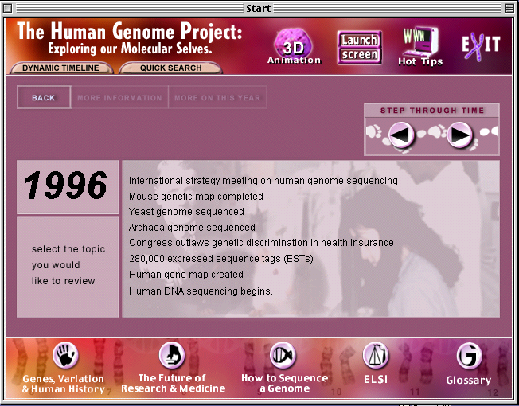
Genetics DNA / RNA
Proteins
http://www.genome.gov/25019879
http://unlockinglifescode.org/timeline?tid=4

Slide 24
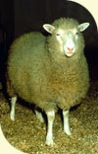
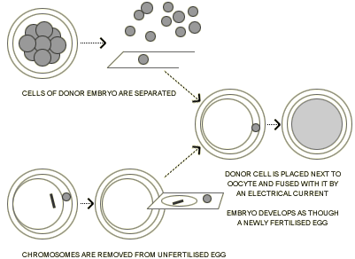
1996
CLONING
Hello Dolly!

Slide 25
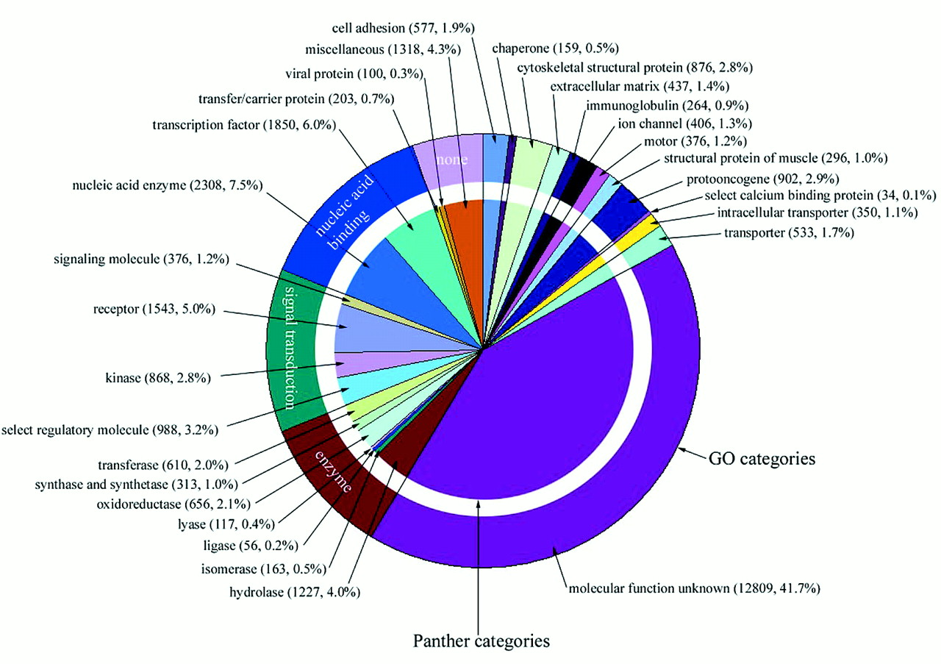

Human Genome: Distribution of the molecular functions of 26,383 human genes.
2001
J. Craig Venter et al. Science 2001;291:1304-1351
Published by AAAS
Notes:
Distribution of the molecular functions of 26,383 human genes. Each slice lists the numbers and percentages (in parentheses) of human gene functions assigned to a given category of molecular function. The outer circle shows the assignment to molecular function categories in the Gene Ontology (GO) (179), and the inner circle shows the assignment to Celera's Panther molecular function categories (116).

Slide 26
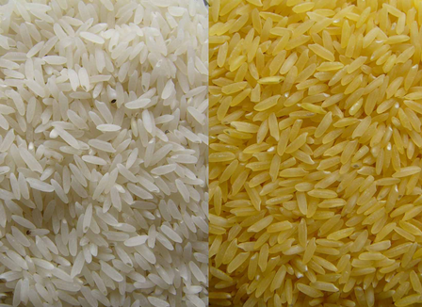
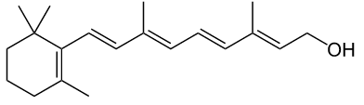
Golden Rice
http://www.goldenrice.org/
2001
Hunan Study 2008
Golden Rice Paper 2012
Patents for Humanity Awards 2015
http://news.sciencemag.org/asiapacific/2013/09/golden-rice-not-so-golden-tufts
Notes:
vitamin A deficiency, a major global health problem estimated to cause blindness in up to half a million children every year, half of whom die within 12 months after losing their eyesight.

Slide 27
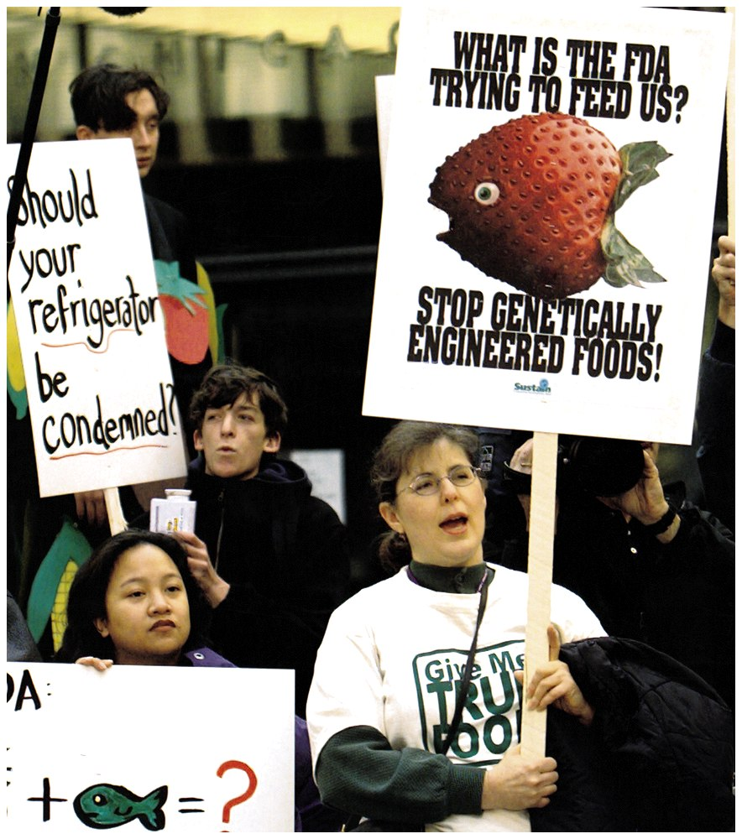
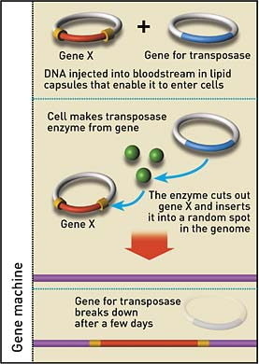
Transgenic Crops
Genetically Modified Organisms (GMOs)
http://www.greenpeace.org/international/Global/international/publications/agriculture/2013/458%20-%20Golden%20Illusion-GE-goldenrice.pdf
http://www.i-sis.org.uk/rice.php

Slide 28
Golden Rice
http://www.goldenrice.org/
2015
Hunan Study 2008
Golden Rice Paper 2012
Patents for Humanity Awards 2015
WITHDRAWN July 2015
http://news.sciencemag.org/asiapacific/2013/09/golden-rice-not-so-golden-tufts
Notes:
vitamin A deficiency, a major global health problem estimated to cause blindness in up to half a million children every year, half of whom die within 12 months after losing their eyesight.

Slide 29

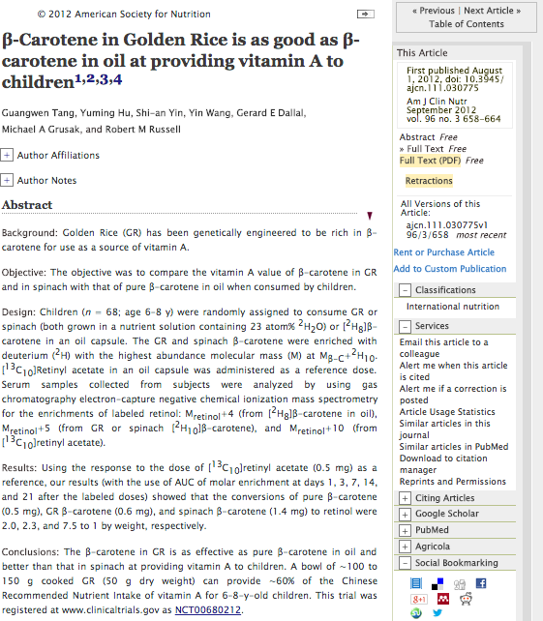
WITHDRAWN:
For lack of evidence that all human participants provided full consent
supported
by Massachusettes Court (August 3, 2015)
Notes:
http://www.the-scientist.com/?articles.view/articleNo/43656/title/Judge-Decides-on-GM-Rice-Retraction/
Judge Decides on GM Rice Retraction
Ethical breaches in a study on the benefits of so-called “golden rice” lead to the paper being pulled from the literature.
By Kerry Grens | August 3, 2015

Slide 30
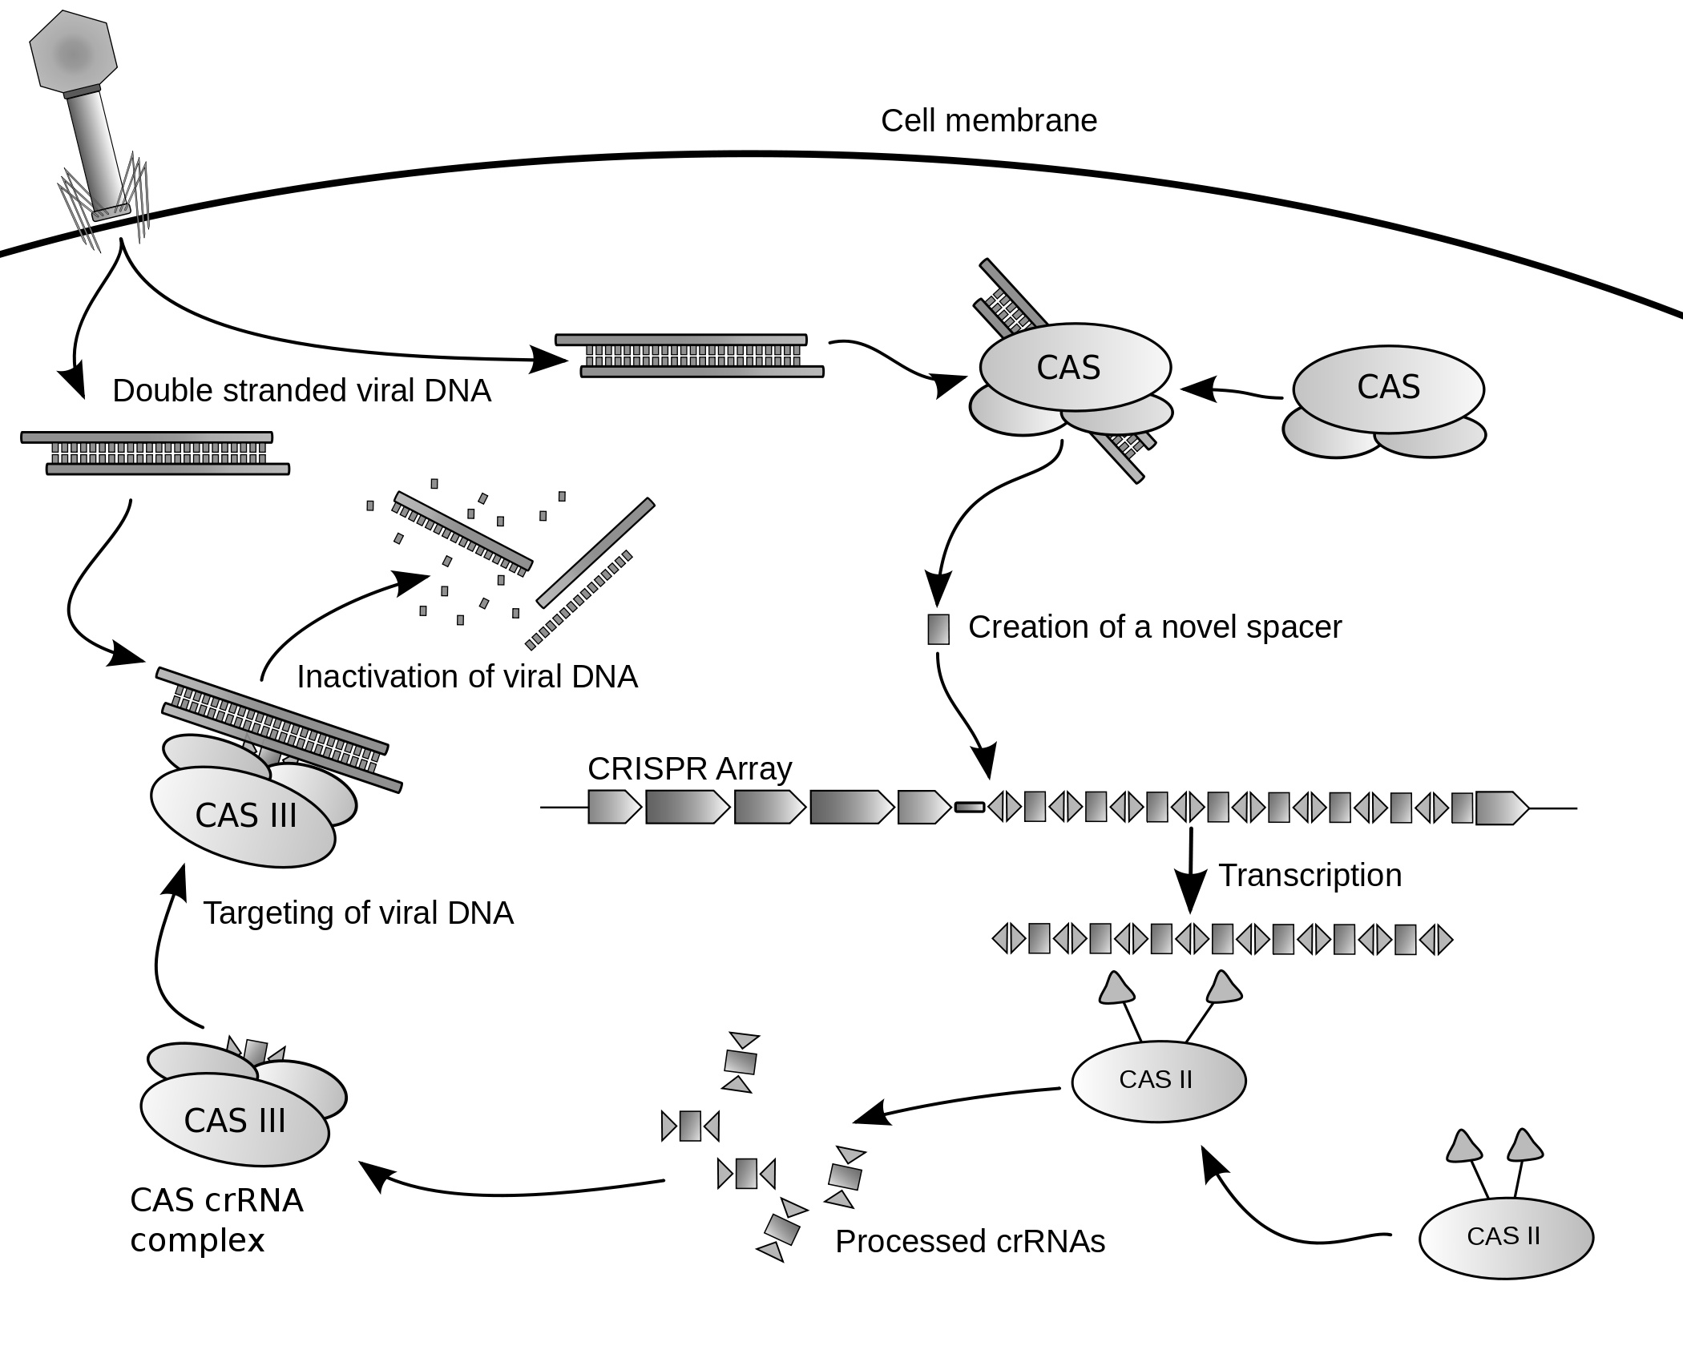
2012
Genome Editing / CRISPR-Cas9
https://www.youtube.com/watch?v=2pp17E4E-O8
https://www.youtube.com/watch?v=SuAxDVBt7kQ
Notes:
Clustered Regularly Interspersed Short Palindromic Repeats
CRISPRs are found in approximately 40% of sequenced bacteria genomes and 90% of sequenced archaea.^{[4][5]}
CRISPRs are often associated with cas genes that code for proteins related to CRISPRs. The CRISPR/Cas system is aprokaryotic immune system that confers resistance to foreign genetic elements such as plasmids and phages^{[6][7]} and provides a form of acquired immunity. CRISPR spacers recognize and cut these exogenous genetic elements in a manner analogous to RNAi in eukaryotic organisms.^{[2]}
Since 2013, the CRISPR/Cas system has been used for gene editing (adding, disrupting or changing the sequence of specific genes) and gene regulation in species throughout the tree of life.^{[8]} By delivering the Cas9 protein and appropriate guide RNAs into a cell, the organism's genome can be cut at any desired location.

Slide 31
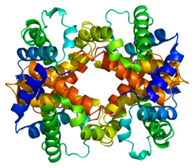
2016
Genome Editing / CRISPR-Cas9
Target
β-Thalassemia: Shortage of β-globin Protein
Normal β-globin
https://www.dnalc.org/resources/3d/17-sickle-cell.html
Notes:
The human β-globin (HBB) gene, which encodes a subunit of the adult hemoglobin and is mutated in β-thalassemia (Hill et al., 1962). In China, CD14/15, CD17, and CD41/42, which are frame-shift or truncated mutations of β-globin, are three of the most common β-thalassemia mutations (Cao and Galanello, 2010). Located on chromosome 11, HBB is within the β-globin gene cluster that contains four other globin genes with the order of (from 5′ to 3′) HBE, HBG2, HBG1, HBD, and HBB (Schechter, 2008). Because the sequences of HBB and HBD are very similar, HBD may also be used as a template to repair HBB.
Using online tools developed by Feng Zhang and colleagues (http://crispr.mit.edu/), we designed and generated three gRNAs (named G1, G2, and G3) that targeted different regions of the HBB gene (Fig. 1A), and transfected the gRNA-Cas9 expression vectors into human 293T cells.

Slide 32
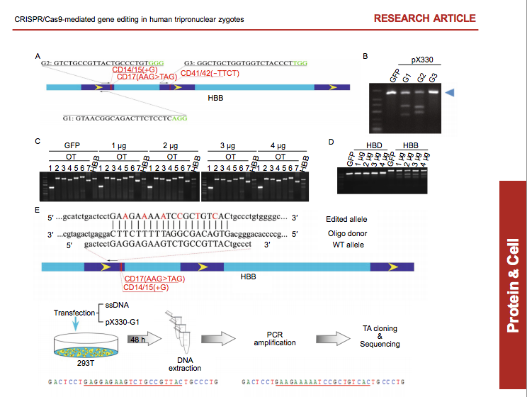
Genome Editing / CRISPR-Cas9
β-Thalassemia / Human Embryo Research
2016
http://chemconnections.org/general/chem121/Gene%20Editing/Gene%20Editing%202015-0153.pdf
Notes:
The human β-globin (HBB) gene, which encodes a subunit of the adult hemoglobin and is mutated in β-thalassemia (Hill et al., 1962). In China, CD14/15, CD17, and CD41/42, which are frame-shift or truncated mutations of β-globin, are three of the most common β-thalassemia mutations (Cao and Galanello, 2010). Located on chromosome 11, HBB is within the β-globin gene cluster that contains four other globin genes with the order of (from 5′ to 3′) HBE, HBG2, HBG1, HBD, and HBB (Schechter, 2008). Because the sequences of HBB and HBD are very similar, HBD may also be used as a template to repair HBB.
Using online tools developed by Feng Zhang and colleagues (http://crispr.mit.edu/), we designed and generated three gRNAs (named G1, G2, and G3) that targeted different regions of the HBB gene (Fig. 1A), and transfected the gRNA-Cas9 expression vectors into human 293T cells.

Slide 33
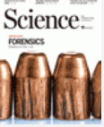
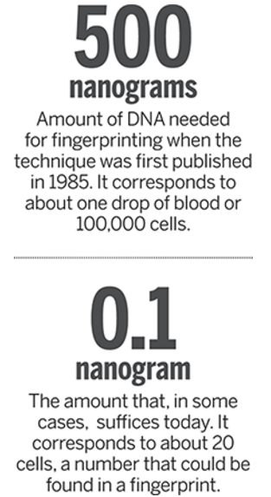
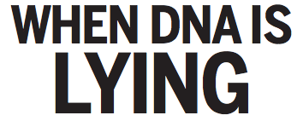
Genetic Fingerprinting
1985
2016
Forensics
Paternity
Military-ID
Food
Wine
Anthropology
Medical Diagnosis
http://science.sciencemag.org/content/sci/351/6278/1133.full.pdf
Notes:
http://www.pbs.org/wgbh/nova/education/body/create-dna-fingerprint.html
DNA profiles help forensic investigators determine whether two tissue samples -- one from the crime scene and one from a suspect -- came from the same individual. Fortunately, the genetic comparison doesn't require that investigators look at all of the DNA found in the tissue samples. That would take months or even years. Instead, by marking a small number of segments of DNA in one sample and then checking for the presence or absence of those segments in the other sample, investigators can say with some assurance whether the samples are from the same person.
How do they do it? Investigators use chemicals to cut the long strands of DNA into much smaller segments. Each segment has a specific length, but all of them share the same repeating sequence of bases (or nucleotides). The chemicals cut the segments at the beginning and at the end of the repeating string of nucleotides, so one segment might be ATCATCATCATCATC, for example, while another might be ATCATC. (The DNA segments used in forensic investigations are, of course, much longer than this.)
Investigators use a process called gel electrophoresis to separate these repeating segments according to length. Next, they introduce a small set of radioactive "markers" to the sample. These markers are segments of DNA of known length, with bases that complement the code of, and bind to, sample segments of the same length. The sample segment above (ATCATCATCATCATC), for example, would be tagged by a marker with the complementary code TAGTAGTAGTAGTAG.
Markers that do not bind to sample segments are then rinsed away, leaving in place only those markers that bound to complementary sample segments. Photographic film, which darkens when exposed to the radioactive markers, identifies the location of all marked sample segments. This film, then, becomes the DNA "fingerprint" that forensic investigators analyze.
The final step is a relatively simple matter of lining up the sample profiles side by side and comparing them for the presence or absence of segments with particular lengths. The more segments the two samples have in common, the more likely it is that the samples came from the same person.

Slide 34
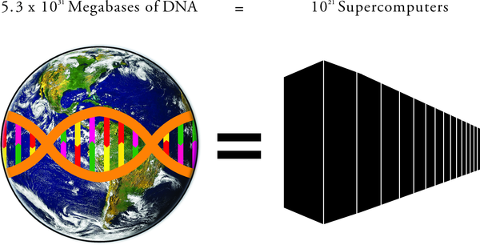

Fig 1. Storing the total amount of information encoded in DNA in the biosphere, 5.3 × 1031 megabases (Mb), would require approximately 1021 supercomputers with the average storage capacity of the world’s four most powerful supercomputers.
2016
http://journals.plos.org/plosbiology/article?id=10.1371/journal.pbio.1002168#pbio-1002168-g001
Landenmark HKE, Forgan DH, Cockell CS (2015) An Estimate of the Total DNA in the Biosphere. PLoS Biol 13(6): e1002168. doi:10.1371/journal.pbio.1002168
http://127.0.0.1:8081/plosbiology/article?id=info:doi/10.1371/journal.pbio.1002168
Notes:
Fastest computer 2015 for the 5th straight year: The Tianhe-2, which was developed by China's National University of Defense Technology, performs at a rate of 33.86 petaflops per second. One petaflop equals around one quadrillion calculations per second.

Slide 35
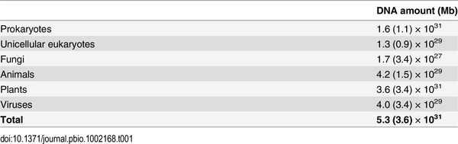
Table 1. The total DNA content in the biosphere
2016
Landenmark HKE, Forgan DH, Cockell CS (2015) An Estimate of the Total DNA in the Biosphere. PLoS Biol 13(6): e1002168. doi:10.1371/journal.pbio.1002168
http://127.0.0.1:8081/plosbiology/article?id=info:doi/10.1371/journal.pbio.1002168

Slide 36
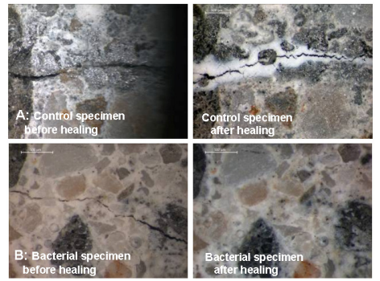
2016
Bioengineering:
Structural Materials & Molecules
Bacteria & Yeast
Healing Concrete
http://heronjournal.nl/56-12/1.pdf

Slide 37




2017-2019
Bioengineering:
Bacteria, Yeast & Chemical Synthesis
Brewer’s Yeast
(Saccharomyces cerevisiae)
Chinese Wormwood
(Artemisia annua)
anti-malarial
cannabadiol (CBD)
Notes:
In April 2013, Sanofi announced the launch^{[82]} of a production facility in Garessio, Italy, to manufacture the anti-plasmodial drug on a large scale. The partnership to create a new pharmaceutical manufacturing process was led by PATH’s Drug Development program (through an affiliation with OneWorld Health), with funding from the Bill & Melinda Gates Foundation and based on a modified biosynthetic process for artemisinic acid, initially designed by Jay Keasling at the University of California, Berkeley and optimized by Amyris. The reaction is followed by a photochemical process creating singlet oxygen to obtain the end product. Sanofi expects to produce 25 tons of artemisinin in 2013, ramping up the production to 55–60 tons in 2014. The price per kg will be $350–400, roughly the same as the botanical source.^{[83]} Despite concerns that this equivalent source would lead to the demise of companies, which produce this substance conventionally through extraction of A. annua biomass, an increased supply of this drug will likely produce lower prices and therefore increase the availability for ACTs treatment. In August 2014, Sanofi announced the release of the first batch of semisynthetic artemisinin. 1.7 million doses of Sanofi's ArteSunate AmodiaQuine Winthrop (ASAQ Winthrop), a fixed-dose artemisinin-based combination therapy will be shipped to half a dozen African countries over the next few months.^{[84]}

