Slide 1
Chemistry & STEM
Measurement II
Discussion Guide 1.4
Density
An Objects’ Relationship of its Mass & Volume
Dr. Ron Rusay

Slide 2
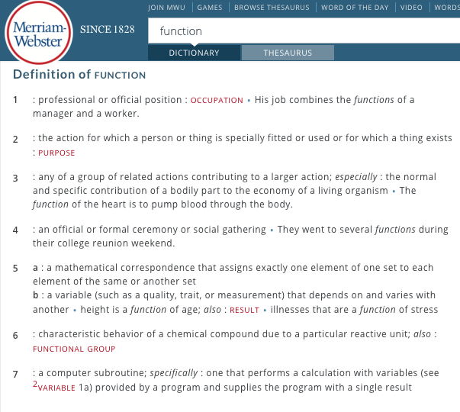
Comparison of Relative Properties
FUNCTIONS
Density is a function of an object’s mass and volume.

Slide 3
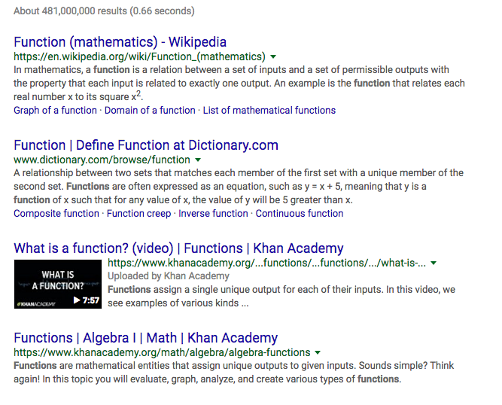

Comparison of Relative Properties
FUNCTIONS

Slide 4
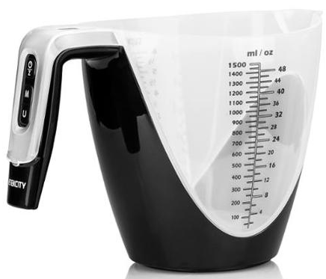
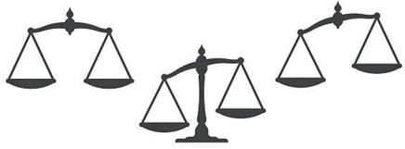
Comparisons of Relative Properties
FUNCTIONS
Example: density : mass : volume
Functions & variables can be described interchangeably between:
Density
Images (Symbols)
Words
Sounds (Voice)
Numbers
Tables
Graphs
Formulas
Powers of Ten (Images) http://www.wordwizz.com/imagendx.htm
http://www.eamesoffice.com/
Mass Volume
Density is a function of an object’s mass and volume.

Slide 5
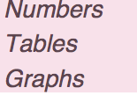
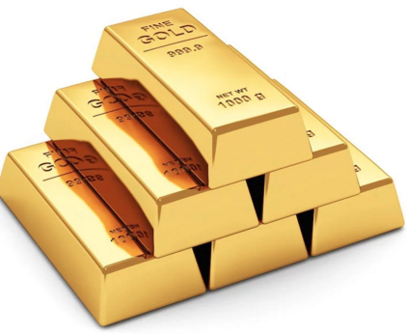
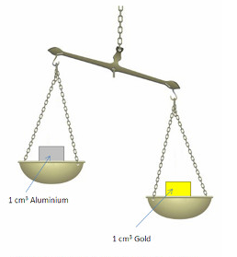
Density
Mass & Volume
Unknown Metal
Sample | Mass (grams) | Volume (mL)
1 | 10.0 | 0.5
2 | 55.0 | 2.8
3 | 113.5 | 5.9
4 | 586.0 | 30.4
5 | 1587.0 | 82.2
6 | 2270.0 | 117.6
Numbers, Tables, & Graphs
Notes:
Table

Slide 6
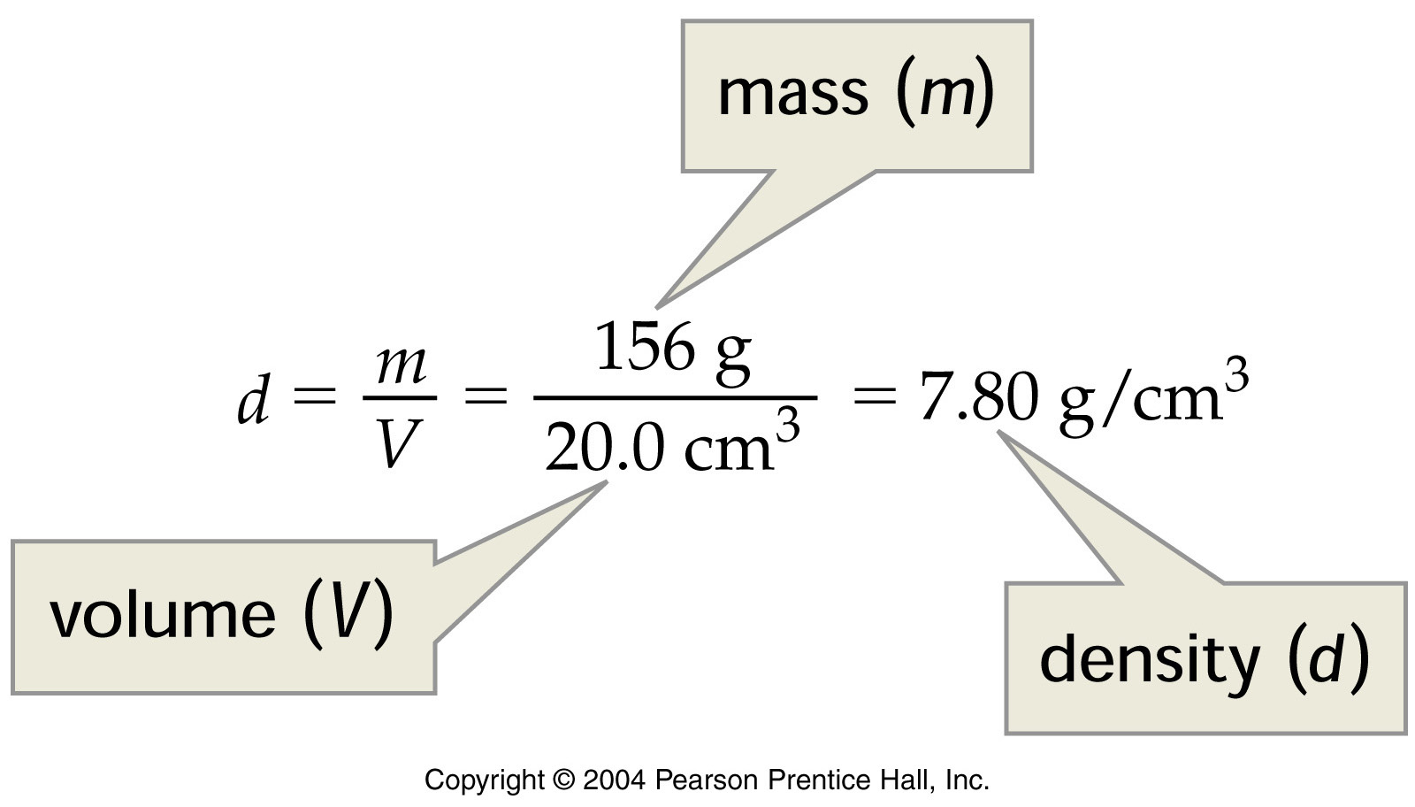
Density
http://www.density.com/what.htm
Density = Mass / Volume [g/mL or g/cm³; g/L]
Archimedes 250 B.C.E. Does iron float?.... The RMS Titanic?
Notes:
Calculation of iron density
Notes:
Proper units for density are mass per unit volume.

Slide 7
Density
http://www.density.com/what.htm
Archimedes 250 B.C.E. Does iron float?.... The RMS Titanic?
NOVA: The Secrets of Archimedes
https://www.youtube.com/watch?v=0n347dxm5uE
NOVA: Why Do Ships Sink?
https://www.youtube.com/watch?v=n_xDZjrZ6zs
Notes:
Calculation of iron density
Notes:
Proper units for density are mass per unit volume.

Slide 8
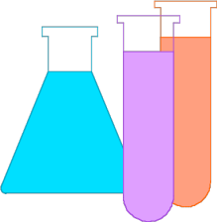
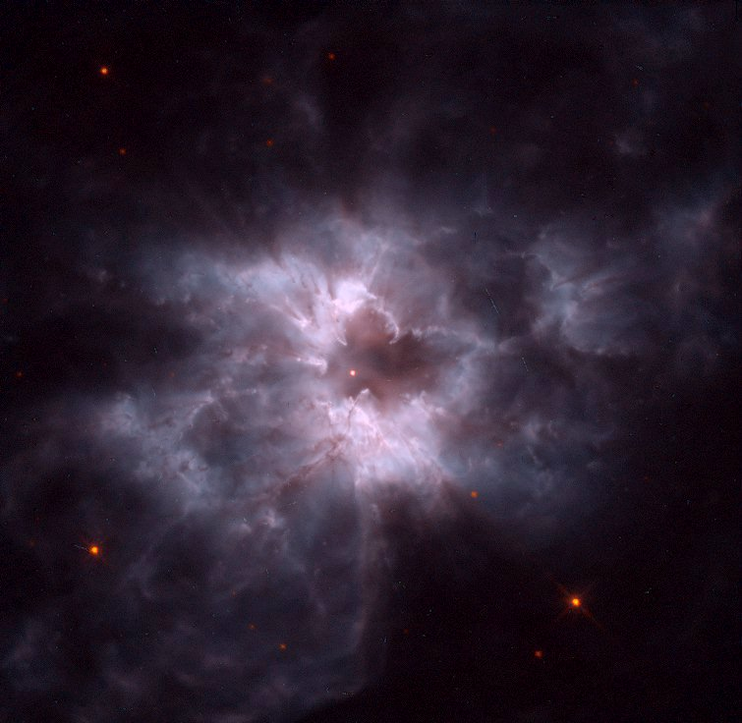
Density
Density = Mass / Volume [g/mL or g/cm³; g/L] (kg/m³)
Very Dense Astronomical Objects: White Dwarfs
http://antwrp.gsfc.nasa.gov/apod/ap961203.html
  D(ρ) = 1 x 10 ⁹ kg/m³ = 1 x 10 ³ kg/cm³
  = 1 x 10 ⁶ g/cm³
A White Dwarf’s mass is comparable to our Sun's, but its volume is about a million times smaller; the average density is ~1,000,000 times greater than the Sun’s 1.4 kg/m³
Our Sun will eventually become a white dwarf “butterfly”….. but not for ~5 billion years.

Slide 9
Dimensional Analysis
Conversion/Unit Factor Calculations
Using exact numbers / “scale factors” UNITS
A Bookkeeping Process: Example
Calculating the density [D(ρ) = ? g/cm³ ] of a white dwarf, 1.0 x 10⁹ kg / 1 m³
(1 kg = 1000g; 1 m³ = 1 x 10 ⁶ cm³; 1 Ton (T) = 1000kg)
__________________ = ________
kg
m³
g
? g
? cm³
m³
cm³
kg

Slide 10
Dimensional Analysis
Conversion/Unit Factor Calculations
Using exact numbers / “scale factors” UNITS
A Bookkeeping Process: Example
Calculating the density [D(ρ) = ? g/cm³ ] of a white dwarf, 1.0 x 10⁹ kg / 1 m³
(1 kg = 1000g; 1 m³ = 1 x 10 ⁶ cm³; 1 Ton (T) = 1000kg)
1.0 x 10 ⁹
1,000,000 = 1 .0 x 10⁶
1
__________________ = ________
1,000
kg
m³
g
? g
1
? cm³
1
m³
cm³
kg
1
1.000 x 10⁶ ⁼ (100 cm)³

Slide 11
Dimensional Analysis
Continued
Example for an astronomical object where 1 teaspoon weighs 3 Tons. (~ 3 pick up trucks).
3 T /1 tsp ? g/cm³
(1 tsp = 4.9289 mL; 1 T (Ton) = 1,000 kg; 1 kg = 1,000 g; 1 mL = 1 cm³ )
___________________________ = ________
T
tsp
mL
kg
g
? g
tsp
mL
cm³
T
kg
? cm³

Slide 12
Dimensional Analysis
Continued
Example for an astronomical object where 1 teaspoon weighs 3 Tons. (~ 3 pick up trucks).
3 T /1 tsp ? g/cm³
(1 tsp = 4.9289 mL; 1 T (Ton) = 1,000 kg; 1 kg = 1,000 g; 1 mL = 1 cm³ )
1.000 x 10³
1.000 x 10³
___________________________ = ________
3
T
1
tsp
1
mL
kg
g
? g
tsp
mL
1
cm³
1
T
1
kg
? cm³
1
4.9289
6 x 10⁵ g/cm³

Slide 13
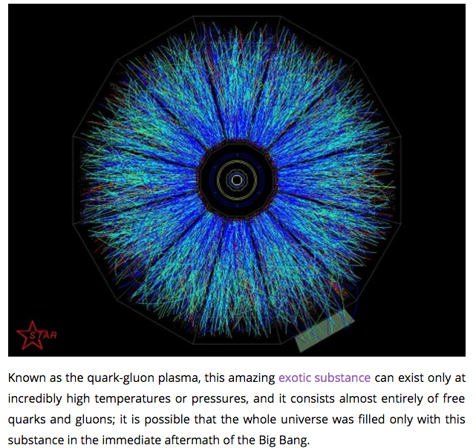
Density
Density = Mass / Volume [g/mL or g/cm³; g/L; kg/m³]
“Besides black holes, there’s nothing denser than what we’re creating,” said David Evans, a team leader for the Large Hadron Collider’s ALICE detector, which helped observe the quark-gluon plasma shown. “If you had a cubic centimeter of this stuff, it would weigh 40 billion tons.”
http://www.zmescience.com/science/physics/quark-gluon-plasma-lhc-26052011/#ixzz3foandtPt
How does quark-gluon plasma’s density compare to a white dwarf? (1 ton = 1,000 kg)

Slide 14
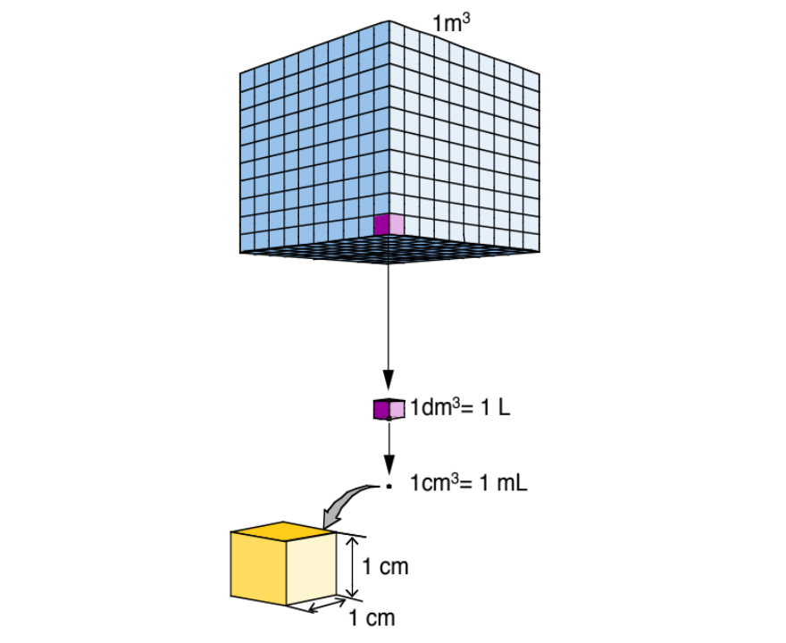
Calculate the density [D(ρ) = ?] (kg/cm³…or g/cm³..or kg/m³)
of quark-gluon plasma: 1 cm³ has a mass of 4.0 x 10¹⁰ T (metric tons)
for comparison to White Dwarf.
  (1 T = 1,000 kg; 1 kg = 1,000g; 1,000,000 cm³ = 1 m³ )
4.0 x 10¹⁰ greater
___________________ =
4.0 x 10¹⁰ T
1,000 kg
4.0 x 10¹³ kg/cm³
  1 x 10 ³ kg/cm³
cm³
T
_________________________ =
4.0 x 10¹⁰ T
1,000 kg
1,000 g
4.0 x 10¹⁶ g/cm³
cm³
T
kg
  1 x 10 ⁶ g/cm³
_______________________ =
4.0 x 10¹³ kg
1,000,000 cm³
4.0 x 10¹⁹ kg/m³
cm³
m³
1 x 10 ⁹ kg/m³
Notes:
4.9289 mL = 1 tsp

Slide 15
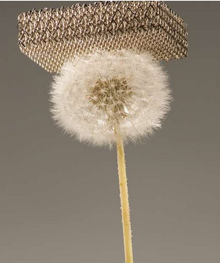

Density: Ultralight microlattices
Density = Mass / Volume [g/mL or g/cm³; g/L; kg/m³]
T. A. Schaedler et al. Science 2011;334:962-965
http://www.gizmag.com/ultralight-micro-lattice-material/20537/
0.9 mg/cm³ (air = 1.2 mg/cm³)
Published by AAAS
Notes:
Design, processing, and cellular architecture of ultralight microlattices. (A) Polymer microlattice templates are fabricated from a three-dimensional array of self-propagating photopolymer waveguides. (B) The open-cellular templates are electroless plated with a conformal Ni-P thin film followed by etch removal of the template. (C) Image of the lightest Ni-P microlattice fabricated with this approach: 0.9 mg/cm³. (D and E) Images of two as-fabricated microlattices along with a breakdown of the relevant architectural elements.

Slide 16
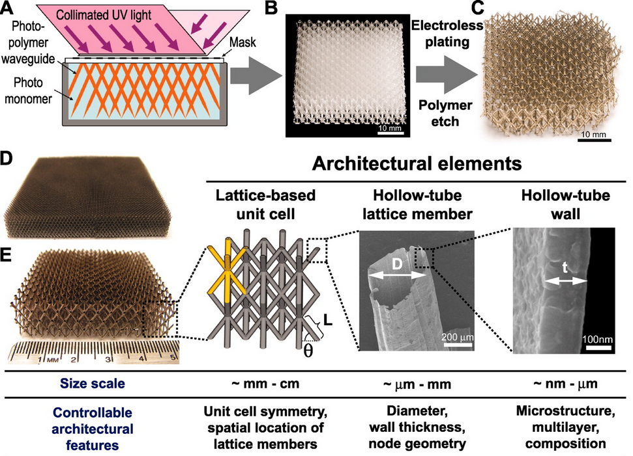
Engineering Ultralight Microlattices
Density = Mass / Volume [g/mL or g/cm³; g/L; kg/m³]
T. A. Schaedler et al. Science 2011;334:962-965
0.9 mg/cm³
Published by AAAS
Notes:
Design, processing, and cellular architecture of ultralight microlattices. (A) Polymer microlattice templates are fabricated from a three-dimensional array of self-propagating photopolymer waveguides. (B) The open-cellular templates are electroless plated with a conformal Ni-P thin film followed by etch removal of the template. (C) Image of the lightest Ni-P microlattice fabricated with this approach: 0.9 mg/cm³. (D and E) Images of two as-fabricated microlattices along with a breakdown of the relevant architectural elements.

Slide 17
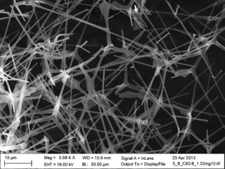
Density
Density = Mass / Volume [g/mL or g/cm³; g/L; kg/m³]
Aerographite is a synthetic foam consisting of a porous interconnected network of carbon nanotubes. It was first reported by researchers at the University of Kiel and the Technical University of Hamburg in Germany in a scientific journal in June 2012. It’s density is:
D = 0.18 mg/cm³

Slide 18
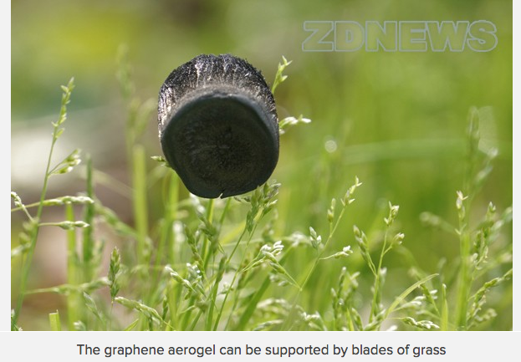
Density
Density = Mass / Volume [g/mL or g/cm³; g/L; kg/m³]
https://www.youtube.com/watch?v=3bIXUBXj070
0.16 mg/cm³
Chao Gao et. al., Zhejiang University, Department of Polymer Science and Engineering
Nature 494, 404 (28 February 2013)
doi:10.1038/494404a

Slide 19
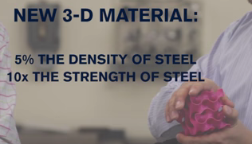
Density
Density = Mass / Volume [g/mL or g/cm³; g/L; kg/m³]
https://www.youtube.com/watch?v=VIcZdc42F0g
Structural 3-D Graphene
One of the strongest lightweight materials known
MIT: January 2017

Slide 20
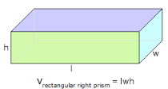
QUESTION
    A metal sample is hammered into a rectangular sheet
    with an area of 31.2 ft² and an average thickness of
    2.30 × 10⁻⁶ cm. If the mass of this sample is 0.4767 g,
    predict the identity of the metal.
The density of the metal is shown in parenthesis.
Useful information: 1 ft² = 929 cm²
A) Aluminum (2.70 g/cm³) B) Copper (8.95 g/cm³)
C) Gold (19.3 g/cm³) D) Zinc (7.15 g/cm³)
Set up a dimensional analysis path to solve the problem

Slide 21
Dimensional Analysis
    A metal sample is hammered into a rectangular sheet
    with an area of 31.2 ft² and an average thickness of
    2.30 × 10⁻⁶ cm. If the mass of this sample is 0.4767 g,
    predict the identity of the metal.
The density of the metal is shown in parenthesis.
Useful information: 1 ft² = 929 cm²
A) Aluminum (2.70 g/cm³) B) Copper (8.95 g/cm³)
C) Gold (19.3 g/cm³) D) Zinc (7.15 g/cm³)
What goes in here?
1
0.4767
? g
ft²
g
=
929
2.30 × 10⁻⁶
? cm³
31.2
ft²
cm²
cm

Slide 22
QUESTION
    A metal sample is hammered into a rectangular sheet
    with an area of 31.2 ft² and an average thickness of
    2.30 × 10⁻⁶ cm. If the mass of this sample is 0.4767 g,
    predict the identity of the metal.
The density of the metal is shown in parenthesis.
Useful information: 1 ft = 12 in; 1 in = 2.54 cm
A) Aluminum (2.70 g/cm³) B) Copper (8.95 g/cm³)
C) Gold (19.3 g/cm³) D) Zinc (7.15 g/cm³)

Slide 23
Dimensional Analysis
Solved in 2 Steps
    A metal sample is hammered into a rectangular sheet
    with an area of 31.2 ft² and an average thickness of
    2.30 × 10⁻⁶ cm. If the mass of this sample is 0.4767 g,
    predict the identity of the metal.
The density of the metal is shown in parenthesis.
Useful information: 1 ft = 12 in; 1 in = 2.54 cm
__________________________ =
? cm³
ft²
in²
cm²
cm
cm³
ft²
in²

Slide 24
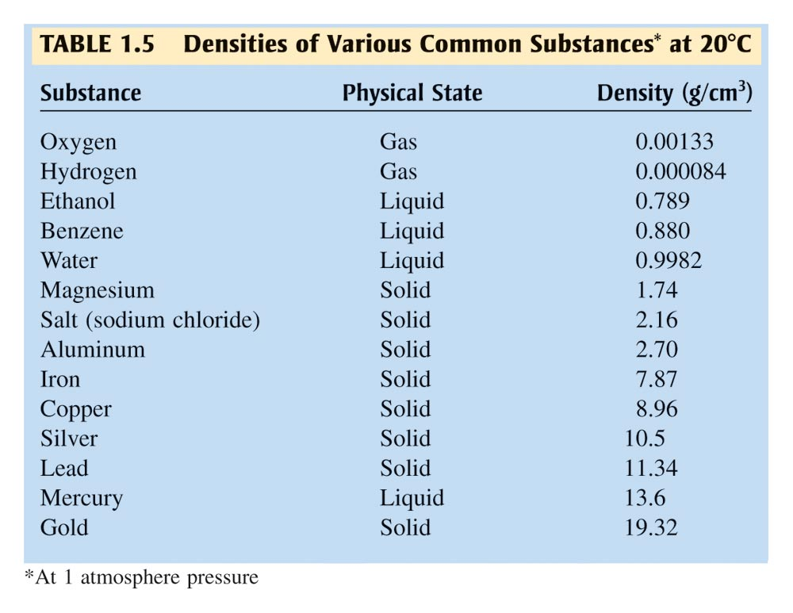
Densities of Various Common Substances*

Slide 25
QUESTION
Which would provide more grams of NaCl, sample one with a mass of 2,350 mg, or sample two, a solid with a volume of 2.00 cm³? (The density of solid salt is 2.16 g/cm³.) Select the most massive sample and its mass in grams.
Sample two; 1.08 grams
Sample two; 4.32 grams
Sample one; 2.35 grams
Sample one; 2.350 grams

Slide 26
QUESTION
The volume of any material can be obtained from its density and mass.
If the mass of a sample of acid from a battery were 5.00 grams and its density was 1.2 g/mL, what would the correct reported volume in mL with the proper number of significant digits?
6.0 mL
6.00 mL
4.2 mL
4.17 mL

Slide 27
Density
Density = Mass / Volume [g/mL or g/cm³; g/L]
Mass = Density x Volume
How many grams of air are there in PS 277?
The room has dimensions of ~ 3.5 m x 11 m x 10. m.
D_{air} = 1.22 x 10⁻³ g/cm³ (1.22 g/L)
1m³ = 100 cm x 100 cm x 100 cm;
1000 cm³ = 1 L; 1 mL = 1 cm³
1.22 x 10³ g
385,000,000 g
3.85 x 10 ⁶ g
47,000,000 g
4.70 x 10 ⁸ g

Slide 28
Dimensional Analysis
Conversion/Unit Factor Calculations
How many grams of air are there in PS 277?
The room has dimensions of ~ 3.50 m x 11.0 m x 10.0 m. = ? m³
D_{air} = 1.22 x 10⁻³ g/cm³ (1.22 g/L)
1m³ = 100 cm x 100 cm x 100 cm;
1000 cm³ = 1 L; 1 mL = 1 cm³
385 m³
___________________ =
1 x 10⁶
1.22
385
m³
cm³
g
1
1
m³
cm³

Slide 29
Density
Density = Mass / Volume [g/mL or g/cm³; g/L]
QUESTION
If the room were filled with pure oxygen,
D_{oxygen} = 1.429 x 10⁻³ g/cm³ (1.429 g/L)
there will be a higher mass of gas in the room.
True (A) / False (B)
(Be able to explain the reason(s) for your answer.)

Slide 30
QUESTION
General Chemistry Level Challenge
How many pounds of air are there in PS 277? It has a volume of ~220 yd³.
D_{air} = 1.22 x 10⁻³ g/cm³ (1.22 g/L)
Mass = Density x Volume
Mass = 450 lbs (451.996005)
27
28316.8
0.00122
1
220
yd³
ft³
cm³
g
lb
=
? lb
1
1
1
454
yd³
ft³
cm³
g

Slide 31
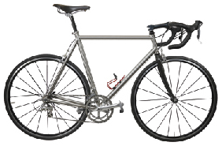
QUESTION
General Chemistry Level Challenge
Titanium is abundant in the earth’s crust, but horrendously difficult to turn into a bicycle frame. From extraction, to final welding and finishing, titanium is fraught with very complex processes that are as expensive as they are essential. One slip, omission on behalf of the mill, machinist, welder or finisher or the slightest contamination of oxygen, nitrogen, and hydrocarbon (i.e. human fingertips) at the wrong time and the frame will almost certainly fail at some point. Hence most bike companies don't use titanium.
http://cyclefit.co.uk/journal/5-questions-to-ask-before-buying-a-titanium-bike
Notes:
http://cyclefit.co.uk/journal/5-questions-to-ask-before-buying-a-titanium-bike

Slide 32
QUESTION
General Chemistry Level Challenge
However, titanium’s tolerance to cyclical load is infinite. This is a huge advantage both in terms of safety and for ride quality. It means that as long as the tube spec and frame design is well executed, a bicycle will offer exceptional comfort, performance and ride the same in its first mile as its millionth!
Titanium is much lighter than steel alloy, which has been commonly used in frames.
Titanium (4.50 g/cm³); steel alloy (7.75 g/cm³).
http://cyclefit.co.uk/journal/5-questions-to-ask-before-buying-a-titanium-bike
Notes:
http://cyclefit.co.uk/journal/5-questions-to-ask-before-buying-a-titanium-bike

Slide 33
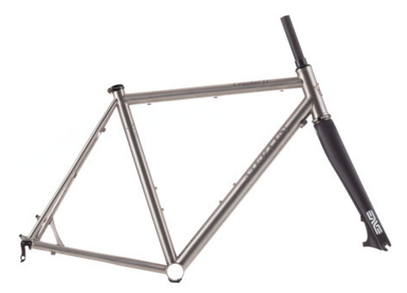
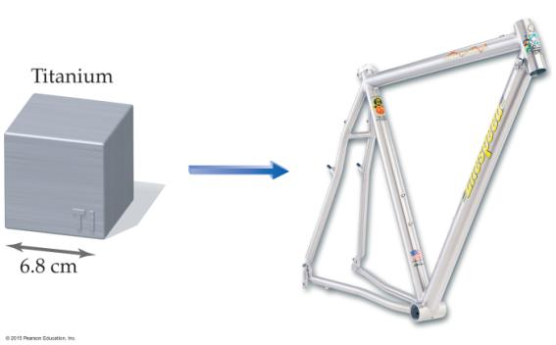
QUESTION
General Chemistry Level Challenge
$4,199.00
A titanium bicycle frame contains the same amount of titanium as a titanium cube measuring 6.8 cm on a side.
Use the density of titanium to calculate the mass in kilograms of titanium in the frame.
What would be the mass of a similar frame composed
of steel alloy?
Titanium (4.50 g/cm³); Steel alloy (7.75 g/cm³).

Slide 34
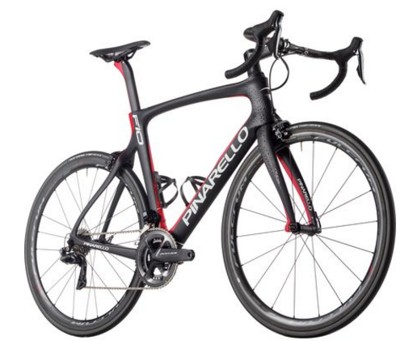
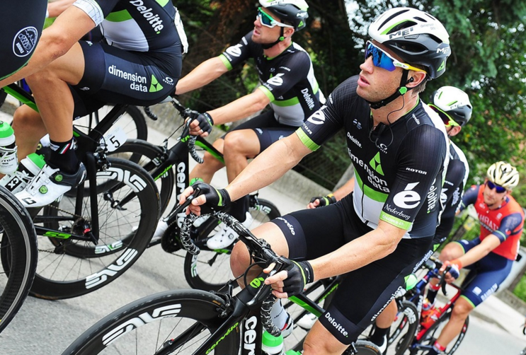
QUESTION
General Chemistry Level Challenge
$9,000.00 frame
A stiff light weight carbon fiber bicycle frame is said to weigh as little as 690g.
Carbon fiber frames are the mainstay of the Tour de France.
What is the percent difference in the weight of a carbon fiber frame versus titanium?
What is the relative cost per kg for each of them?
Assuming the volume of carbon fiber in the frame is equal to titanium, what is the density of the carbon fiber?

Slide 35
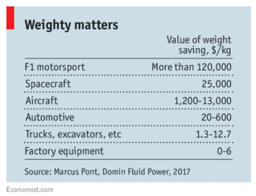
QUESTION
General Chemistry Level Challenge
http://chemconnections.org/general/chem108/3D%20printing%20transforms%20the%20economics%20of%20manufacturing.pdf
http://chemconnections.org/general/chem108/3D%20printers%20start%20to%20build%20factories%20of%20the%20future.pdf
Reducing weight offers large returns besides winning the Tour de France.
Read the linked articles above, and briefly explain how 3D printing relates to these savings in one or more of the examples from the table. Also, are there any opportunities in your chosen career path for 3D printing applications?

