Slide 1
Electrolytes
(Solutions/ Molarity)
Why a sodium chloride solution, NaCl_{(aq)},
is also described in its ionic form:
NaCl_{(aq)} Na⁺_{aq)} + Cl⁻_{(aq)}
Dr. Ron Rusay

Slide 2

Electrolytes
Ions in an aqueous (water) solution
Pure Water does not conduct electricity.
A water solution must have ions to conduct electricity.
Aqueous solutions can be categorized into 3 types: non-electrolytes, strong electrolytes or weak electrolytes based on their ability to conduct electricity in a homogeneous aqueous solution (aq).
Aqueous solutions can be tested for conductivity which will determine the degree of ionization of the solute, that is, the substance dissolved in water.
It is possible to have full or partial ionization.

Slide 3
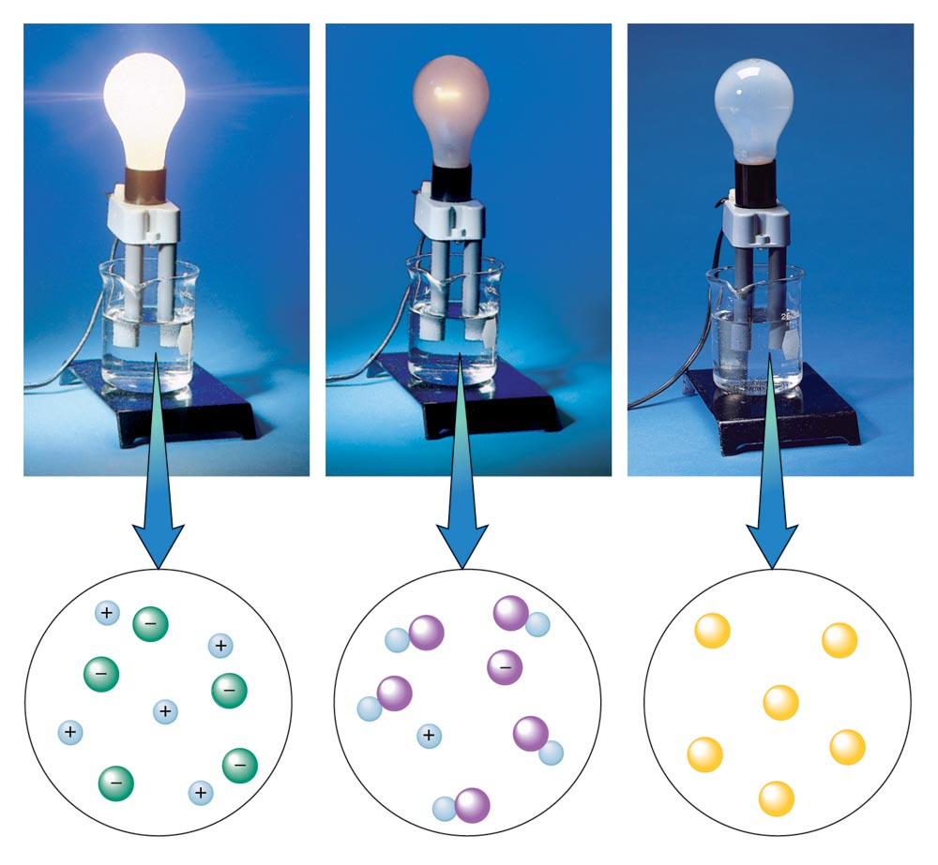
Solution Conductivity Apparatus for Electrolytes (Ions)
Conductivity
depends on the amount of ions in solution
strong
weak
non-

Slide 4
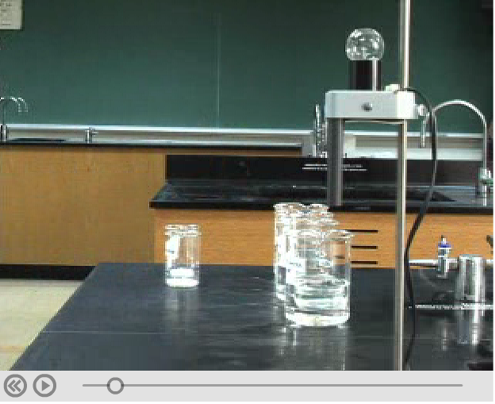
Conductivity
http://chemconnections.org/general/movies/html-swf/electrolytes.htm

Slide 5

Electrolytes
Molarity (M) = moles solute / Liter solution
Almost all ionic compounds and a few molecular compounds are strong electrolytes.
Several molecular compounds are weak conductors, most are non-conductors.
Conductivity is directly related to the amount of ionization, i.e. ions in solution. Table salt, sodium chloride, is completely ionized:
NaCl_{(s)} + H₂O_{(l)} NaCl_{(aq)} 0.10M Na ⁺_{(aq)} + Cl ⁻_{(aq)} 0.10M 0.10M
Add 5.8g of sodium chloride to water to make 1.0 L of solution = 0.10M
= 0.10 mol/L
All of the sodium chloride ionizes to make 1.0 L of solution = 0.10M Na⁺ and 0.10M Cl⁻

Slide 6
Electrolytes
Molarity (M) = moles solute / Liter solution
Concentrations:
CaCl_{2 (s)} + H₂O_{(l)} CaCl_{2(aq)} 0.10M Ca ²⁺_{(aq)} + 2 Cl ⁻_{(aq)} 0.10M 0.20M
How many grams of calcium chloride (MM =111 g/mol) should be added to water to make 1.00 L of a 0.10M solution of calcium chloride?
How many grams of calcium chloride (MM =111 g/mol) should be added to water to make 1.00 L of a solution having 0.10M chloride ion?
0.10 mol x
111 g/mol
0.10 mol/2 x
111 g/mol

Slide 7
QUESTION
If an antacid contains Al(OH)₃ it will form AlCl₃ upon neutralization of stomach acid. How many moles of Cl– ions are in 100.0 mL of 0.010 M AlCl₃?
0.0010 mol
0.010 mol
0.0030 mol
0.030 mol
Molarity (M) = moles AlCl₃ / Liter solution
mol AlCl₃ = Molarity AlCl₃ x Volume solution (L)
AlCl₃ dissociates into 3 moles of Cl–.

Slide 8

Calculations
Reactant Product
moles (Reactant)
moles (Product)
AlCl₃ dissociates into 3 moles of Cl–.
AlCl_{3 (aq)} Al³⁺_{(aq)} + 3 Cl–_{(aq)}
0.010 mol
(AlCl₃)
(Volume) 1 L
? mol Cl -₋
100.0 mL (AlCl₃)
? mol (Cl -)
(Volume)
1000 mL
? mol AlCl₃
1 L (AlCl₃)
"Gatekeepers”
from
Balanced reaction

Slide 9
Conductivity
Which of these solutions will have highest conductivity?
A | B | C
0.1 M HCl_{(aq)} | 0.1 M CaCl_{2 (aq)} | 0.2 M HC₂H₃O_{2(aq)}
Notes:
Multi-sim question: Sugar and salt solutions + Concentration
Correct answer: B
Representative results from pre-general chemistry: 66% correct (with a roughly even split between the other two options)
Follow-up discussion: Ask students how they determined the higher conductivity solution – students have previously asked why this dissociates into 2 Cl⁻ instead of 1 Cl₂²⁻ since chlorine occurs naturally as Cl₂. Other students responded to this query with ideas about ion charges and the absence of charge on molecular Cl₂ gas.

Slide 10

Electrolytes & Equilibrium
Molarity (M) = moles solute / Liter solution
Sugars like sucrose are non-ionic, molecular compounds that dissolve but produce no ions.
C₁₂H₂₂O_{11 (S)} + H₂O_{(l)} C₁₂H₂₂O_{11 (aq)}
Some molecular compounds like acetic acid ionize partially (dissociate) in water
HC₂H₃O_{2 (l)} + H₂O_{(l)} H₃O⁺_{(aq)}+ 0.1000M C₂H₃O₂ ⁻_{(aq)}
0.09987M 0.00013M
Acetic Acid (HC₂H₃O₂)
NOT Completely Ionized (99.87% un-ionized)
Example of equilibrium

Slide 11
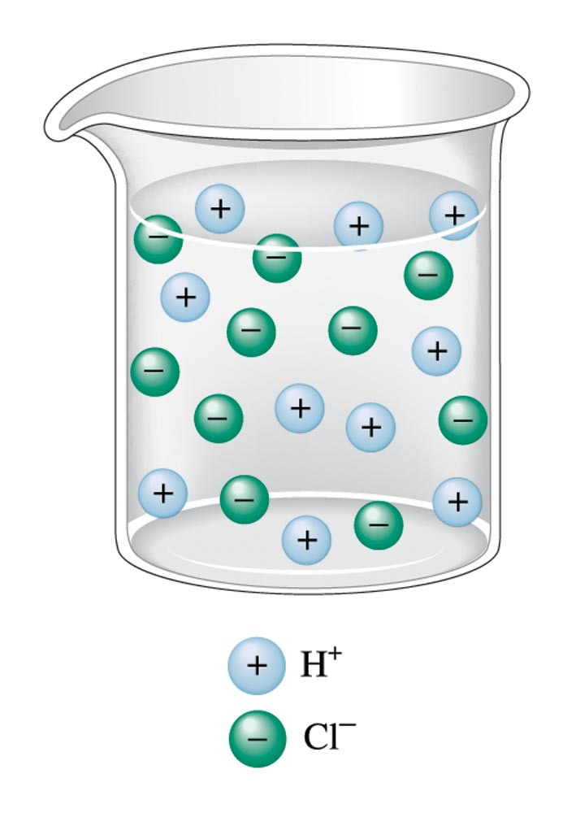
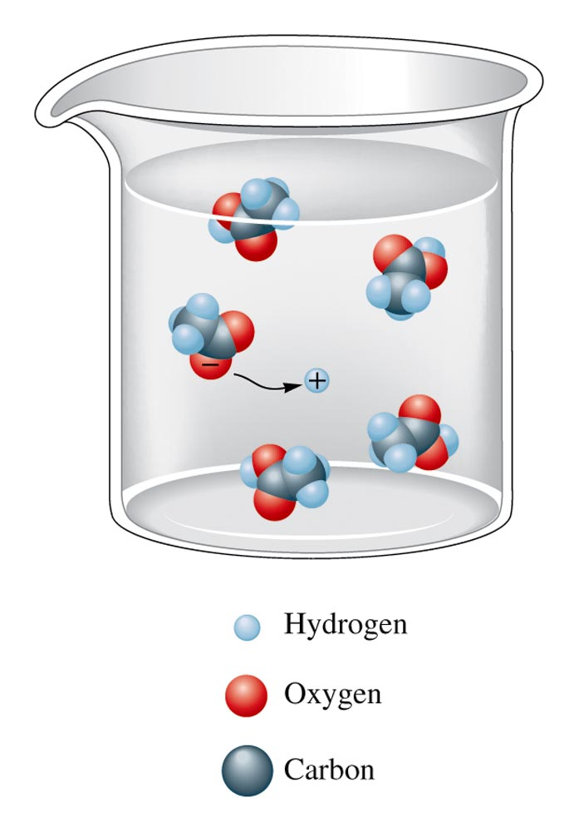
HCl
Completely Ionized
Acetic Acid (HC₂H₃O₂)
NOT Completely Ionized
Example of equilibrium

Slide 12
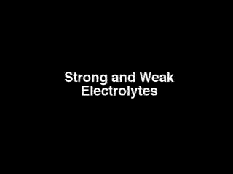
Electrolytes
How would the conductivity of acetic acid compare to hydrochloric acid?

Slide 13
Conductivity
Which of these solutions will have highest conductivity?
A | B | C
0.1 M KCl_{(aq)} | 0.2 M HCl_{(aq)} | 0.3 M HC₂H₃O_{2(aq)}
Notes:
Multi-sim question: Sugar and salt solutions + Concentration
Correct answer: B
Representative results from pre-general chemistry: 91% correct
Follow-up discussion: Ask students about the concentration of each ion and discuss how conductivity is impacted by ion concentration

Slide 14
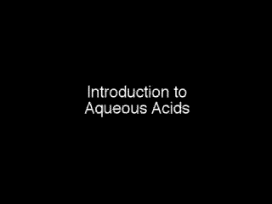
Aqueous Acids
Any compound that provides a proton can be considered an acid. Strong acids are sulfuric acid, nitric acid, perchloric acid, HI, HBr and HCl.

Slide 15
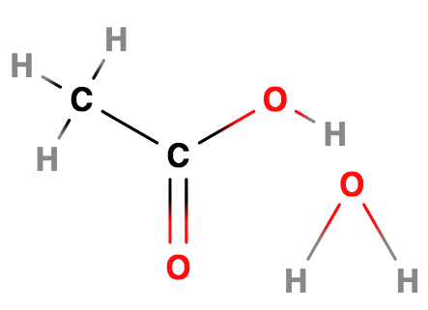
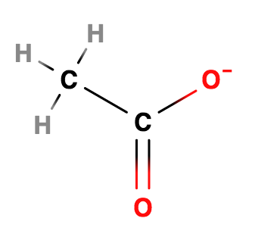

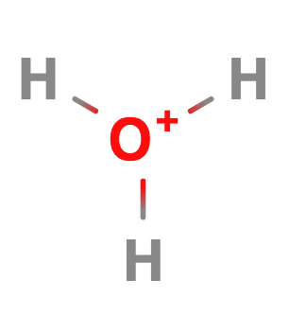


HCl
Completely Ionized
strong
weak
-
Acetic Acid (HC₂H₃O₂)
NOT Completely Ionized
Example of equilibrium

Slide 16

Aqueous Bases
Any compound that accepts a proton is a base.
The common bases are group IA & IIA metal hydroxide compounds. They are strong bases, dissociating completely in water.
An example of a weak base is ammonia.
NH_{3 (g)} + H₂O_{(l)} NH_{3 (aq)} NH₄⁺_{(aq)}+ OH⁻_{(aq)}
Consider that aqueous ammonia is in equilibrium with ammonium hydroxide. The names have often been used interchangeably.

Slide 17
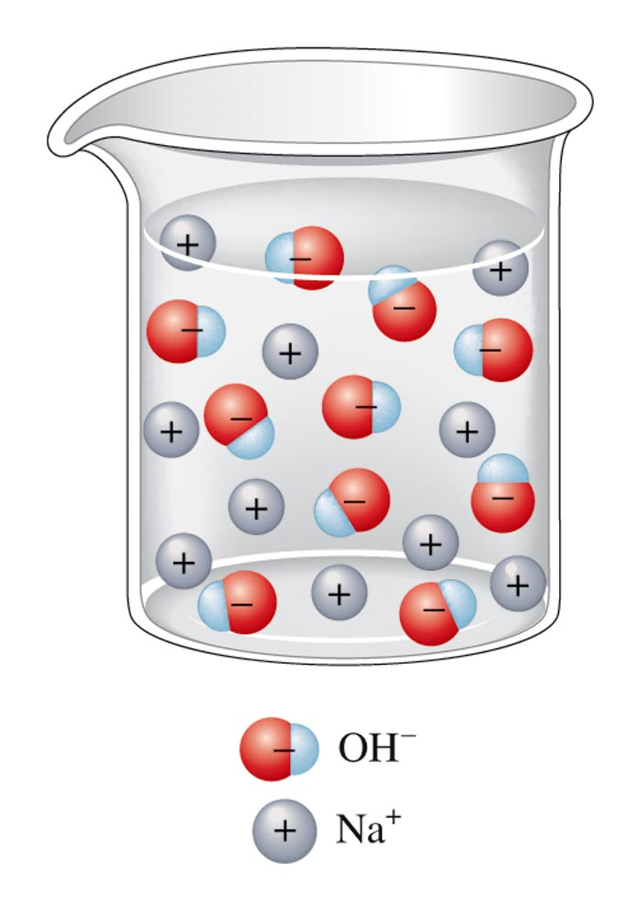
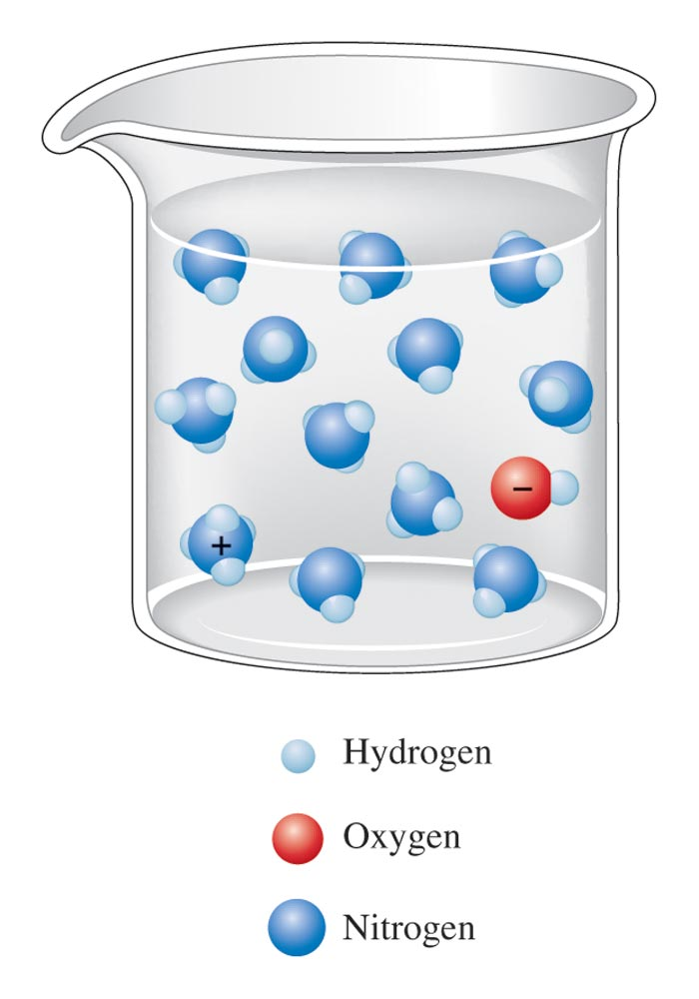
An Aqueous Solution of Sodium Hydroxide
strong
weak
An Aqueous Solution of Ammonia
NaOH _{(aq)} Na⁺_{(aq)}+ OH⁻_{(aq)}
NH_{3 (aq)} NH₄⁺_{(aq)}+ OH⁻_{(aq)}
Completely Ionized
NOT Completely Ionized
Example of equilibrium

Slide 18
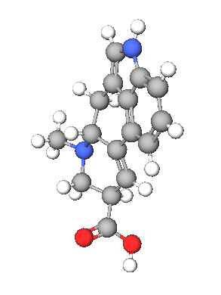
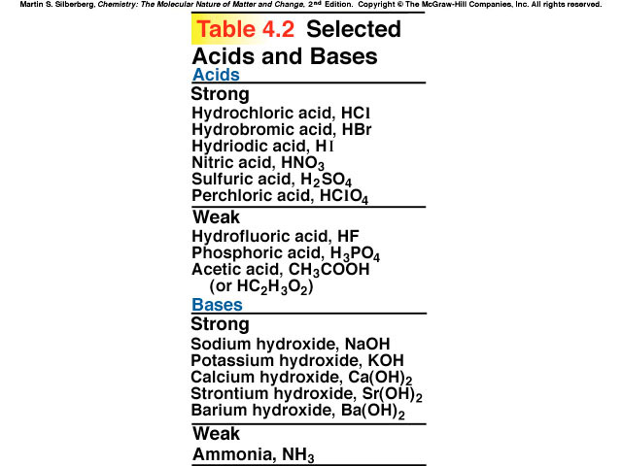
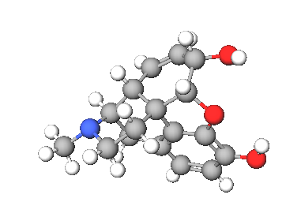
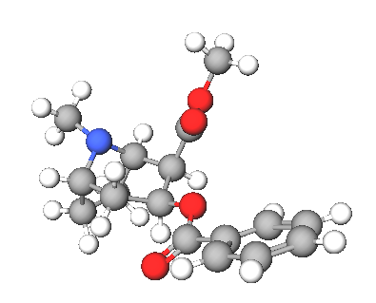
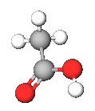
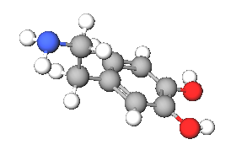

Morphine
Lysergic acid
Acetic acid
Cocaine
Dopamine

Slide 19
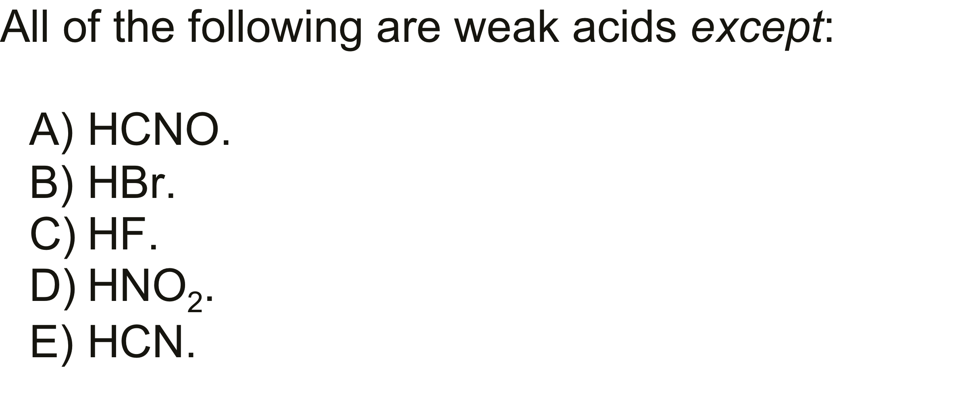
QUESTION

Slide 21
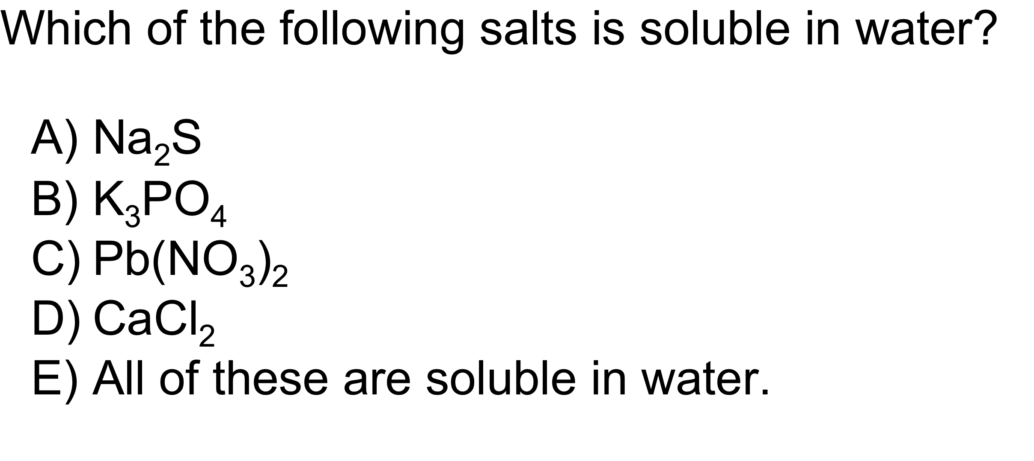
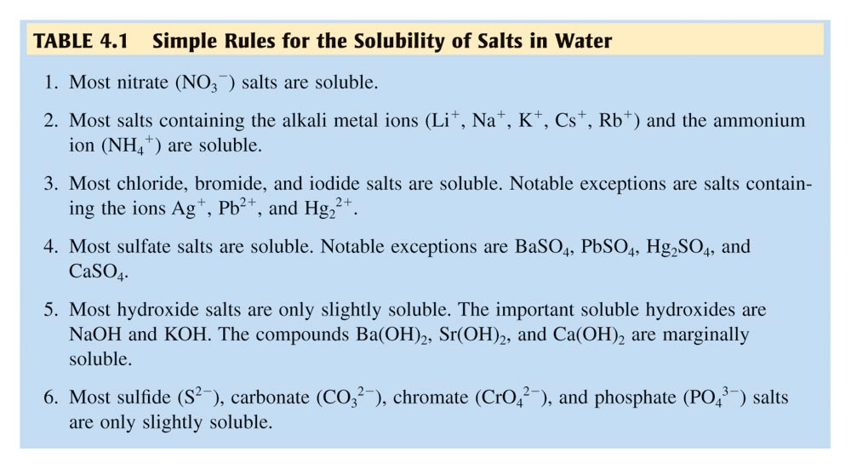
QUESTION

Slide 22
ANSWER
E)
All of these are soluble in water.
According to the solubility rules for ionic
compounds, compounds containing Group IA
ions or nitrate ions will always be soluble.
Compounds containing halides are generally
soluble, aside from silver, lead
and mercury(I)
halides.
Notes:
HMCLASS PREP: Table 4.1
HMCLASS PRESENT: Animation: The Precipitation of CaCO₃

Slide 23
QUESTION
If you began a reaction with the following ions in solution (all would be written with an (aq) subscript how would you represent the proper final net ionic equation? (Consult solubility Table.)
6Na⁺ + 2PO₄^{3–} + 3Fe²⁺ + 6NO₃– →
3Na⁺ + PO₄^{3–} + Fe²⁺ + 2NO₃– → No Reaction
6Na⁺ + 2PO₄^{3–} + 3Fe²⁺ + 6NO₃– → Fe₃(PO₄)₂ (s)+ 6 NaNO₃
3Na⁺ + PO₄^{3–} + Fe²⁺ + 2NO₃– → Fe₃(PO₄)₂ (s)+ 6 Na⁺ + 6 NO₃–
2PO₄^{3–} + 3Fe²⁺ → Fe₃(PO₄)₂ (s)

Slide 24
QUESTION
An aqueous solution of H₂SO₄ is added to aqueous Ba(OH)₂. The reaction is monitored using a conductivity tester.
Predict the correct statement(s).
I) Both H₂SO₄ and Ba(OH)₂ are strong electrolytes.
II) This is a neutralization reaction.
III) This is a precipitation reaction.
IV) The light bulb will glow at the neutralization point.
A) II B) I and II
C) I, II and III D) I, II, III and IV

Slide 25
ANSWER
An aqueous solution of H₂SO₄ is added to aqueous Ba(OH)₂. The reaction is monitored using a conductivity tester.
Predict the correct statement(s).
I) Both H₂SO₄ and Ba(OH)₂ are strong electrolytes.
II) This is a neutralization reaction.
III) This is a precipitation reaction.
IV) The light bulb will glow at the neutralization point.
A) II B) I and II
C) I, II and III D) I, II, III and IV
Notes:
Correct Answer: C
Question Number: 6

Slide 26
Aqueous Reactions: Neutralization
Net Ionic Equations
HCl_{(aq)} + NaOH _{(aq)} NaCl _{(aq)} + H₂O_{(l)}
  ___________________________________________________
HCl_{(aq)} H⁺_{(aq)} + Cl ⁻_{(aq)}
NaOH _{(aq)} Na⁺_{(aq)}+ OH⁻_{(aq)}
NaCl _{(aq)} Na⁺_{(aq)}+ Cl⁻_{(aq)}
________________________________________________
Na⁺_{(aq)}+ OH⁻_{(aq)} + H⁺_{(aq)} + Cl ⁻_{(aq)}
Na⁺_{(aq)}+ Cl⁻_{(aq)} + H₂O_{(l)}
  _______________________________________________________
H⁺_{(aq)} + OH ⁻_{(aq)} H₂O_{(l)}

Slide 27
Aqueous Reactions: Precipitation
Net Ionic Equations
50mL of a 0.1M solution of sodium sulfate is mixed with 50mL of a 0.2M solution of silver nitrate. What is the result?
Molecular Equation:
?Na₂SO_{4(aq)}+ ?AgNO_{3(aq)}
?Ag₂SO_{4(s)} + ?NaNO_{3(aq)}
1
2
1
2

Slide 28
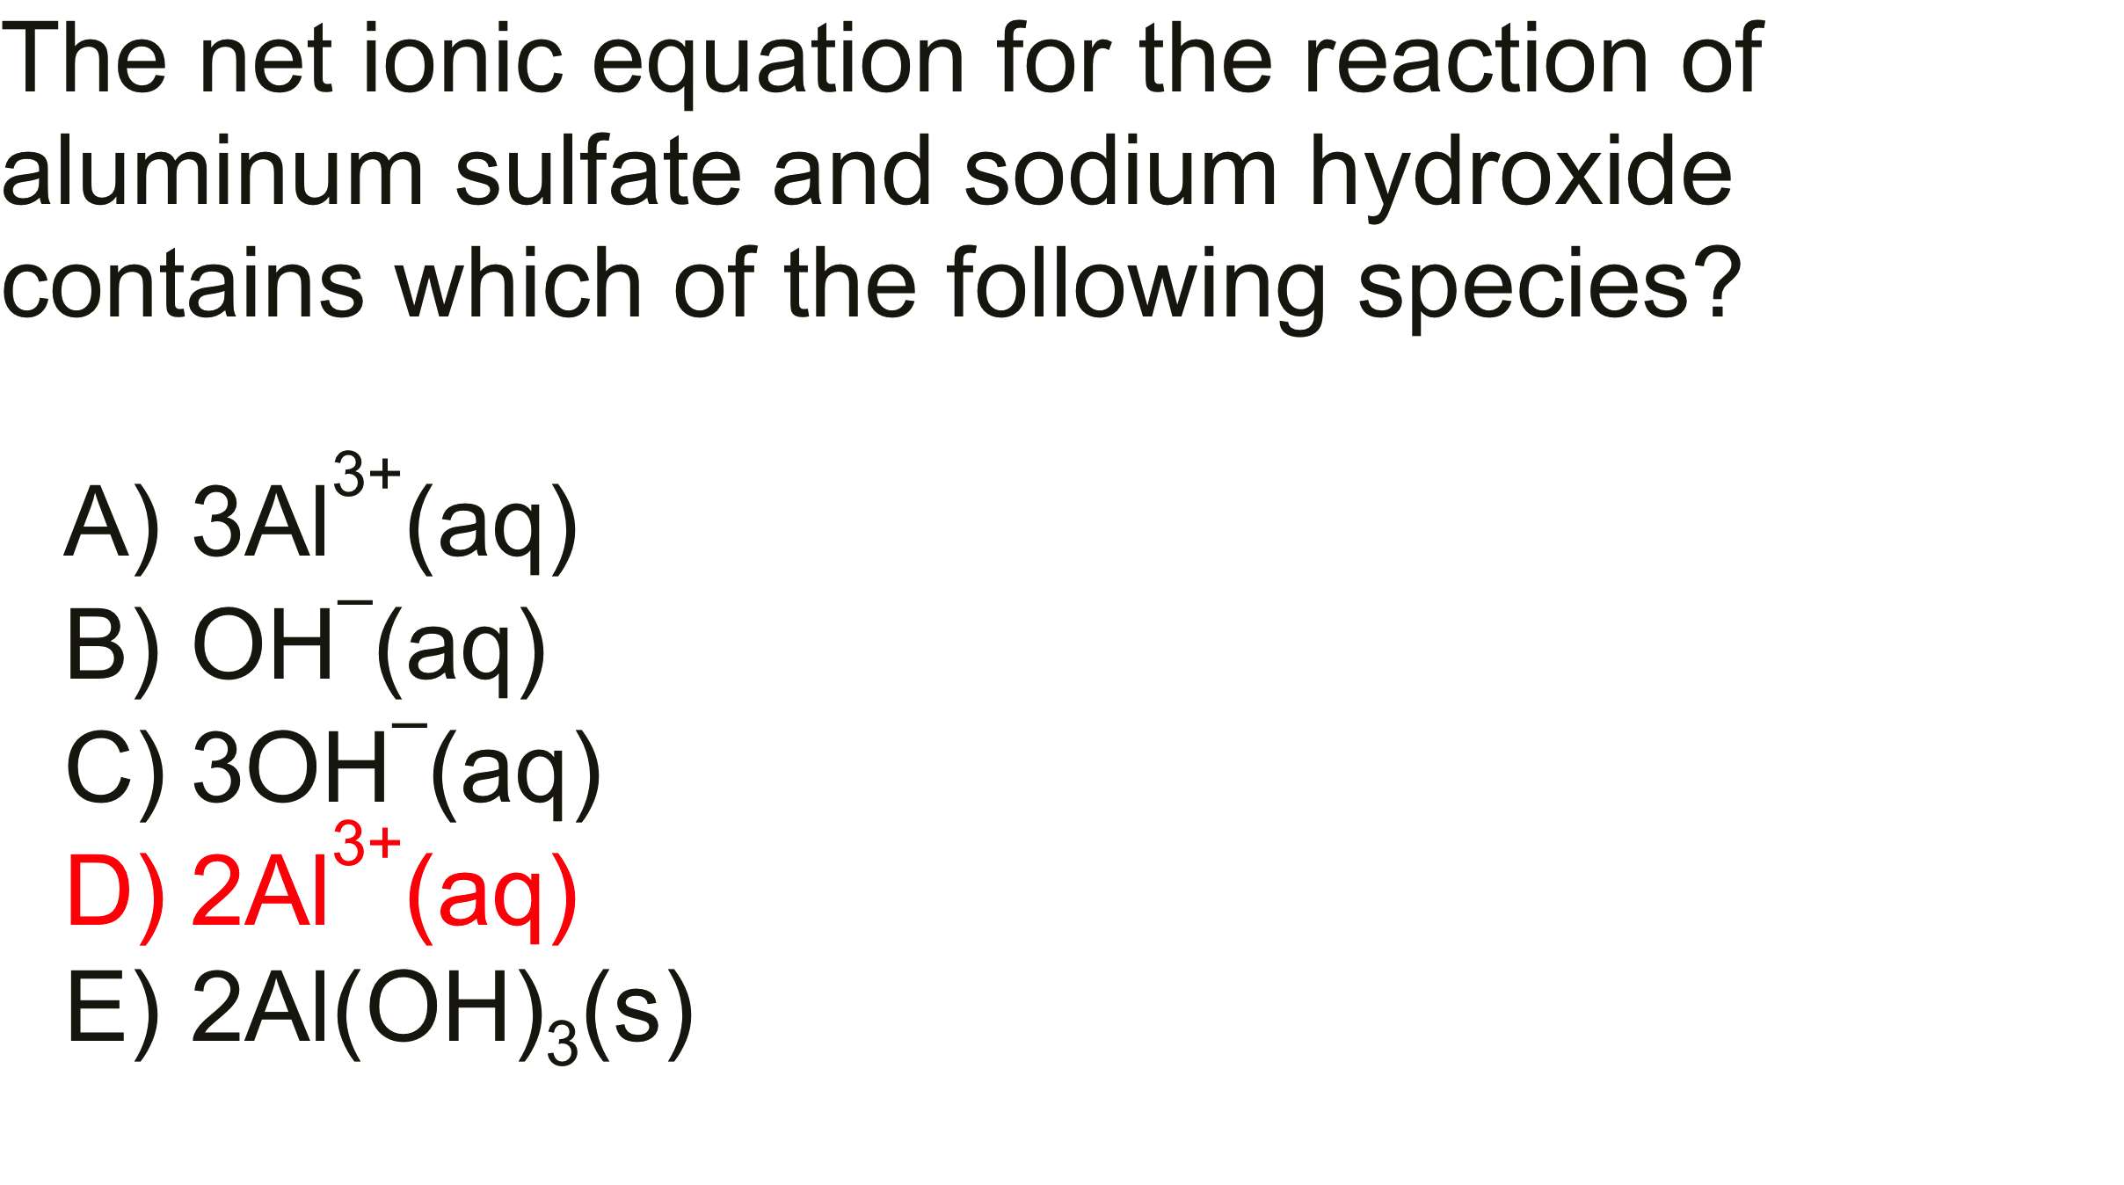
QUESTION & ANSWER
2PO₄^{3–} + Al³⁺ → Al(OH)₃ (s)
–

