Slide 1
Organic Molecules
Functional Groups
Lipids:
terpenes, fats, oils, waxes, steroids
Dr. Ron Rusay

Slide 2
Lipids:
Fats & Oils
Lipids are natural plant & animal products more soluble in non-polar solvents like gasoline than in water.
Combustion (burning) of one gram: of carbohydrate produces 4 to 5 Calories, protein produces 4 to 5 Calories, fat produces 9 to 10 Calories — more than twice that of either sugars or proteins.

Slide 3
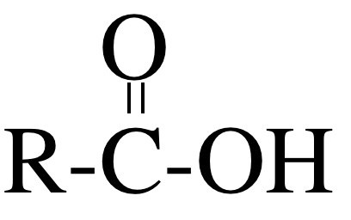
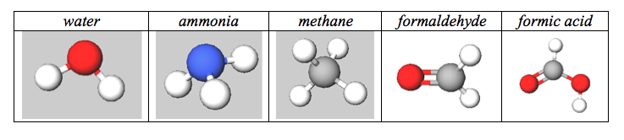
Lipids
Common Functional Groups
Name General Formula
Alcohols R−ΟΗ
Ethers R−Ο−R′
Amines R−ΝΗ₂
Carboxylic Acids
(R is very large, note: glycerol is not a lipid)
(R is very large)

Slide 4
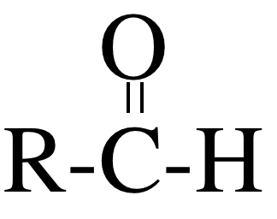
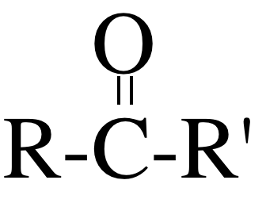
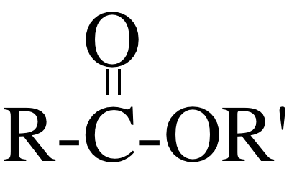
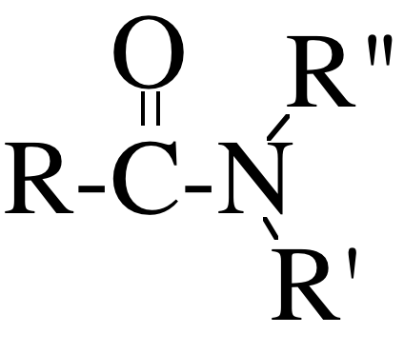
Lipids
Common Functional Groups
Name General Formula
Aldehydes
Ketones
Carboxylic Acids
Esters
Amides
(R is very large)
(R is very large)

Slide 5
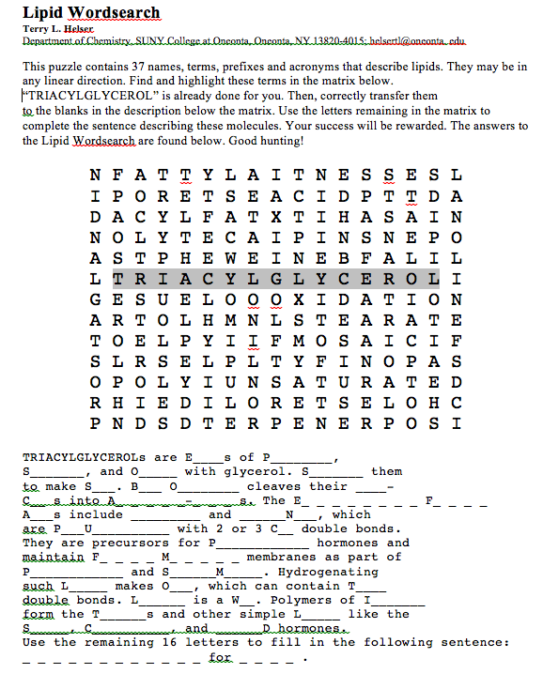

Slide 6
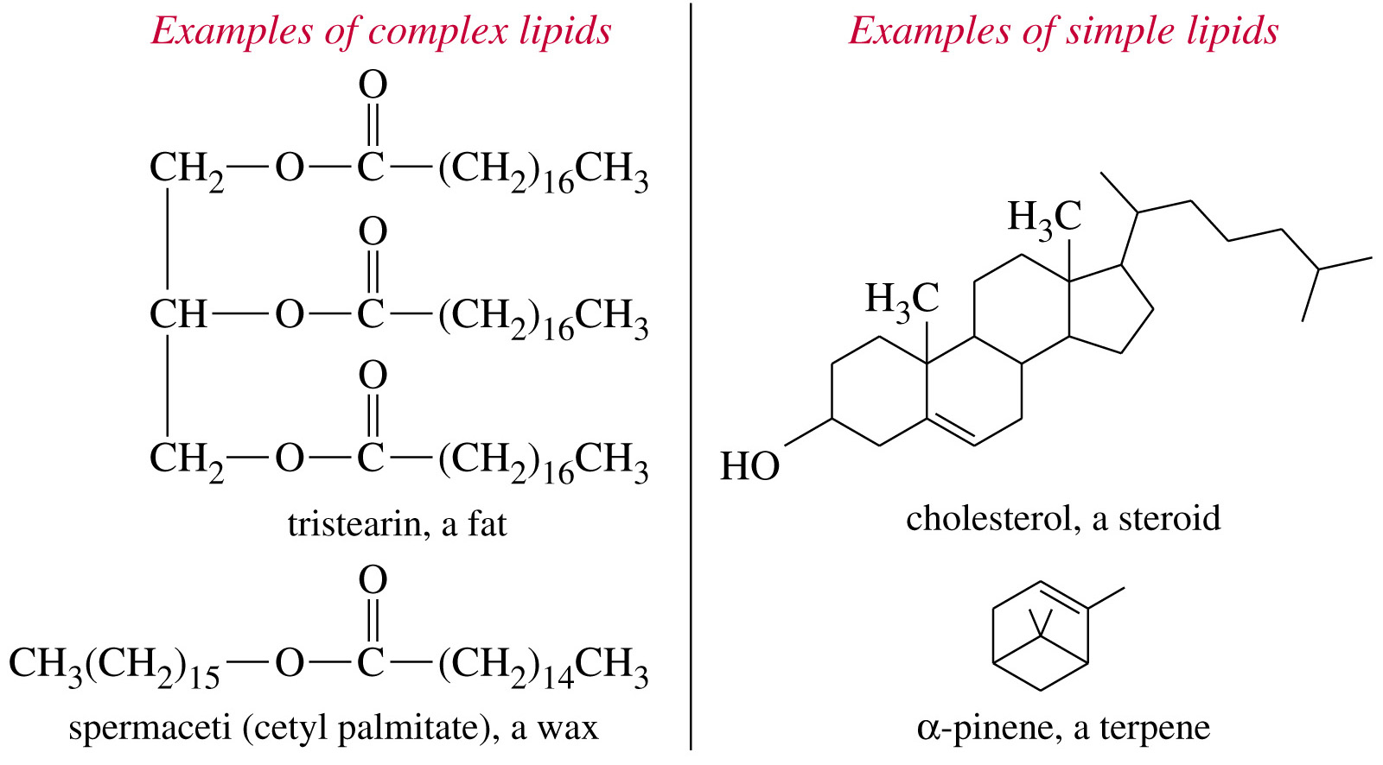

Molecular Formula: C₅₇H₁₁₀O₆
Molecular weight: 891.4797
kJ/mol
Notes:
Figure: 25-01
Caption:
Complex lipids contain ester functional groups that can be hydrolyzed to acids and alcohols. Simple lipids are not easily hydrolyzed.

Slide 7
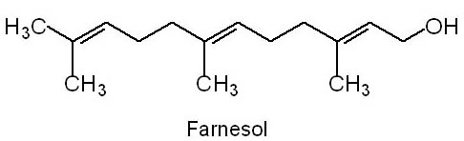
Question
Farnesol is a lipid that is classified as a
A) C₁₀, monoterpene, aldehyde.
B) C₁₅, sesquiterpene, aldehyde.
C) C₁₀, monoterpene, alcohol.
D) C₁₅, sesquiterpene, alcohol.

Slide 8
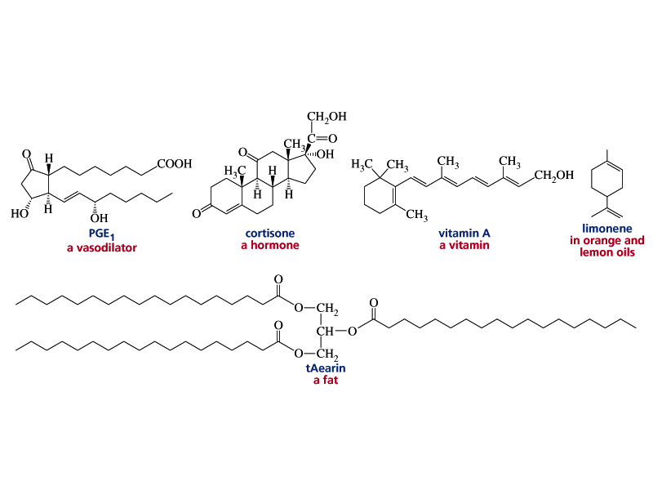
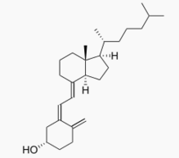

Lipid Examples
Vitamin D3

Slide 9
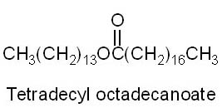
Question
Tetradecyl octanoate is classified as a(n)
A) ester (wax). B) fatty acid.
C) ketone (terpene). D) steroid.

Slide 10
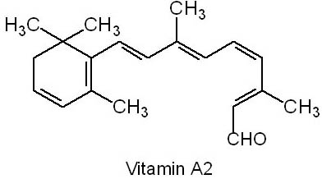
Question
Vitamin A2 binds to opsin. It is a(n) _________ and has an important C=C double bond, which is ________.
A) alcohol, trans
B) alcohol, cis
C) aldehyde, trans
D) aldehyde, cis

Slide 11
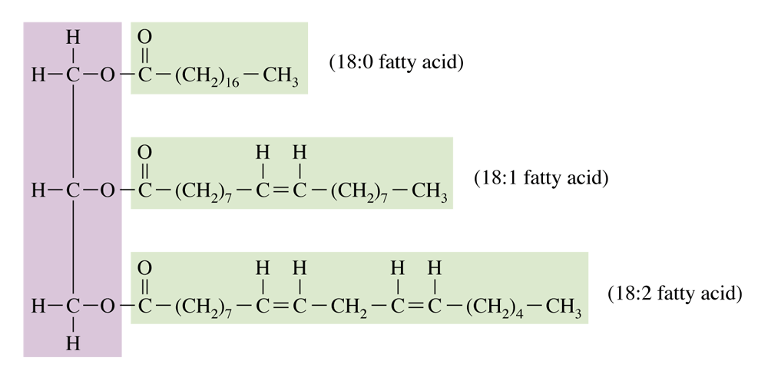
Structure of a mixed triacylglycerol in which three different fatty acid residues are present.
Saturated
Mono-unsaturated (cis)
Polyunsaturated (cis)

Slide 12
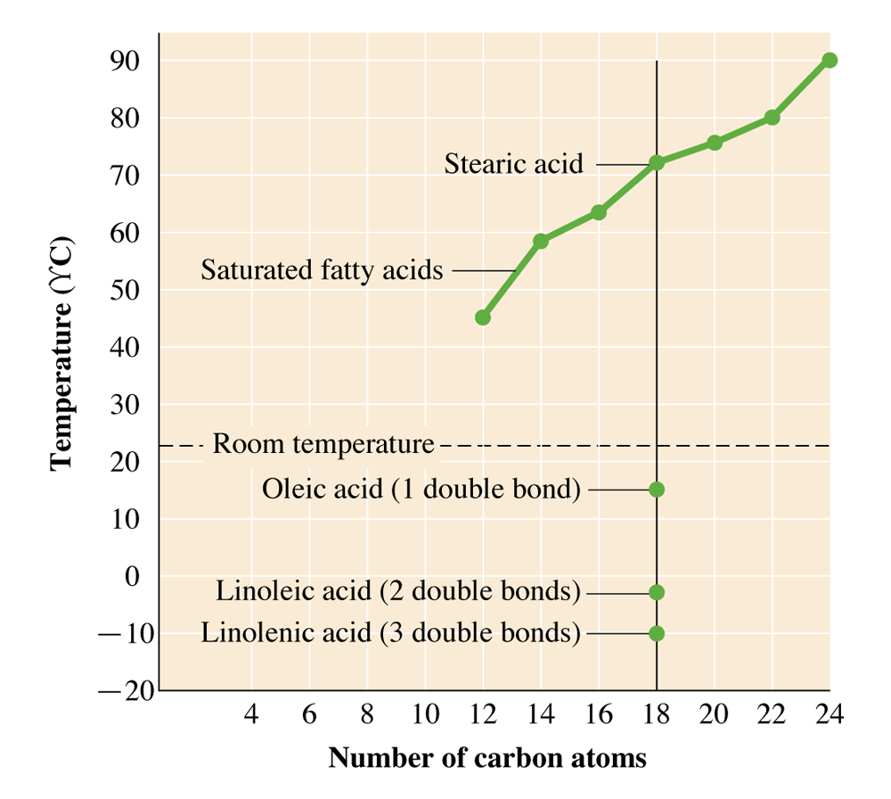
The melting point of a fatty acid depends on the length of the carbon chain and on the number of double bonds present in the carbon chain.

Slide 13
Question
Which of the following statements regarding fatty acids is false?
A) Fatty acid can have one or more carbon-carbon double bonds.
B) Naturally occurring fatty acids have an odd number of carbons.
C) The configuration of the double bond(s) is (are) generally cis in naturally occurring fatty acids.
D) Unsaturated fatty acids have a lower melting point than saturated ones.

Slide 14
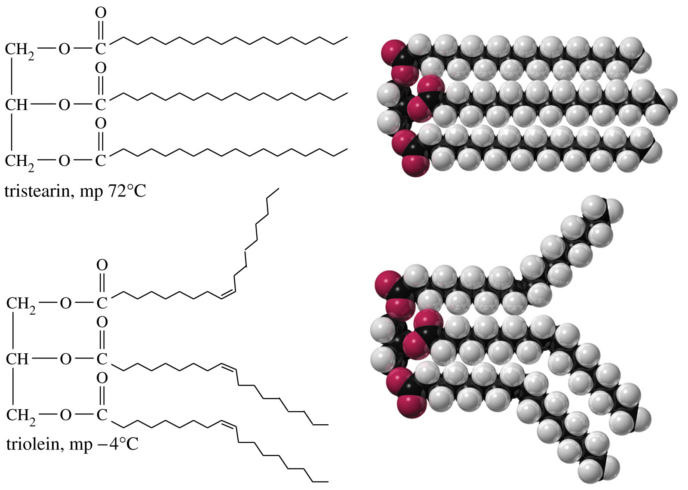
How do fat molecules differ?
Notes:
Figure: 25-03
Caption:
Unsaturated triglycerides have lower melting points because their unsaturated fatty acids do not pack as well in a solid lattice.

Slide 15
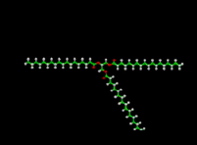
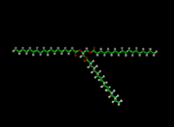
http://chemconnections.org/general/movies/fat-satd.MOV
http://chemconnections.org/general/movies/fat-unsatd.MOV
Notes:
Figure: 25-03
Caption:
Unsaturated triglycerides have lower melting points because their unsaturated fatty acids do not pack as well in a solid lattice.

Slide 16
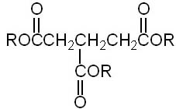
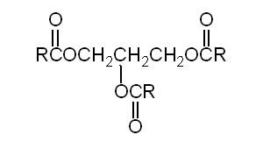
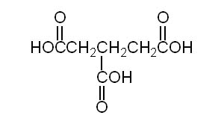
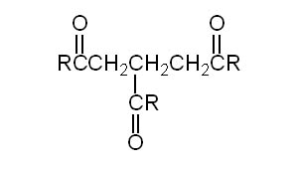
Question
Which one of the following is a fat, triacylglycerol (triglyceride)?
A) B)
C) D)

Slide 17
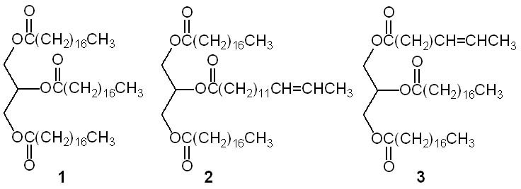
Question
Which of the triglycerides below is (are) chiral?
A) 1 B) 2
C) 3 D) 2 and 3

Slide 18
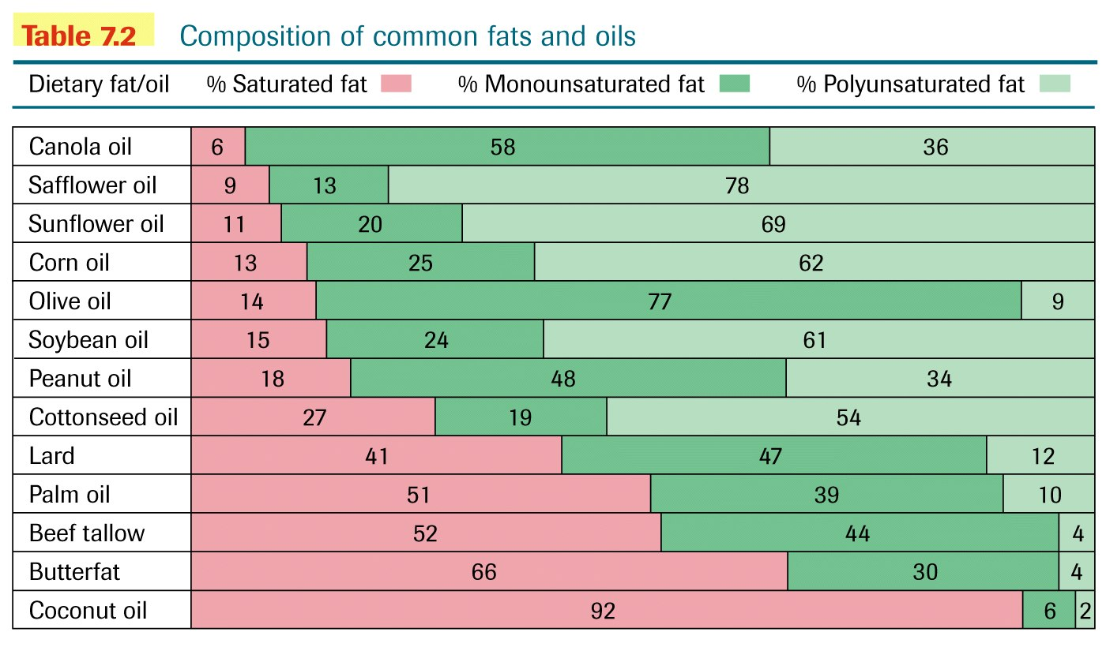
The collapse of movie theater popcorn sales!

Slide 19
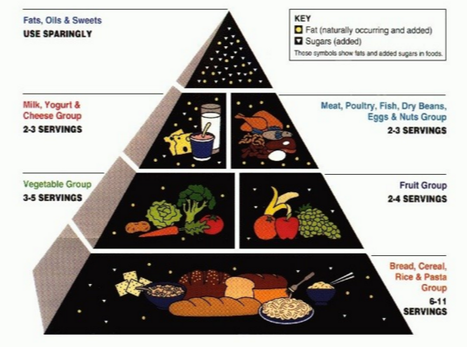
Food Pyramid, April 2016

Slide 20
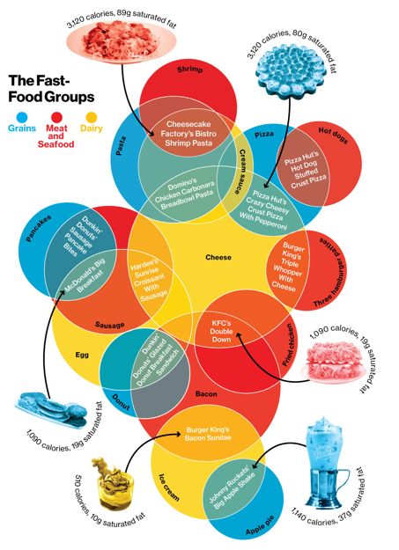
Businessweek, April 2013

Slide 21
The human body is 60-70 percent water, blood is ~90 percent, the brain and muscles are ~75 percent , and bones are ~20 percent by mass. * A human can survive for a month or more without eating food, but only 1-2 weeks without drinking water.
How much energy is required to raise the water in your body from 25ºC (average room temperature) to 37ºC (average body temperature [that is, chemical -biological temperature])? Assume that there is the equivalent of 5 liters of water, d = 1.0 g/mL in your body. The heat capacity of water is 4.184 J/g ºC (1.00 cal /g ºC); (0.001 Cal / g ºC); (0.001 kcal /g ºC)
How many grams of fat would need to be burned? (9 Cal/g)

Slide 22
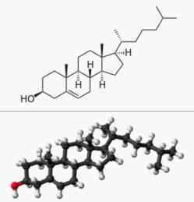
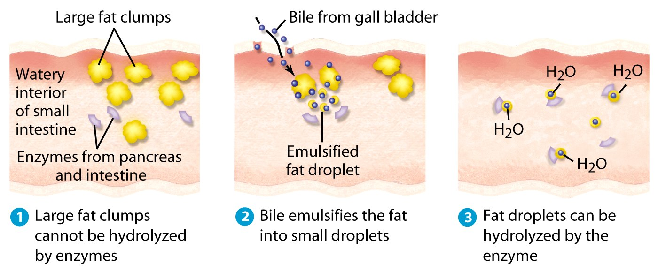
What is cholesterol?
Is there such a thing as “good” vs. “bad” cholesterol?
How does it relate to fat?

Slide 23
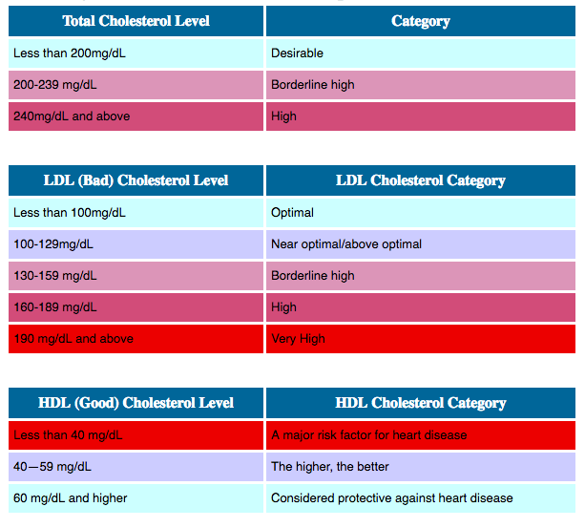

https://www.nlm.nih.gov/medlineplus/magazine/issues/summer12/articles/summer12pg6-7.html

Slide 24
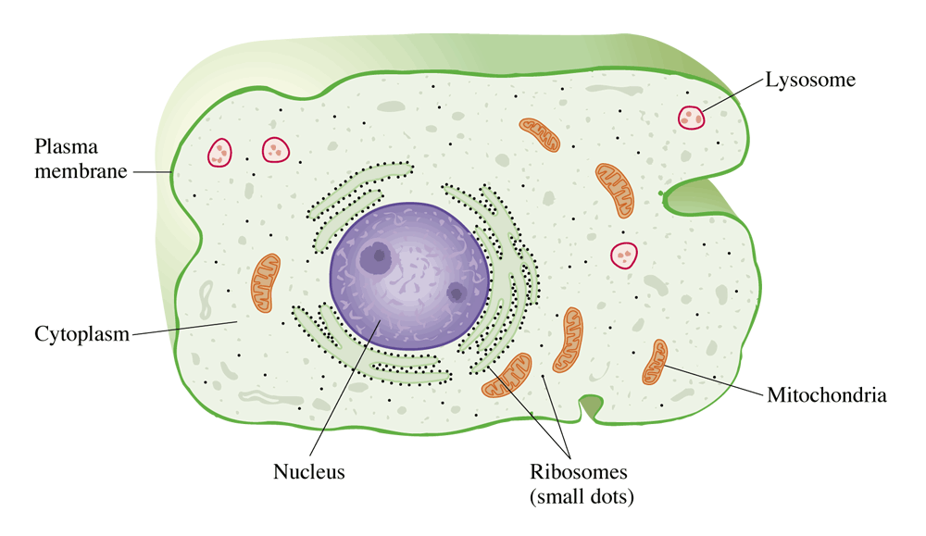
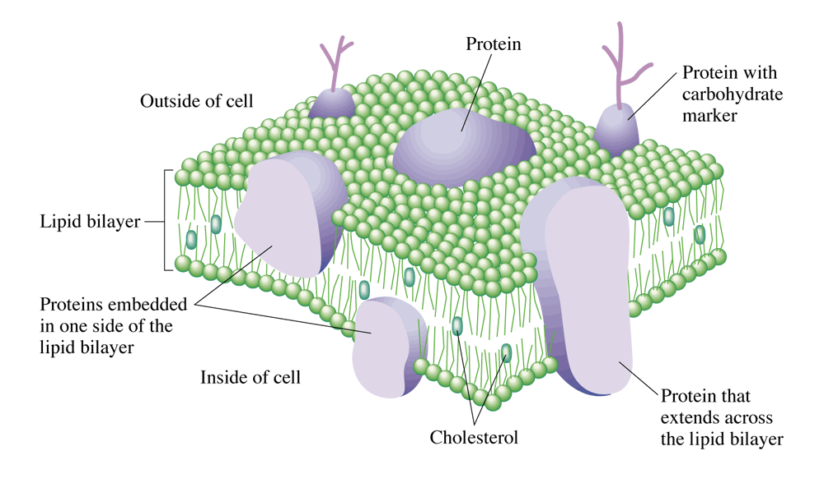
Eukaryotic Cell and Cell Wall
Cell Wall

Slide 25
Question
A major component of a lipid bilayer is
A) carbohydrate
B) wax
C) cholesterol
D) fat

Slide 26
Steroids

Slide 27
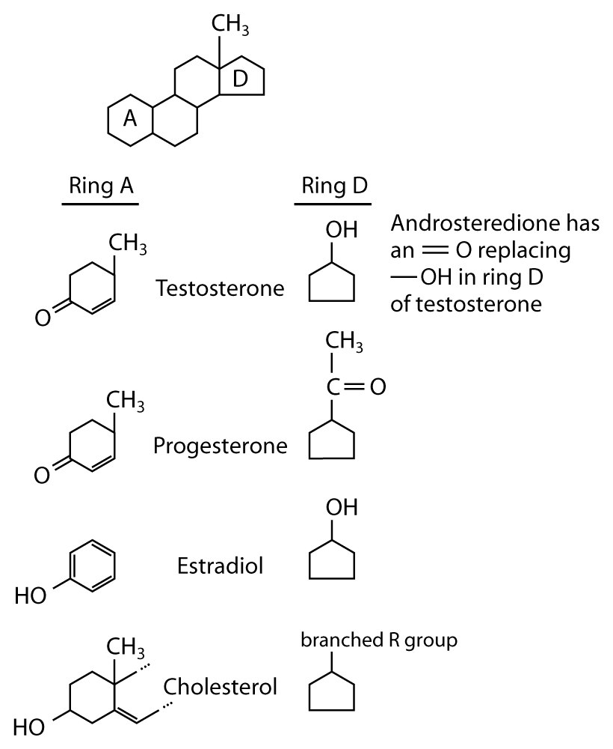

Slide 28
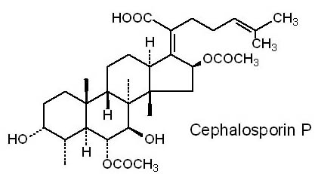
Question
The backbone structure of cephalosporin P is classified as a
A) fatty acid. B) steroid.
C) cholesterol. D) wax.

Slide 29
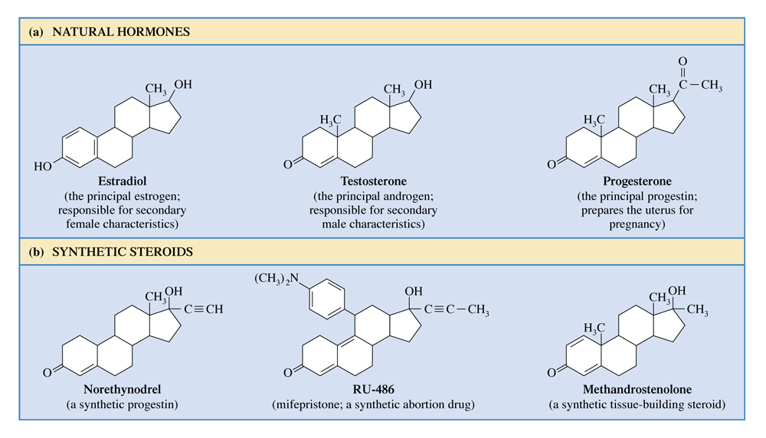
Structures of selected steroids. (Sex hormones and synthetic compounds that have similar actions.)

Slide 30

http://www.cbsnews.com/videos/russias-dark-secret/
Anabolic Steroids

Slide 31
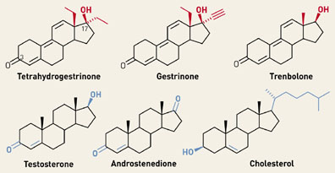
http://www.cbsnews.com/videos/russias-dark-secret/
Anabolic Steroids

Slide 32
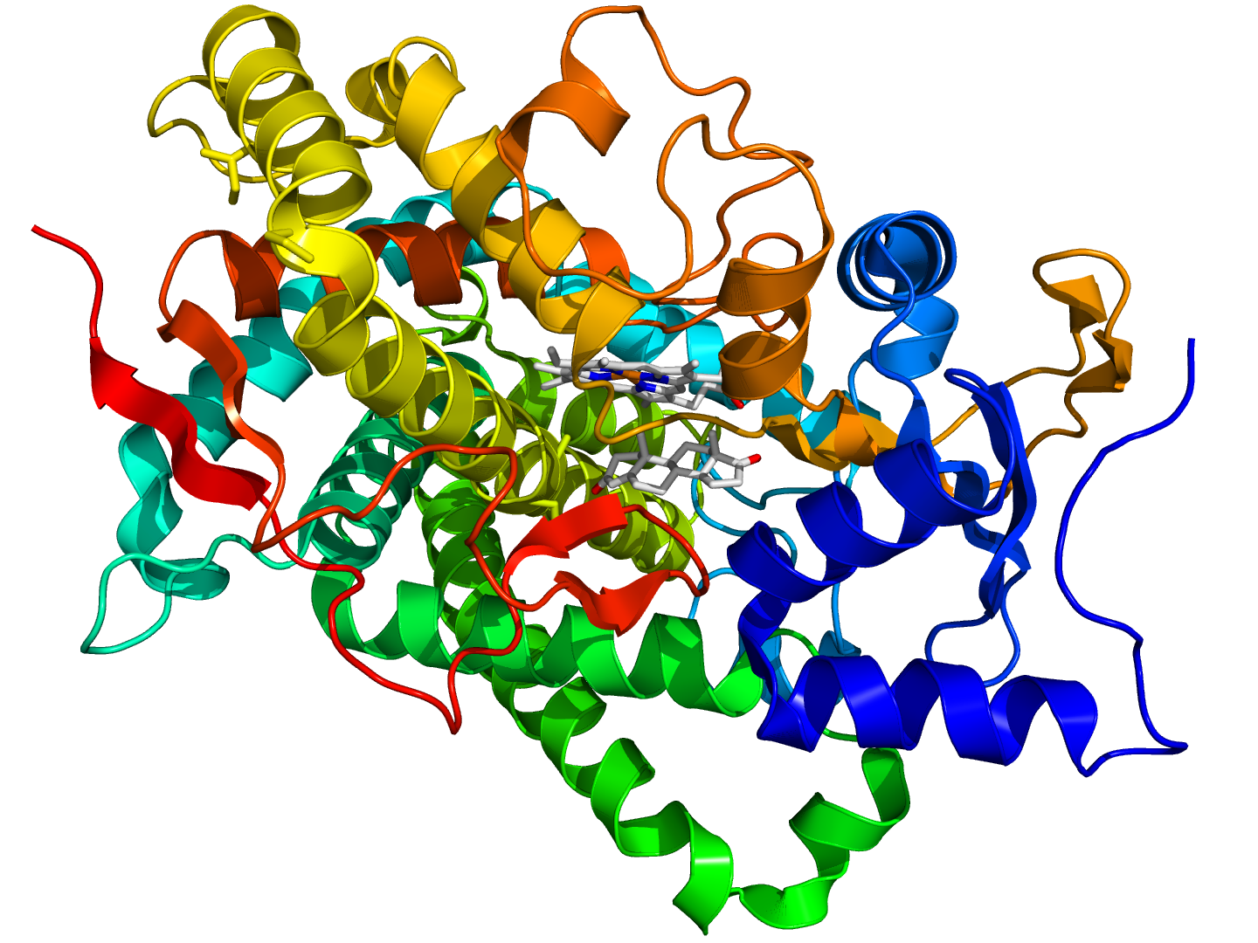
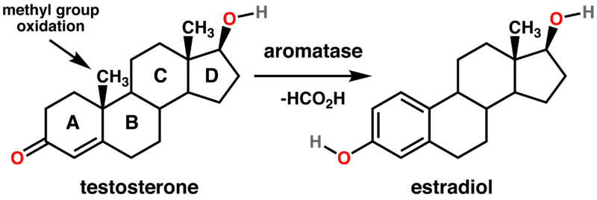
Enzyme Inhibition: Estrogen & Breast Cancer
Inhibiting a cancer cell’s division
Cytochrome p450
Notes:
Crystallographic structure of the human aromatase cytochrome P450 (rainbow colored cartoon, N-terminus = blue, C-terminus = red) in complex with the cofactor protoporphyrin IX (top) and the substrate androstenedione (bottom) depicted as stick diagrams (carbon = white, oxygen = red, nitrogen = blue, iron = orange).^{[1]}

Slide 33
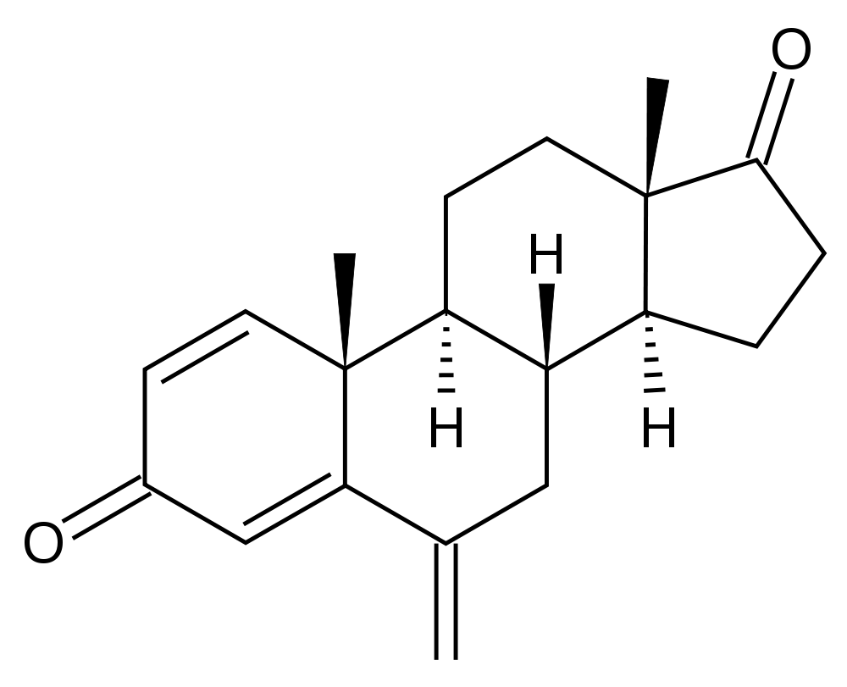
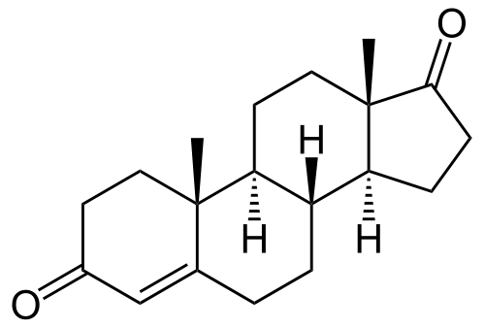
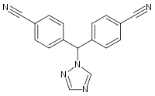
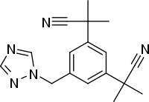
Enzyme Inhibition
Exemestane
Androstenedione
Letrozole
Anastrozole
Aromatase: Cytochrome p450
Notes:
Exemestane (trade name Aromasin) is an oral steroidal aromatase inhibitor used in the adjuvant treatment of hormonally-responsive (also called hormone-receptor-positive, estrogen-responsive) breast cancer in postmenopausal women. An aim in the treatment of hormone-receptor-positive patients in preventing recurrence is to lower estrogen levels that this breast cancer thrives on.
The main source of estrogen is the ovaries in premenopausal women, while in post-menopausal women most of the body's estrogen is produced in the adrenal gland from the conversion of androgens into estrogen by the aromatase enzyme. Exemestane is an irreversible, steroidal aromatase inactivator, structurally related to the natural substrate androstenedione. It acts as a false substrate for the aromatase enzyme, and is processed to an intermediate that binds irreversibly to the active site of the enzyme causing its inactivation
The estrogen suppression rate for exemestane varies from 85% for estradiol (E2) to 95% for estrone (E1).

Slide 34
Question
Which of the following is not classified as a steroid?
A) testosterone
B) estradiol
C) cortisone
D) β-carotene

