Slide 1
Molecular Modeling
Computational Chemistry
Shapes Lewis Structures
http://molview.org
Covalent Bonds:
Lewis Structures, Molecular Shapes
Dr. Ron Rusay

Slide 2
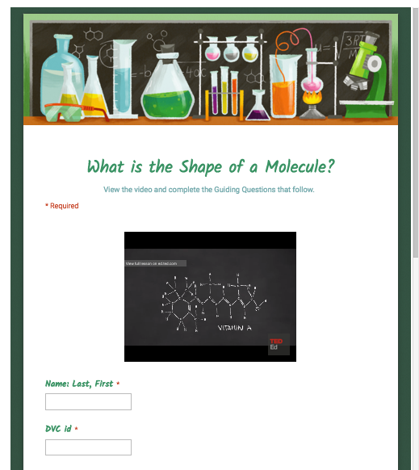

Shapes of Molecules
https://www.youtube.com/watch?v=Jq_Ca-HKh1g
View: What is the shape of a molecule?
George Zaidan and Charles Morton
http://chemconnections.org/general/chem108/Molecular%252520Shapes-Guide.html

Slide 3
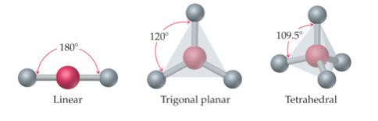
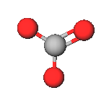
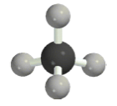
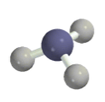
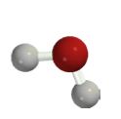
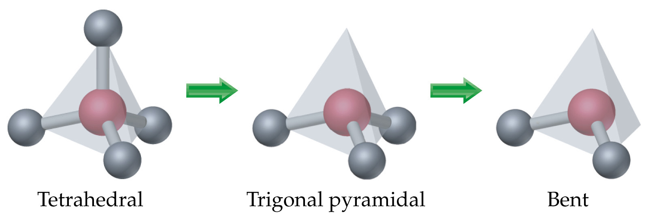
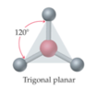
Molecular Shapes
Molecular Models for C, H, N, O
Fundamental repeating shapes found in every biological and synthetically made organic molecule including plastics
C =black
H = gray
N = blue
O = red
pink = generic atom

Slide 4
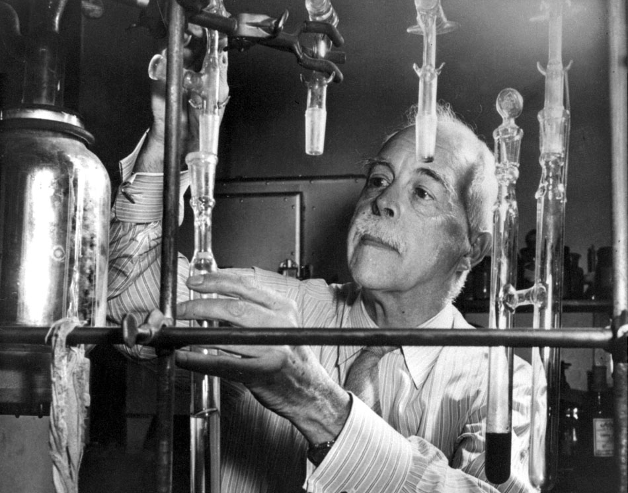
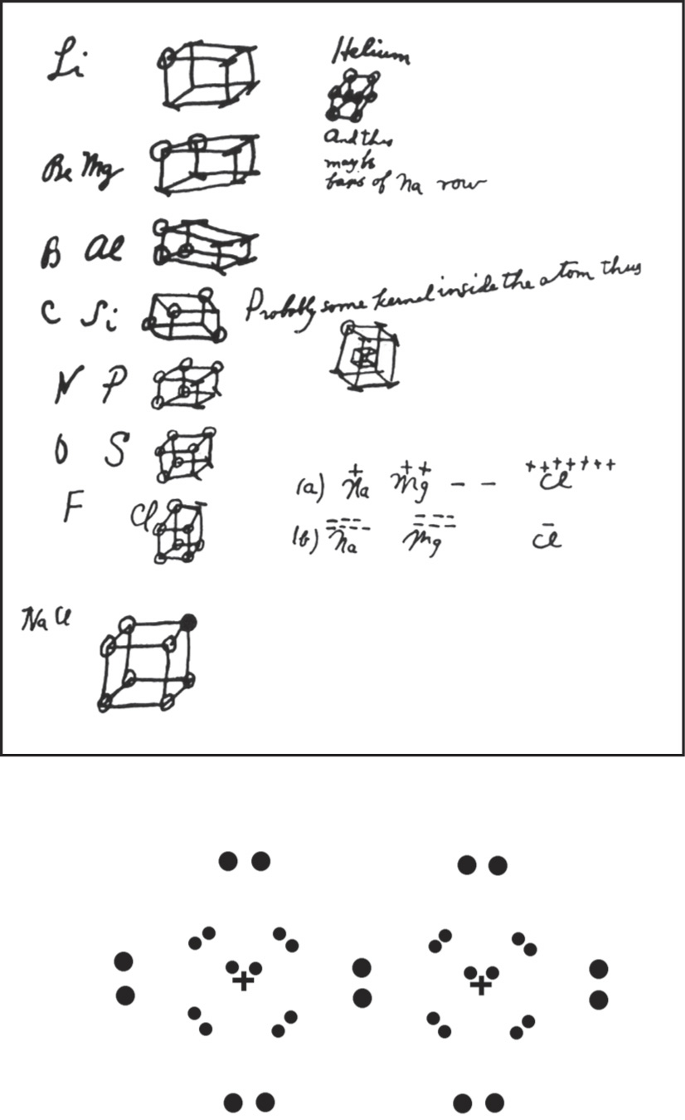
Professor Gilbert Newton Lewis (circa 1940)
G.N. Lewis
Photo Bancroft Library, University of California/LBNL Image Library
Footnote:
G.N. Lewis, despite his insight and contributions to chemistry, was never awarded the Nobel prize.
Notes from Lewis’s notebook
and his “Lewis” structure.

Slide 5
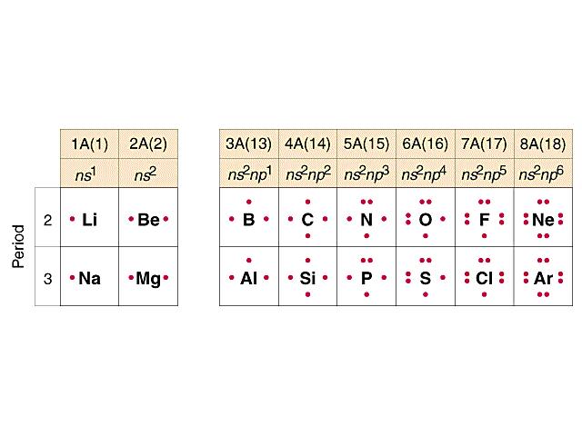



Valence Electrons – Lewis Dot Drawings
A Groups-Periods 2 & 3
.H

Slide 6

Covalent Bond Numbers
(Neutral Atoms!)
.H
one bond
H
F
Cl
Br
I
..
two bonds
:
O
..
three bonds
N
four bonds
C

Slide 7
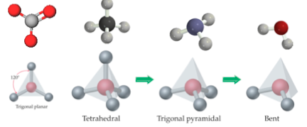
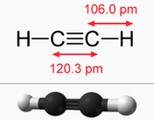
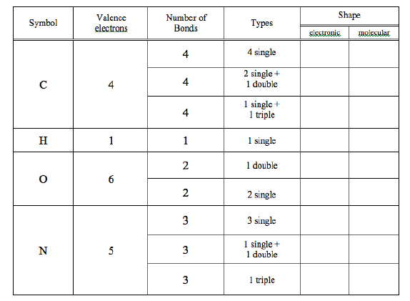
Linear
Trigonal Planar Tetrahedral Trigonal Pyramidal Bent
(Handout)
..
..
molecular shape
:
“electronic”/”VSEPR” shape
includes the electron pairs
(VSEPR: Electron Domain)
Linear
Trigonal Planar Tetrahedral Tetrahedral Tetrahedral
T
TPl
L
L
TPl
T
L
TPl
T
T
TPl
L
L
L
B
L
B
TPy
Linear = L
Trigonal Planar = TPl
Tetrahedral =T
Trigonal Pyramidal =TPy
Bent = B
Due End of Lab Next Week

Slide 8
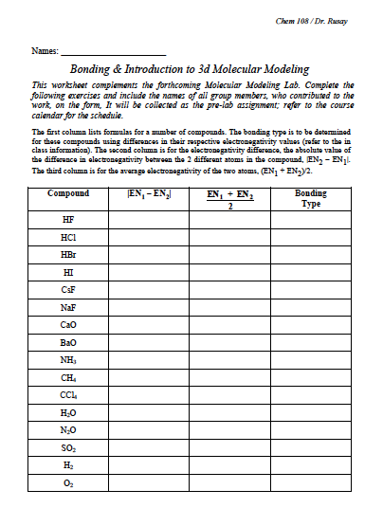
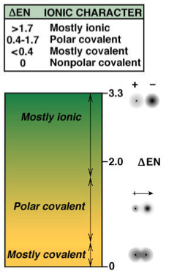
(Collaborative)
(Collaborative)
BondingH? and F?
mostly ionic =
polar covalent
4.0 – 2.1 = 1.9
3.0
polar covalent

Slide 9
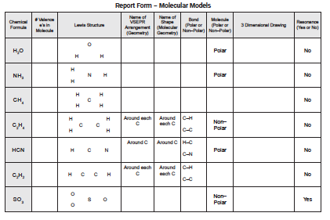
Lewis Structures Molecular Shapes
http://molview.org
Name?
8
Ammonia
Molecular Modeling: Bonding & Lewis Structures
Computational Chemistry: Molecular Modeling Report Form

Slide 10




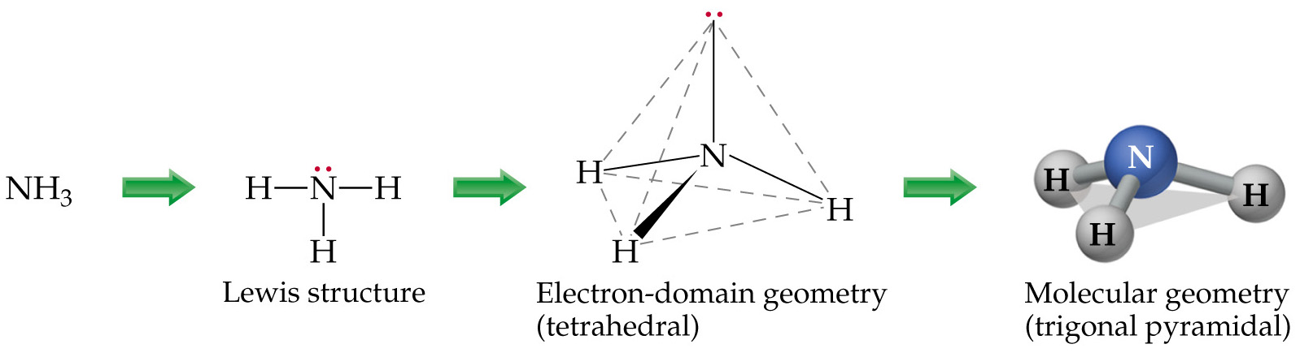
Lewis Structures Molecular Shapes
For simple Lewis structures:
  Draw the individual atoms using dots to represent the valence electrons.
  Put the atoms together so they share PAIRS of electrons to make complete octets.
NH₃, for example:
Eg. Ammonia:

Slide 11

Molecular Shapes Lewis Structures
http://molview.org
optional
Name?
8
Ammonia
Molecular Modeling: Bonding & Lewis Structures
Computational Chemistry: Molecular Modeling Report Form

Slide 12
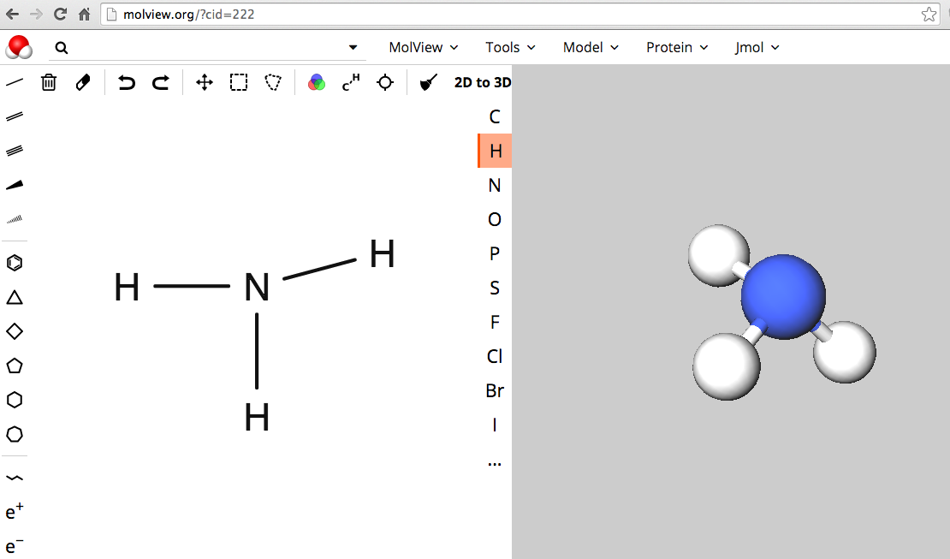
Molecular Shapes Lewis Structures
MolView: Visual On-line Molecular Modeling
http://molview.org
Bonding, Lewis Structures, Molecular Modeling:
Computational Experiments

Slide 13
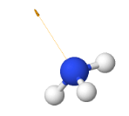

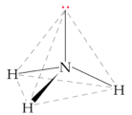
Molecular Shapes Lewis Structures
http://molview.org
optional
Name?
8
Tetra-
hedral
Trigonal
Planar
Polar
Ammonia
Molecular Modeling: Bonding & Lewis Structures
Computational Chemistry: Molecular Modeling Report Form

Slide 14
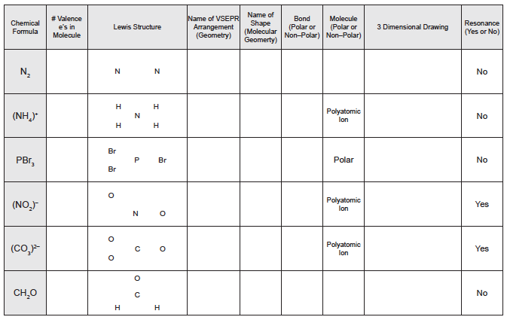
Molecular Shapes Lewis Structures
http://molview.org
Ammonium
Molecular Modeling: Bonding & Lewis Structures
Computational Chemistry: Molecular Modeling Report Form

Slide 15
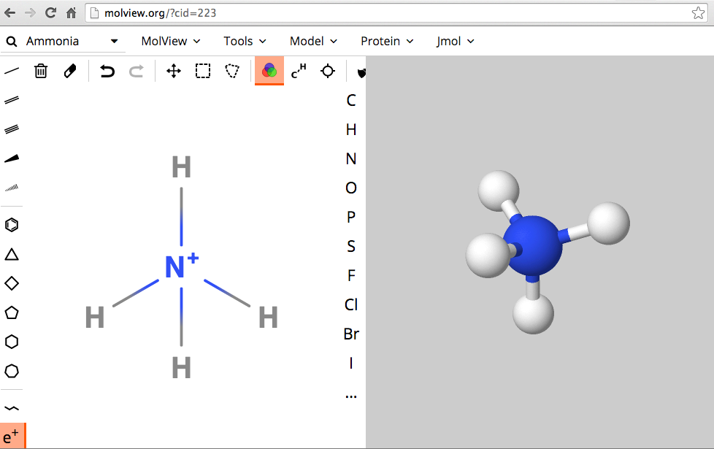
Molecular Shapes Lewis Structures
MolView: Visual On-line Molecular Modeling
http://molview.org
Ammonium
(polyatomic ion)
Molecular Modeling: Bonding & Lewis Structures
Computational Chemistry: Molecular Modeling Report Form

Slide 16
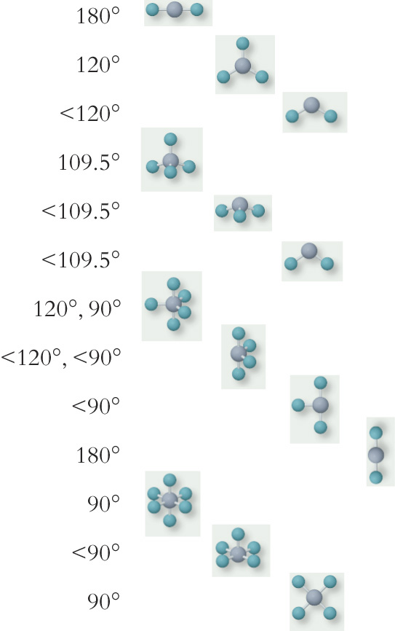
VSEPR (Electronic)
Geometry
Molecular
Geometry
Bond Angle
# of lone pairs
Important
in
Organic
Compounds
Linear Linear
Trigonal Planar Trigonal Planar
Trigonal Planar Bent
Tetrahedral Tetrahedral
Tetrahedral Trigonal Pyramidal
Tetrahedral Bent
Trigonal Bipyramidal Trigonal Bipyramidal
Trigonal Bipyramidal Seesaw
Trigonal Bipyramidal T-shape
Trigonal Bipyramidal Linear
Octahedral Octahedral
Octahedral Square Pyramidal
Octahedral Square Planar
0
0
1
0
1
2
0
1
2
3
0
1
2
See again
in
Chem 120
and possibly
in
Chem 109

Slide 17
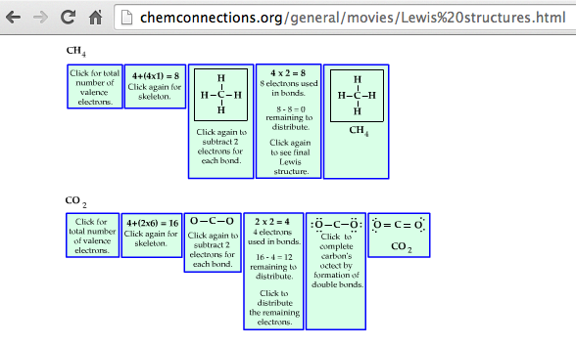
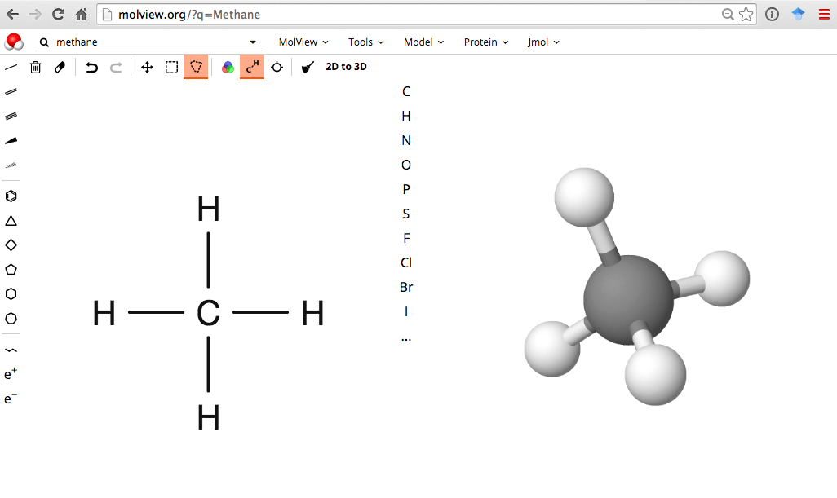
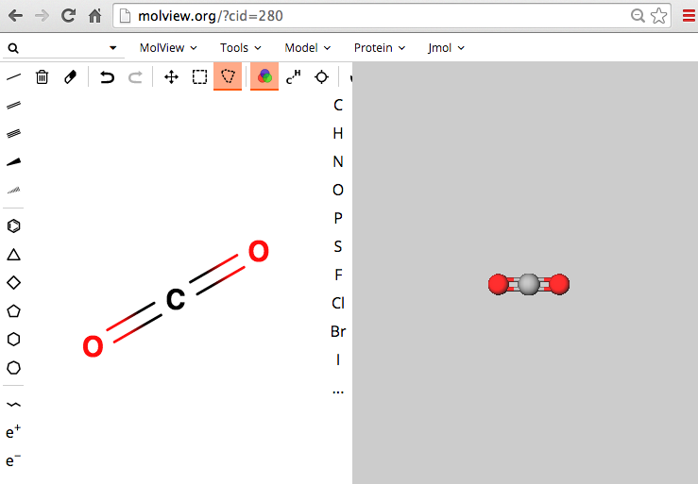
http://chemconnections.org/general/movies/Lewis%20structures.html

Slide 18
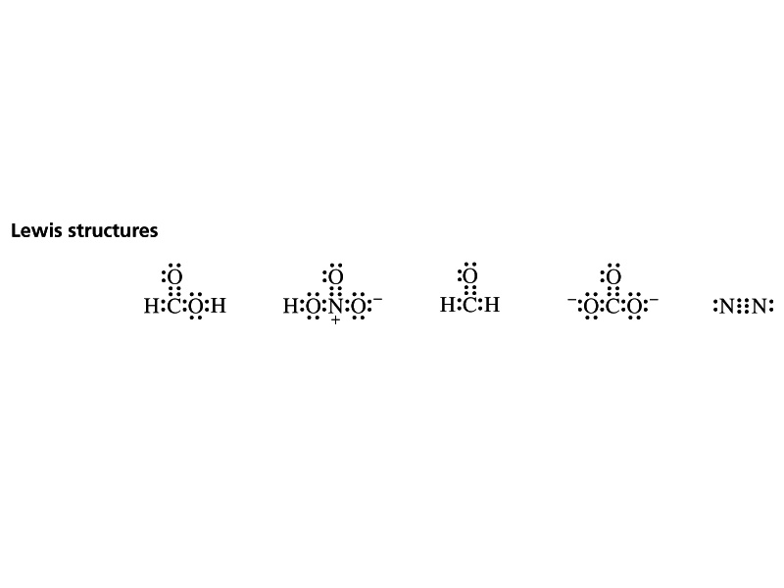
Lewis Structures / Covalent Compounds
Share valence electrons.
1 pair = 1 bond; maximum # of atom-atom bonds = 3.
Octet rule (“duet” for hydrogen)
Lewis structure examples:
Notice the “formal” charges:
In one case they balance, can you name the compound?
In the other they do not.
They both have “formal” charges. Can you name the polyatomic ion?

Slide 19
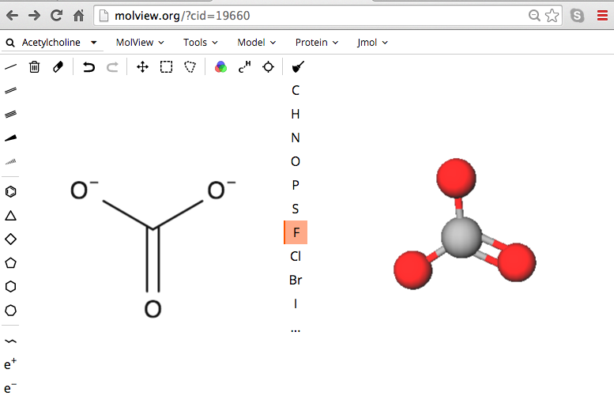
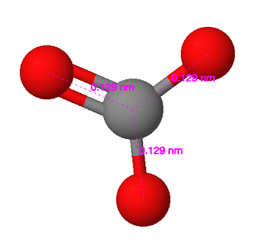
Molecular Shapes Lewis Structures
MolView: Polyatomic Ions
http://molview.org
resonance structures
Bonding, Lewis Structures, Molecular Modeling:

Slide 20
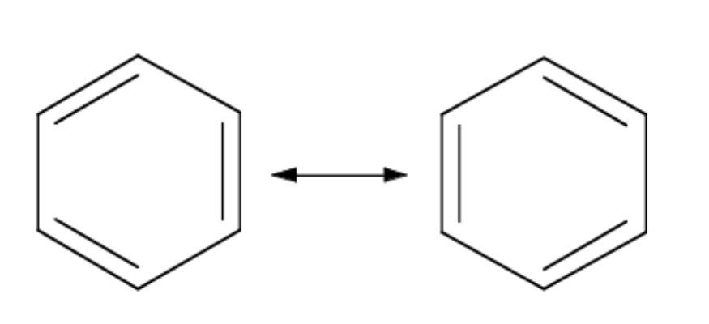
Resonance
Occurs when more than one valid Lewis structure can be written for a particular molecule. [Adjacent free electrons, double or triple bonds.]
These are resonance structures. The actual structure is an average of all of the resonance structures.

Slide 22
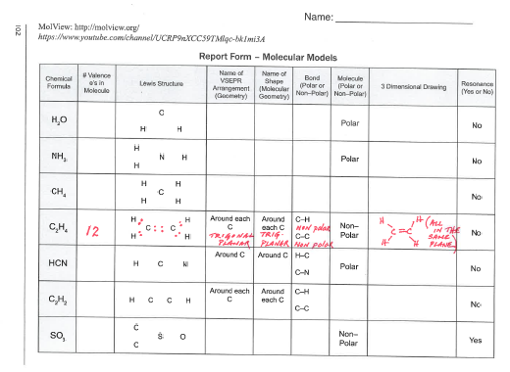
Molecular Shapes → Lewis Structures
http://molview.org
Molecular Modeling: Bonding & Lewis Structures
Computational Chemistry: Molecular Modeling Report Form

Slide 23

Lewis Structures → Molecular Shapes
For simple Lewis structures:
  Draw the individual atoms using dots to represent the valence electrons.
  Put the atoms together so they share PAIRS of electrons to make complete octets.
NH₄⁺
+
H
+
+
Ammonium

Slide 24
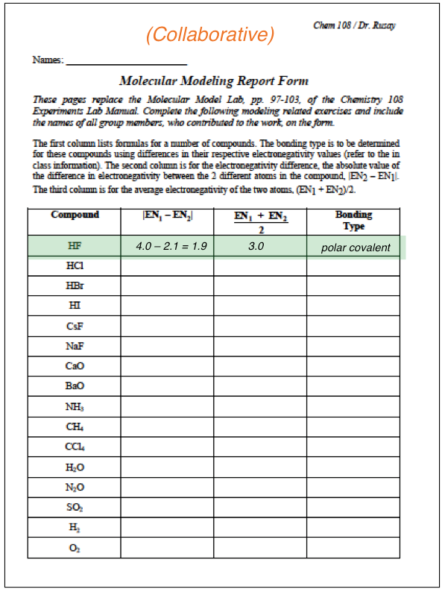
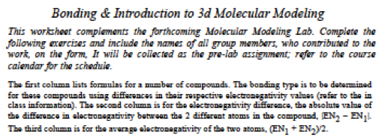
mostly ionic =
polar covalent

