Slide 1
CHEM 108
Discussion Guide 1.7
Molecules/ Compounds/ Bonds
and
The Periodic Table

Slide 2
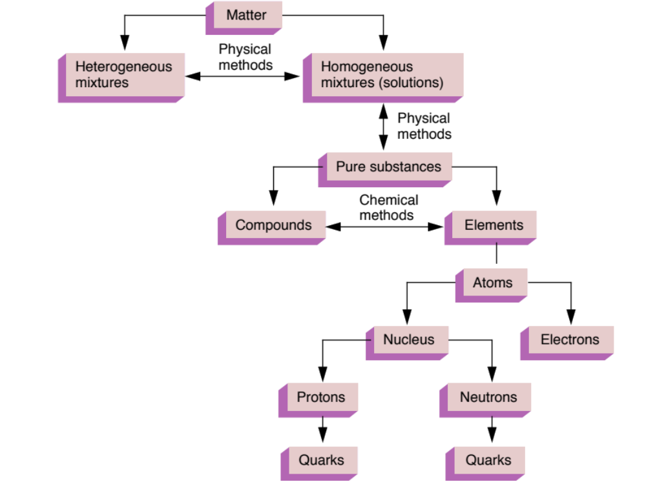
Atoms & Molecules
[BONDS]
Molecules

Slide 3
Compounds & Chemical Bonds
Atoms in a compound (molecule) are in ratios of whole numbers with specific 3-dimensional arrangements due to attractive inter-atomic forces (Bonds). These provide favorable energy states & spatial positions (lower energy & farther apart are better), which result in molecules having new chemical, physical, and biological properties.

Slide 4
Electrons, Configurations, & Bonds
Noble Gases and The Rule of Eight
When a nonmetal and a metal combine, they form an ionic bond: Valence electrons of the metal are lost and the nonmetal gains these electrons to achieve a Noble gas electron configuration.
When two nonmetals combine, they form a covalent bond: They share electrons to achieve a Noble gas electron configuration.

Slide 5
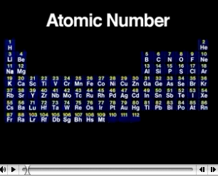
Periodic Properties
http://chemconnections.org/general/movies/periodic-prop.MOV

Slide 6
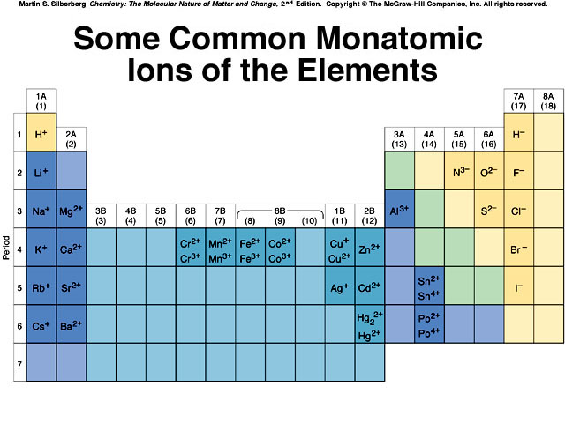
Number of Valence Electrons for Elements in the “A” lettered Vertical Columns Equal the Column Number

Slide 7
Ionic Bonds
Result from electrostatic attractions of closely packed, oppositely charged ions.
Form when an atom which can easily lose electrons reacts with one which has a high electronegativity (electron affinity), that is, it can easily gain electrons.
Eg. Mg and Cl; K and O

Slide 8
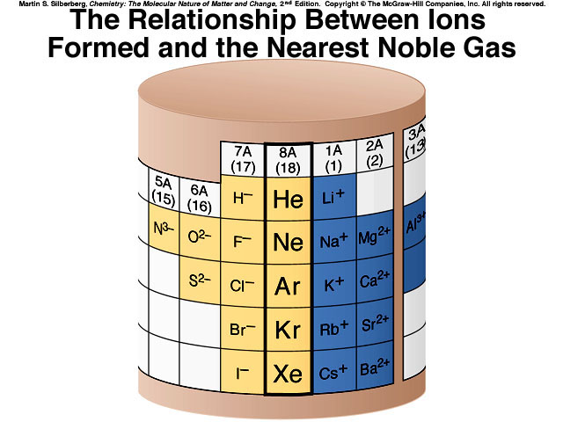
Electron Configurations

Slide 9
Ionic Compounds
Neutrally Charged
Eg. Salt: NaCl → 1 Na⁺ and 1 Cl ⁻
What is the proportion of ions for a compound formed from Mg ion and chlorine?
Mg²⁺ and Cl⁻
1 Mg²⁺ combines with 2 Cl⁻
MgCl₂

Slide 10
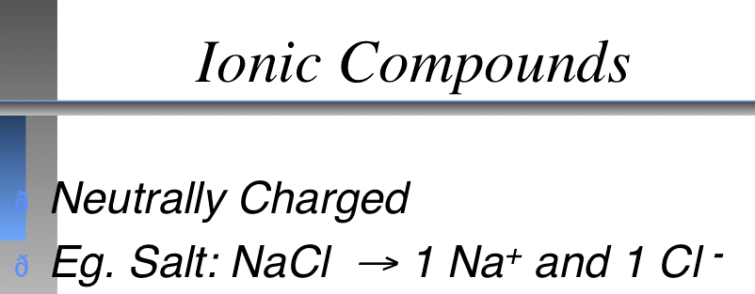
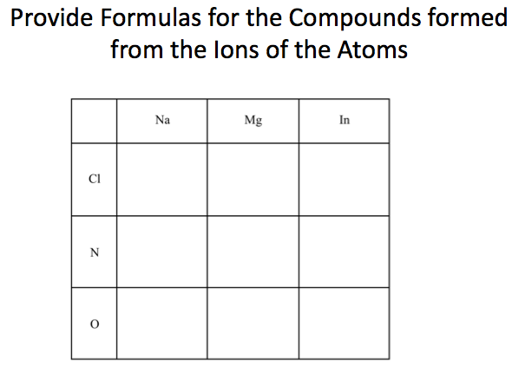
Ionic Compounds

Slide 11
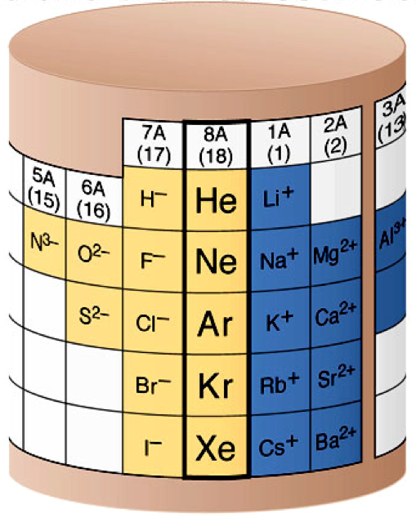
Ionic Compounds
Mg
MgCl₂
Name the compound.
Mg²⁺ and Cl⁻
Cl

Slide 12
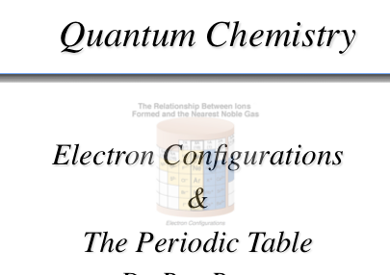
Discussion Guide 1.7

Slide 13
QUESTION
Predict the formula for the binary ionic compound formed
by aluminum and oxygen.
    A) Al₂O₃ B) Al₃O₂ C) Al₂O D) AlO₂

Slide 14
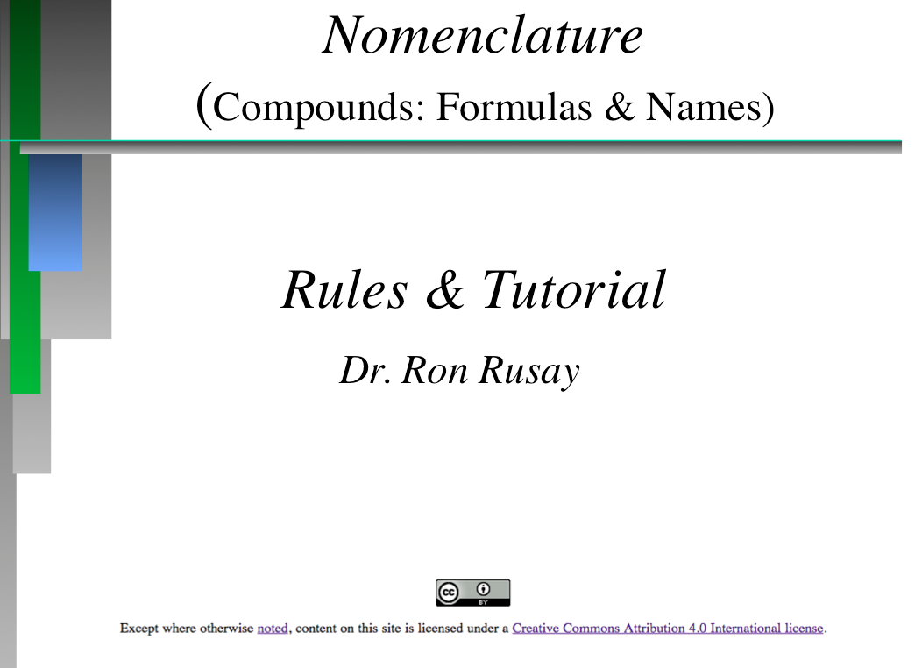
Complete Self-Paced Tutorial
http://chemconnections.org/general/chem108/Nomenclature.htm
Nomenclature Tutorial Powerpoint; .html, .ppt, Print: .pdf (6 slides per page)
Lab Manual pp. 104-108
One set per Lab Group

Slide 15
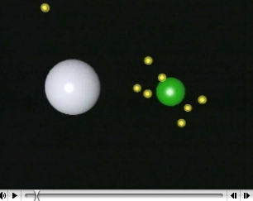
Ionic vs. Covalent Bonding
http://chemconnections.org/general/movies/ionic-covalent.mov

Slide 16
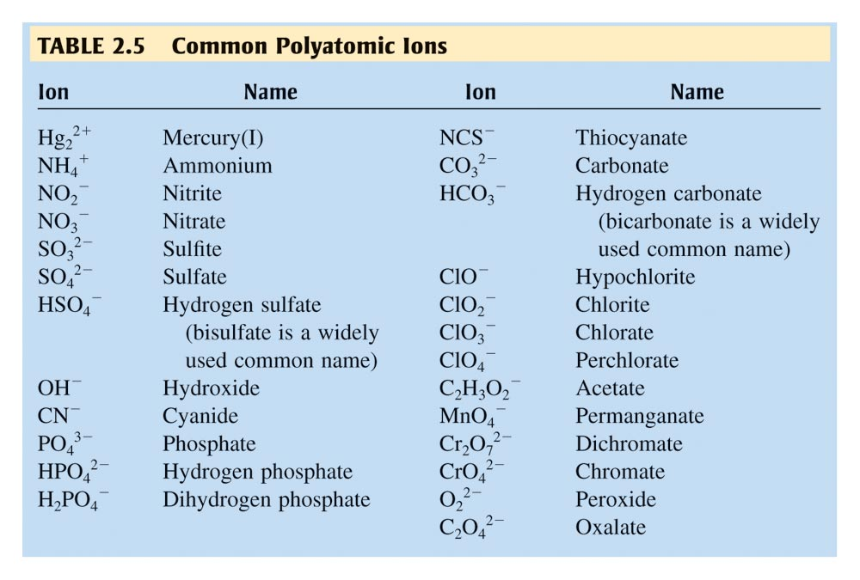
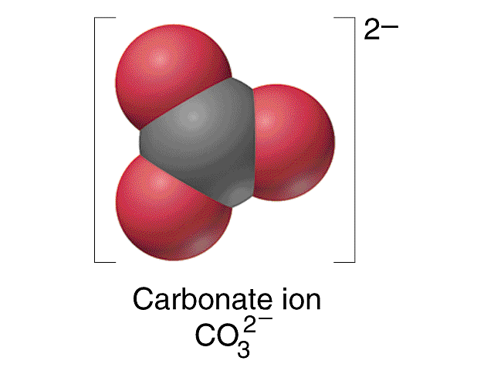
Polyatomic Ions
http://chemconnections.org/general/chem120/polyatomics.html

Slide 17
QUESTION
Which formula is correct?
A) MgNO₃ B) NH₄CO₃ C) Na(PO₄)₃ D) Al₂(SO₄)₃

Slide 18
Ionic Bonds
Result from electrostatic attractions of closely packed, oppositely charged ions.
Form when an atom which can easily lose electrons reacts with one which has a high electronegativity (electron affinity), that is, it can easily gain electrons.
Eg. Mg and Cl; K and O

Slide 19
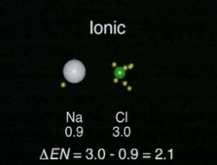
Electronegativity
http://chemconnections.org/general/movies/electronegativity.mov

Slide 20
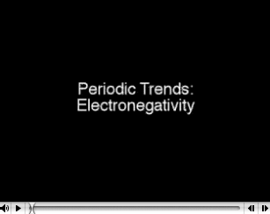
Electronegativity
http://chemconnections.org/general/movies/Periodic-e.n.MOV

Slide 21
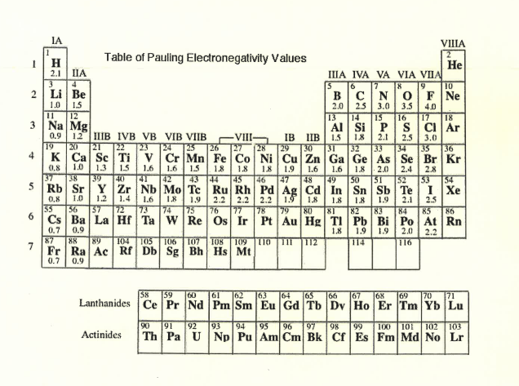
Covalent Bonding

Slide 22
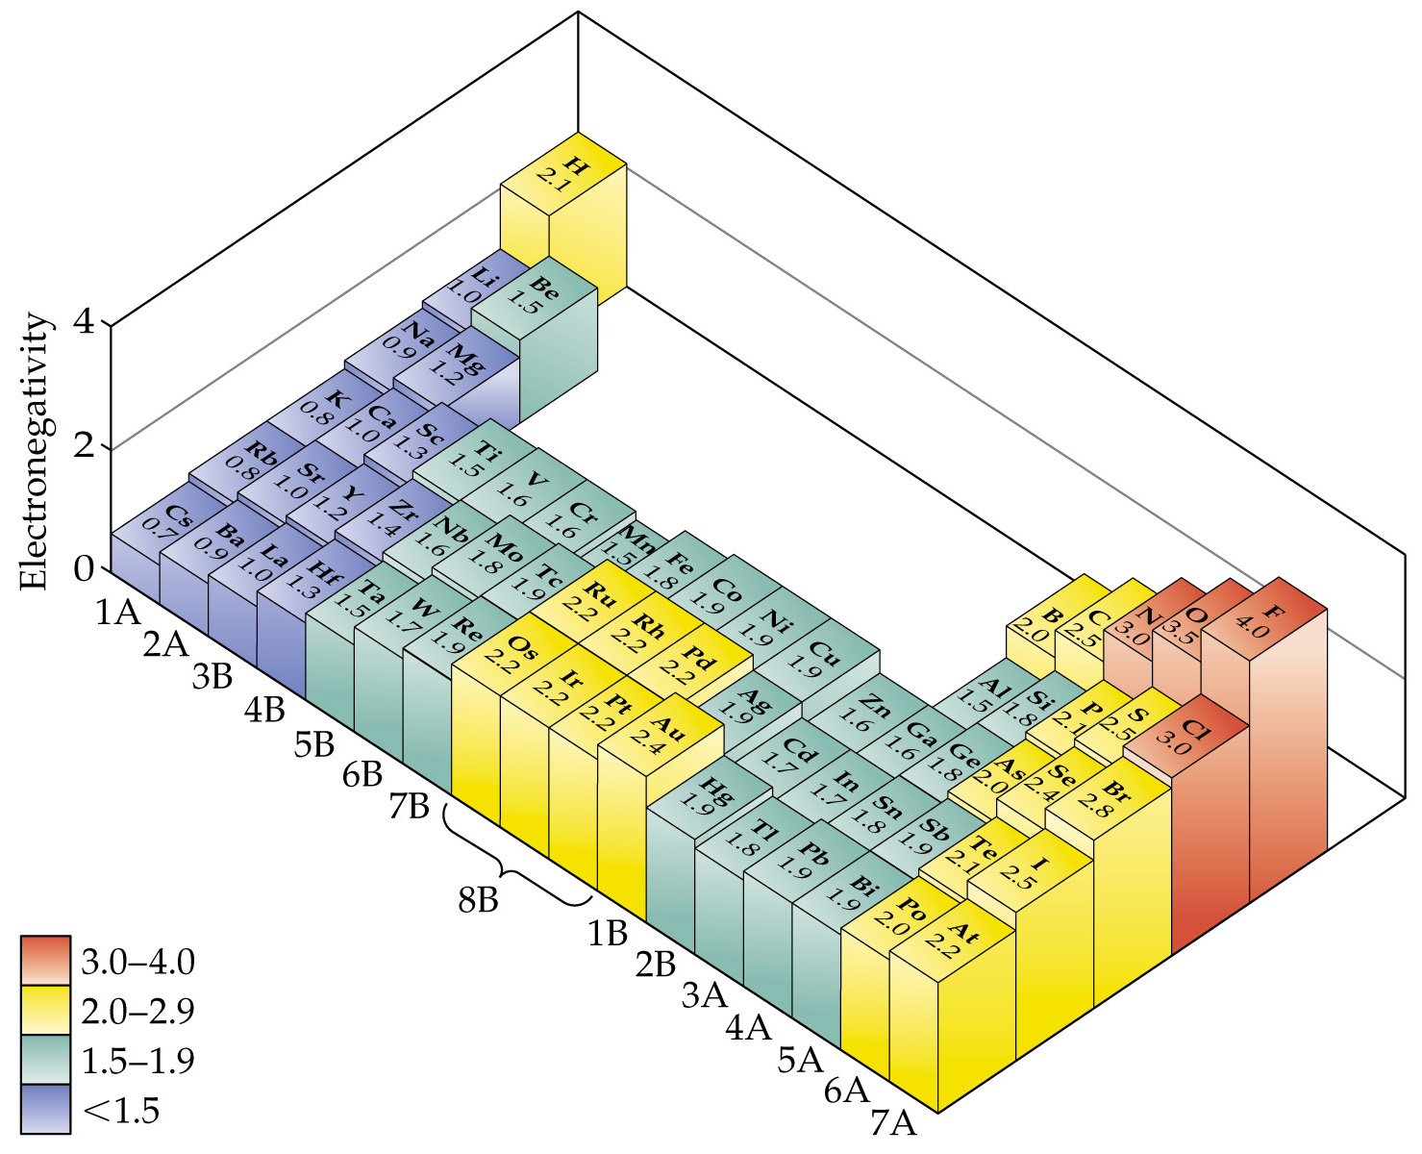
Notes:
Figure: 08-06

Slide 23
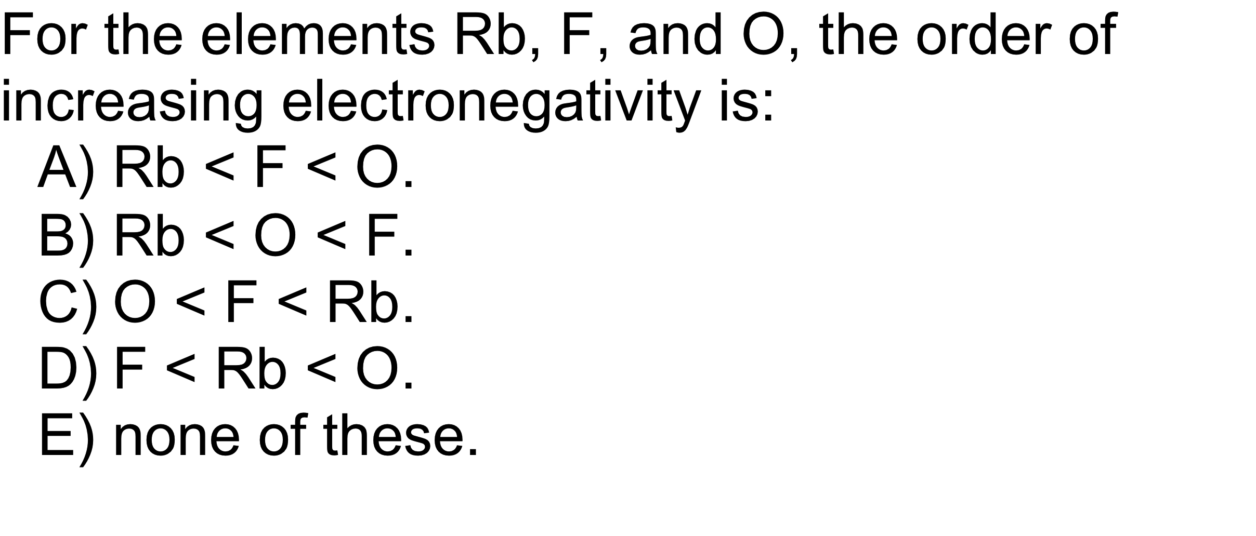
QUESTION

Slide 24
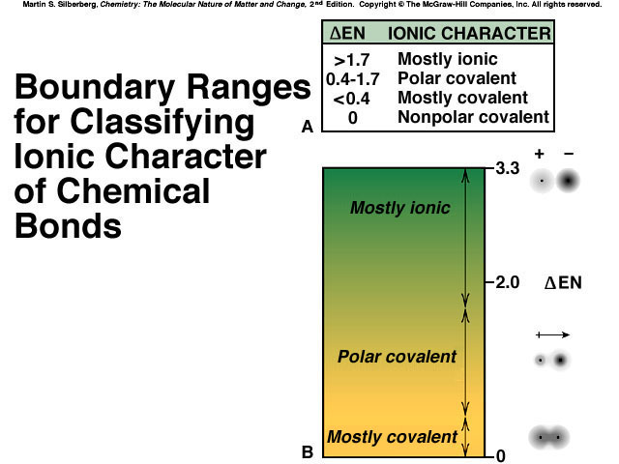

Slide 25
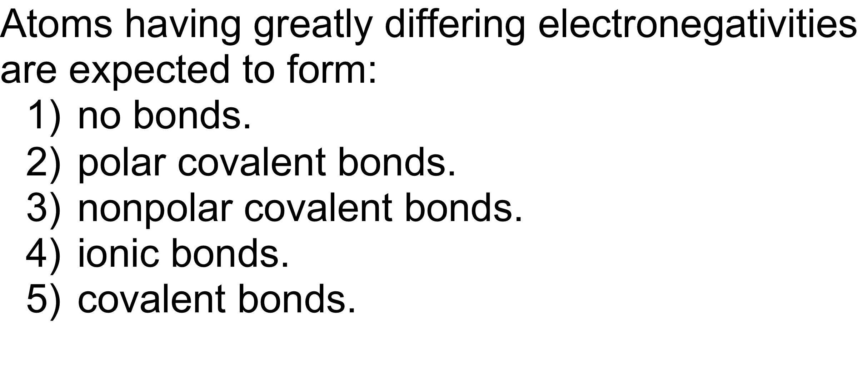
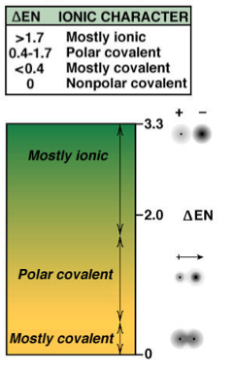
QUESTION

Slide 26
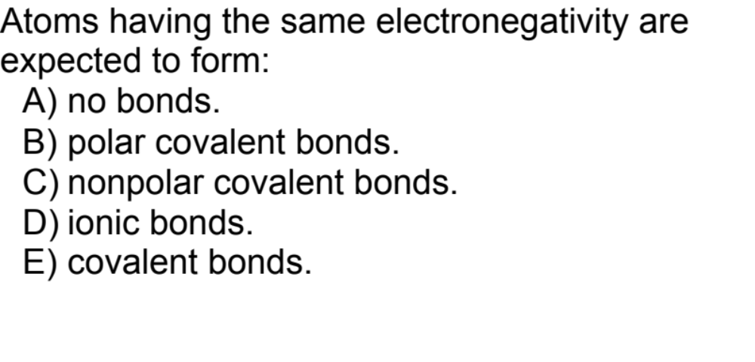
QUESTION

Slide 27




Question
Which of the following bonds is the most polar?
A) B)
C) D)

Slide 28
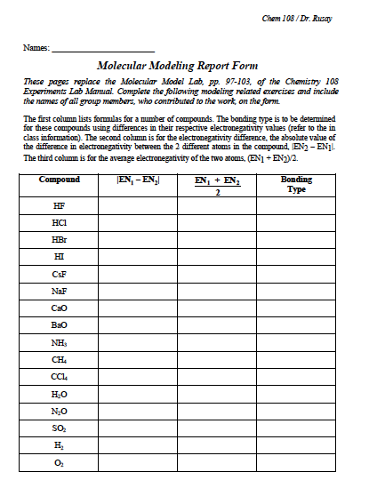
(Collaborative)
BondingH? and F?
4.0 – 2.1 = 1.9
3.0
polar covalent

Slide 29
(Collaborative)
BondingH? and F?
4.0 – 2.1 = 1.9
3.0
polar covalent
Complete first & second pages.
To be checked in lab.

Slide 30
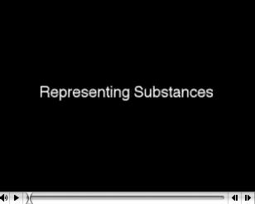
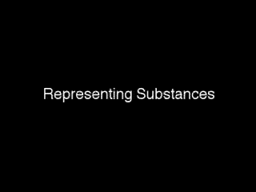
Chemical Formulas &
Molecular Representations
http://chemconnections.org/general/movies/Representations.MOV

Slide 31
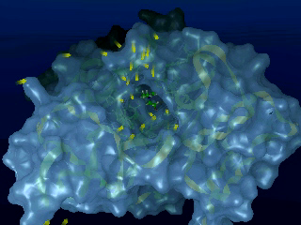
Proteins & Small Molecules
The interaction of a large protein bio-polymer, acetylcholinesterase, with a relatively small molecule of acetylcholine. A general process similar to the way that scientists that think we smell and many physiological processes.
http://chemconnections.org/general/movies/richard.mpg

Slide 32
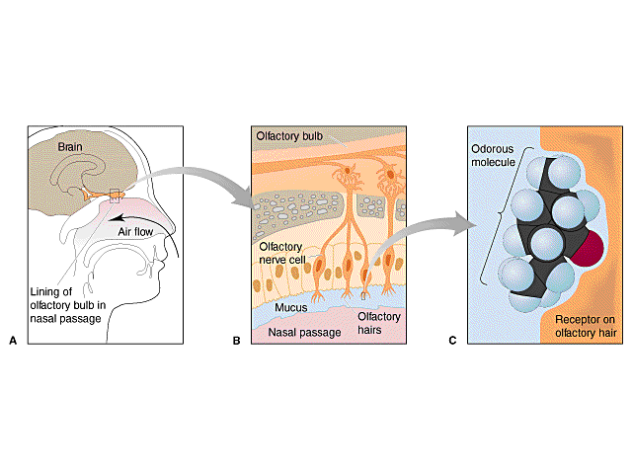
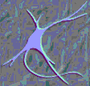
Detecting stuff we cannot see: the Sense of Smell
Models, Theories & Interactions
http://chemconnections.org/organic/chem226/Labs/Smell/smell-links.html
The Nobel Prize in Physiology or Medicine (2004)
Richard Axel and Linda B. Buck
“Odorant receptors and the organization of the olfactory system"
Structure-Odor Relationships
Karen J. Rossiter, Chem. Rev., 1996, 96, 3201-3240

Slide 33
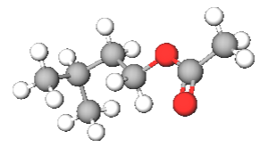
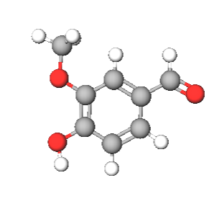
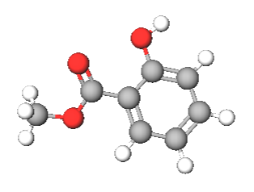
Vanillin (Smell)
Sensitivity
~ 1 x 10⁻⁵ mol / m³_{air}
isoamyl acetate
(banana)
Vanillin (C₈H₈O₃)
methyl salicylate
(wintergreen)

