Slide 1
Organic Molecules
Functional Group Overview
Dr. Ron Rusay

Slide 2
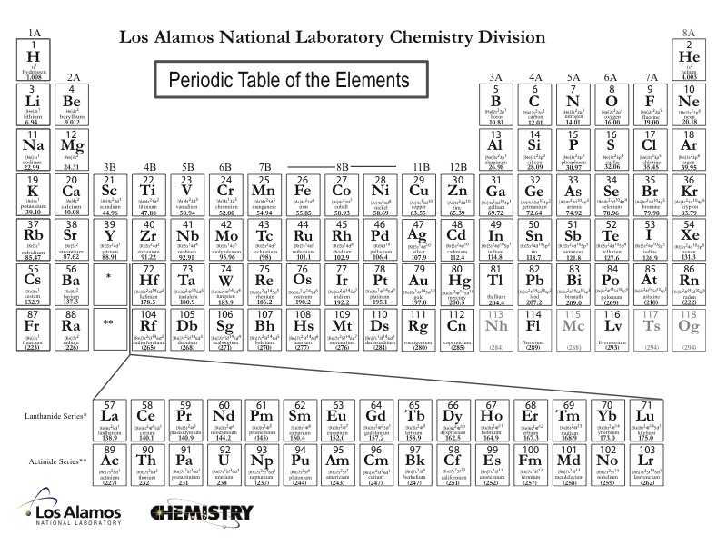
Elemental building blocks for all organic molecules
Notes:
Discipline-Based Education Research: Understanding and
Improving Learning in Undergraduate Science and Engineering
Susan R. Singer, Natalie R. Nielsen, and Heidi A. Schweingruber, Editors
ISBN 978-0-309-25411-3 | DOI 10.17226/13362 2012
Effective instruction involves a range of
approaches, including making lectures more interactive, having students
work in groups, and incorporating authentic problems and activities.
Students who go on to have successful careers in science or engineering
must be problem solvers, skilled in quantitative reasoning and modeling,
effective at communication and cross-disciplinary collaboration, and cognizant
of relationships between science and society (Brewer and Smith,
2011). Students who do not pursue these careers need to understand science
and engineering to serve in their roles as citizens, consumers, and leaders
of business and government who need to make wise science-informed
decisions in their personal and professional lives. Choosing healthcare for
one’s children, buying a car, voting about land-use regulations, or retrofitting
one’s house or business to be more earthquake-resistant are but a few
of the decisions that today’s undergraduates may face. Their decisions on
these and other issues will be based, in part, on their confidence in the
methods of science and engineering and their understanding of the findings
of science and engineering.
The importance of science and engineering in preparing the technical
workforce and a science-literate citizenry has drawn increased attention to
the quality of undergraduate science and engineering education and how it
can be improved. There are persistent concerns that undergraduate science
and engineering courses are not providing students with high-quality learning
experiences, nor are they attracting and retaining students in science
and engineering fields (President’s Council of Advisors on Science and Technology,
2012). Colleges and universities also face the challenge of serving
an increasingly socially, economically, and ethnically diverse undergraduate
population entering college classrooms directly from high school, after a
military career or other life experiences, or from postsecondary educational
experiences at another institution. Sustained attention to motivating, engaging
and supporting the learning of all students who enter college science
and engineering classrooms is an imperative.

Slide 3
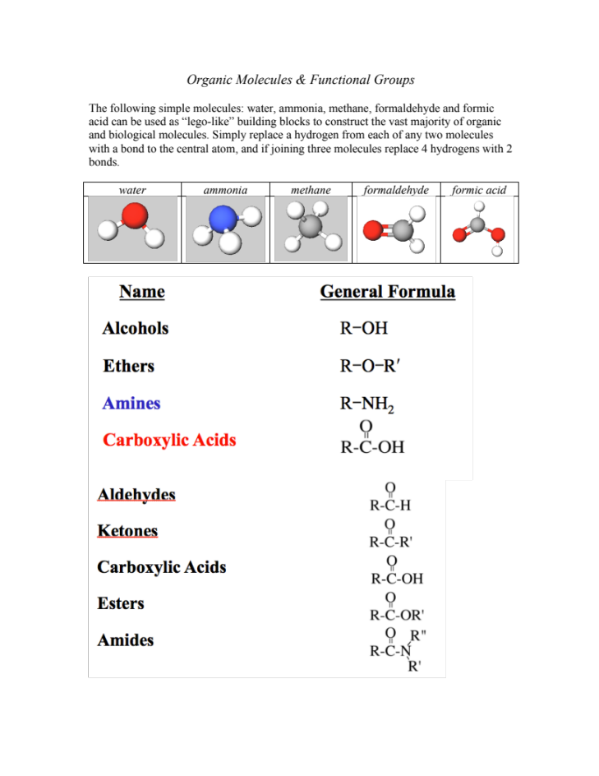
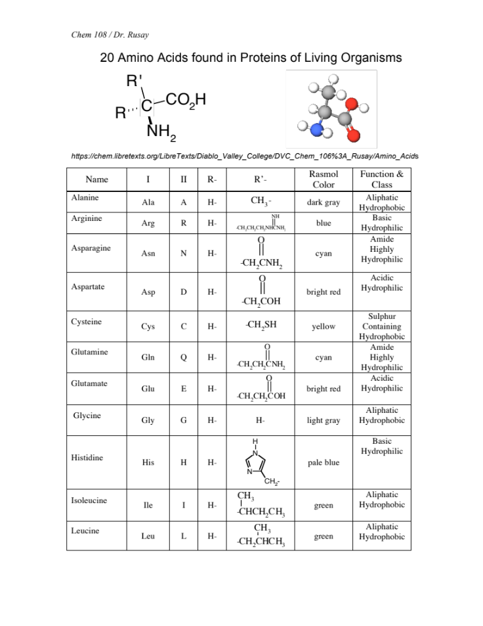
Functional Groups & Amino Acids

Slide 4
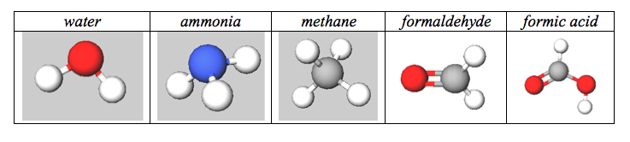
Shapes, Functions & Structural Analogies
Water, Ammonia, Methane
Plus C=O “carbonyls”
Organic Molecules
Notes:
1

Slide 5


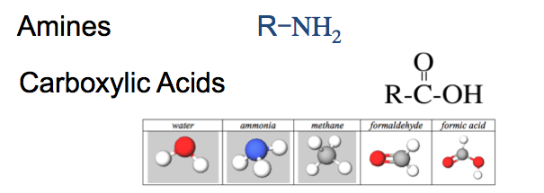
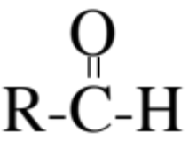
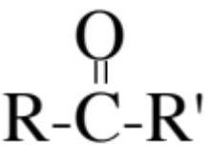
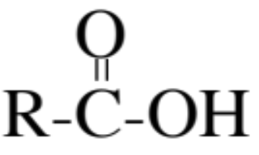
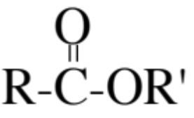
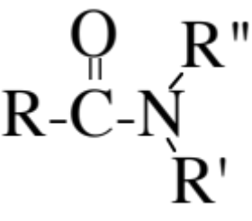
Amino acids: two functions, an acid & a base, in the same molecule
Functions
 | Alcohol | R−ΟΗ
 | Ether | R−Ο−R′
X | Amine | R−ΝΗ₂
 | Aldehyde
 | Ketone
X | Carboxylic Acid
 | Ester
 | Amide
https://www.youtube.com/watch?v=JQZQiEdOPJY

Slide 6
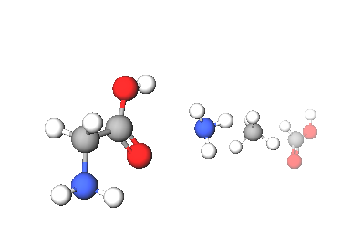
Amino Acids
Legos of Chemical Biology
Amino acids containing carbon, hydrogen, oxygen, and nitrogen, which resemble the following shapes & structural components
20 different amino acids are encoded in humans’ genetic code, which is archived in DNA.
Hundreds of amino acids link together with amide (peptide) bonds to form proteins, which provide the machinery and molecular structures for the chemistry of life.
There are less than 20,000 total proteins produced from humans’ entire genome, each coded by a specific gene in DNA’s ~3 billion genetic bases.
http://chem.libretexts.org/LibreTexts/Diablo_Valley_College/DVC_Chem_106%3A_Rusay/Amino_Acids
Notes:
http://www.jbc.org/content/262/2/549.short
http://pdb101.rcsb.org/motm/54
http://www.rcsb.org/pdb/explore/jmol.do?structureId=1CFJ&bionumber=1

Slide 7
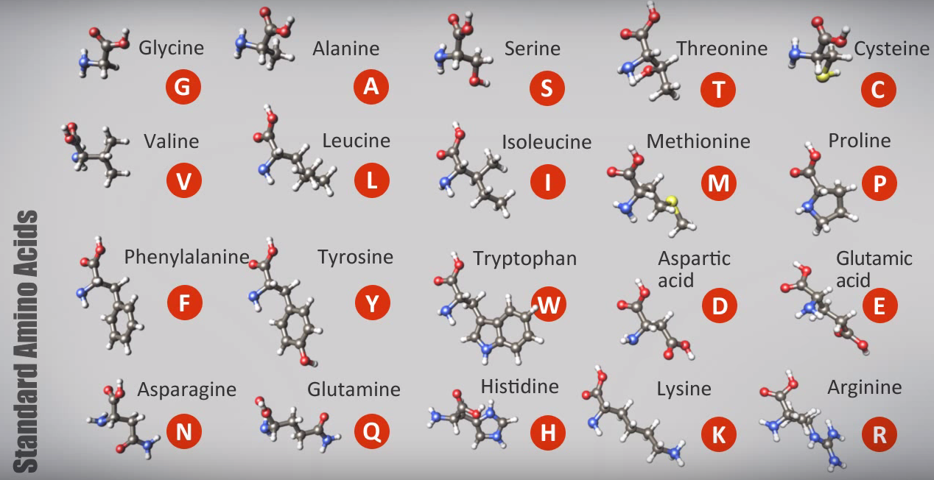
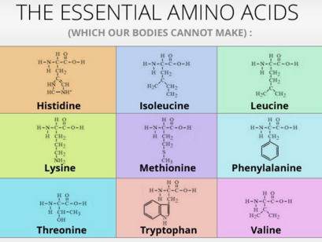
Amino Acids
Legos of Chemical Biology
All amino acids contain C, H, O, and N; two, C & M. also have sulfur.
http://chem.libretexts.org/LibreTexts/Diablo_Valley_College/DVC_Chem_106%3A_Rusay/Amino_Acids
Notes:
http://www.jbc.org/content/262/2/549.short
http://pdb101.rcsb.org/motm/54
http://www.rcsb.org/pdb/explore/jmol.do?structureId=1CFJ&bionumber=1

Slide 8
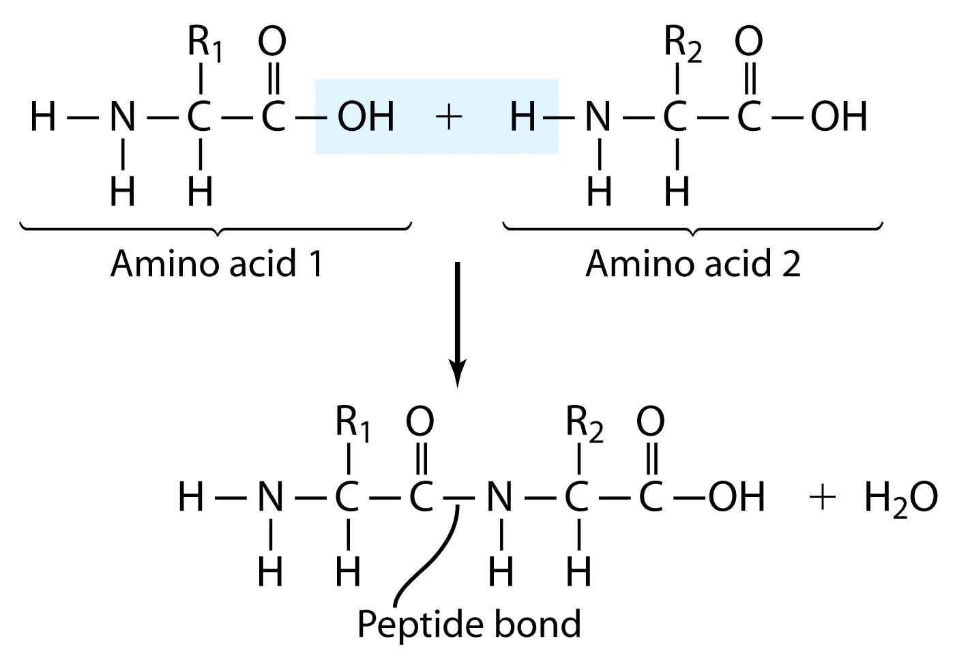
(Amide bond)

Slide 9
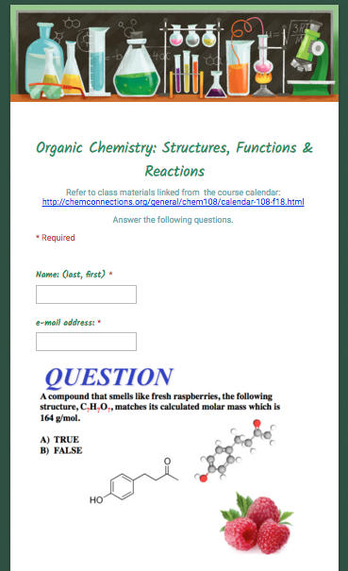
http://chemconnections.org/general/chem108/Organic%20Chemistry%20Guide.html

Slide 10
Organic Molecules
Common Functional Groups
Name General Formula
Alcohols R−ΟΗ
Ethers R−Ο−R′
Amines R−ΝΗ₂
Carboxylic Acids
R′− or R− represents any generic carbon atom bonded in the functional group

Slide 11
Organic Molecules
Common Functional Groups
Name General Formula
Aldehydes
Ketones
Carboxylic Acids
Esters
Amides
R′− or R− represents any generic carbon atom bonded in the functional group

Slide 12
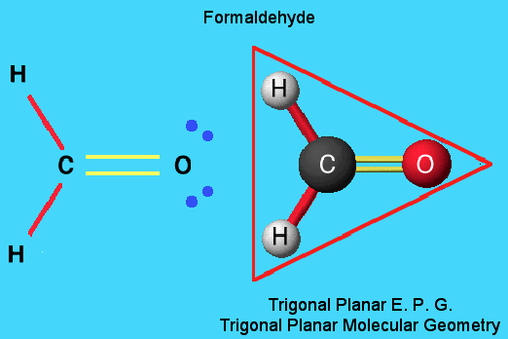
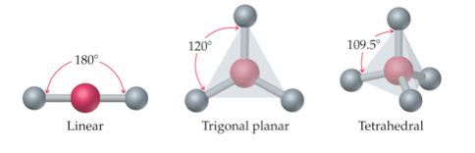
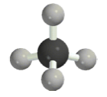
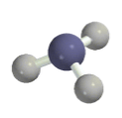
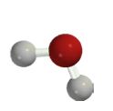
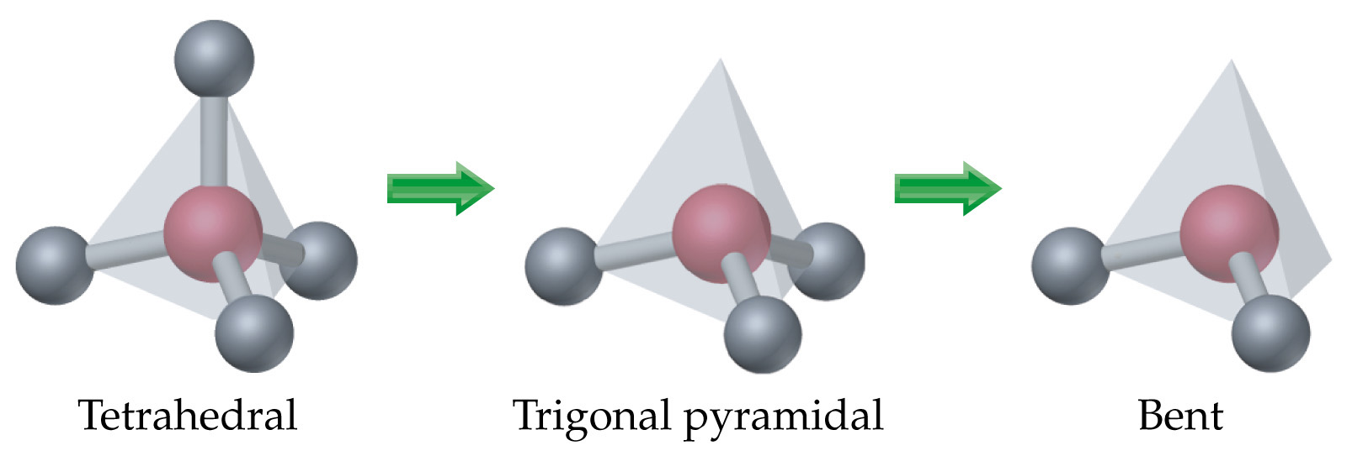
Molecular Models for C, H, N, O
Fundamental repeating shapes found in every biological molecule
C =black
H = gray
N = blue
O = oxygen
pink = generic atom

Slide 13
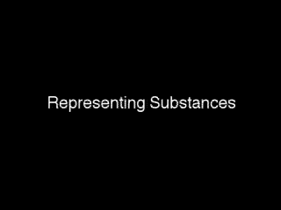
Representing Organic Molecules
http://chemconnections.org/general/movies/Representations.MOV
Notes:
Discipline-Based Education Research: Understanding and
Improving Learning in Undergraduate Science and Engineering
Susan R. Singer, Natalie R. Nielsen, and Heidi A. Schweingruber, Editors
ISBN 978-0-309-25411-3 | DOI 10.17226/13362 2012
Effective instruction involves a range of
approaches, including making lectures more interactive, having students
work in groups, and incorporating authentic problems and activities.
Students who go on to have successful careers in science or engineering
must be problem solvers, skilled in quantitative reasoning and modeling,
effective at communication and cross-disciplinary collaboration, and cognizant
of relationships between science and society (Brewer and Smith,
2011). Students who do not pursue these careers need to understand science
and engineering to serve in their roles as citizens, consumers, and leaders
of business and government who need to make wise science-informed
decisions in their personal and professional lives. Choosing healthcare for
one’s children, buying a car, voting about land-use regulations, or retrofitting
one’s house or business to be more earthquake-resistant are but a few
of the decisions that today’s undergraduates may face. Their decisions on
these and other issues will be based, in part, on their confidence in the
methods of science and engineering and their understanding of the findings
of science and engineering.
The importance of science and engineering in preparing the technical
workforce and a science-literate citizenry has drawn increased attention to
the quality of undergraduate science and engineering education and how it
can be improved. There are persistent concerns that undergraduate science
and engineering courses are not providing students with high-quality learning
experiences, nor are they attracting and retaining students in science
and engineering fields (President’s Council of Advisors on Science and Technology,
2012). Colleges and universities also face the challenge of serving
an increasingly socially, economically, and ethnically diverse undergraduate
population entering college classrooms directly from high school, after a
military career or other life experiences, or from postsecondary educational
experiences at another institution. Sustained attention to motivating, engaging
and supporting the learning of all students who enter college science
and engineering classrooms is an imperative.

Slide 14
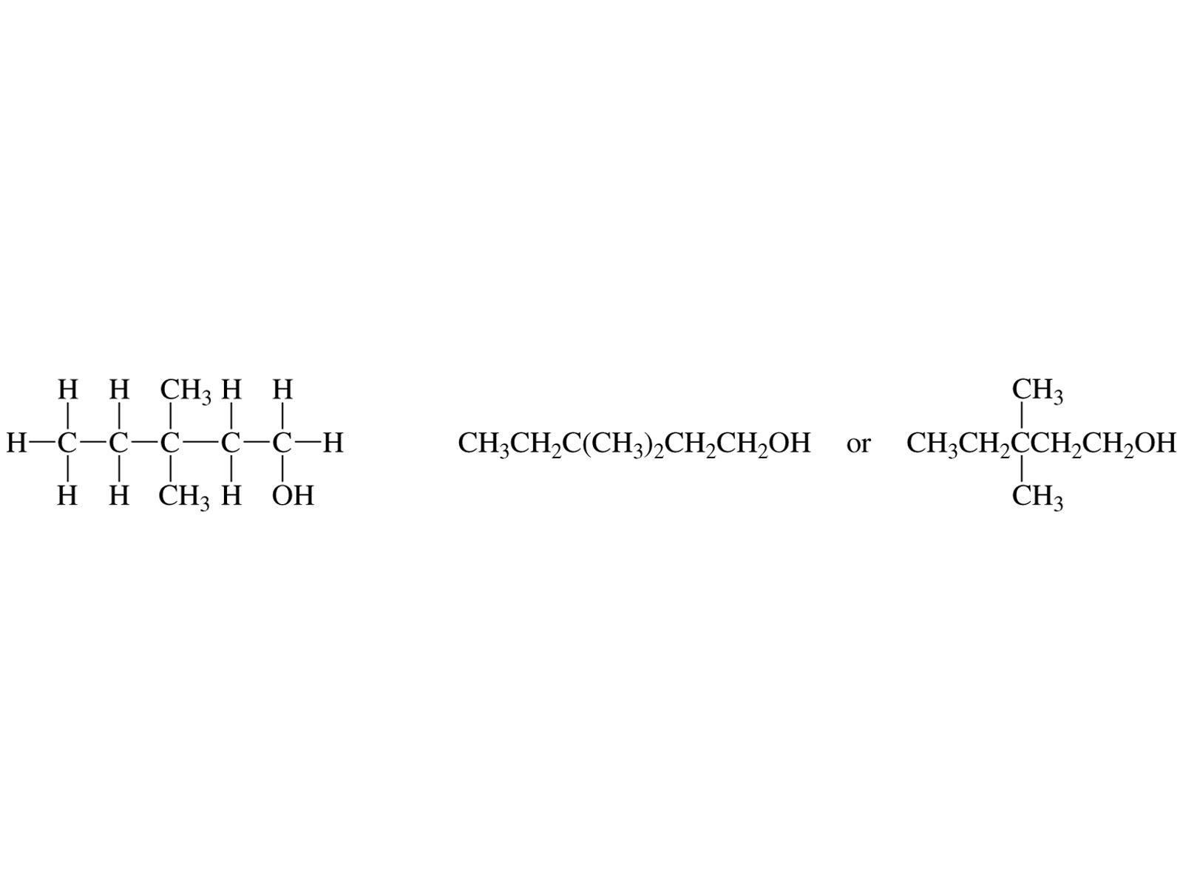
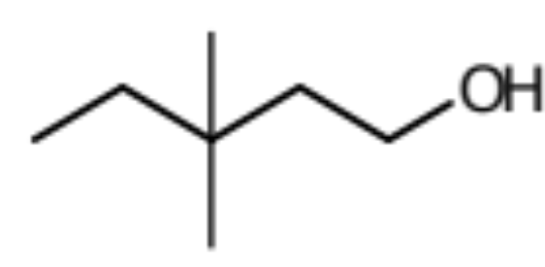
Representing Organic Molecules
Common Formulas & Drawings
Molecular formula:
C₇H₁₆O
Empirical Formula:
C₇H₁₆O
Condensed Structure:
Bond-Line Structure:

Slide 15
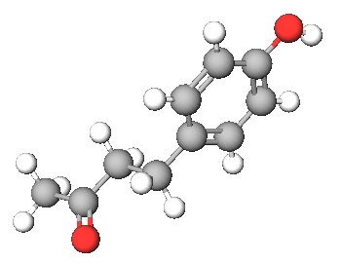
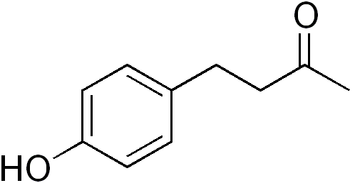
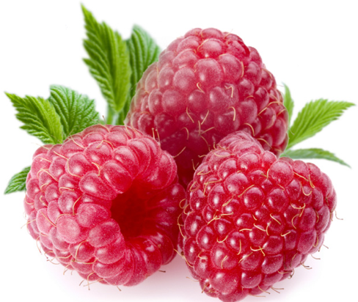
QUESTION
A compound that smells like fresh raspberries, the following structure, C?H?O?, matches its calculated molar mass which is 164 g/mol.
A) TRUE
B) FALSE
Organic Chemistry: Structures, Functions & Reactions
http://chemconnections.org/general/chem108/Organic%20Chemistry%20Guide.html

Slide 16
QUESTION
Select the function(s) in the molecule
 | Alcohol | R−ΟΗ
 | Ether | R−Ο−R′
 | Amine | R−ΝΗ₂
 | Aldehyde
 | Ketone
 | Carboxylic Acid
 | Ester
 | Amide

Slide 17
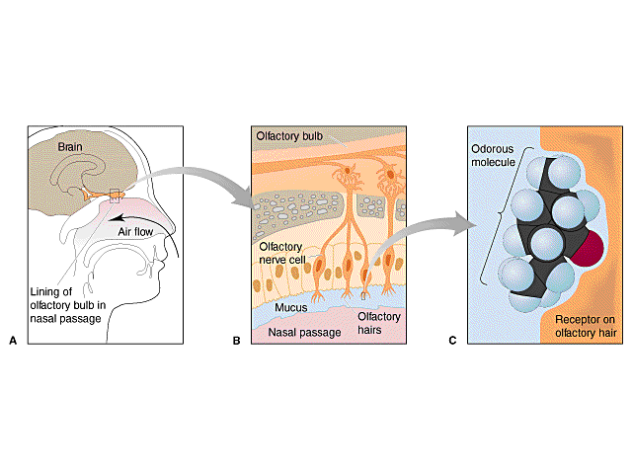
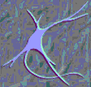
Detecting stuff we cannot see: the Sense of Smell
Models, Theories & Interactions
http://chemconnections.org/organic/chem226/Labs/Smell/smell-links.html
Structure-Odor Relationships
Karen J. Rossiter, Chem. Rev., 1996, 96, 3201-3240

Slide 18
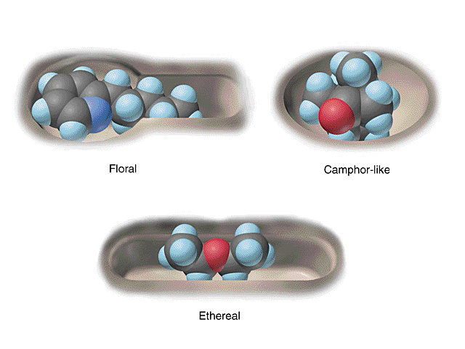
Historical view of a few smell receptors.
4 October 2004
The Nobel Assembly at Karolinska Institutet has today decided to award
The Nobel Prize in Physiology or Medicine for 2004
jointly to
Richard Axel and Linda B. Buck
for their discoveries of
"odorant receptors and the organization of the olfactory system"
http://chemconnections.org/organic/chem226/Labs/Smell/ChemComm.html
Notes:
They discovered a large gene family, comprised of some 1,000 different genes (three per cent of our genes) that give rise to an equivalent number of olfactory receptor types. These receptors are located on the olfactory receptor cells, which occupy a small area in the upper part of the nasal epithelium and detect the inhaled odorant molecules.

Slide 19
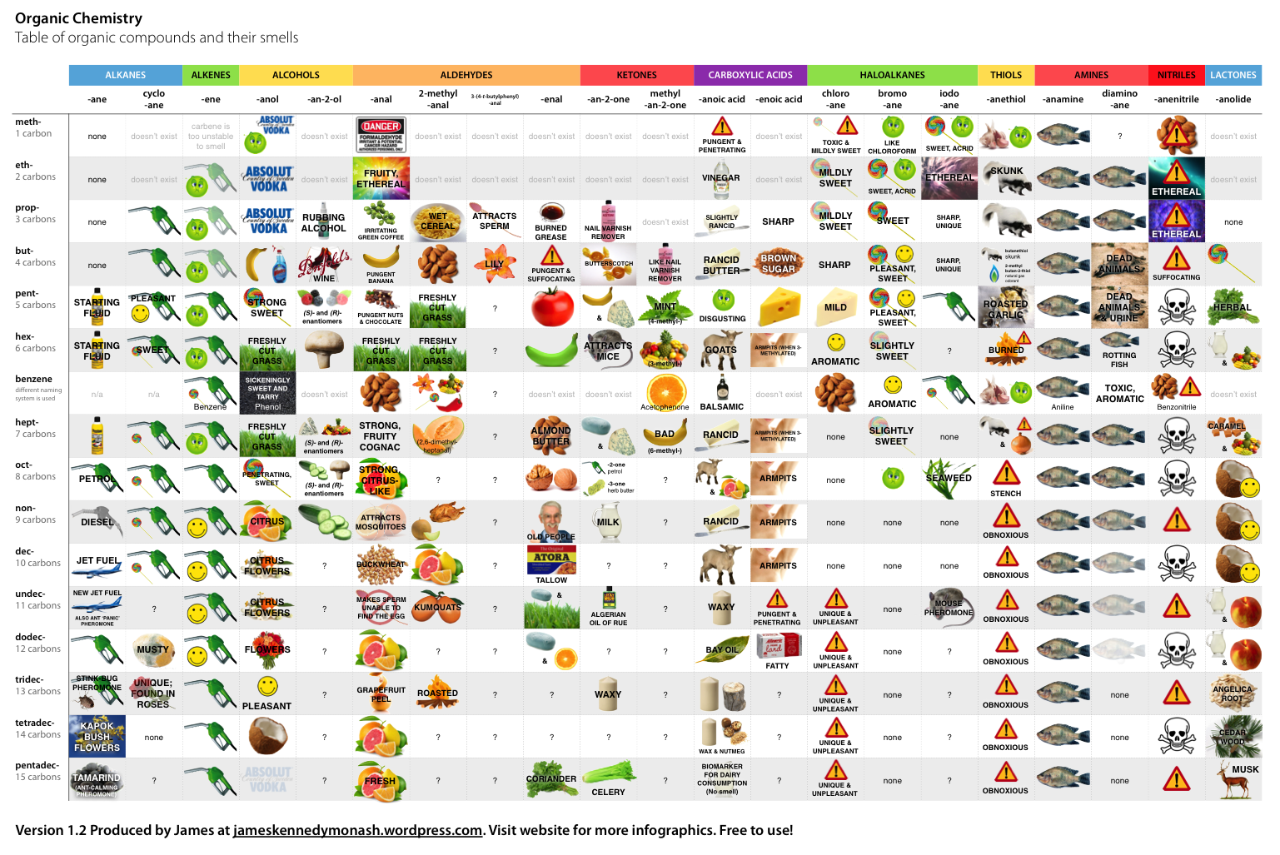
Organic Functions & Smell Receptors.
Notes:
Marcel Proust, was a French novelist, critic, and essayist best known for his monumental novel À la recherche du temps perdu (In Search of Lost Time; earlier rendered as Remembrance of Things Past), published in seven parts between 1913 and 1927. He is considered by critics and writers to be one of the most influential authors of the 20th century.[
1

Slide 20
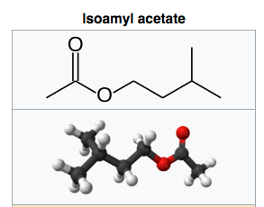
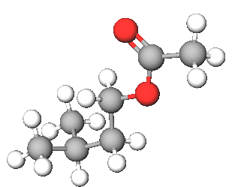
One molecule, one function: One Smell Receptor
Isoamyl acetate, also known as isopentyl acetate, is formed from isoamyl alcohol and acetic acid. It is a colorless liquid that is only slightly soluble in water, but very soluble in most organic solvents. Isoamyl acetate has a strong odor which is also described as similar to both banana and pear.[3] Banana oil may be either pure isoamyl acetate, or flavorings that are mixtures of isoamyl acetate, amyl acetate, and other flavors.
C₇H₁₄O₂
Notes:
Marcel Proust, was a French novelist, critic, and essayist best known for his monumental novel À la recherche du temps perdu (In Search of Lost Time; earlier rendered as Remembrance of Things Past), published in seven parts between 1913 and 1927. He is considered by critics and writers to be one of the most influential authors of the 20th century.[
1

Slide 21
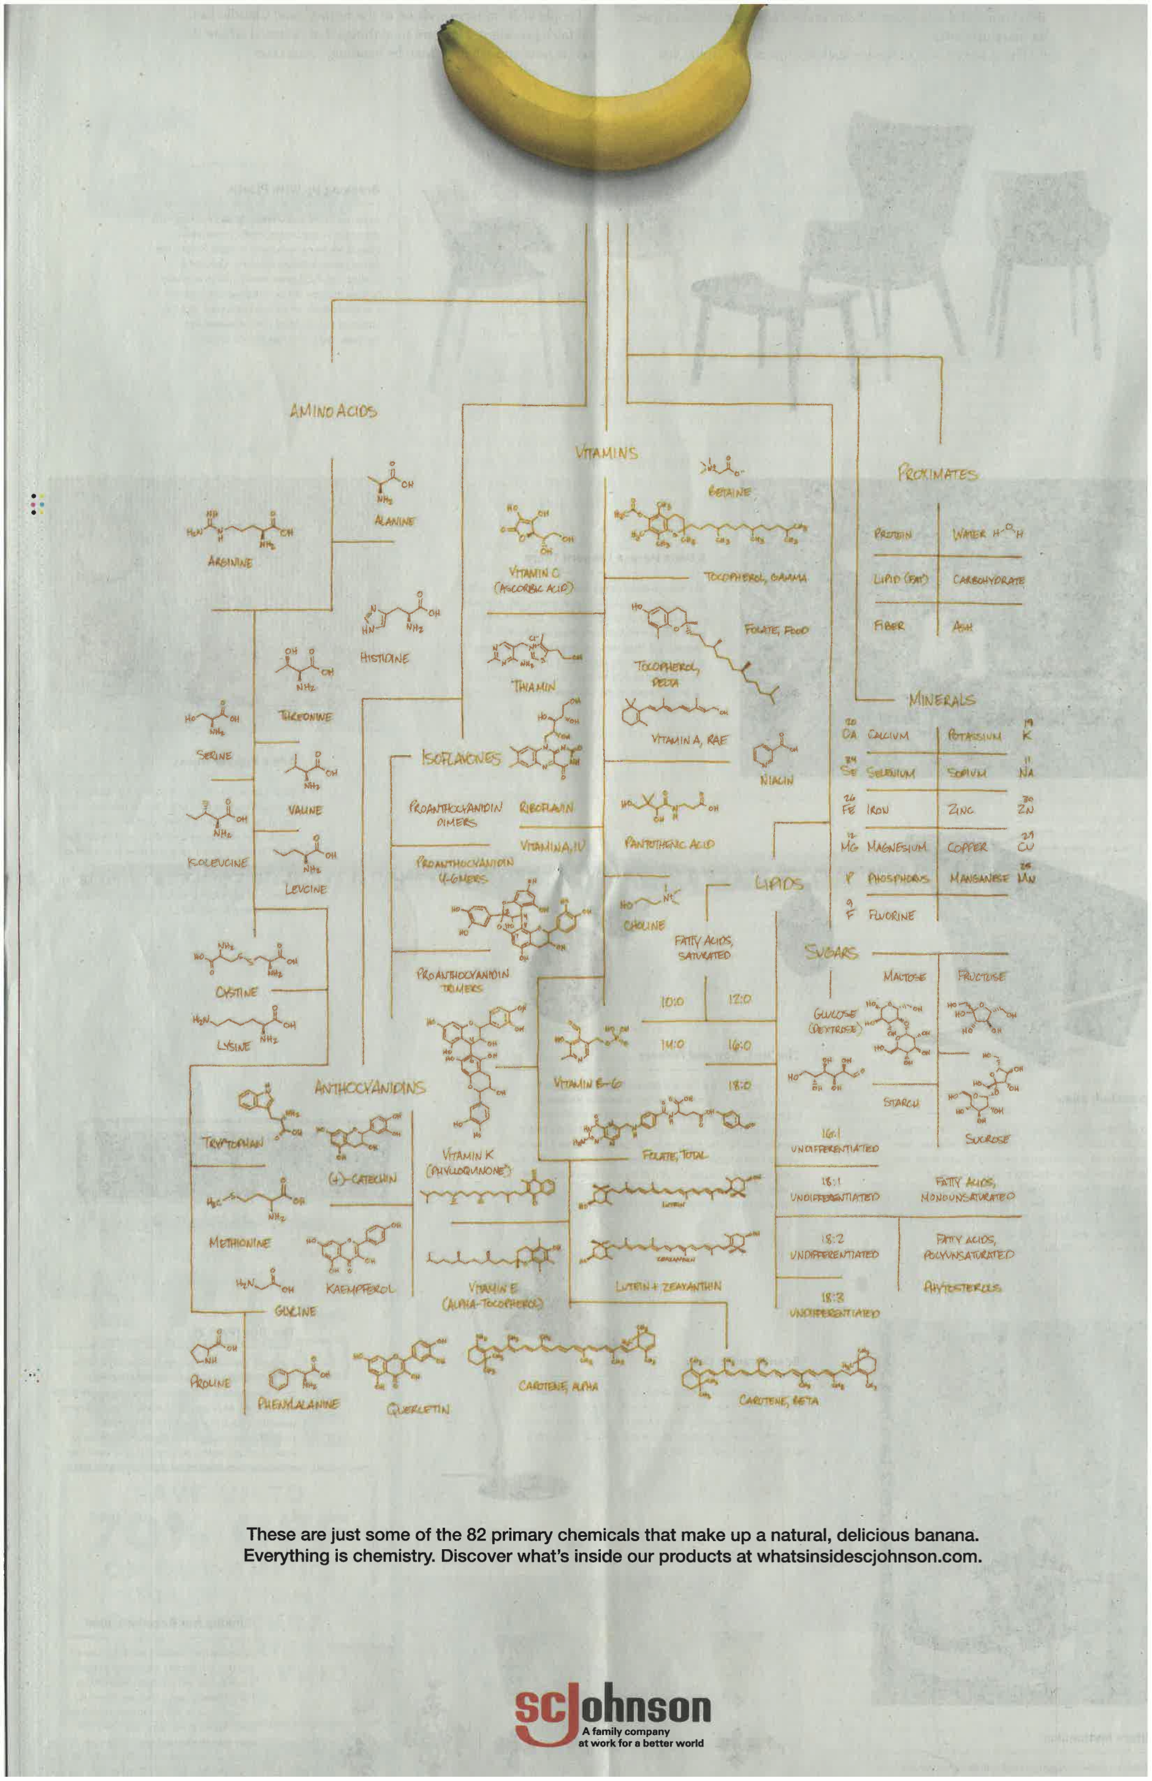
One molecule among 82 primary chemicals found in bananas:
C₇H₁₄O₂
Notes:
Marcel Proust, was a French novelist, critic, and essayist best known for his monumental novel À la recherche du temps perdu (In Search of Lost Time; earlier rendered as Remembrance of Things Past), published in seven parts between 1913 and 1927. He is considered by critics and writers to be one of the most influential authors of the 20th century.[
1

Slide 22
QUESTION
C₇H₁₄O₂
The function in isoamyl acetate’s structure is a(n):
Alcohol
Aldehyde
Ketone
Ester
Carboxylic Acid
Notes:
Marcel Proust, was a French novelist, critic, and essayist best known for his monumental novel À la recherche du temps perdu (In Search of Lost Time; earlier rendered as Remembrance of Things Past), published in seven parts between 1913 and 1927. He is considered by critics and writers to be one of the most influential authors of the 20th century.[
1

Slide 23
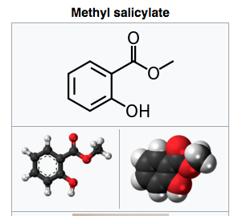
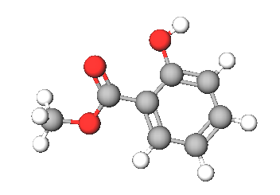
One molecule, two functions: One Smell Receptor
Methyl salicylate (oil of wintergreen or wintergreen oil) is naturally produced by many species of plants, particularly wintergreens. It is also synthetically produced, used as a fragrance, in foods and beverages, and in liniments.
C₈H₈O₃
Notes:
Methyl salicylate (oil of wintergreen or wintergreen oil) is an organic ester naturally produced by many species of plants, particularly wintergreens. It is also synthetically produced, used as a fragrance, in foods and beverages, and in liniments.
The compound methyl salicylate was first isolated (from the plant Gaultheria procumbens) in 1843 by the French chemist Auguste André Thomas Cahours (1813–1891), who identified it as an ester of salicylic acid and methanol.[4]
1

Slide 24
QUESTION
C₈H₈O₃
One of the functions, an ester, is circled. What is the other function?:
Alcohol
Ether
Ketone
Aldehyde
Carboxylic Acid
Notes:
Methyl salicylate (oil of wintergreen or wintergreen oil) is an organic ester naturally produced by many species of plants, particularly wintergreens. It is also synthetically produced, used as a fragrance, in foods and beverages, and in liniments.
The compound methyl salicylate was first isolated (from the plant Gaultheria procumbens) in 1843 by the French chemist Auguste André Thomas Cahours (1813–1891), who identified it as an ester of salicylic acid and methanol.[4]
1

Slide 25
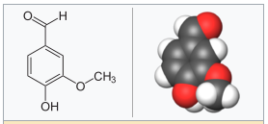
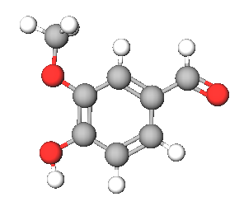
One molecule, three functions: One Smell Receptor
Vanillin
An extract of the cured, full-grown, unripe fruit of an orchid produces a popular flavoring. The natural extract sells for ~ $1500/kg versus ~ $20/kg for the synthetic version. The structure of the compound that is responsible for the smell/flavor is shown to the right. The Guinness Book of World Records once listed this compound as having the lowest smell detection limit of all chemicals (2 x 10 ^{–11} g per 1,000 cm³ of air).
Bonus:
The space (volume) of the Oakland Coliseum Arena, aka Oracle Arena, is approximately 90,000,000 ft³. If 1.00g of the compound were released at center court, and was completely and evenly dispersed throughout the building, would you smell it sitting in sec. 204, row H, seat 121? Show your calculation. (1 ft³ = 0.0283 m³)
Notes:
Marcel Proust, was a French novelist, critic, and essayist best known for his monumental novel À la recherche du temps perdu (In Search of Lost Time; earlier rendered as Remembrance of Things Past), published in seven parts between 1913 and 1927. He is considered by critics and writers to be one of the most influential authors of the 20th century.[
1

Slide 26
QUESTION
Vanillin
One of the functions, an alcohol, is circled. What are the other two functions?:
Aldehyde + Ketone
Carboxylic Acid + Ester
Ketone + Ether
Aldehyde + Ether
Carboxylic Acid + Aldehyde
Notes:
Methyl salicylate (oil of wintergreen or wintergreen oil) is an organic ester naturally produced by many species of plants, particularly wintergreens. It is also synthetically produced, used as a fragrance, in foods and beverages, and in liniments.
The compound methyl salicylate was first isolated (from the plant Gaultheria procumbens) in 1843 by the French chemist Auguste André Thomas Cahours (1813–1891), who identified it as an ester of salicylic acid and methanol.[4]
1

Slide 27
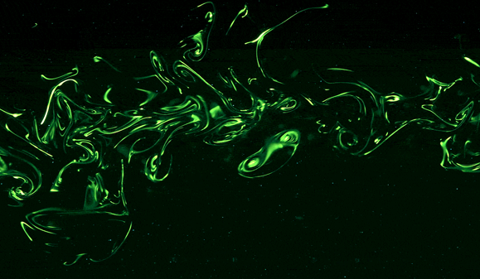
What a smell looks like
https://www.youtube.com/watch?v=58U52lDTuvk&list=PLgawtcOBBjr9I-NDoUX-HmTQr_VN465G2&index=3

Slide 28
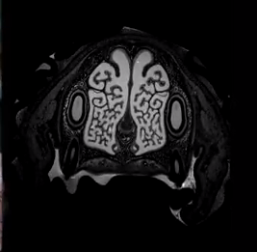
Inside the extraordinary nose of a search-and-rescue dog
https://www.youtube.com/watch?v=FLH36ML8IEU

Slide 29

Dogs Can Smell Cancer - Secret Life of Dogs - BBC
https://www.youtube.com/watch?v=e0UK6kkS0_M

Slide 30
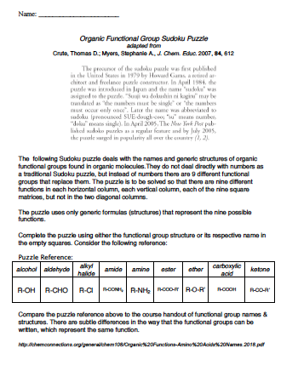
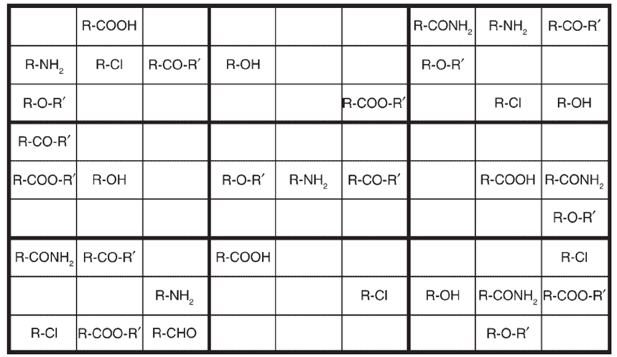

Slide 31
Organic Molecules
Functional Groups
Proteins
Amines, Carboxylic Acids
Amides (Peptides)
Dr. Ron Rusay
Physiological reactions (metabolism) of one gram of protein produces 4 to 5 Calories (kcal), which is enough energy to raise the water in your body about 1 ºC.

Slide 32
(Amide bond)

Slide 33
Proteins: Macromolecular Biopolymers
Structural proteins: Collagen
  Connectin proteins, β - MW of 2.1 million g/mol; length = 1000 nm; can stretch to 3000 nm.
Mechanical (Contractile) proteins: Actin, Myosin
Transport proteins: Hemoglobin
Enzymes: Glutamine synthetase - 12 subunits of 468 residues each; total mol. wt. = 600,000 daltons
Regulatory proteins: Insulin - α -alpha chain of 21 residues, β - beta chain of 30 residues; total mol. wt. of 5,733 amu
Specialized proteins: Antifreeze in fish
A gene was first defined as: one piece of DNA that codes for one protein. (The definition is being expanded beyond proteins to include certain types of RNA.)

Slide 34
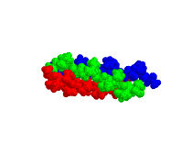
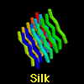

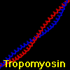
Collagen: connective tissue
Proteins: Macromolecular Biopolymers
Examples of Structural Proteins
Notes:
Representative Proteins -
Keratin Fibrous Found in hair, wool, skin, fingernails, .. Primarily a-helix Doesn't contain proline Disulfide bridges between helices increase strength
Collagen Fibrous Connective Tissue - Most abundant protein in vertebrates
Triple helix Within each chain: Gly-X-Y where X and Y often proline
Hydroxylation increases strength
X-ray diffraction of a crystal of chicken muscle myosin has revealed the molecular structure of the crossbridges. The fulcrum in the animation is nothingbut pure imagination. It is likely that movement is much more distributed than that shown. There is also likely to be considerable movement at the actin-myosin interface. Each myosin molecule contains two peptide heavy chains which are cleaved enzymatically to produce a myosin tail and two globular heads or crossbridges. The crossbridge heavy chain has a tail region (shown in blue) around which two smaller peptides wrap. These peptides are the light chains (yellow and red) which stabilize, and in some cases, regulate the myosin. With due acknowledgements to Rayment et al. (1993) Science 261: 50-58

Slide 35

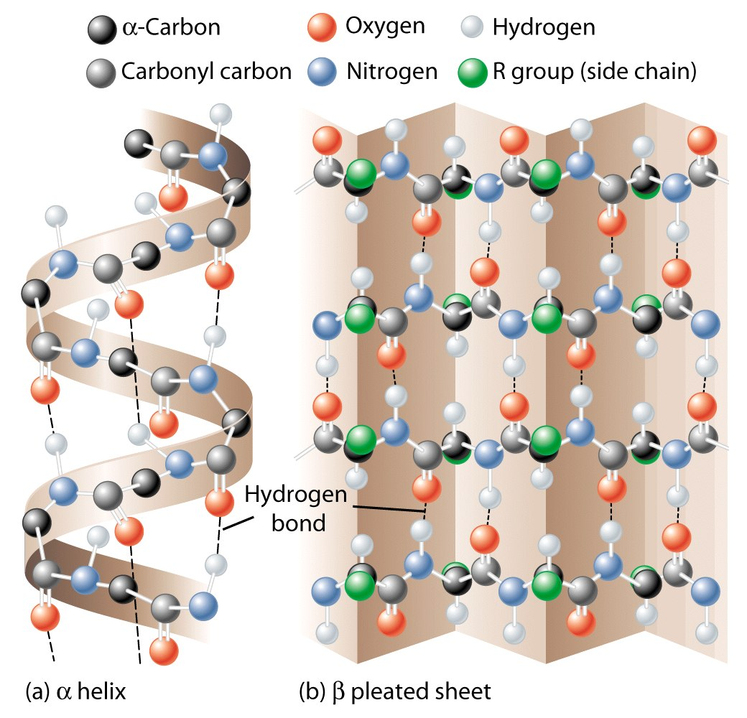
Structural Proteins:
Silk
β-Sheets
http://chemconnections.org/general/movies/proteins-silk-2.mov

Slide 36
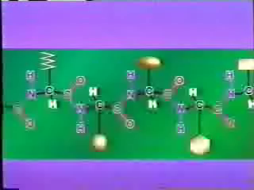
Structural Proteins:
α-Helix
Curly Hair
http://chemconnections.org/general/movies/protein-hair-2.mov
Annenberg World of Chemistry
#23 Proteins : http://www.learner.org/resources/series61.html

Slide 37
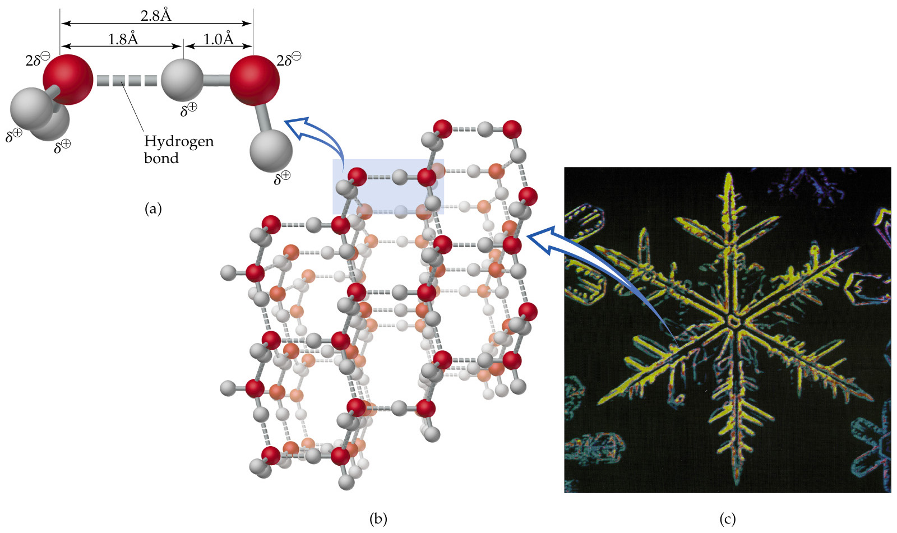
Intra- & Inter-molecular
Hydrogen Bonding
Inter-molecular
Hydrogen Bonds
α-Helix
β-Sheets
Intra-molecular
Hydrogen Bonds
http://chemconnections.org/general/movies/ice-structure.MOV

Slide 38
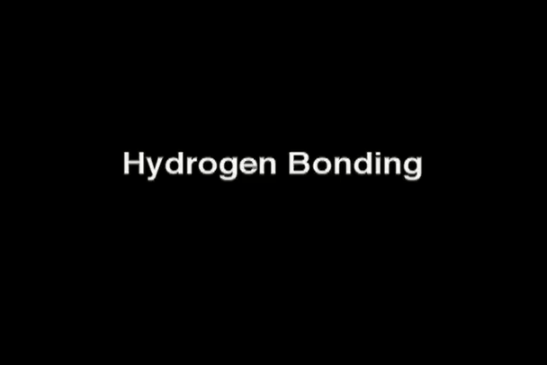
http://chemconnections.org/general/movies/HydrogenBonding.MOV

Slide 39
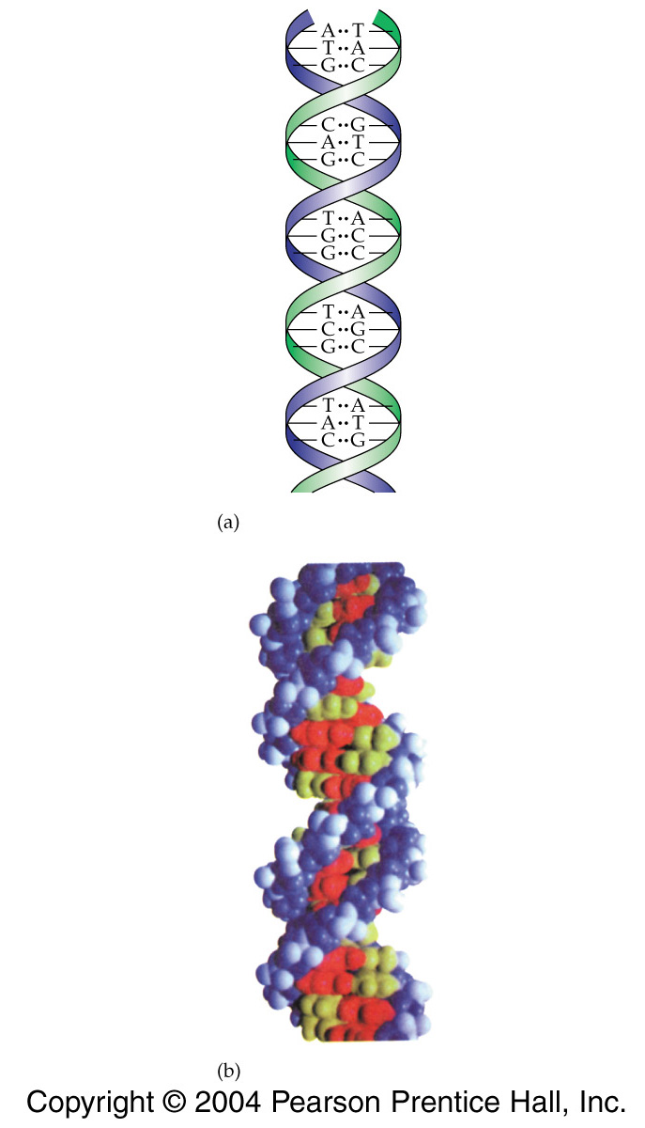




DNA: Shape & Hydrogen Bonding
http://www.umass.edu/microbio/chime/beta/pe_alpha/atlas/atlas.htm
Views & Algorithms
Uracil
10.85 Å
10.85 Å
Chemical Biology
DNA  RNA  Proteins
Uracil
Notes:
15-23
Title:
Base Pairs
Caption:
Representation of the base pairings of thymine and adenine, and cytosine and guanine, in line as well as ball-and-stick models.
Notes:
Base pairs occur through hydrogen bonding.

Slide 40

https://www.youtube.com/watch?v=gG7uCskUOrA
Chemical Biology
DNA  RNA  Proteins
https://www.youtube.com/watch?v=X_tYrnv_o6A

Slide 41




Mechanical proteins:
Pathogens & Cell Invasion http://chemconnections.org/organic/chem226/Announcements-info/Staph-infection/infection.html
myosin-actin: muscle
Michael Ferenczi
Streptococcus pyogenes
96,000 x
Vincent A. Fischetti Ph.D., Rockefeller University
http://www.chm.bris.ac.uk/motm/motm.htm
Notes:
Representative Proteins -
Keratin Fibrous Found in hair, wool, skin, fingernails, .. Primarily a-helix Doesn't contain proline Disulfide bridges between helices increase strength
Collagen Fibrous Connective Tissue - Most abundant protein in vertebrates
Triple helix Within each chain: Gly-X-Y where X and Y often proline
Hydroxylation increases strength
X-ray diffraction of a crystal of chicken muscle myosin has revealed the molecular structure of the crossbridges. The fulcrum in the animation is nothingbut pure imagination. It is likely that movement is much more distributed than that shown. There is also likely to be considerable movement at the actin-myosin interface. Each myosin molecule contains two peptide heavy chains which are cleaved enzymatically to produce a myosin tail and two globular heads or crossbridges. The crossbridge heavy chain has a tail region (shown in blue) around which two smaller peptides wrap. These peptides are the light chains (yellow and red) which stabilize, and in some cases, regulate the myosin. With due acknowledgements to Rayment et al. (1993) Science 261: 50-58

Slide 42


Transport Proteins: Hemoglobin & Oxygen

Slide 43


Normal hemoglobin vs sickle cell hemoglobin
Valine replaces Glutamate
http://chemconnections.org/Presentations/Columbia/slide8-3.html
Firefox to listen

Slide 44

Catalytic Proteins: Enzymes
Acetylcholinesterase (ACE)
ACE, an enzyme, which catalyzes a key reaction in a repetitive biochemical cycle that is crucial to neurological and physiological functions in humans…. and insects among others.
4,496 atoms; 4,404 bonds
574 amino acid residues
Notes:
https://www.ncbi.nlm.nih.gov/pmc/articles/PMC5309389/
Choline is a water‐soluble B‐group vitamin, which humans must consume through their diet to remain healthy. Meat, eggs and yeast extract are great sources of choline, an essential component of cell membranes and also the precursor of the neurotransmitter acetylcholine (ACh). the ‘signal’ (the ACh) is terminated by the enzyme ACh esterase which hydrolyses ACh to choline and acetate. The beauty of this system is partly efficiency, because the choline and the acetate are rapidly (within seconds) recycled.
http://www.rcsb.org/pdb/explore/jmol.do?structureId=1CFJ&bionumber=1
http://pdb101.rcsb.org/motm/54

Slide 45

Human’s total ~ 100 x 10 ⁶ immunoproteins
Protective Proteins
Antibodies
Prolific Immunoproteins
Immunoglobin
Combinatorial syntheses from libraries of 250, 10, and 6 possible contributors
Human Genome ~20,000 proteins

Slide 46

Metabolic Pathways
&
Enzymes

Slide 48
Organic Molecules
Functional Groups
alcohols, ethers, aldehydes, ketones
Carbohydrates / Saccharides / Sugars
Dr. Ron Rusay
Physiological reactions (metabolism) of one gram of carbohydrate produces about the same energy as 1 gram of protein: 4 to 5 Calories (kcal); enough to raise the water in your body about 1 ºC.

Slide 49

Sugars (Carbohydrates)
Common Functional Groups
Name General Formula
Alcohols R−ΟΗ
Ethers R−Ο−R′
Amines R−ΝΗ₂
Carboxylic Acids

Slide 50




Sugars (Carbohydrates)
Common Functional Groups
Name General Formula
Aldehydes
Ketones
Carboxylic Acids
Esters
Amides

Slide 51
Carbohydrate (“-ose”) Formation
Photosynthesis
Light + chlorophyll an + two greenhouse gases, which provide oxygen & sugars
  n CO₂ + n H₂O C_{n} (H₂O)_{n} + n O₂
Empirical formula = CH₂O
Monosaccharides (simple sugars)
C₅ : pent-oses – rib-ose
C₆ : hex-oses – fruct-ose, gluc-ose
Can be either an ald-ose (aldehyde + alcohols) or ket-ose (ketone + alcohols)

Slide 52

Aldehyde
Aldose
Aldose or Ketose?
Aldose or Ketose?
Ketose
Aldose
C
Ketone
Ketose
n=4
2⁴
n=3
2³
There are 2^{n} possible stereoisomers, where n = the number of chiral atoms (alcohols). Glucose? Fructose? Ribose?

Slide 53

D-glucose can cyclize intramolecularly
Plus the cyclized forms of each of the sixteen, which adds a chiral carbon, D-Glucose for example:
Ethers

Slide 54


Slide 56
Organic Molecules
Functional Groups
Lipids:
fats, oils, waxes, steroids,
plant natural products (terpenes)
Dr. Ron Rusay
Fats produce 9 to 10 Calories per gram; More than twice the energy of sugars or proteins, which produce 4 to 5 Calories.

Slide 57
Lipids:
Fats & Oils
Lipids are natural plant & animal products more soluble in non-polar solvents like gasoline than in water.

Slide 58
Lipids
Common Functional Groups
Name General Formula
Alcohols R−ΟΗ
Ethers R−Ο−R′
Amines R−ΝΗ₂
Carboxylic Acids
(R is very large, note: glycerol is not a lipid)
(R is very large)

Slide 59
Lipids
Common Functional Groups
Name General Formula
Aldehydes
Ketones
Carboxylic Acids
Esters
Amides
(R is very large)
(R is very large)

Slide 60


Slide 61


Molecular Formula: C₅₇H₁₁₀O₆
Molecular weight: 891 amu; MM= 891 g/mol
kJ/mol
C₁₀ , C₁₅ , C₂₀ , etc.
Notes:
Figure: 25-01
Caption:
Complex lipids contain ester functional groups that can be hydrolyzed to acids and alcohols. Simple lipids are not easily hydrolyzed.

Slide 62



http://chemconnections.org/general/movies/fat-satd.MOV
FATS:
http://chemconnections.org/general/movies/fat-unsatd.MOV
Notes:
Figure: 25-03
Caption:
Unsaturated triglycerides have lower melting points because their unsaturated fatty acids do not pack as well in a solid lattice.

