Slide 1
Solutions I
Concentrations
Dr. Ron Rusay

Slide 2
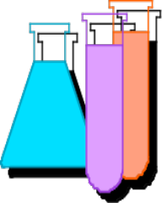
Solutions
Homogeneous solutions are comprised of solute(s), the substance(s) dissolved, [The lesser amount of the component(s) in the mixture], and
solvent, the substance present in the largest amount.
Solutions with less solute dissolved than is physically possible are referred to as “unsaturated”. Those with a maximum amount of solute are “saturated”.
Occasionally there are extraordinary solutions that are “supersaturated” with more solute than normal.

Slide 3
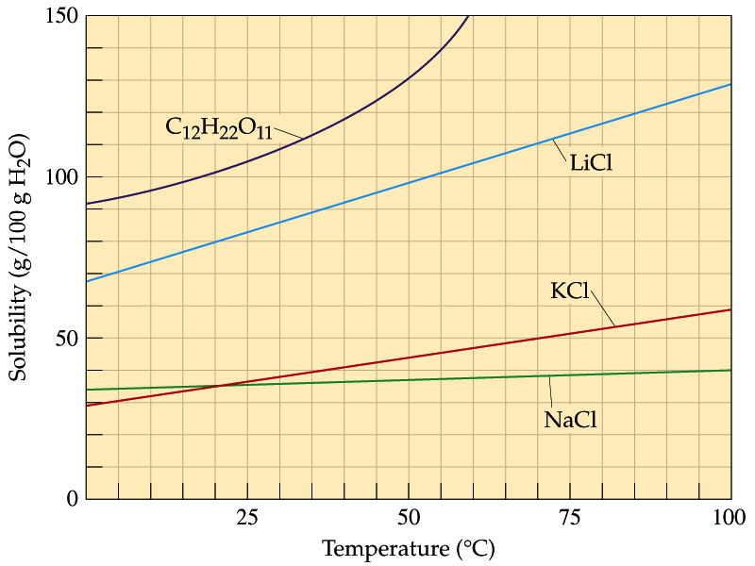
Concentration and Temperature
Relative Solution
Concentrations:
Saturated
Unsaturated
Supersaturated
_____________
Dilute
Concentrated
A solution of 35g of potassium chloride in 100g H₂O @ 25ºC is Saturated & Concentrated; @ 75ºC it is Unsaturated but Concentrated.

Slide 4
What describes a solution of 25.0g NaCl in 0.100L of H₂O @ 10ºC?
QUESTION
A) Dilute
B) Concentrated
C) Saturated
D) Unsaturated

Slide 5
What describes a solution of 100.0g sucrose in 0.100L of H₂O @ 10ºC?
QUESTION
A) Dilute
B) Concentrated
C) Saturated
D) Unsaturated

Slide 6
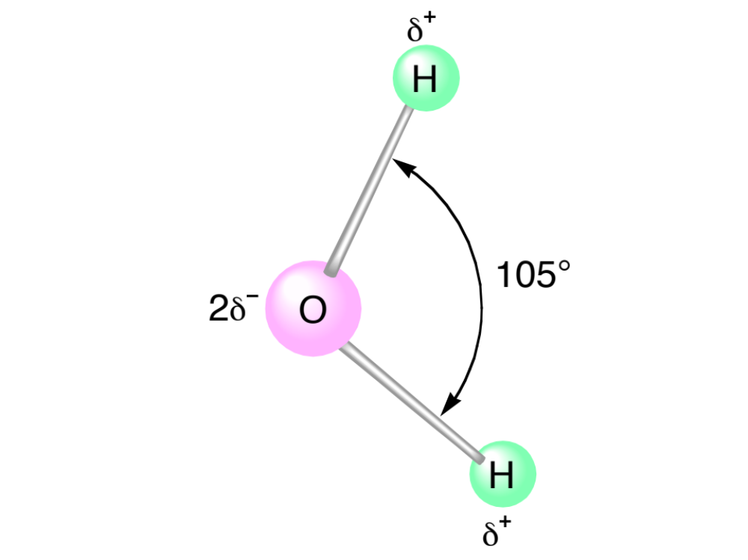
DHMO, dihydromonoxide :
“The Universal” Solvent
http://www.dhmo.org

Slide 7
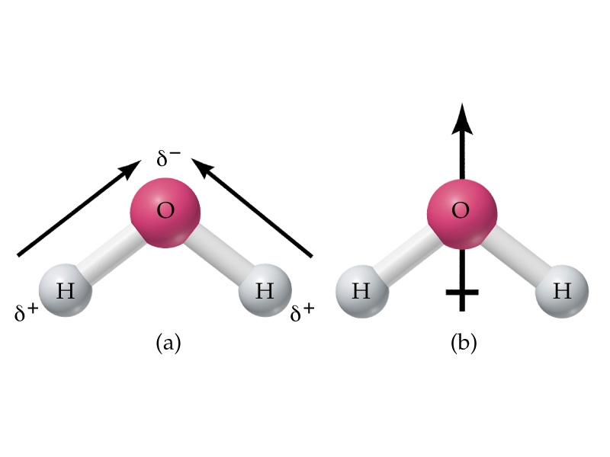
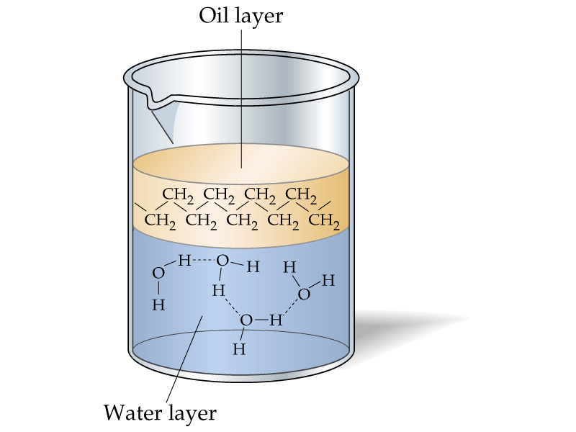
Water : “The Universal” Solvent
The oil (nonpolar) and water (polar) mixture don’t mix and are immiscible. If liquids form a homogeneous mixture, they are miscible.
Generally, likes dissolve likes, i.e. polar-polar and nonpolar-nonpolar. If polar and nonpolar mix , eg. oil and water:

Slide 8
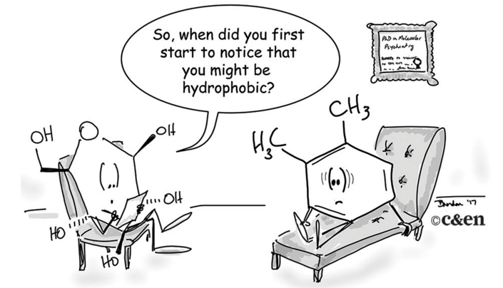
Water : “The Universal” Solvent
Generally, likes dissolve likes, i.e. polar (water)-polar (solutes) “hydrophilic”
Water (polar) repels nonpolar solutes “hydrophobic”

Slide 9
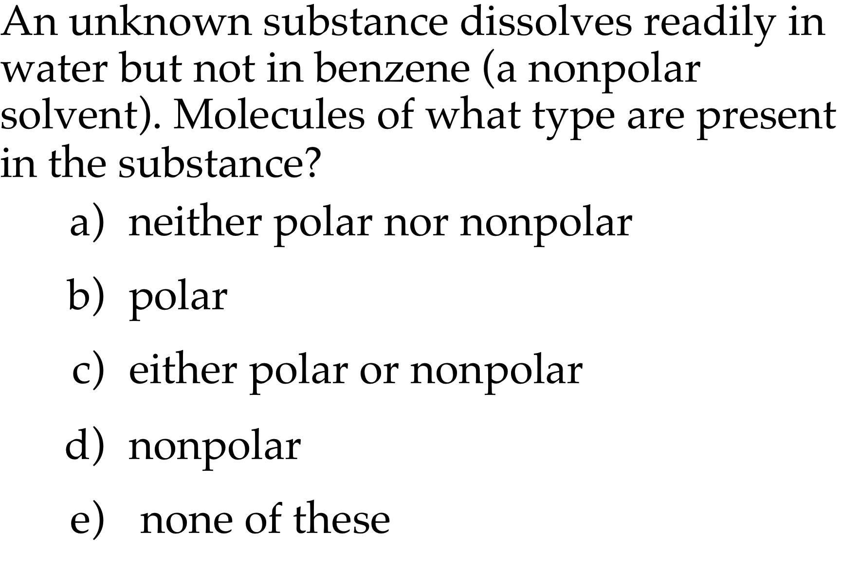
QUESTION

Slide 10
Aqueous Reactions & Solutions
Many reactions are done in a homogeneous liquid or gas phase which generally improves reaction rates.
The prime medium for many inorganic reactions is water which serves as a solvent (the substance present in the larger amount), but does not react itself.
The substance(s) dissolved in the solvent is (are) the solute(s). Together they comprise a solution. The reactants would be the solutes.
Reaction solutions typically have less solute dissolved than is possible and are “unsaturated”.

Slide 11
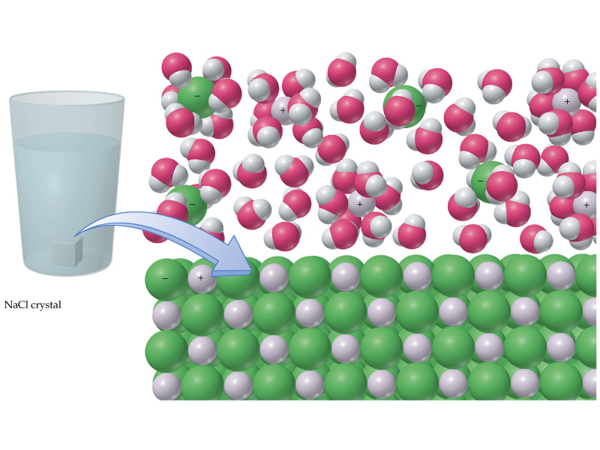
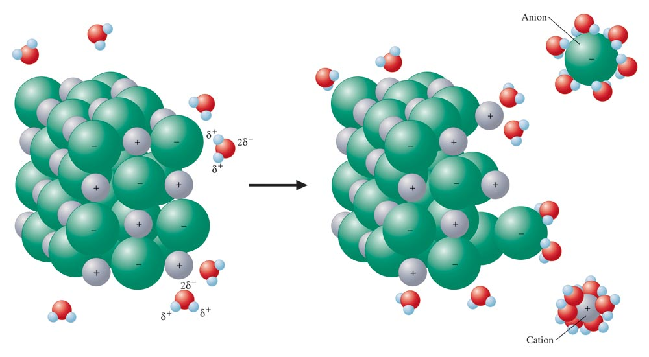
Salt dissolving in a glass of water

Slide 12
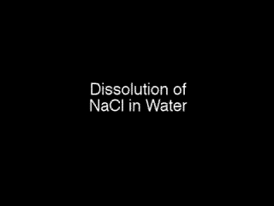
Water dissolving an ionic solid
How can a salt solute be separated from a solution?
http://chemconnections.org/crystals/

Slide 13

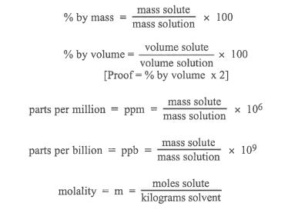

Solution Concentrations

Slide 14
Solution Concentrations
https://phet.colorado.edu/sims/html/molarity/latest/molarity_en.html
Molarity (M) = moles solute / Liter_{solution}
What is the molarity of a solution of 0.50 mol NiCl₂ in 200.0 mL of solution?
M _{NiCl2} = [0.50 mol _{NiCl2} / 200.0 mL] x [ 1000 mL / L]
= 0.25 mol _{NiCl2} / L

Slide 15
Solution Concentrations
https://phet.colorado.edu/sims/html/molarity/latest/molarity_en.html
Molarity (M) = moles solute / Liter_{solution}
What is the molarity of a solution of 10.00 g NiCl₂ in 200.0 mL of solution?
M_{NiCl2} = [10.00g _{NiCl2} / 200.0mL ][1mol_{NiCl2} / 129.5 g _{NiCl2}][ 1000mL / L]
= 0.386 mol_{NiCl2} / L

Slide 16
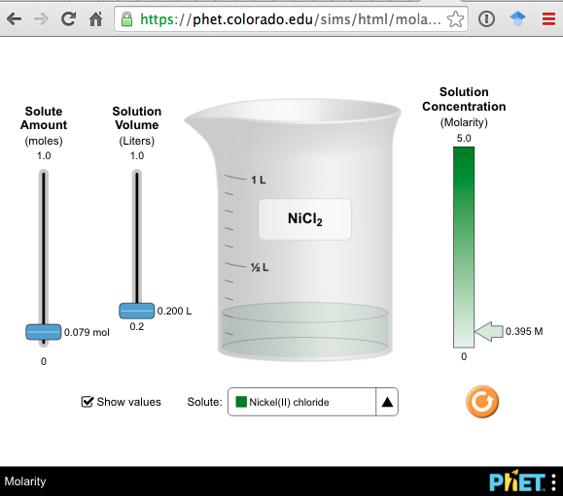
Solution Concentrations
https://phet.colorado.edu/sims/html/molarity/latest/molarity_en.html
Molarity (M) = moles solute / Liter_{solution}
What is the molarity of a solution of 10.00 g NiCl₂ in 200.0 mL of solution?
M_{NiCl2} = [10.00g _{NiCl2} / 200.0mL ][1mol_{NiCl2} / 129.5 g _{NiCl2}][ 1000mL / L]
= 0.386 mol_{NiCl2} / L

Slide 17
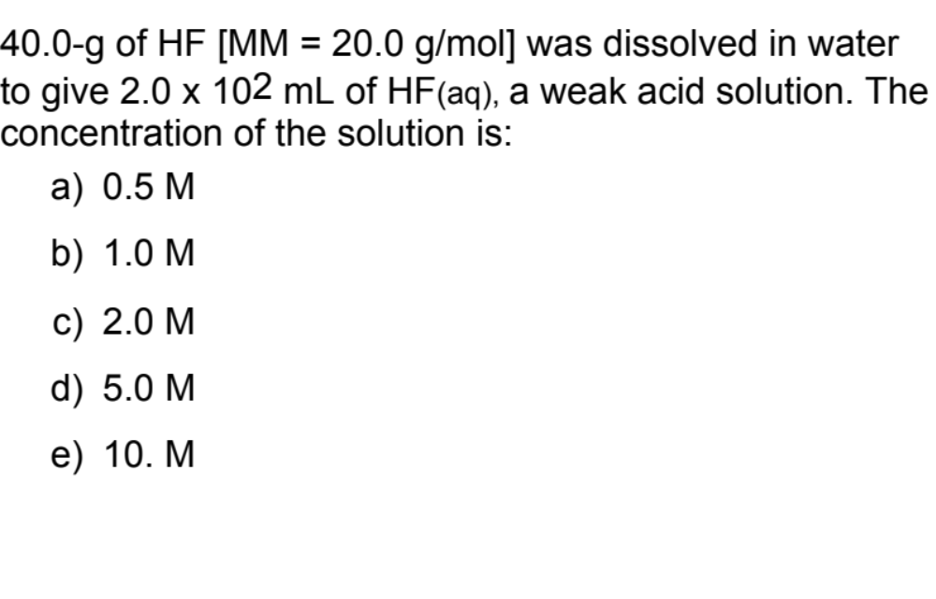
QUESTION
https://phet.colorado.edu/sims/html/molarity/latest/molarity_en.html

Slide 18
Solution Concentrations
Mass percent, eg. Glucose, Saline and Ringer’s lactate solutions
Mass % = Mass solute / [Mass solute + Mass solvent ] x100
What is the mass % of 65.0 g of glucose dissolved in 135 g of water?
Mass % = 65.0 g / [65.0 + 135]g x 100
= 32.5 %

Slide 19
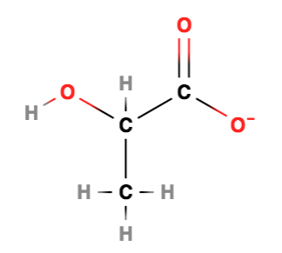
Solution Concentrations
Molarity (M) = moles solute / Liter (Solution)
Ringer’s lactate solution
Na ¹⁺ = 0.130 mol/ L
Cl ¹⁻ = 0.109 mol/ L
Lactate anion (C₃H₅O₃) ¹⁻ = 0.028 mol/ L
K ¹⁺ = 0.004 mol / L
Ca ²⁺ = 0.0015 mol/ L
After blood loss due to trauma, surgery, or burn, it is used for fluid resuscitation usually @ rate equal to 20 to 30 ml/kg body weight/hour.

Slide 20
Solution Concentrations
Molarity (M) = moles solute / Liter_{solution}
mol = (mol solute / Liter_{solution}) x Liter_{solution}
An important relationship is M x V_{solution}= mol
It is used directly in mass calculations of chemical reactions and in the dilutions of solutions.

Slide 21
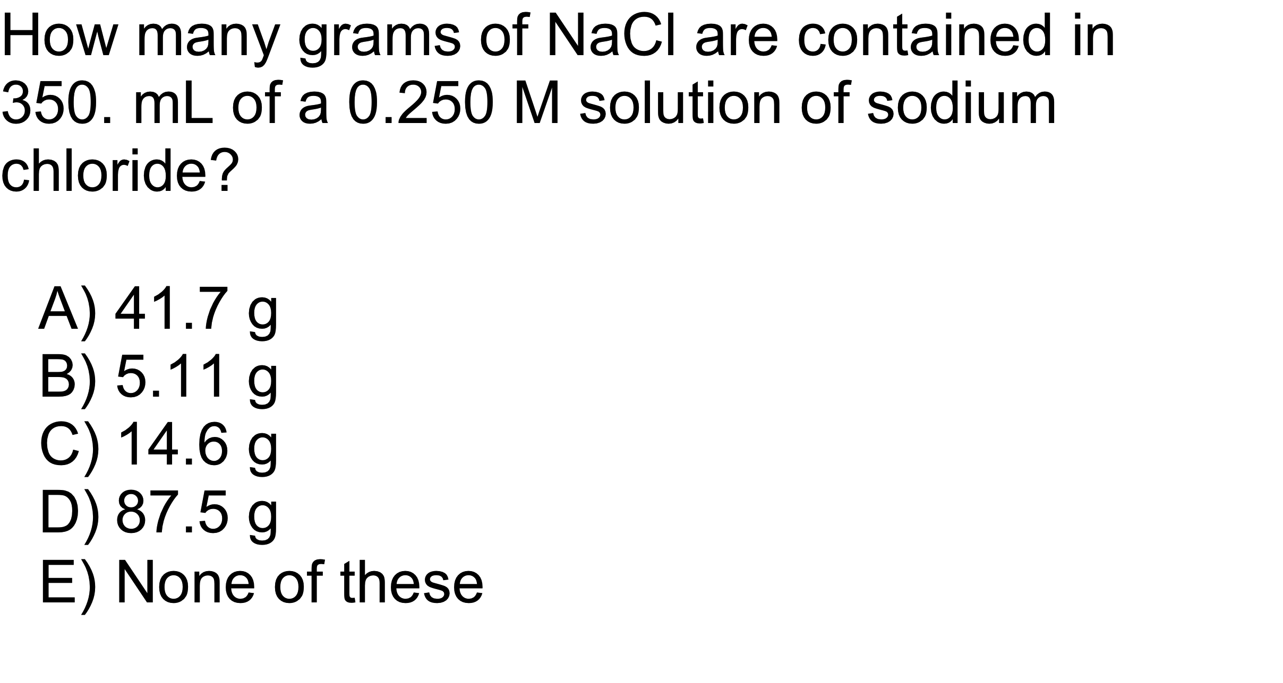
QUESTION
Seven Solutions Post Lab Questions
http://chemconnections.org/general/chem120/solutions-mixes.108.html
Solutions: molarity & volume → mass

Slide 22
ANSWER
B)
5.11 g
Seven Solutions Post Lab Questions
http://chemconnections.org/general/chem120/solutions-mixes.108.html
Volume
(L) times concentration
(mol/L) gives
moles. Moles are then converted to grams.

Slide 23
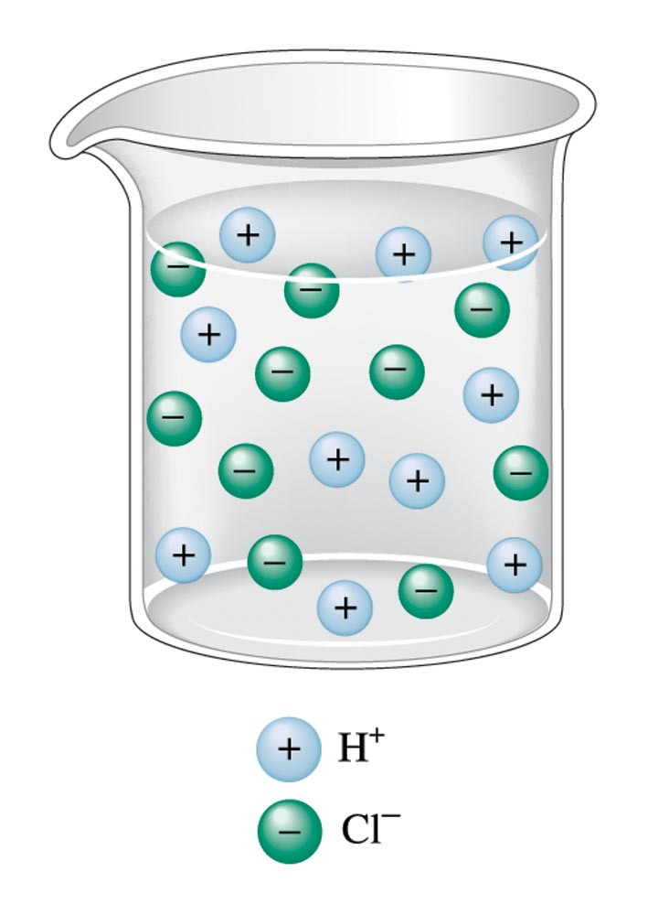
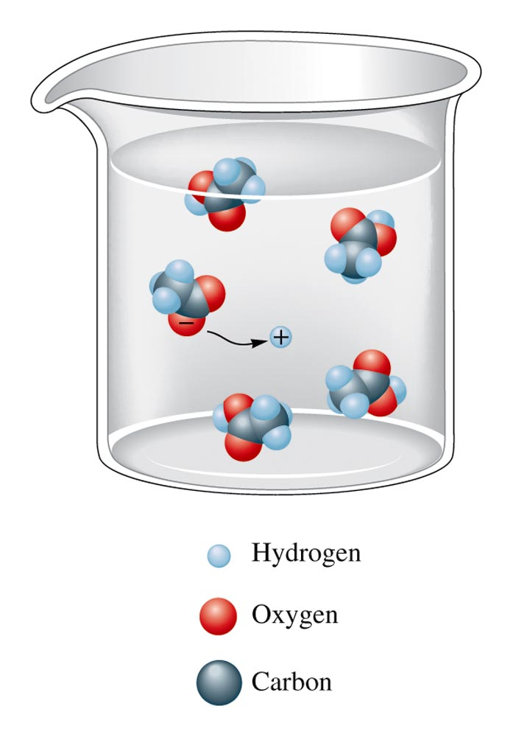
HCl
1.0M 100% Ionized
Solution Concentrations:
Solute vs. Ion Concentrations
Acetic Acid (HC₂H₃O₂) < 100% Ionized
[H+] = [Cl-] = 1.0M
[H+] = [C₂H₃O₂-] < 1.0M

Slide 24
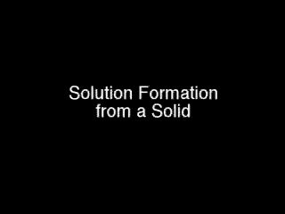

Preparation of Solutions

Slide 25
Solutions II
(Solutions/ Molarity)
Applications / Calculations
Dr. Ron Rusay

Slide 26
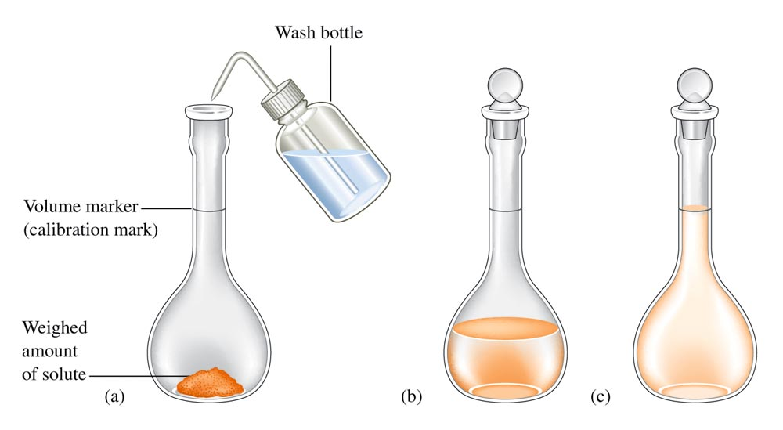
Preparing a Standard Solution of a Targeted Molarity, M (mol/L)
250.00 mL
? grams KCl

Slide 27
Preparation of Solutions used in chemistry
Molarity (M) = Moles solute / Liter (Solution)

Slide 28
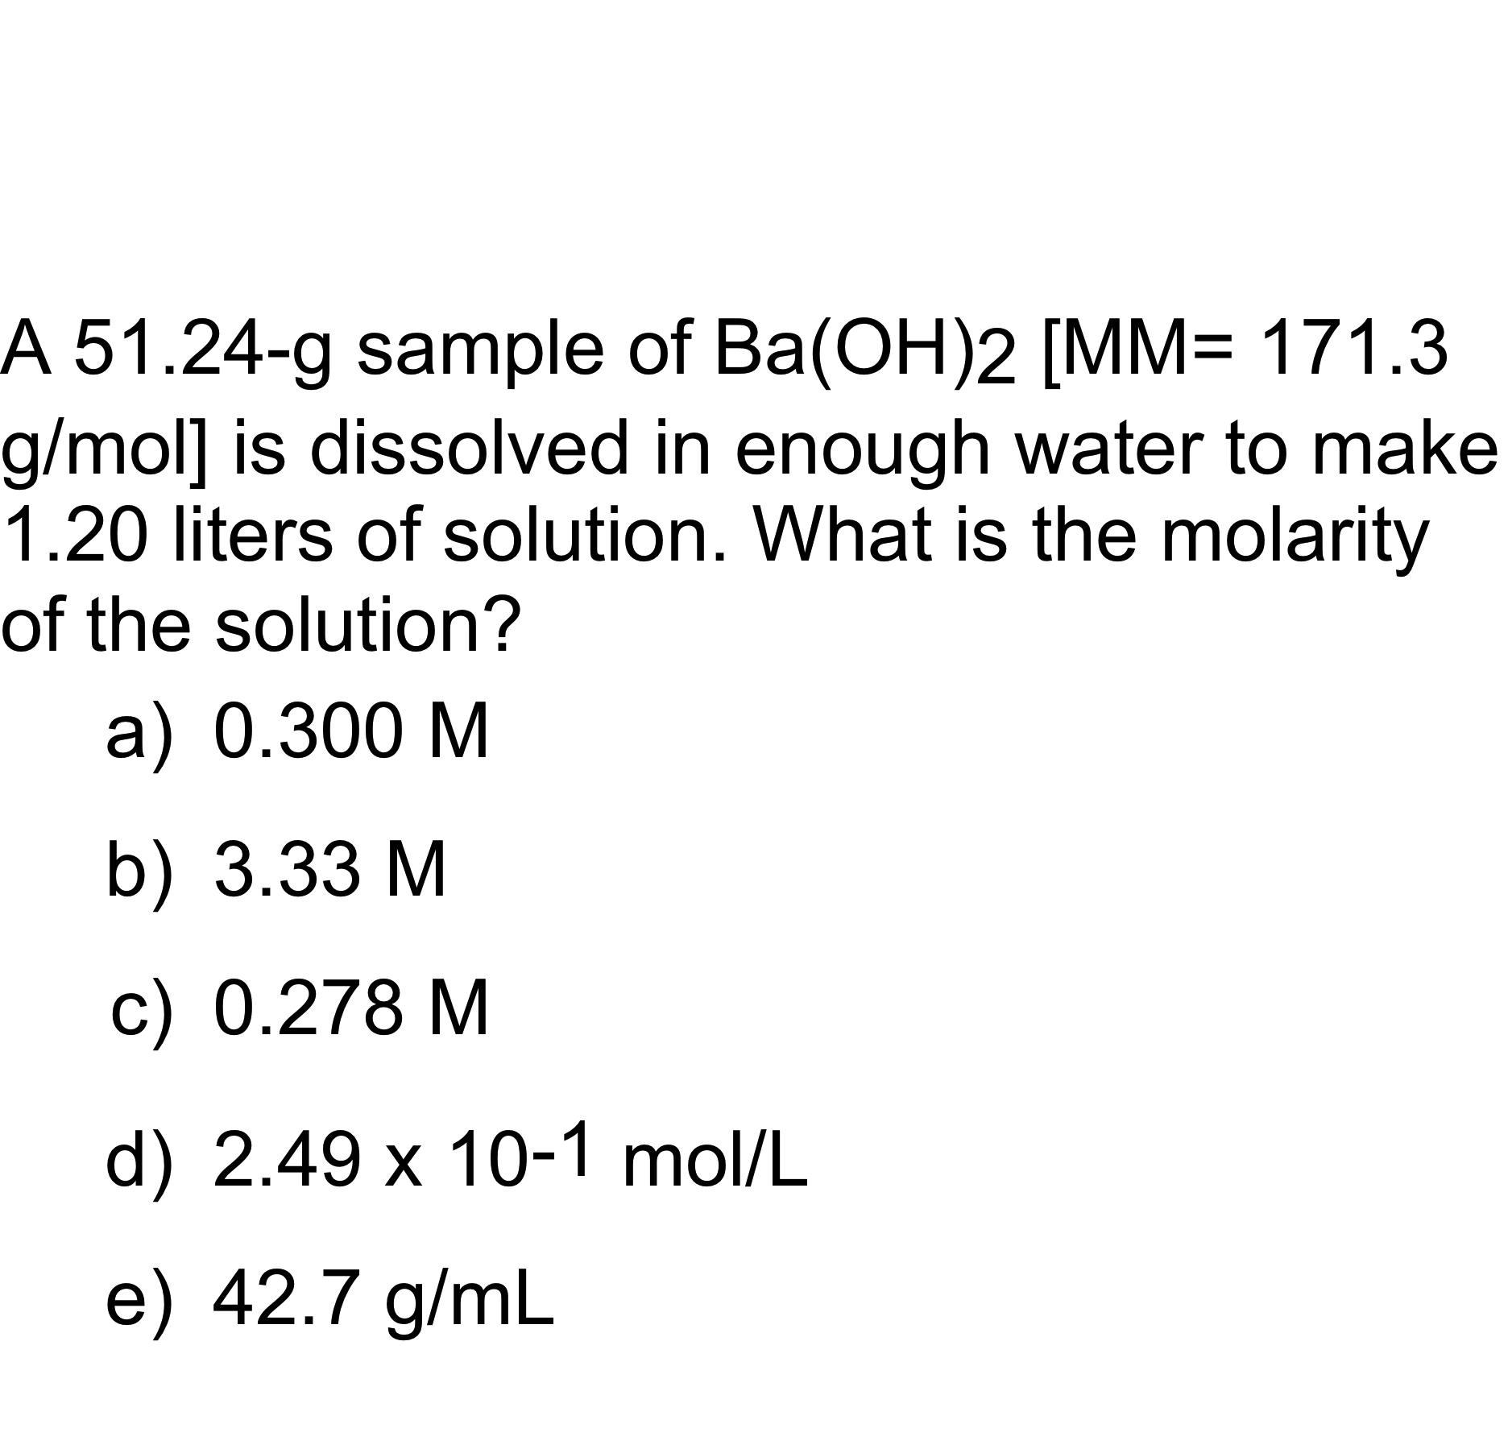
QUESTION

Slide 29
Solution Concentration
The following formula can be used in dilution calculations:
M₁V₁ = M₂V₂
A concentrated stock solution is much easier to prepare and then dilute rather than preparing a dilute solution directly. Concentrated sulfuric acid is 18.0M. What volume would be needed to prepare 250.mL of a 1.50M solution?
V₁ = M₂V₂ / M₁
V₁ = 1.50 M x 250. mL / 18.0 M
V₁ = 20.8 mL

Slide 30
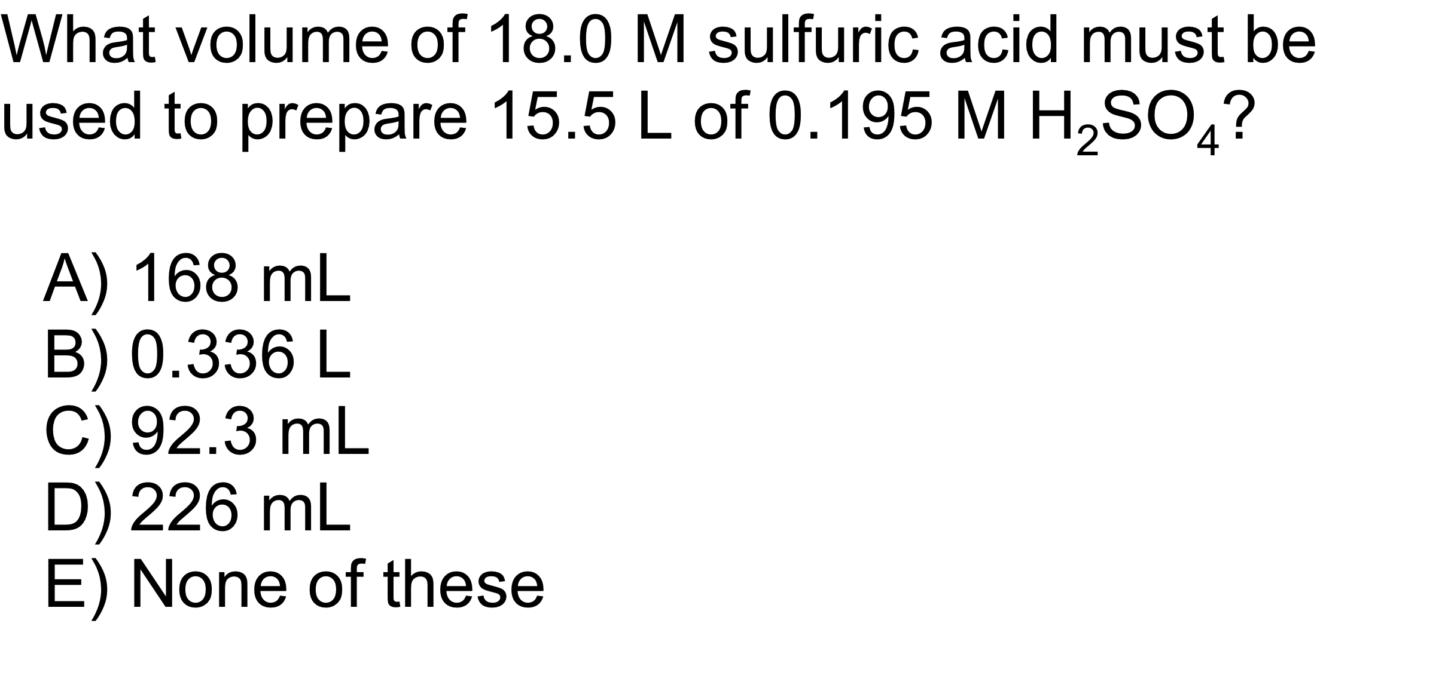
QUESTION

Slide 31
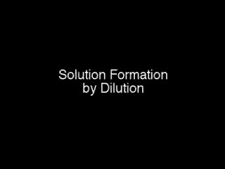
Solution Dilution

Slide 32
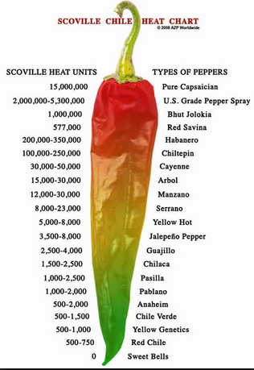
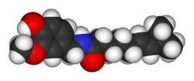
Solution Applications
Scoville Units / Capsaicin
Capsaicin: C₁₈H₂₇NO₃
Carolina Reaper
“Thunderclap Headache”
http://en.wikipedia.org/wiki/Scoville_scale
https://www.youtube.com/watch?v=hrF3jVppfr4
Notes:
reversible cerebral vasoconstriction syndrome (RVS), https://www.nytimes.com/2018/04/09/health/hot-pepper-thunderclap-headaches.html
https://www.acs.org/content/acs/en/education/resources/highschool/chemmatters/past-issues/archive-2013-2014/peppers.html

Slide 33
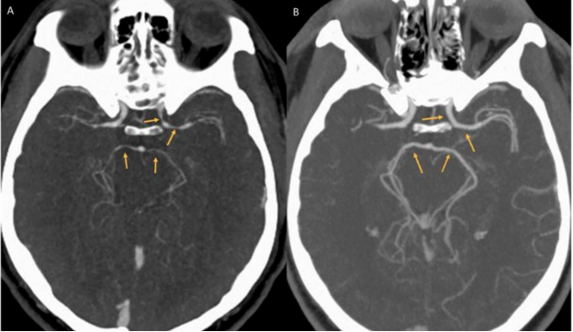
Reversible Cerebral
Vasoconstriction Syndrome (RVS)
Capsaicin: C₁₈H₂₇NO₃
Carolina Reaper
Thunderclap Headache
http://en.wikipedia.org/wiki/Scoville_scale
https://www.youtube.com/watch?v=hrF3jVppfr4
Notes:
reversible cerebral vasoconstriction syndrome (RVS),

Slide 34
QUESTION
What happens to the number of moles of C₁₂H₂₂O₁₁ (sucrose) when 100.0 mL of a 0.20 M solution is diluted to a final concentration
of 0.10 M?
A) The number of moles of C₁₂H₂₂O₁₁ decreases.
B) The number of moles of C₁₂H₂₂O₁₁ increases.
C) The number of moles of C₁₂H₂₂O₁₁ does not change.
D) There is insufficient information to answer the question.

Slide 35

Solution Applications
A solution of barium chloride was prepared by dissolving 26.0287 g in water to make 500.00 mL of solution. What is the concentration of the barium chloride solution? M_{BaCl2} = ?
M_{BaCl2} =
= [26.0287g _{BaCl2} / 500.00mL ][1mol _{BaCl2} / 208.23g _{BaCl2} ] [1000mL / L]
= 0.25000 mol / L

Slide 36
Solution Applications
10.00 mL of this solution was diluted to make exactly 250.00 mL of solution which was then used to react with a solution of potassium sulfate. What is the concentration of the diluted solution. M₂ = ?
    M_{BaCl2} = M₁
    M₂ = M₁V₁ / V₂
    M₂ = 0.25000 M x 10.00 mL / 250.00 mL
    M₂ = 0.010000 M

Slide 37
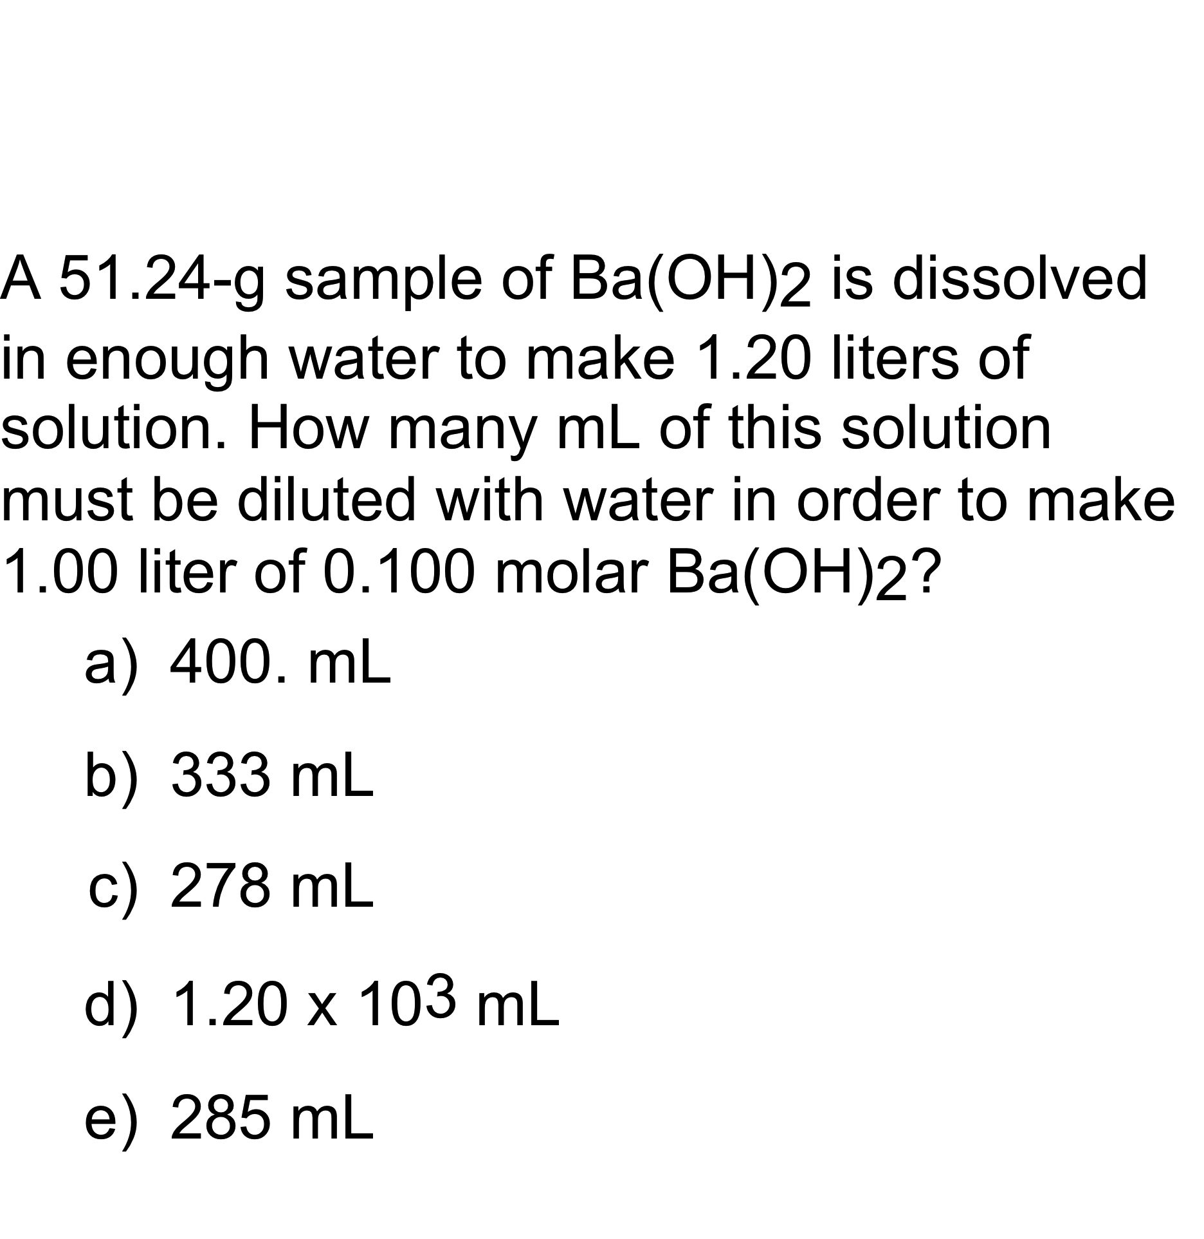
QUESTION

Slide 38
Solution Applications
(Chem 120 Prep)
  20.00 mL of a M₂ = 0.010000 M barium chloride solution required 15.50 mL of the potassium sulfate solution to react completely. M_{K2SO4} = ?
BaCl₂(aq) + K₂SO₄(aq) → ? + ?
BaCl₂(aq) + K₂SO₄ (aq) → 2 KCl(aq) + BaSO₄ (s)
?M_{K2SO4} = [M_{BaCl2}x V_{BaCl2} / V_{K2SO4} ] [? mol_{K2SO4} / ? mol_{BaCl2} ]
0.010000 mol_{BaCl2} x 0.02000 L_{BaCl2} x 1 mol_{K2SO4}
L_{BaCl2} x 0.01550 L_{K2SO4} x 1 mol_{BaCl2}
?M_{K2SO4} =
?M_{K2SO4} = 0.01290 mol_{K2SO4} / L_{K2SO4} = 0.01290 M_{K2SO4}

Slide 39
Solution Applications
(Chem 120 Prep)
How many grams of potassium chloride are produced?
BaCl₂(aq) + K₂SO₄(aq) → ? + ?
BaCl₂(aq) + K₂SO₄ (aq) → 2 KCl(aq) + BaSO₄ (s)
1
?g_{KCl} = 0.010000 mol_{BaCl2} / L_{BaCl2} x 0.02000 L_{BaCl2} X 2 mol_{KCl} / 1 mol_{BaCl2} X
74.55 g_{KCl} /mol_{KCl}
= 0.02982 g_{KCl}

Slide 40
Solution Applications
(Chem 120 Prep)
If 20.00 mL of a 0.10 M solution of barium chloride was reacted with 15.00 mL of a 0.20 M solution of potassium sulfate, what would be the theoretical yield of barium sulfate?
BaCl₂(aq) + K₂SO₄ (aq) → 2 KCl(aq) + BaSO₄ (s)
Which is the Limiting Reagent?
Mol_{BaCl2} = M_{BaCl2}x V_{BaCl2}
= 0.10 mol_{BaCl2} / L_{BaCl2} x 0.02000 L_{BaCl2}
1 mol_{BaCl2}
= 2.0 x 10⁻³
Mol_{K2SO4}= M_{K2SO4}x V_{K2SO4}
= 0.20 mol_{K2SO4} / L_{K2SO4} x 0.01500 L_{K2SO4}
1 mol_{K2SO4}
= 3.0 x 10⁻³
2.0 x 10⁻³ < 3.0 x 10⁻³
2.0 x 10⁻³ mol is limiting

Slide 41
Solution Applications
(Chem 120 Prep)
If 20.00 mL of a 0.10 M solution of barium chloride was reacted with 15.00 mL of a 0.20 M solution of potassium sulfate, what would be the theoretical yield of barium sulfate?
BaCl₂(aq) + K₂SO₄ (aq) → 2 KCl(aq) + BaSO₄ (s)
Must use the limiting reagent:
0.10 mol_{BaCl2} x 0.02000 L_{BaCl2} x 1 mol_{BaSO4} x 233.39 g _{BaSO4}
L_{BaCl2} 1 mol_{BaCl2} mol_{BaSO4}
=
= 0.47 g

Slide 42
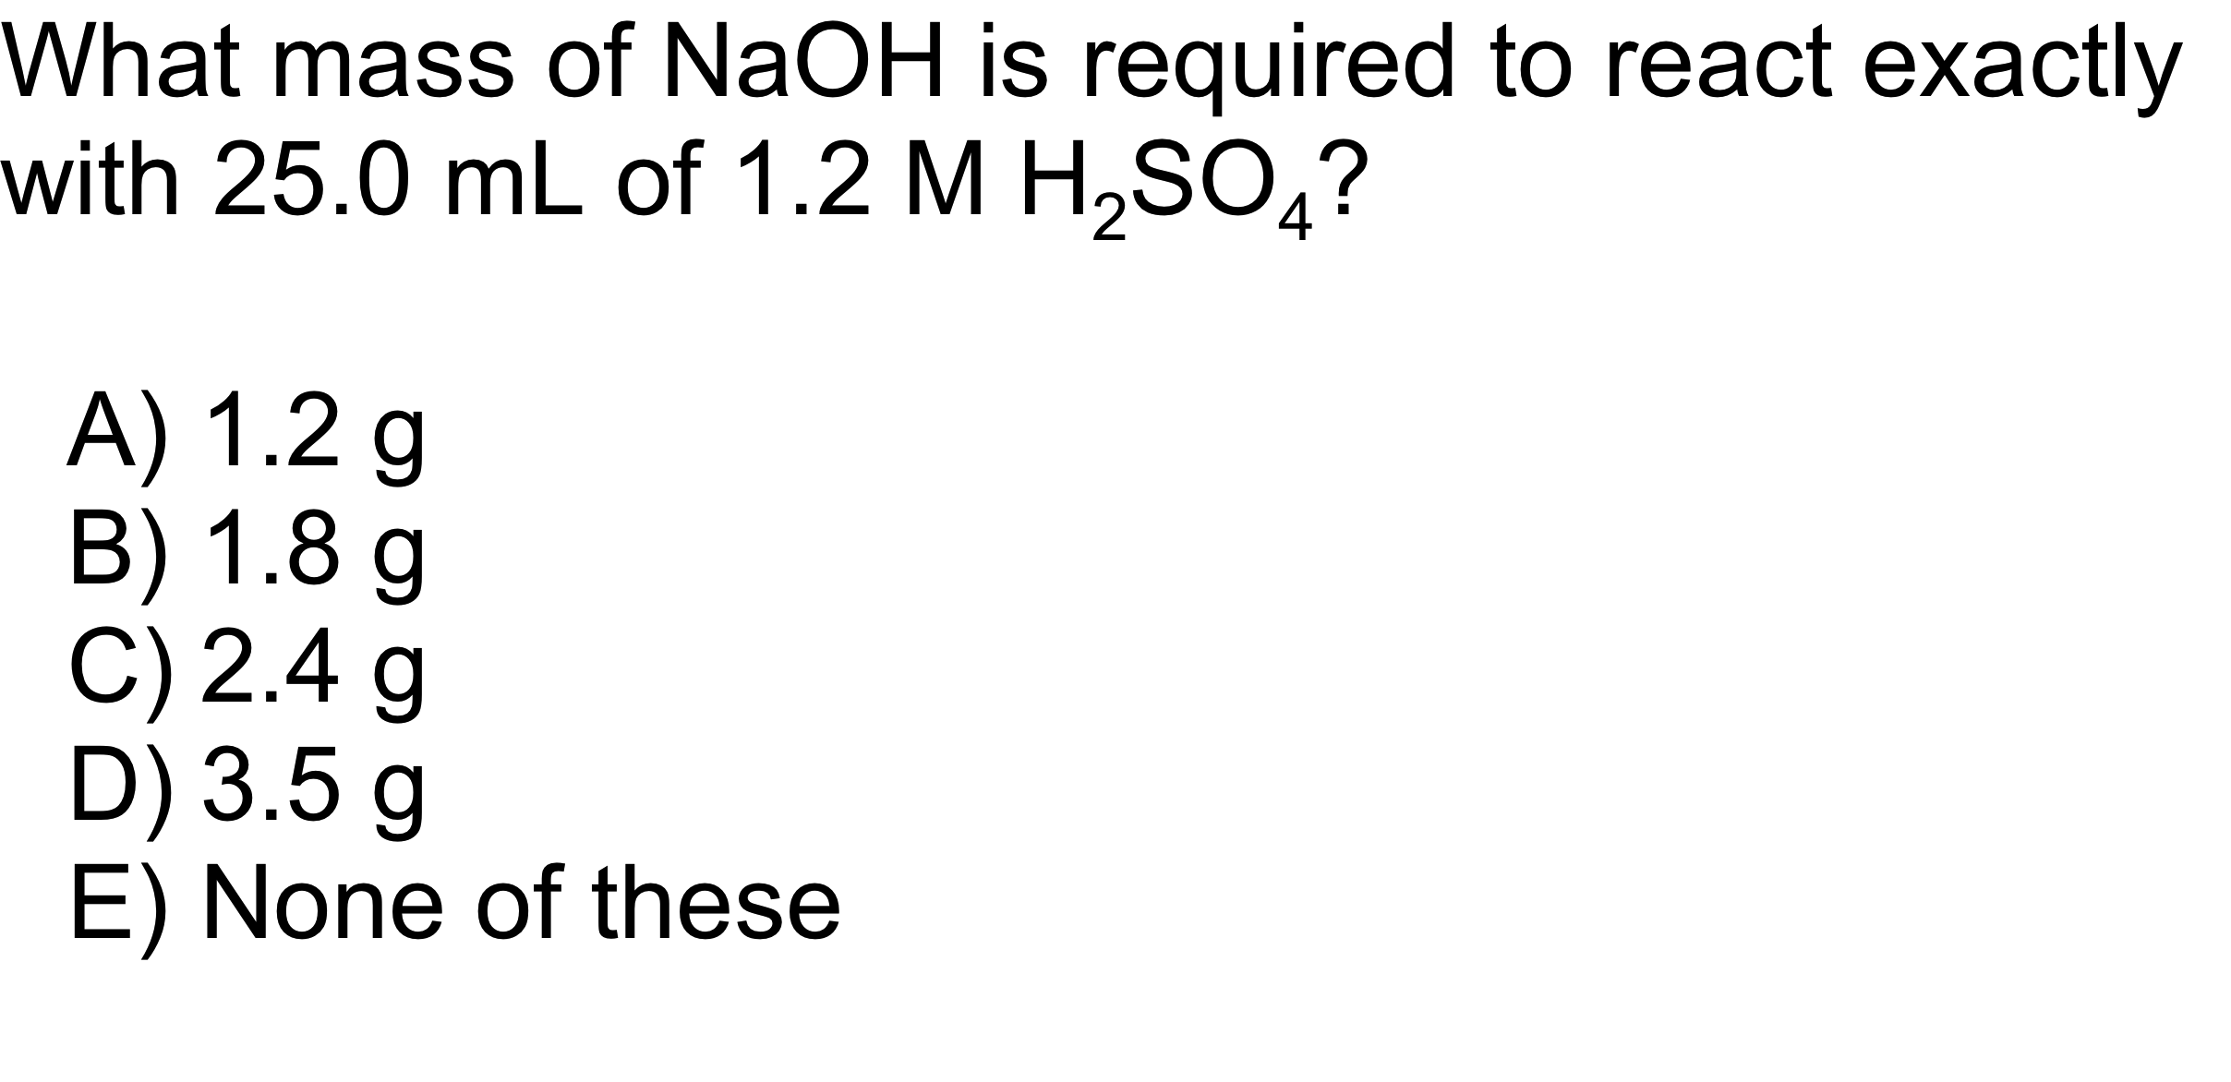
QUESTION

Slide 43
ANSWER
C)
2.4 g
-
Remember that the reaction is 2NaOH + H
SO
2
4
→
Na
SO
+ 2H
O, so there are two moles of
2
4
2
NaOH used per one mole of H
SO
.
2
4

