Slide 1
Stoichiometry
Dr. Ron Rusay

Slide 2
Chemical Stoichiometry
Stoichiometry is the study of mass in chemical reactions. It deals with both reactants and products.
It quantitatively and empirically relates the behavior of atoms and molecules in a balanced chemical equation to observable chemical change and measurable mass effects.
It accounts for mass and the conservation of mass, just as the conservation of atoms in a balanced chemical equation.

Slide 3
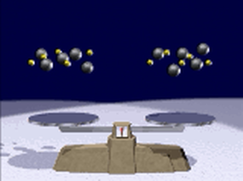
Chemical Reactions
Atoms, Mass & Balance: eg. Zn(s) + S(s)

Slide 4
Stoichiometry
Must begin with a correctly balanced equation:
_ C₂H₅OH + _ O₂ → _ CO₂ + _ H₂O
Reactants Products
C=2; H =5+1=6; O=2+1 C=1; H=2; O=2+1
1 C₂H₅OH + 3 O₂ → 2 CO₂ + 3 H₂O

Slide 5
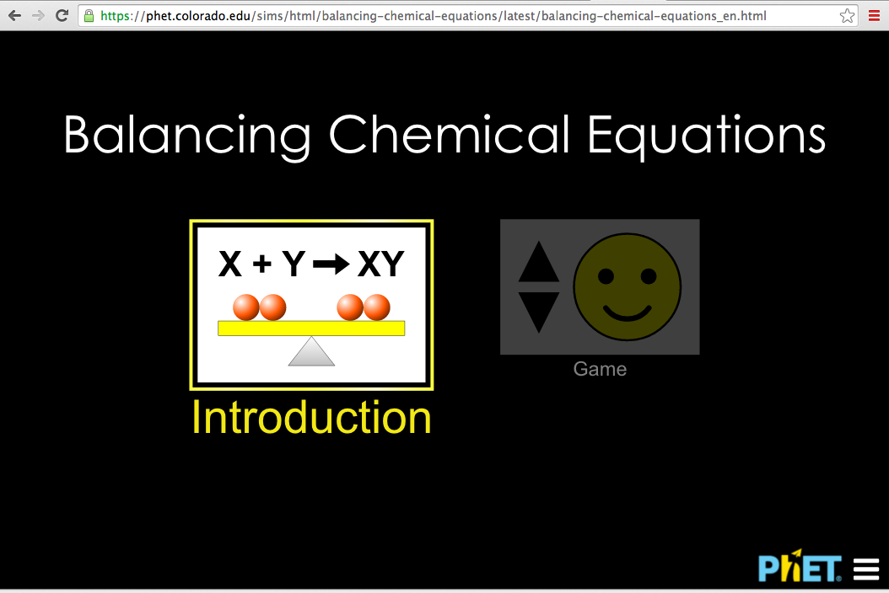
https://phet.colorado.edu/sims/html/balancing-chemical-equations/latest/balancing-chemical-equations_en.html

Slide 6
Chemical Equation
C₂H₅OH + 3 O₂ → 2 CO₂ + 3 H₂O
The balanced equation can be completely stated as:
1 mole of ethanol reacts with 3 moles of oxygen to produce 2 moles of carbon dioxide and 3 moles of water.

Slide 7
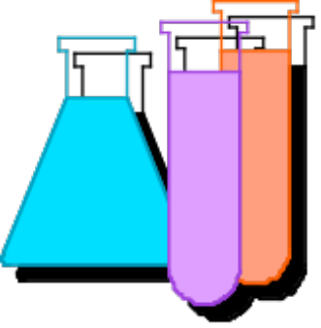
Chemical Equation
All Balanced Equations relate on a molar mass basis. For example the combustion of octane:
2 C₈H_{18(l)}+ 25 O_{2(g)} 16 CO_{2(g)} +18 H₂O_{(l)}
moles of octane react with 25 moles of oxygen to produce 16 moles of carbon dioxide and 18 moles of water.

Slide 8
The Chemical Equation:
Mole & Masses
C₂H₅OH + 3 O₂ → 2 CO₂ + 3 H₂O
46g (1 mole) of ethanol reacts with 3 moles of oxygen (96g) to produce 2 moles of carbon dioxide and 3 moles of water.
How many grams of carbon dioxide and water are respectively produced from 46g (1 mole) of ethanol ?
2 mol x 44 g/mol = 88g
3 mol x 18 g/mol = 54 g

Slide 9
The Chemical Equation:
Moles & Masses
C₂H₅OH + 3 O₂ → 2 CO₂ + 3 H₂O
How many grams of oxygen are needed to react with 15.3g of ethanol in a 12oz. beer ?
15.3g_{ethanol} x mol_{ethanol} /46.0g_{ethanol} = 0.333mol_{ethanol}
0.333mol_{ethanol} x 3mol_{oxygen} / 1mol_{ethanol} = 0.999mol_{oxygen}
32.0g_{oxygen} /mol_{oxygen} x 0.999mol_{oxygen} = 32.0g_{oxygen}
NOTE: It takes approximately 1 hour for the biologically equivalent amount of oxygen available from cytochrome p450 to consume the alcohol in a human in 1 beer to a level below the legal limit of 0.08%.

Slide 10
Chemical Stoichiometry
Epsom salt (magnesium sulfate heptahydrate) is one of five possible hydrates: mono-, di-, tri-, hexa-, or hepta- hydrate.
How can stoichiometry be used to determine, which hydrate is present in a pure unknown sample, by heating the sample in a kitchen oven at 400 º C for 45 minutes?
MgSO₄ . x H₂O_{(s)} MgSO₄ _{(s)} + x H₂O _{(g)}
Refer to % Hydrate Lab Experiment.

Slide 11
Mass Calculations
All Balanced Equations relate on a molar and mass basis. For the combustion of octane:
2 C₈H_{18(l)}+ 25 O_{2(g)} 16 CO_{2(g)} +18 H₂O_{(l)}
228 g of octane (2 moles)* will react with 800 g of oxygen (25 moles) to produce (16 moles) 704 g of carbon dioxide and (18 moles) 324 g of water.
*(2 moles octane x 114 g/mol = 228 g )

Slide 12
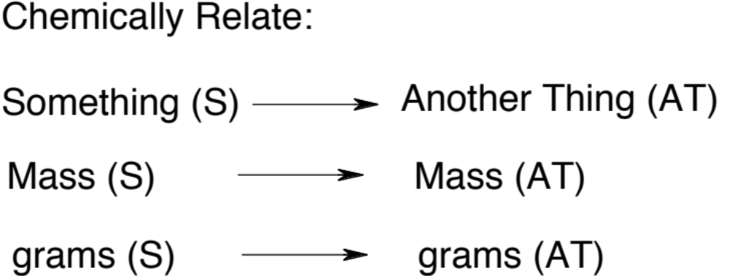
Mass Calculations:
Reactants Products

Slide 13
Mass Calculations:
Reactants Products
1. Balance the chemical equation.
2. Convert mass of reactant or product
    to moles.
3. Identify mole ratios in balanced equation:
      They serve as the “Gatekeeper”.
4. Calculate moles of desired product or
    reactant.
5. Convert moles to grams.

Slide 14
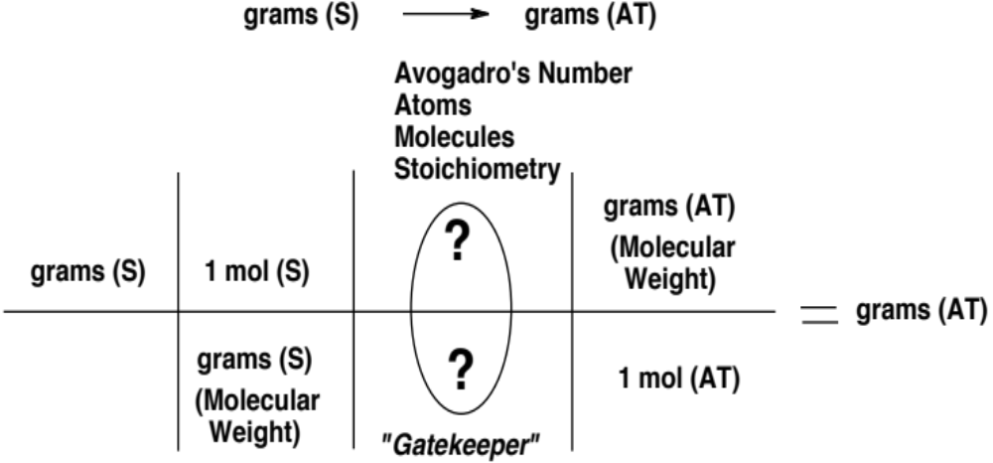
Mass Calculations:
Reactants Products

Slide 15
QUESTION
The fuel in small portable lighters is butane (C₄H₁₀). After using a lighter for a few minutes, 1.0 gram of fuel was used. How many moles of carbon dioxide would it produce?
  58 moles
  0.017 moles
  1.7 × 10^{–24} moles
  0.068 moles

Slide 16
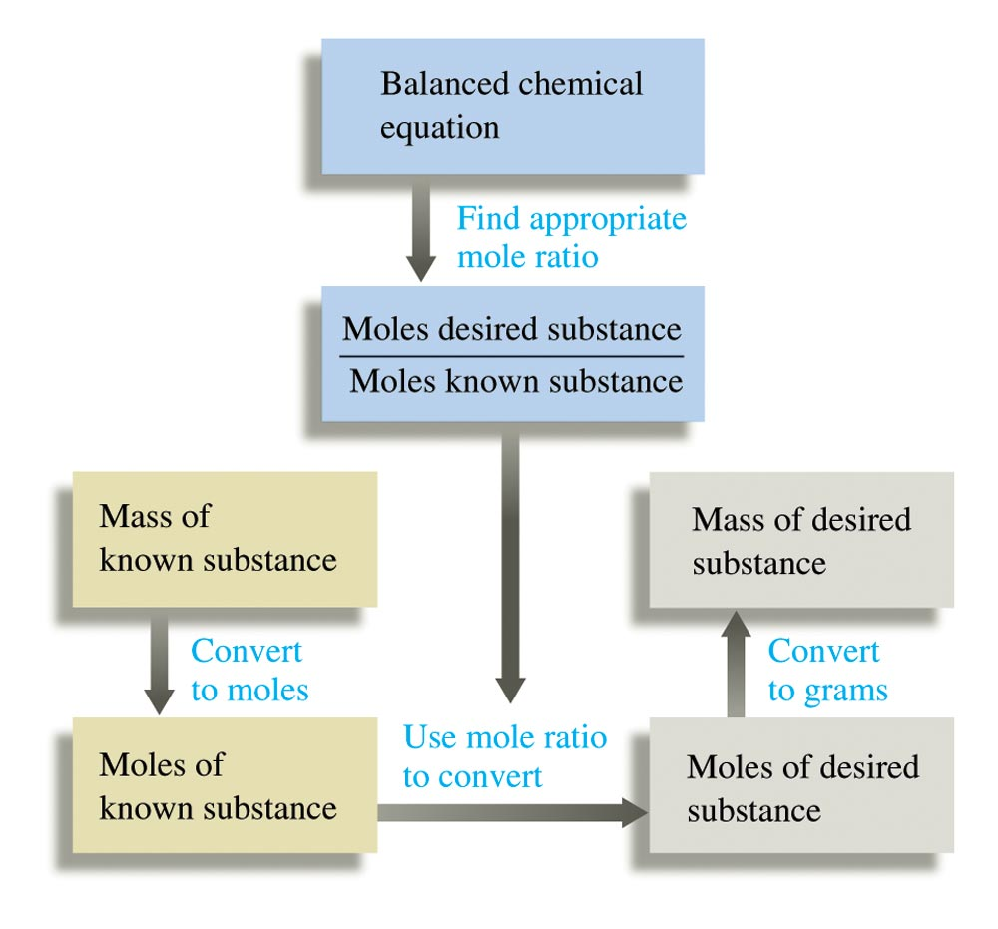
Mass Calculations:
Reactants Products

Slide 17
QUESTION
The fuel in small portable lighters is butane (C₄H₁₀). After using a lighter for a few minutes, 1.0 gram (0.017 moles) of fuel was used. How many grams of carbon dioxide would it produce?
How many grams of carbon dioxide would this produce?
A.) 750 mg B.) 6.0 g
C) 1.5 g D.) 3.0 g

Slide 18
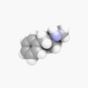
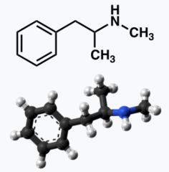
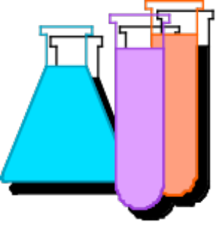
Percent Yield
In synthesis as in any experimentation, it is very difficult and at most times impossible to be perfect. Therefore the actual yield (g) is measured and compared to the theoretical calculated yield (g). This is the percent yield:
% Yield = actual (g) / theoretical (g) x 100
Some DVC students may report percent yields greater than 100% in their first synthesis experiment. Hmmm?....... Why is this not possible?

Slide 19
Theoretical (Yield) Mass Calculations
Reactant Product
grams (Reactant)
grams (Product)
Moles
Molar Mass
grams (R)
1 mol (R)
? mol (P)
grams (P)
? grams (P)
? mol (R)
grams (R)
1 mol (P)
(Divide)
Mass (R)
(Multiply)
Mass (P)
by Molar
"Gatekeepers”
from
Balanced reaction
by Molar

Slide 20
Theoretical (Yield) Mass Calculation
C₂₀H₂₄N₂O_{(s)} + H_{2 (g)} C₂₀H₂₆N₂O_{(s)}
1
1
Ibogaine
3.03
?
grams (C₂₀H₂₄N₂O. Reactant)
grams (C₂₀H₂₆N₂O Product)
Ibogaine
308.4 g·mol⁻¹
Moles
Molar Mass
310.4 g·mol⁻¹
3.03
310.4
3.05
1
grams (P C₂₀H₂₆N₂O)
grams (R C₂₀H₂₄N₂O)
1 mol (R)
? mol (P)
?
grams (P)
308.4
1
? mol (R)
Grams
(R C₂₀H₂₄N₂O)
1 mol (P)
(Divide)
Mass (R C₂₀H₂₄N₂O)
"Gatekeepers”
from
Balanced reaction
(Multiply)
Mass (P C₂₀H₂₆N₂O)
by Molar
by Molar

Slide 21
QUESTION
A synthetic hydrogenation reaction produced 2.85g of Ibogaine, C₂₀H₂₆N₂O, a natural product with strong promise in treating heroin addiction (at least in Europe), the calculated theoretical yield was 3.05g, what is the % yield?
A) 6.6% B) 80.3% C) 93.4% D) 107%

