Slide 1
Synthetic Polymers
“Plastics”
https://www.youtube.com/watch?v=PSxihhBzCjk
The Graduate: Dustin Hoffman (1967)
Notes:
1

Slide 2
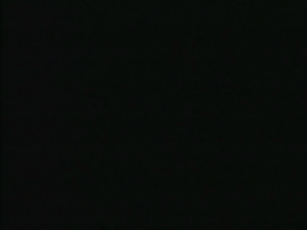
Polymers

Slide 3
Polymers
Macromolecules which are made from small molecules, monomers, or co-monomers which structurally repeat themselves.
Monomer Polymer
Ethylene & Propylene Polyethylene & Polypropylene
Styrene Polystyrene
Vinyl chloride PVC
Co-monomers Nylon
(Proteins)

Slide 4
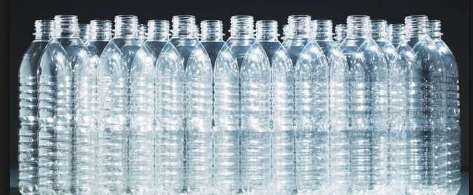
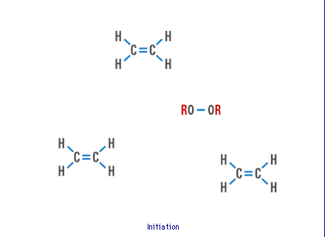
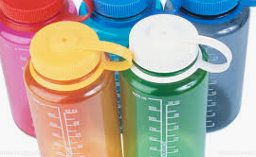
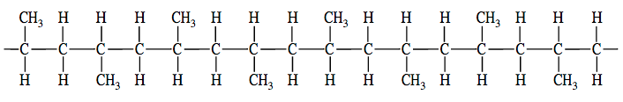
Polyethylene& Polypropylene Polymerization Mechanism

Slide 5
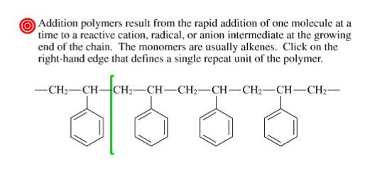
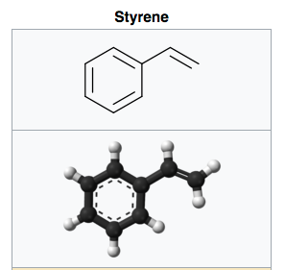
Polystyrene & Others

Slide 6
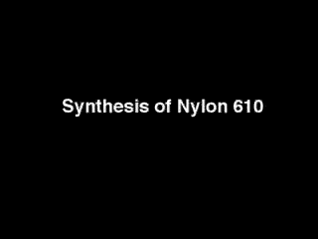
Nylon
A macromolecule which is a poly-amide.
-HN(CH₂)₆-NHCO(CH₂)_{x}CO-

Slide 7
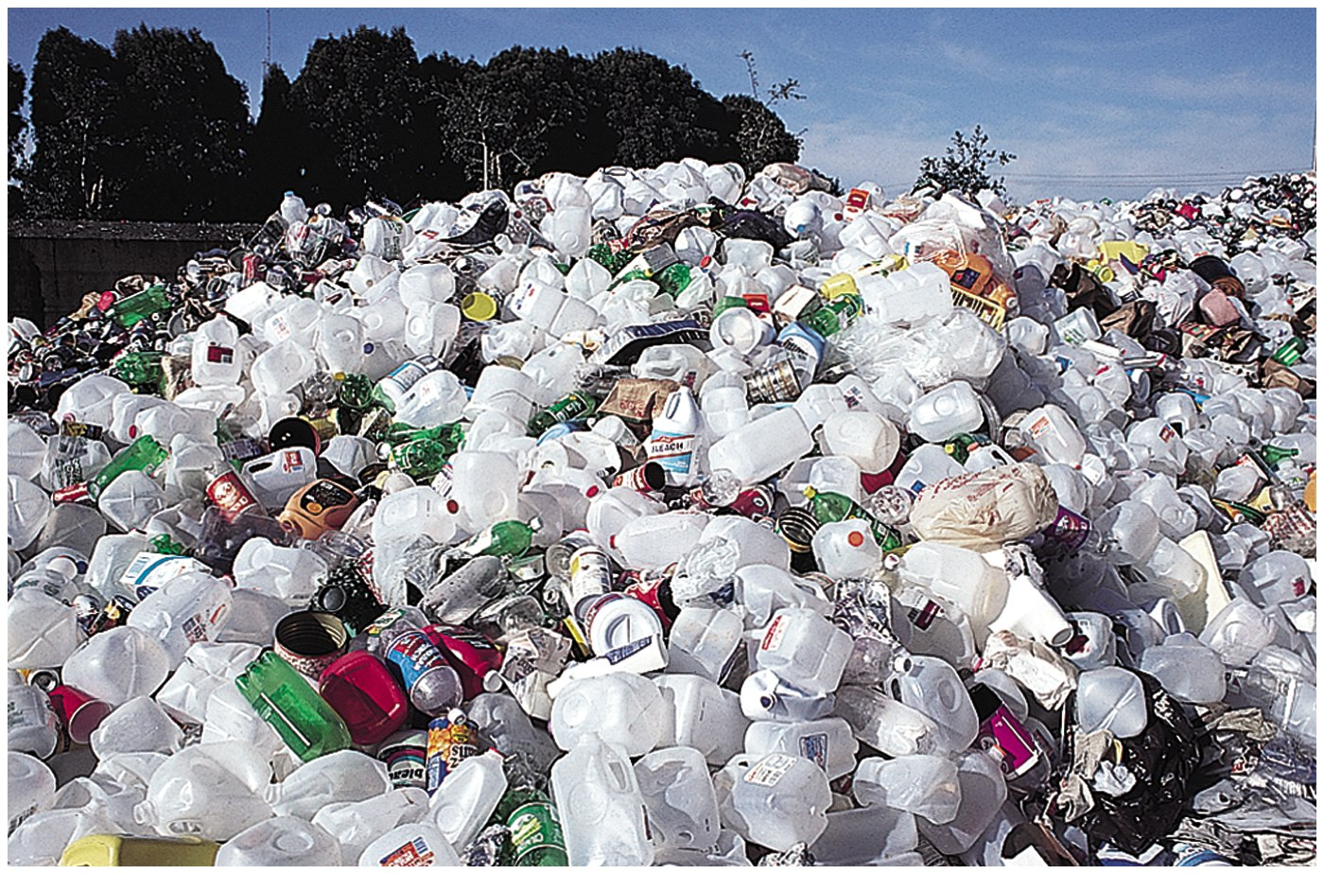
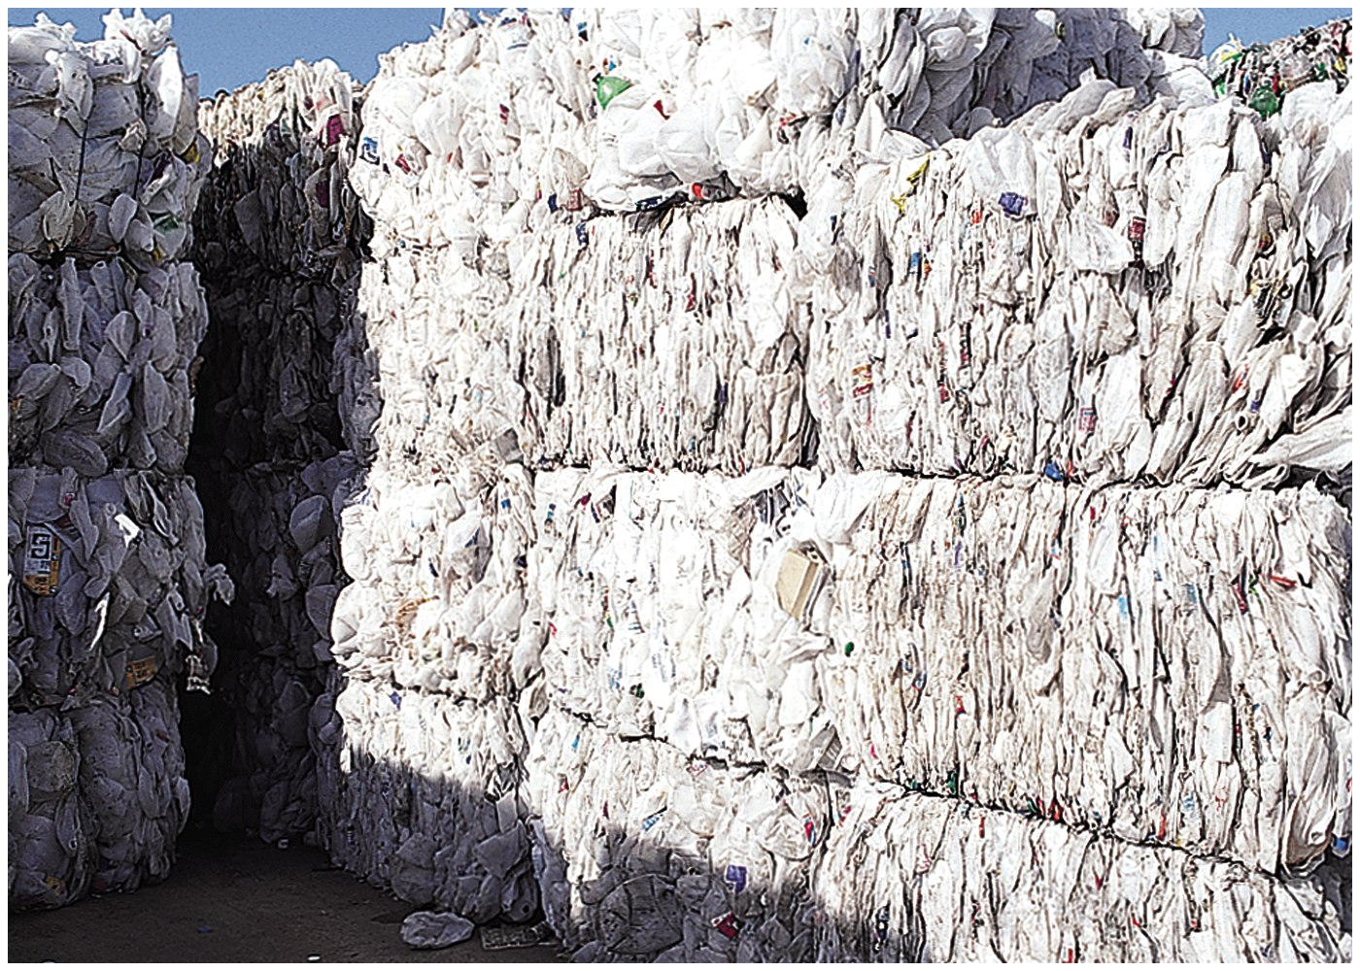
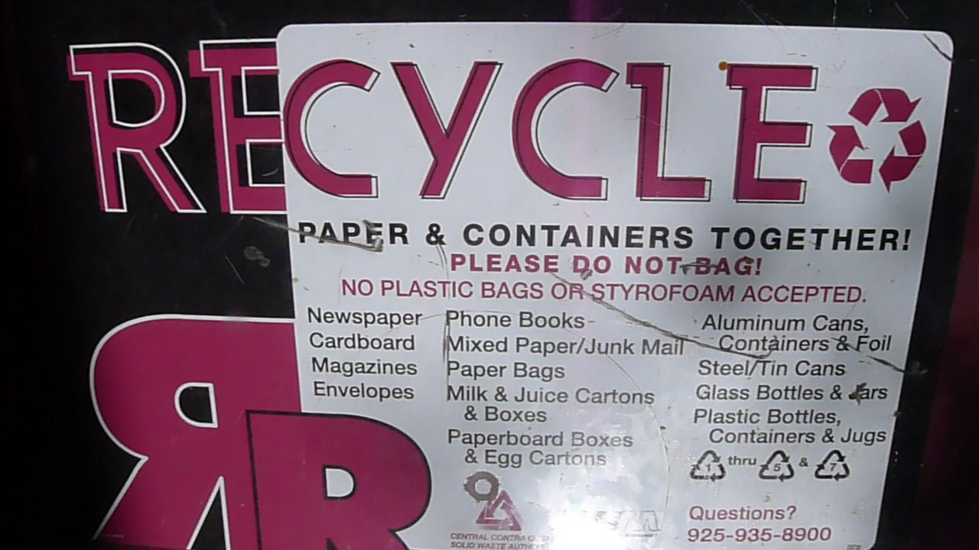
https://www.youtube.com/watch?v=_6xlNyWPpB8
Plastic Waste / Recycling
~300 billion pounds produced annually, Worldwide ~ 5% is recycled

Slide 8
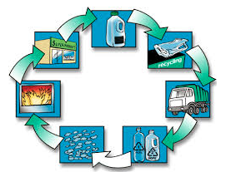
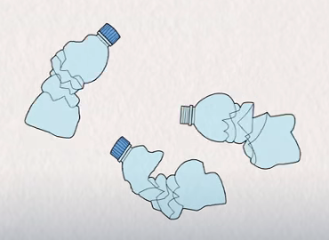
Northern California
https://www.norcalcompactors.net/processes-stages-benefits-plastic-recycling/
Stages in Plastic Recycling
Sorting
Shredding
Identification and Classification
Extruding
https://www.youtube.com/watch?v=_6xlNyWPpB8

Slide 9

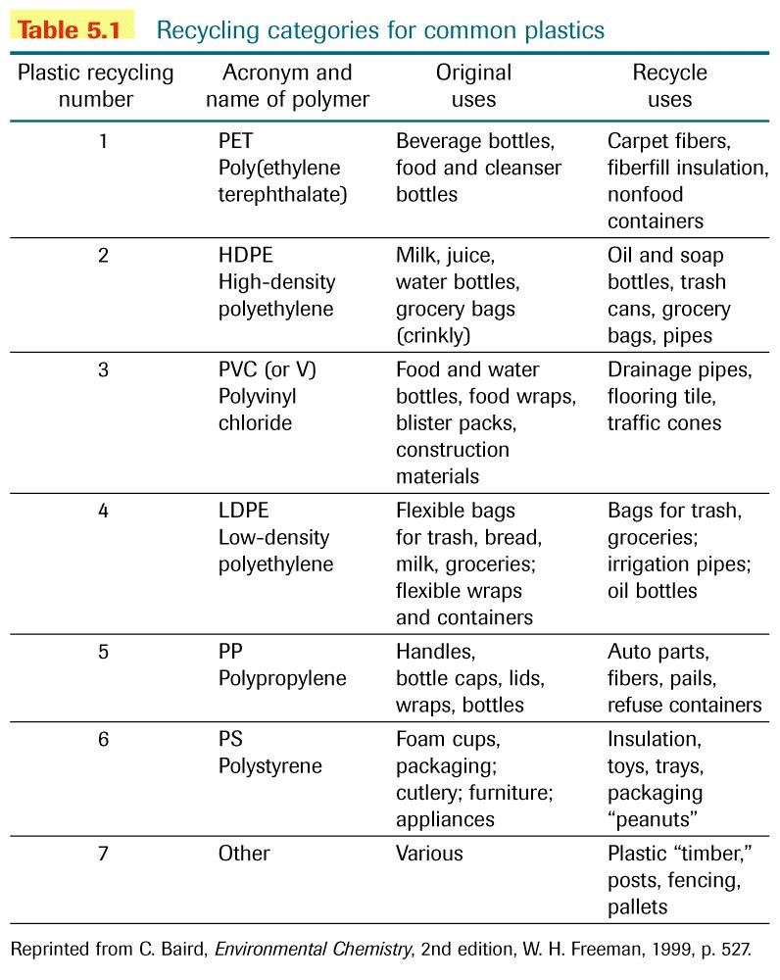
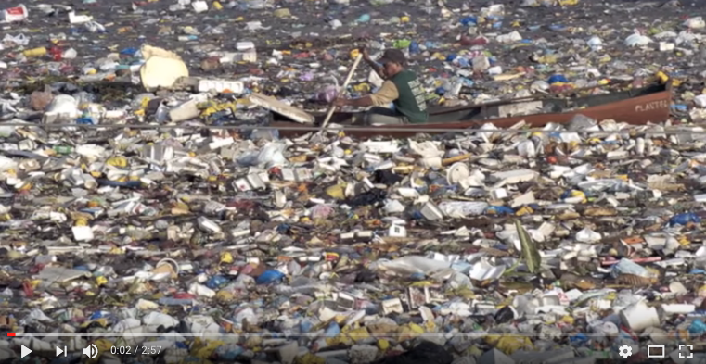







http://www.lotfi.net/recycle/plastic.html

Slide 10
http://www.lotfi.net/recycle/plastic.html
ONE MILLION plastic bottles are bought EVERY MINUTE around the world — and that number will top half a TRILLION by 2021. Less than half of those bottles end up getting recycled. 8 MILLION METRIC TONS of plastic winds up in our oceans each year.

Slide 11
http://www.lotfi.net/recycle/plastic.html
https://www.youtube.com/watch?v=1qT-rOXB6NI

Slide 12
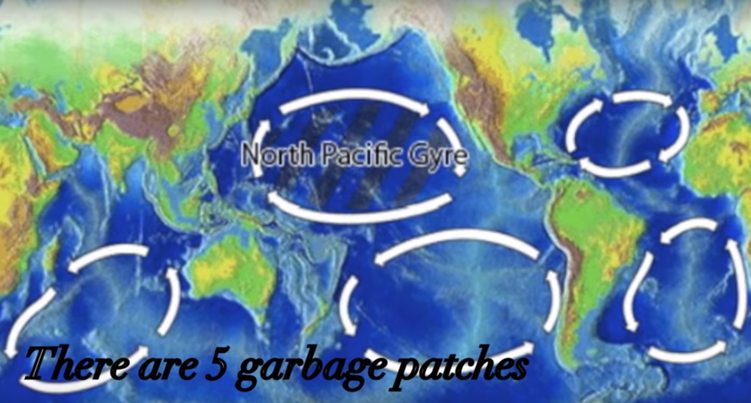
https://www.youtube.com/watch?v=1qT-rOXB6NI

Slide 13
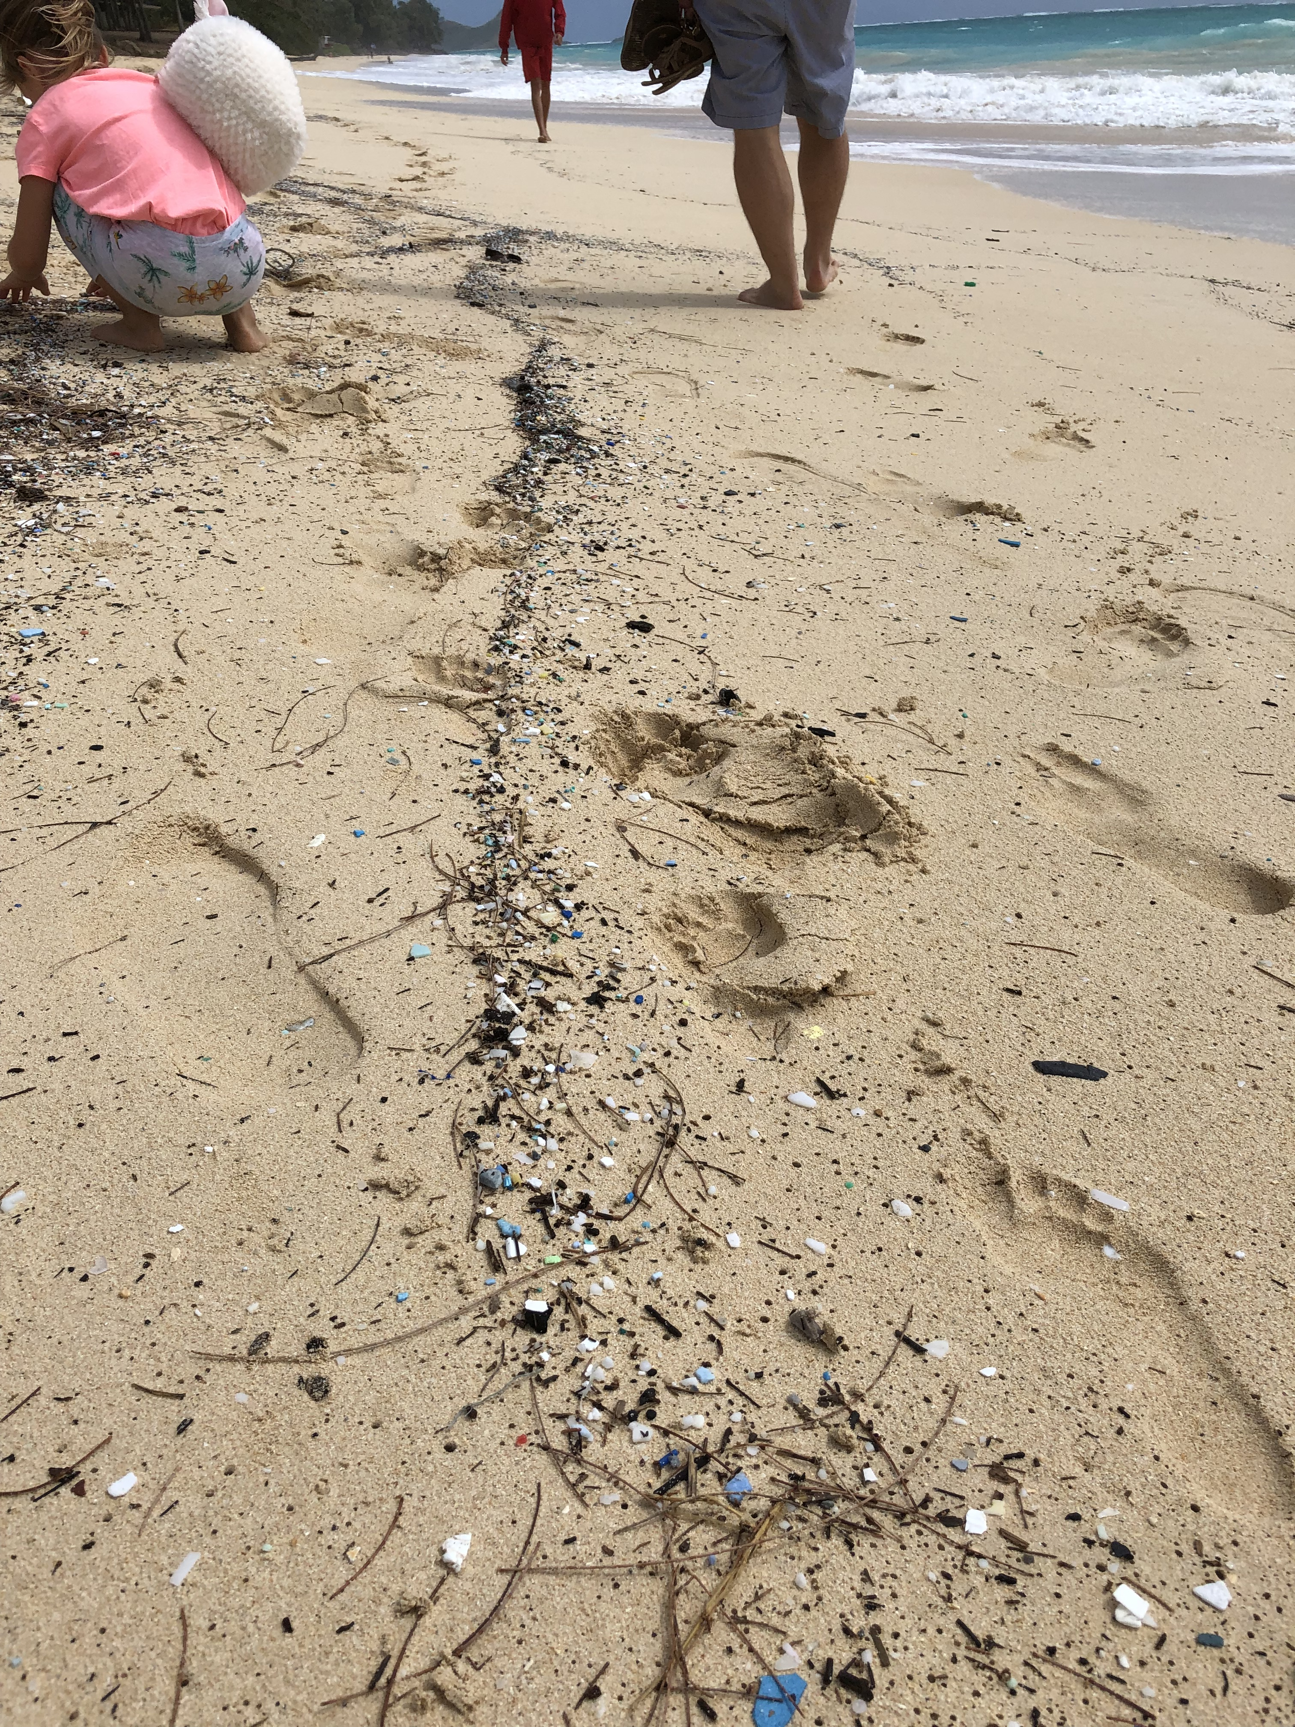
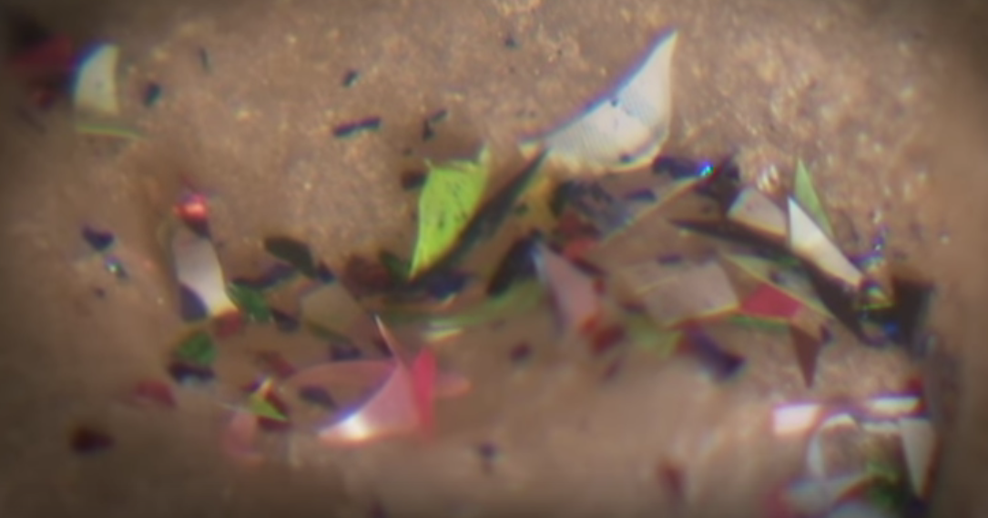
https://www.youtube.com/watch?v=tG4AYagBz9Q
Micro-plastics
Bellows Beach, Oahu, Hawaii

Slide 14
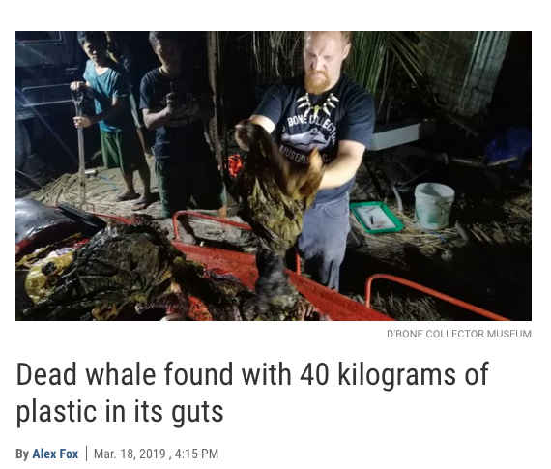
https://www.sciencemag.org/news/2019/03/dead-whale-found-40-kilograms-plastic-its-guts

Slide 15
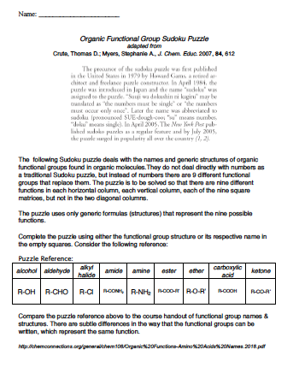
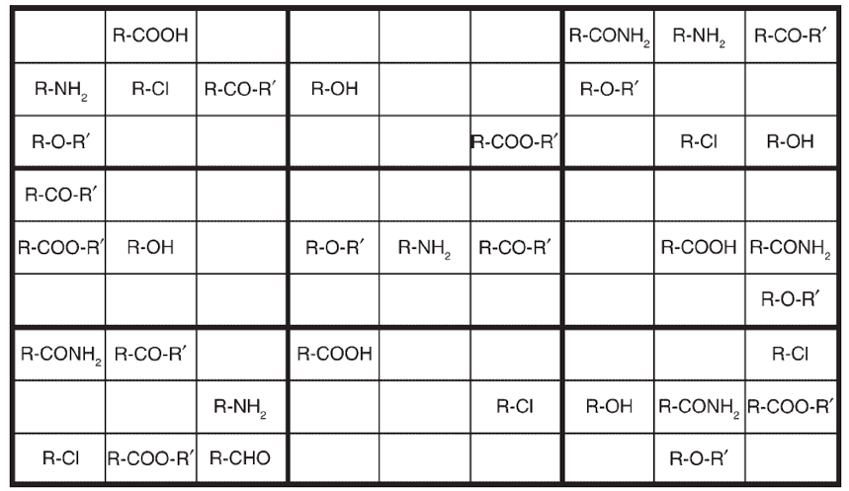
Poly-
  ester
  urethane
  ethylene
  propylene
  styrene
  vinyl chloride
  vinyl alcohol
  amide (Kevlar)
  terephthalate
  acrylonitrile
  imide
  phenylene-bisisoxazole

