Slide 1
Scientific & Chemical
Fundamentals
Dr. Ron Rusay

Slide 2
Scientific & Chemical
Fundamentals
Chemistry & the Scientific Method
Matter : Classification & Properties
Mathematics / Arithmetic:
Exponents, Significant Figures
Measurement & Units: (SI & metric)
Conversions and Relationships: Dimensional Analysis: Density, Percent
VOCABULARY: Key Terms, Bold Style Learning

Slide 3
Background Reading
http://chemconnections.org/general/chem120/zumdahl.9e-int.html
Chemical Foundations
  1.1: Chemical Foundations
  1.2: The Scientific Method
  1.3: Units and Measurements
  1.4: Measurement Uncertainty
  1.5: Significant Figures and Rounding
  1.6: Systematically Solving Problems
  1.7: Unit Conversions
  1.8: Temperature
  1.9: Density
  1.10: Classification of Matter

Slide 4
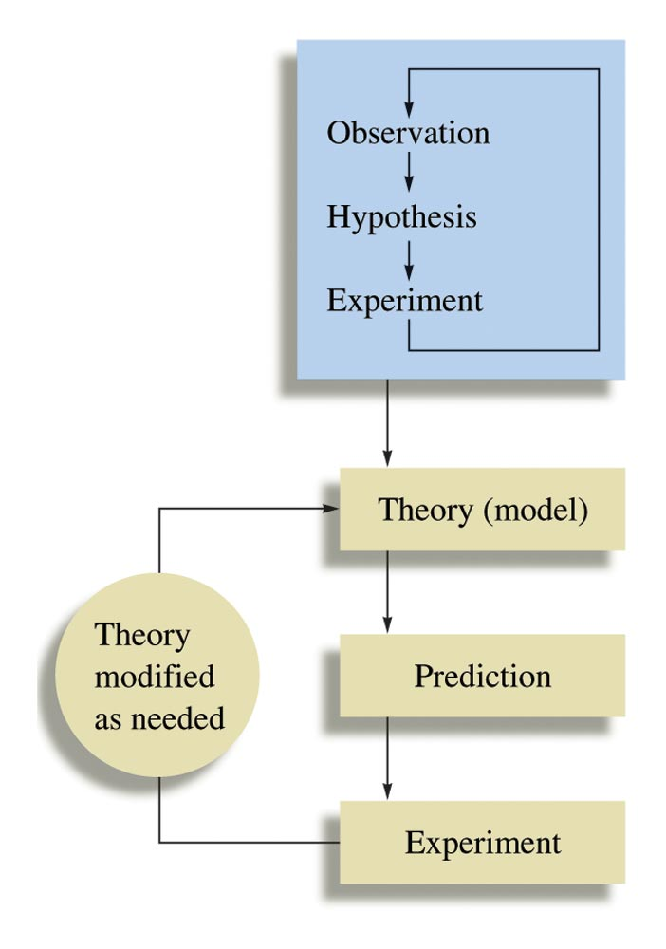
Science & The Scientific Method

Slide 5
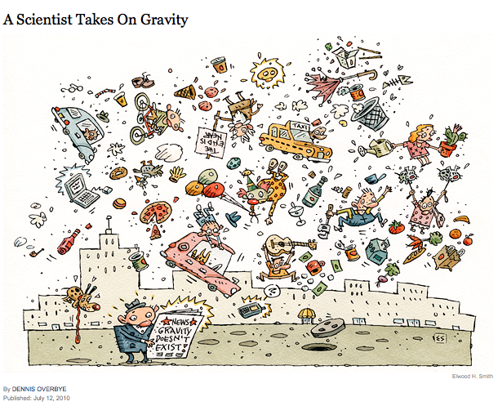
The LAW of Gravity?
New York Times, July 12, 2010
http://www.nytimes.com/2010/07/13/science/13gravity.html?_r=1&ref=space

Slide 6
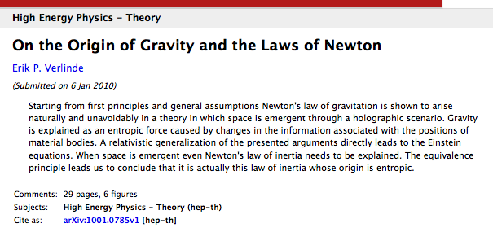
The LAW or THEORY of Gravity?
http://arxiv.org/abs/1001.0785

Slide 7
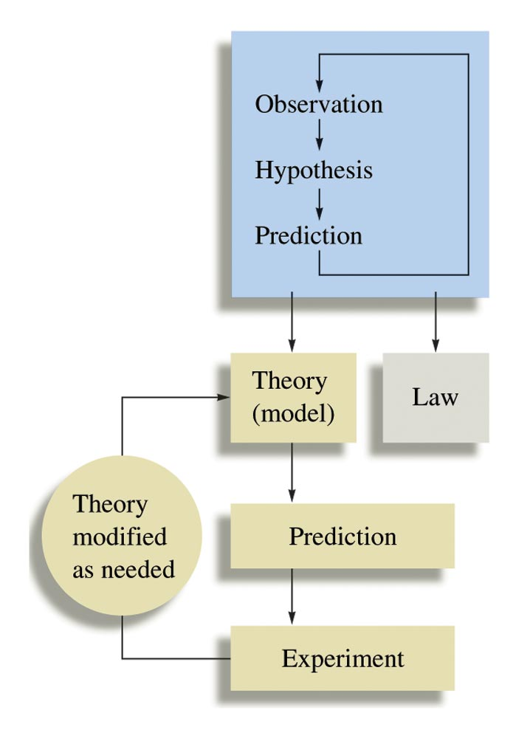
Law vs. Theory
A New Explanation of Gravity
The Case of Gravity
Law(s)? vs. Theory
Spinoza Prize €2.5 x 10⁶
Notes:
Figure: 01-15

Slide 8
QUESTION
The difference between a scientific law and a scientific theory can, at times, be confusing. For example, we will refer to the “Atomic theory” or perhaps the “Law of Gravity.” Should the Law of Gravity be changed to the Theory of Gravity?
Yes, no one can see gravity, it is better described as a theory.
No, scientific laws are based on summaries of many observations and gravity observations are well known and predictable.
Yes, gravity is better described as a theory because gravity explains why masses attract each other and theories are about explaining observations.
No, keep it as a law, laws offer explanations and gravity explains why masses attract each other and laws are about explaining observations.
Notes:
HMClass Prep: Figure 1.5

Slide 9
Some Possible Steps in the Scientific Method
Observations
    (Measurement: See Tomorrow’s Lab)
  qualitative
  quantitative
2. Formulating hypotheses
   possible explanation(s) for the observation
3. Performing experiments
  gathering new information
  testing whether the hypotheses are valid
4. Developing a theory
5. Testing & Refining
Notes:
Fibonacci & Plants
https://www.khanacademy.org/math/recreational-math/vi-hart/spirals-fibonacci/v/doodling-in-math--spirals--fibonacci--and-being-a-plant--1-of-3

Slide 10
Chemistry: The Study of Matter
In all of its forms & all of its behaviors
Sub-categories (not so distinct any longer)
  Organic: carbon
  Inorganic: non-carbon
  Organometallic: organic + inorganic
  Analytical: what?, how much?, how pure?
  Biological / Biochemistry: living organisms
  Physical: energy, changes, rates
  Nuclear: the nucleus
  Environmental: interdisciplinary, eg. Oceanography

Slide 11
Chemistry & Matter (Chemicals)
How many different chemicals do you think have been reported in the scientific literature?
  A) 100,000
  B) 1,000,000
  C) 10,000,000
  D) 100,000,000
  E) 1,000,000,000

Slide 12
Chemistry & Matter:
Properties & States
Physical vs. Chemical Properties
Solid (s), Liquid (l), Gas (g)
Homogeneous vs. Heterogeneous Mixtures
Organization of atoms/molecules:
atoms/elements → molecules/compounds
Extensive vs. Intensive Properties
  Varies with amount (extensive) or does not vary with amount (intensive)
  Heat of reaction is extensive, density is intensive

Slide 13
QUESTION
  Extensive properties of a pure substance depend on sample size whereas intensive properties are characteristic of that substance. Which of these properties are intensive?
          I) Color
          II) Mass
          III) Density
A) I and II B) I and III C) II and III D) I, II and III

Slide 14

Observations of
Physical & Chemical Properties
Physical-Chemical Properties Movie

Slide 15
QUESTION
Which of these are chemical properties of matter?
        I) Corrosiveness
        II) Density
        III) Flammability
        IV) Melting point
A) I and II B) I and III
C) II and IV D) III and IV

Slide 16

States of Matter
States of Matter Movie

Slide 17
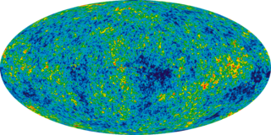
Matter & Energy
E = mc²
http://energy.gov/articles/livestream-our-latest-nobel-prize-winner
Based on the standard model of cosmology, the total mass/energy of the universe is comprised of 4.9% ordinary (Chem 120) matter, 26.8% dark matter and 68.3% dark energy.^{[1][2]} Thus, dark matter is estimated to constitute 84.5% of the total matter in the universe and 26.8% of the total content of the universe.^{[3]}
Dark matter is matter that is undetectable by its emitted radiation, but whose presence can be inferred from gravitational effects.
Ade, P. A. R.; Aghanim, N.; Armitage-Caplan, C.; et al. (Planck Collaboration) (22 March 2013). "Planck 2013 results. I. Overview of products and scientific results – Table 9.". Astronomy and Astrophysics (submitted). arXiv:1303.5062. Bibcode:2013arXiv1303.5062P.
Francis, Matthew (22 March 2013). "First Planck results: the Universe is still weird and interesting". Arstechnica.
3) "Planck captures portrait of the young Universe, revealing earliest light". University of Cambridge. 21 March 2013. Retrieved 21 March 2013.

Slide 18
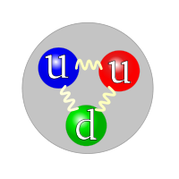
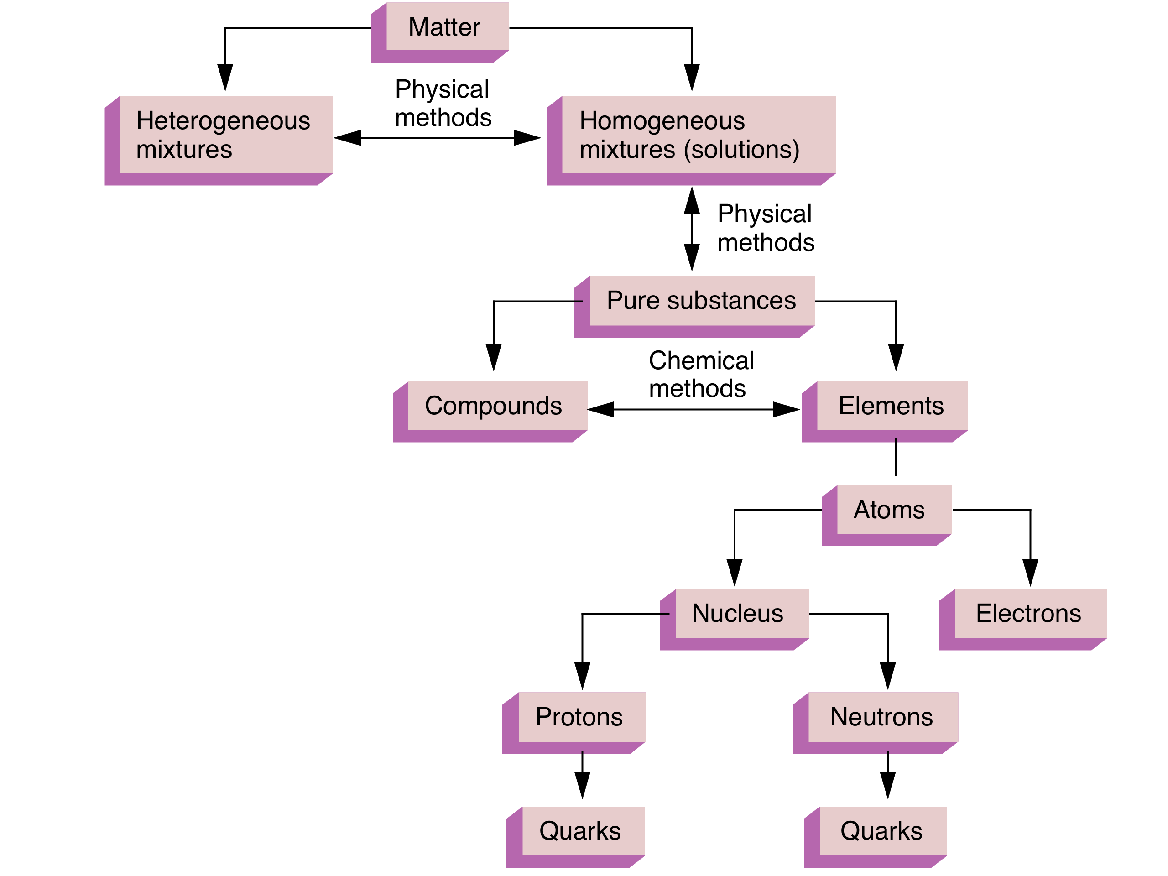
Organization of Matter
proton
Classification of Matter
Quarks (sub-atomic particles):
* Protons: composed of two up and one down quarks (uud)
* Neutrons: composed of two down and one up quarks (ddu)
leptons
muon, tau, neutrino
[up, down, strange, charm, bottom, top]

Slide 19
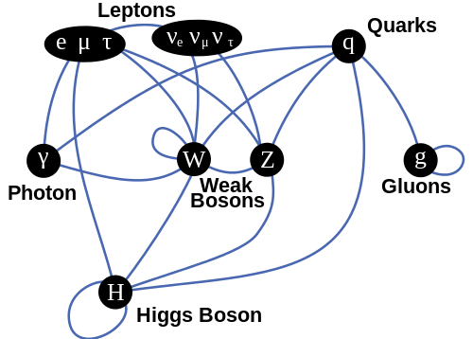
Physics
“Standard” Model Interactions
proton
The Higgs Boson has no spin, no electric charge, nor color charge, Google:
Classical vs Quantum Theory.

Slide 20
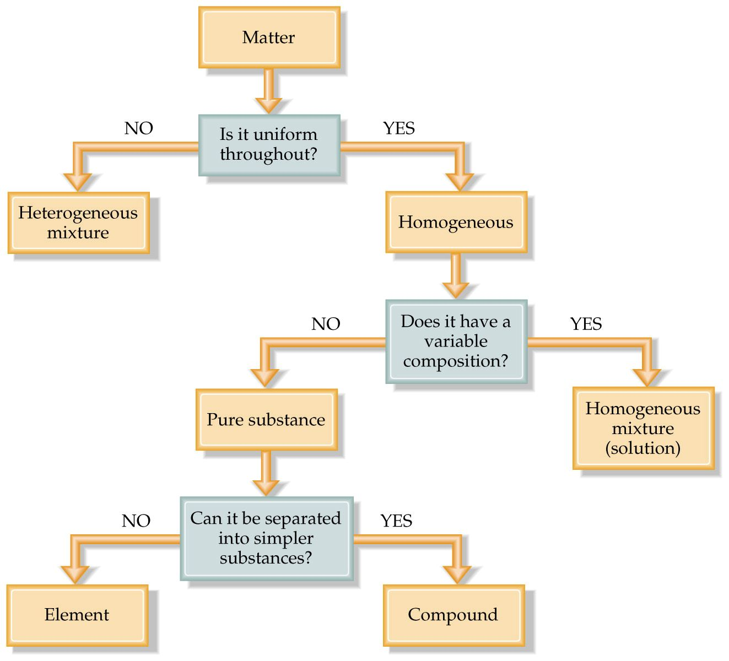
Notes:
Figure: 01-09

Slide 21
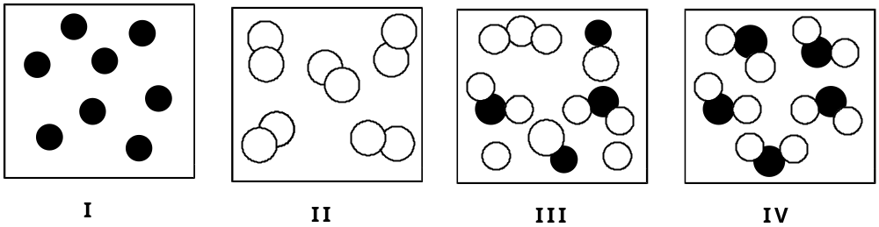
QUESTION
  Which of these atomic and/or molecular views represent pure substances?
A) I and III B) II and IV
C) I, II and IV D) II, III, and IV

Slide 22
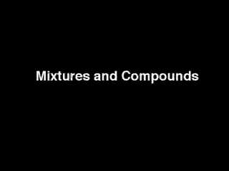
Using Physical & Chemical Properties: Distinguishing a Compound & a Mixture
Mixtures and Compounds Movie

Slide 23
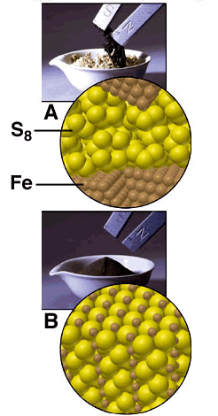
The effects of a magnet on iron: filings in a mixture and atoms in a molecule.

Slide 24
Chemical Separations
Types of Mixtures
Mixtures have variable composition of two or more components.
A homogeneous mixture is a solution (for example, vinegar: water + acetic acid, or steel & bronze: solid metals)
A heterogeneous mixture is, to the naked eye, clearly not uniform (for example, a bottle of ranch dressing with two layers: water + oil, or two solids: iron and sulfur)

Slide 25
Separating Mixtures
: Separates components of a mixture based upon differences in particle size. Examples: a precipitate from a solution, or particles from an air stream.
Separation based upon differences in solubility of components in a mixture. Ideally the impurities are much more soluble in the solvent than the material being purified.
Separation based upon differences in volatility (boiling points) of components in a homogeneous mixture. Example: ethanol & H₂O
Filtration:
Crystallization:
Distillation:

Slide 26
Separating Mixtures
Separation based upon differences in a compound’s solubility between two different solvents, typically immiscible liquids. Examples: ether & H₂O, gasoline (hydrocarbons) and water.
Separation based upon differences a compound’s solubility in a solvent versus a stationary phase. Examples: paper, thin layer (TLC), column, gas-liquid (GC); liquid-liquid: (HPLC), reverse phase.
Extraction:
Chromatography:

Slide 27
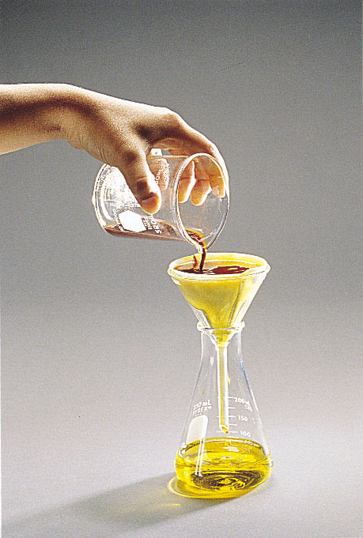
Filtration

Slide 28
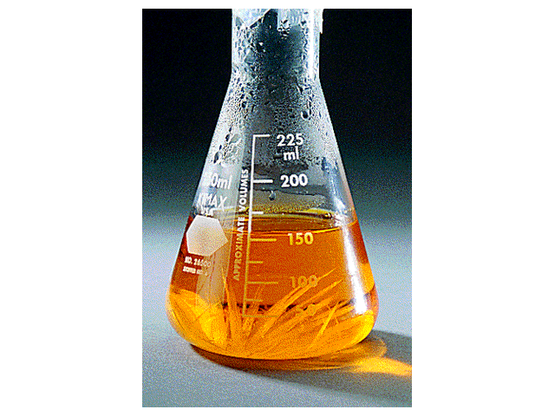
Crystallization

Slide 29
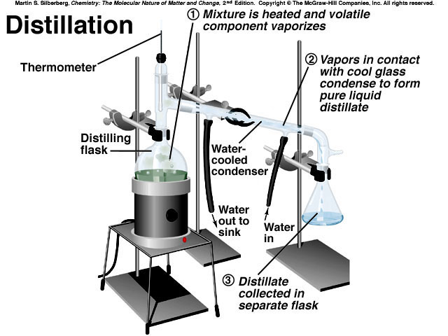

Slide 30
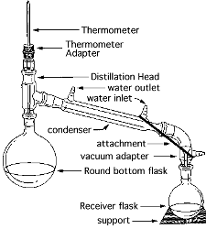
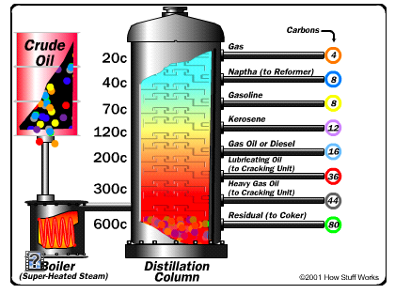
Closer to actual apparatus
Oil Refining:
http://science.howstuffworks.com/oil-refining4.htm

Slide 31
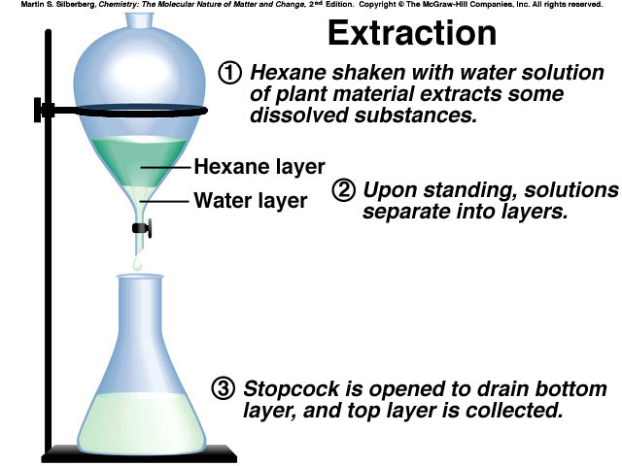
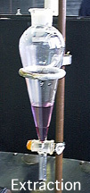

Slide 32


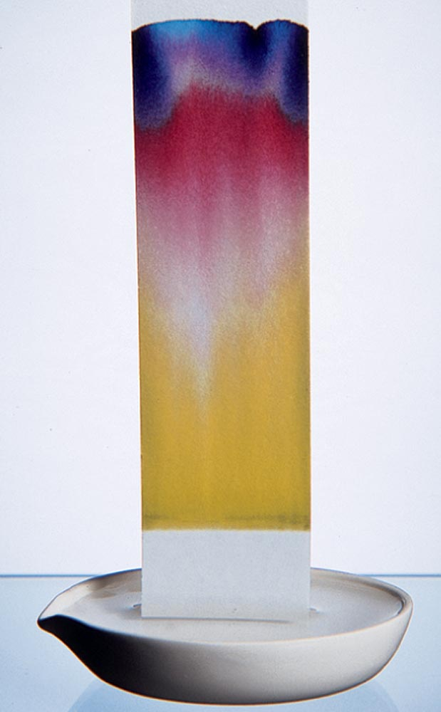
Paper Chromatography

Slide 33
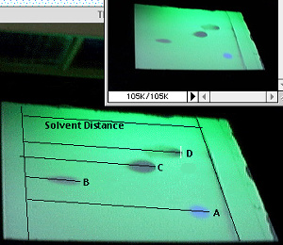
Thin Layer Chromatography
Stationary phase: silica or alumina

Slide 34
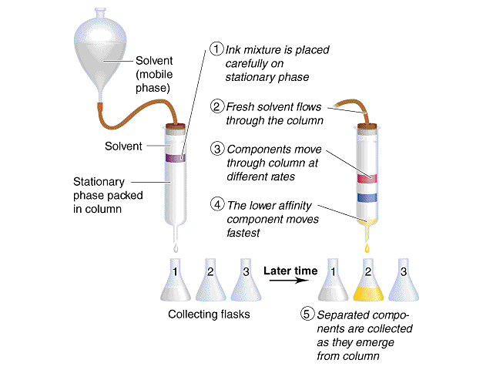
Procedure for Column Chromatography

Slide 35
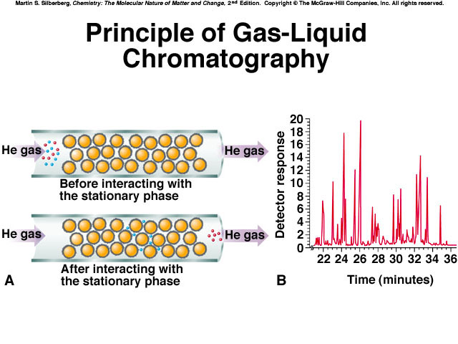

Slide 36
Elements & Compounds
Element: A substance that cannot be broken into simpler substances by chemical means, eg. Fe, Iron or S₈ Sulfur
Elements in Song
Compound: A substance with a constant composition that can be broken down into elements only by chemical processes,eg. FeS, Iron (II) sulfide

Slide 37
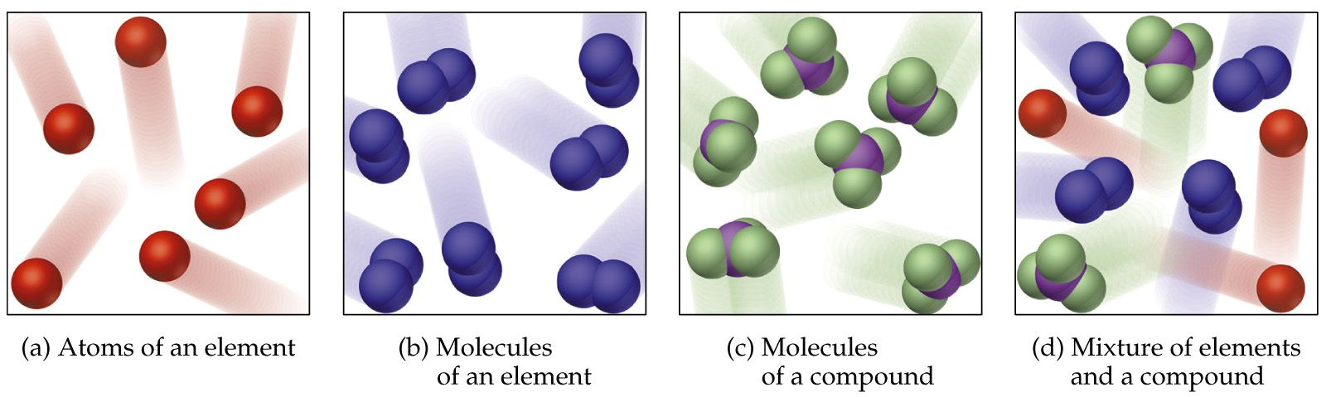
Atomic / Molecular Visualization
Atomic Force Microscopy / Molecular Modeling
Experimental / Mathematical
Notes:
Figure: 01-05a-d

Slide 38
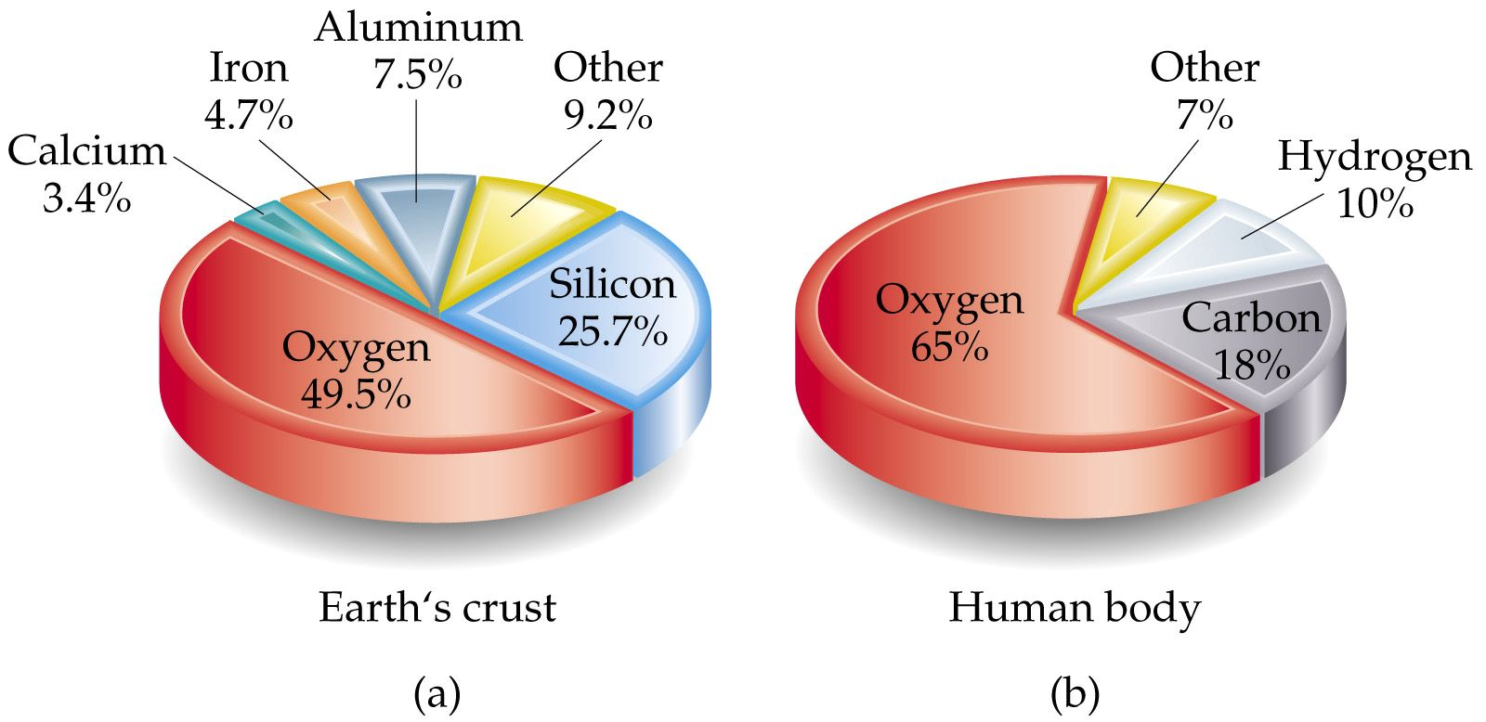
Notes:
Figure: 01-06

Slide 39
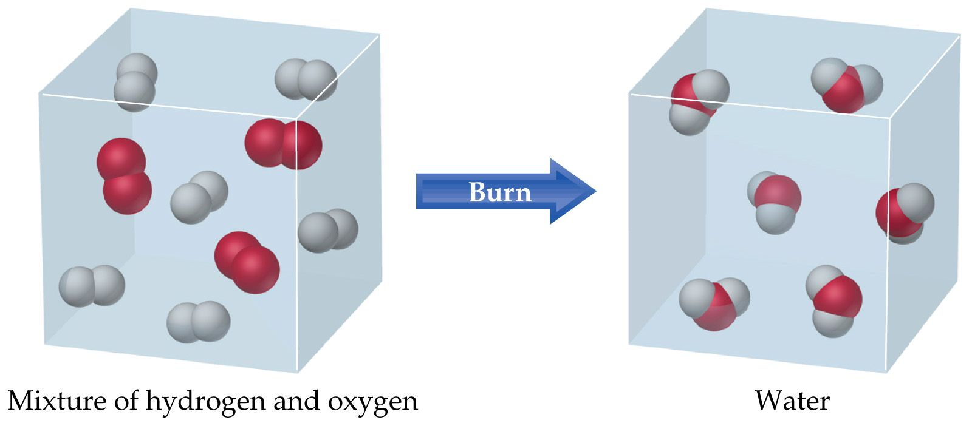
Three Balloons
The red spheres are oxygen and the white/gray are hydrogen.
How many oxygens are there?
How many hydrogens are there?
How many oxygens are there?
How many hydrogens are there?
        6 H₂(g) + 3 O₂(g) → 6 H₂O(l)
Notes:
demo

Slide 40
QUESTION
The electrolysis of water is the reverse of burning (combustion). Which equation best represents the change that takes place when water is electrolyzed?
        A) H₂O(l) → H₂O(g)
        B) H₂O(g) → H₂O(l)
        C) 2 H₂O(l) → 2 H₂(g) + O₂(g)
        D) 2 H₂(g) + O₂(g) → 2 H₂O(l)
Notes:
Correct Answer: C
Question Number: 5

Slide 41
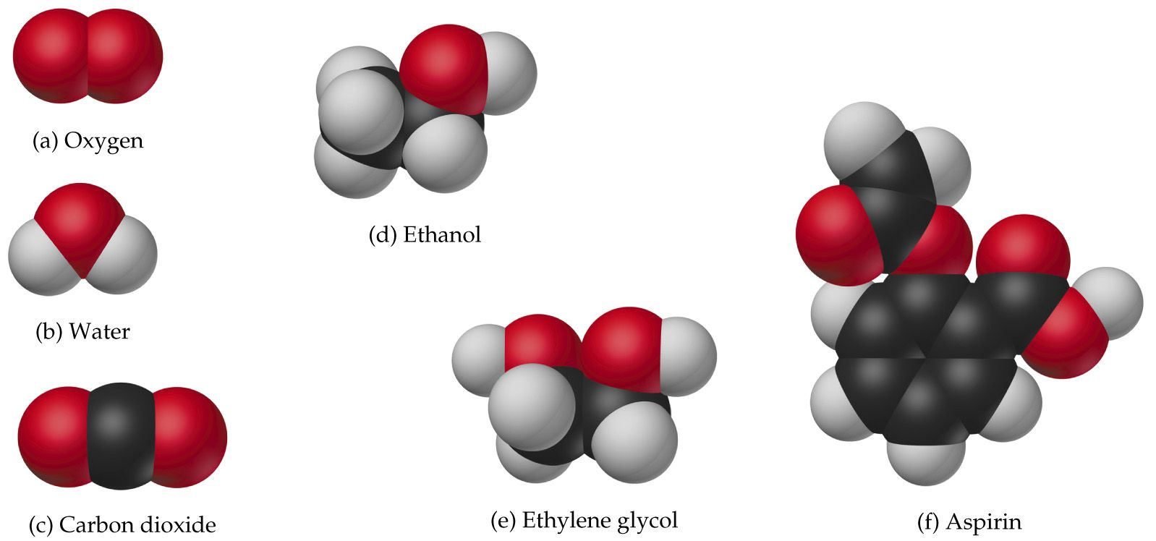
How many hydrogens, oxygens, and carbons are there in:
ethanol?
ethylene glycol?
aspirin?
The red spheres are oxygen, the white/gray are hydrogen, and black carbon.
Notes:
Figure: 01-01

Slide 42
QUESTION
Is a cup of coffee a homogeneous solution or a compound? Which of the following agrees with your reasoning?
The coffee in the cup is a homogeneous solution because it contains the same components throughout, but there are many compounds dissolved to make coffee.
The coffee in the cup is a compound because it has a set ratio of components that make it the same throughout.
The coffee in the cup is both a compound and a solution.
It looks the same throughout like a true solution, yet it always
has the same amount of each component.
The coffee in the cup is a heterogeneous solution not homogeneous because it contains distinct, different
compounds dissolved to make coffee.

